Slide 1
Identifying the most sensitive beta-gamma coincidence detector system for radioxenon measurements at CTBT Radionuclide Laboratories
Matthew A. Goodwin^{1,2}, Taylor P. Gill¹, Ashley V. Davies³, Richard Britton³, Steven J. Bell⁴, Patrick H. Regan^{2,4}
¹ AWE, Aldermaston, UK
² School of Mathematics and Physics, University of Surrey, UK
³ Preparatory Commission for the CTBTO, Vienna, Austria
⁴ National Physical Laboratory (NPL), Teddington, UK
CTBT Radionuclide Laboratories have a unique opportunity to expand and improve the information available during a radionuclide event.
This may include detecting radionuclides that were otherwise undetectable at a station
Previous work has shown the benefit of a high-resolution beta-gamma coincidence detector system for radioxenon measurements. The sensitivity of ^{131m}Xe and ^{133m}Xe is impacted by ¹³³Xe and ¹³⁵Xe, but this impact is reduced by high photon- energy resolution
A HPGe & plastic scintillator-based detector system has the benefit of improved beta/electron efficiency over a silicon-based beta detector
The HPGe-plastic tested is not yet optimised but initial measurements combined with calculations show that this system can provide lower detection limits than a HPGe-PIPSBox system, and NaI(Tl)-Plastic system.

Slide 2
Introduction: An opportunity for Noble Gas IMS Radionuclide Laboratories
Noble Gas Radionuclide Laboratories supporting the IMS have a unique opportunity to improve on the measurements completed at the station. Some of the reasons this is possible are the laboratory:-
may have more efficient detectors
may be able to measure for longer
may have less interference between signals
may be able to remove any interfering Radon
may improve the detectability following a delay
One way in which laboratories could improve a measurement process is by measuring for different amounts of time for each isotope of radioxenon.
Fig. 1 shows the change in the detection limit of four isotopes of radioxenon with acquisition time.
INTRODUCTION
Figure 1.
 |  | Electron Energy Resolution
 |  | Low | High
Photon Energy Resolution | High | Plastic β-cell & HPGe γ-detector Examples: Li et al. 2021 Goodwin et al. 2023 | Silicon β-cell & HPGe γ-detector Examples: Delaune et al. 2018 Goodwin et al. 2020
 | Low | Plastic β-cell & NaI(Tl) γ-detector Example: Ringbom et al. 2003 | Silicon β-cell & NaI(Tl) γ-detector Example: Foxe et al. 2016
Table 1.
Various beta-gamma coincidence detector systems have been configured using different materials and assessed, providing different combinations of high and low energy resolution for electron and photon detection (see Table 1).
GBL15 set up a dual HPGe/PIPSBox detector system and demonstrated improved sensitivity and selectivity over the current certified system [1,2]. However, the Si detector used in the PIPSBox has limited beta detection efficiency, meaning that for lower count-rate samples, it may be favourable to have a low-resolution, high-efficiency beta detector, setup in coincidence with a high-resolution gamma detector.
The following slides detail the measurements of both systems and calculated detection limits expected from the new system.
P3.2-371

Slide 3
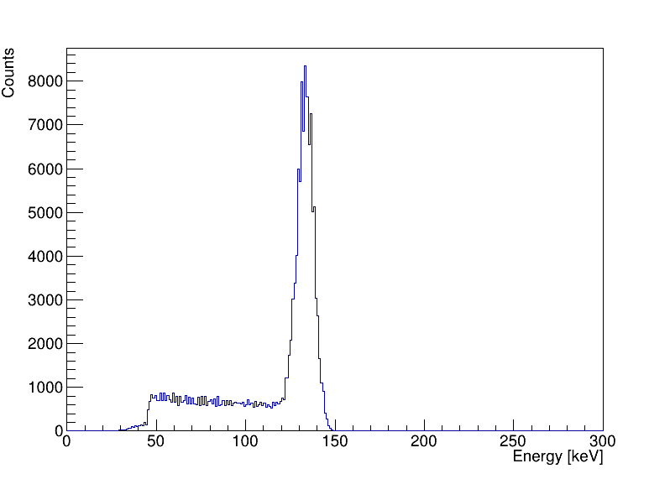
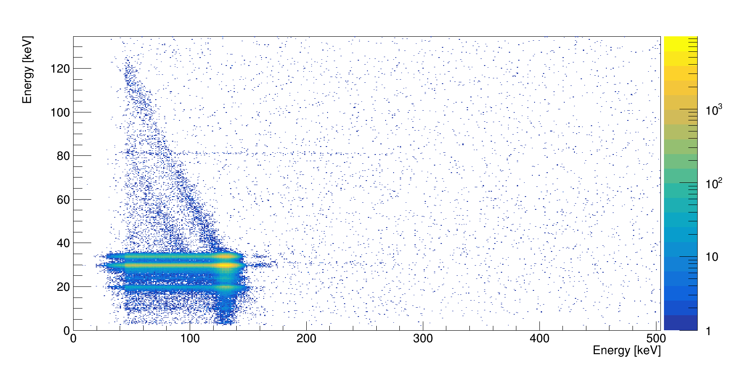
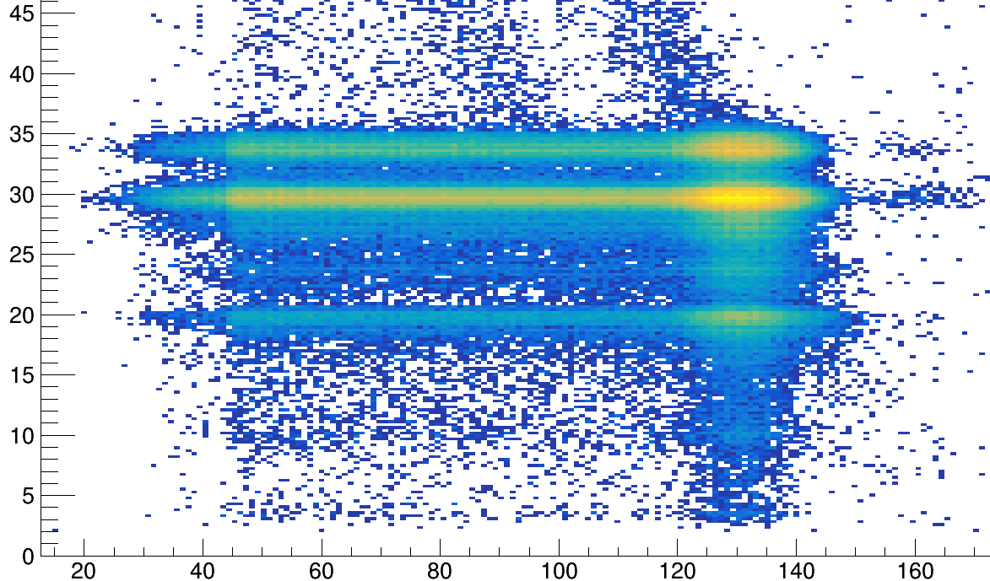
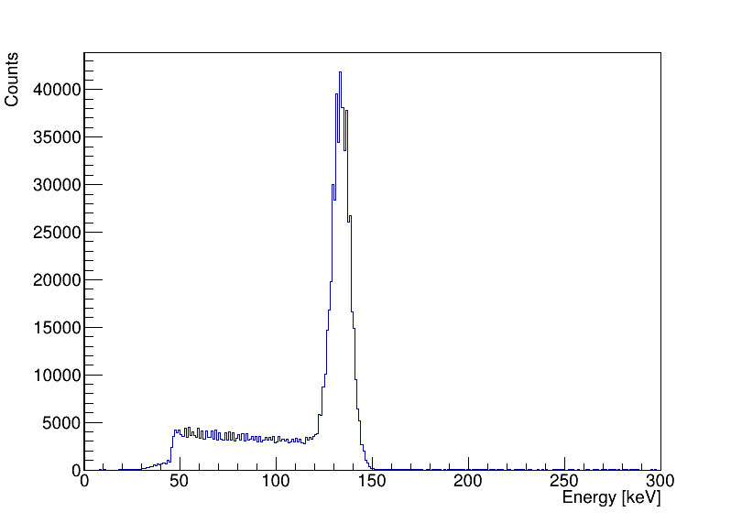
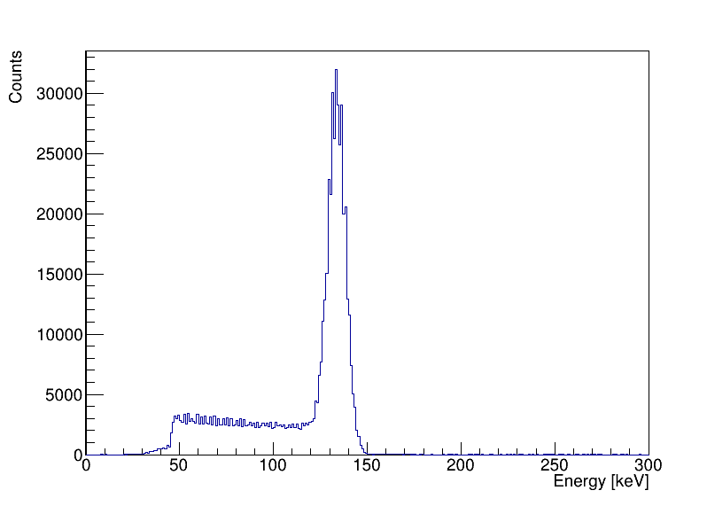
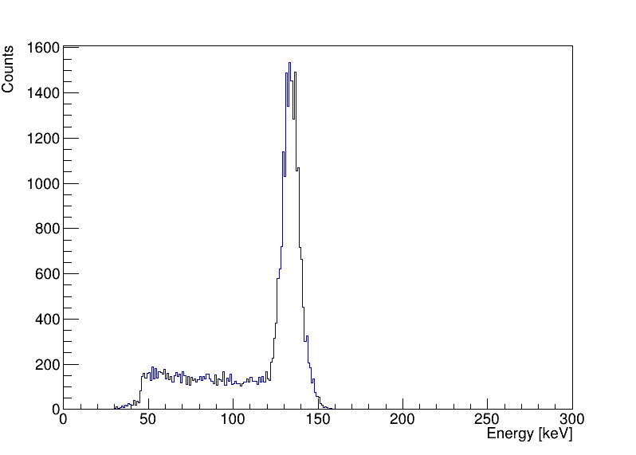
High-resolution β-γ coincidence measurements of radioxenon isotopes
Using multiple HPGe detectors increased the efficiency of the HPGe-PIPSBox system. Whilst the PIPSBox has a much greater energy resolution than a plastic scintillator, it is the HPGe detector (gamma energy resolution) that provides the most discrimination power, since it is able to separate Cs and Xe X-rays. The β—X(Cs)-ray coincidences from the decay of ¹³³Xe and ¹³⁵Xe are better resolved from the CE-X(Xe)-ray coincidences from the decay of ^{131m}Xe and ^{133m}Xe. Selectively gating on the XK_{α}, XK_{β} and corresponding germanium escape peak, and combining them to a single “virtual” region of interest improves the detection limit. Fig. 2 demonstrates this using a ^{131m}Xe measurement.
129 keV e⁻
X K_{β}
Straggled/backscattered conversion electrons. It is possible to “add” this signal, but only if Xe-133m is not in the sample.
Multi-gate summed spectrum – enhance efficiency of 129 keV conversion electron
Photon Energy [keV]
129 keV e⁻
129 keV e⁻
X K_{α}
129 keV e⁻
X K_{α}-Ge esc.
Electron Energy [keV]
Figure 2.
P3.2 371

Slide 4
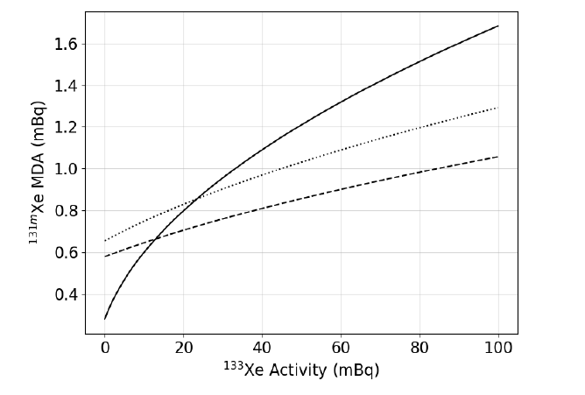
The impact of improved energy resolution = reduced interference
Low-resolution system
Comparison of the effect of ¹³³Xe interference on the detectability of ^{131m}Xe in a low-resolution coincidence detector system (solid line); a high-resolution coincidence detector system using a single ROI (dotted line); and a high-resolution detector system with combined regions (dashed line).
The shaded zone is a combination of activities where ^{131m}Xe is not detectable, due to the interference of ¹³³Xe.
Improving the overall efficiency of the detector system can be achieved using either:
A more efficient beta detector (for β⁻ and CE)
A more efficient gamma detector (for γ- and X-rays)
Optimising the measurement geometry
A more efficient gamma detector will likely result in reduced energy resolution, which would negatively impact the interference between ground states and metastable isomers. However, increasing the beta detector efficiency would not have such an impact. One extra consideration is the impact of the new gas cell counting geometry on the gamma efficiency. Fig 4. shows the R&D system schematic using a single HPGe detector and a SAUNA-II plastic scintillator gas cell (90-100 % detection efficiency for β⁻/e⁻, < 350 keV).
Figure 3.
High-resolution system
Detector systems that can occupy this area are required.
Figure 4.
Schematic of the new R&D system, initially with a single HPGe detector, which will be expanded to two.
P3.2-371

Slide 5
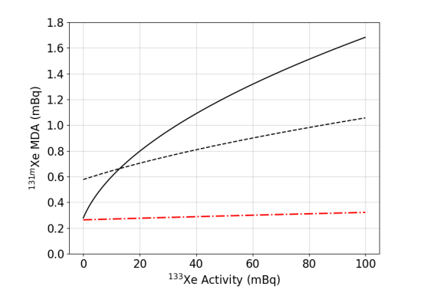
New Measurements
The test system is not the optimal counting geometry (for the HPGe) and the beta cell is underperforming. But let’s assume we can get the plastic detector closer to the detector and add a second HPGe (like the PIPSBox system [3]).
Optimising this allows us to have a better idea of the capability of such a system. Fig. 5 shows the simulated photon efficiency curves of a PIPSBox, as well as for the plastic gas cell. The cell holder is preventing the detector getting closer to the HPGe detector. Once this has been reconfigured, it will be possible to match the photon efficiency of the PIPSBox geometry.
Figure 5.
Figure 6.
Fig. 6 shows the expected ^{131m}Xe MDA (as a function of ¹³³Xe Activity) of a plastic-HPGe detector system (red), assuming closer geometry and two HPGe detectors. This is lower because:
A higher efficiency system means overall lower MDA
High resolution photon detectors mean less interference between ground states and metastable states X_{K}(Cs) → X_{K}(Xe) (i.e. less dependence on ground state activities, less dependence on the sample composition.)
High resolution detectors result in smaller regions of interest in the 2D coincidence energy matrix, further reducing the count-rate.
HPGe-plastic system
P3.2-371

Slide 6
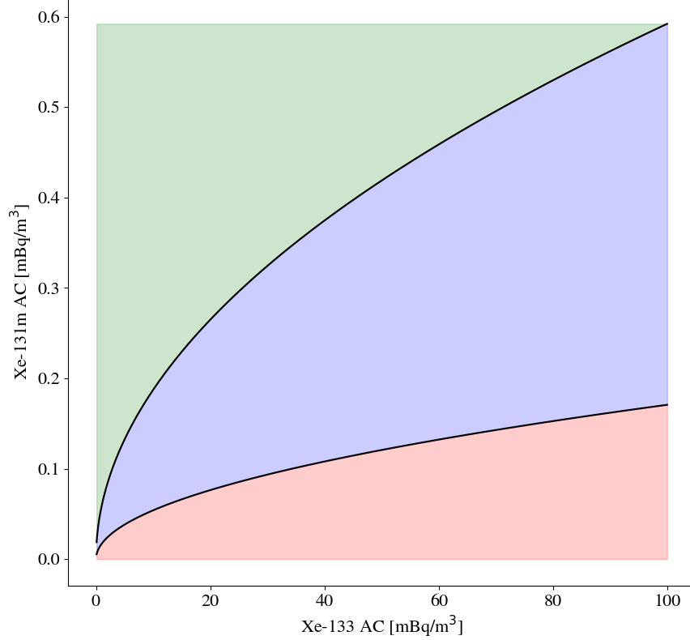
Summary
High resolution photon (γ/X) spectrometry provides improved selectivity for the metastable isomers, with less dependence on the ground state (β⁻-X-ray coincidences) interferences. A HPGe-PIPSBox system can match NaI(Tl)+Plastic for overall sensitivity.
HPGe-PIPSBox system is efficiency-limited. The β-/e- efficiency can be improved by using a plastic scintillator, provided the electron resolution is good-enough. The HPGe still provides the same separation of X-rays.
A HPGe-plastic offers the best compromise, however the current measurement geometry requires improvement to reach this potential – this is work in progress at GBL15.
Fig. 7 shows the detectability of ^{131m}Xe as a function of ¹³³Xe activity on a SAUNA-type IMS system. Green shows the combination of activities where both isotopes are detectable at the station. Blue shows the combination of activities where ^{131m}Xe would only be detectable following re-measurement after ~10 days of decay time. Red shows the combination of activities where the metastable is not detectable, even after re-measurement.
Figure 7.
^{131m}Xe detectable at station
^{131m}Xe detectable ONLY at laboratory (following 10 days decay)
^{131m}Xe not detectable at station or laboratory
P3.2-371

Slide 7
References
Goodwin, M.A., Bell, S.J., Britton, R., Davies, A.V., Collins, S.M., Regan, P.H., A high-resolution 𝛽 − 𝛾 coincidence spectrometry system for radioxenon measurements, 2020, Nuclear Inst. and Methods in Physics Research, A 978 (2020) 164452 https://doi.org/10.1016/j.nima.2020.164452
Goodwin, M.A., Bell, S.J., Britton, R., Davies, A., Abilama, M., Collins, S.M., Shearman, R., Regan, P.H., 2021. Production and Measurement of fission product noble gases. J. Environ. Radioact. 238–239, 106733 https://doi.org/10.1016/j.jenvrad.2021.106733
Goodwin, M.A., et al. (2022) Enhancing the Detection Sensitivity of a High-Resolution Beta-Gamma Coincidence Spectrometer, J. Environ. Radioact., 250 106915, https://doi.org/10.1016/j.jenvrad.2022.106915
P3.2-371

