Slide 1
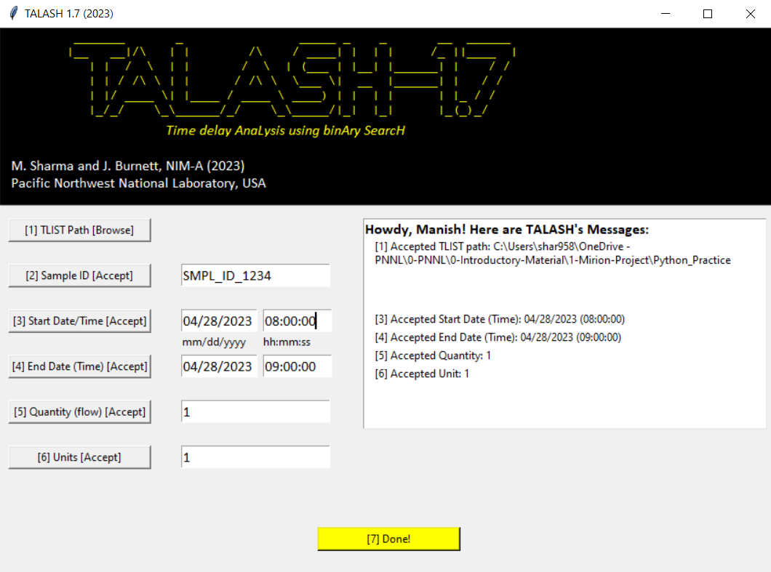
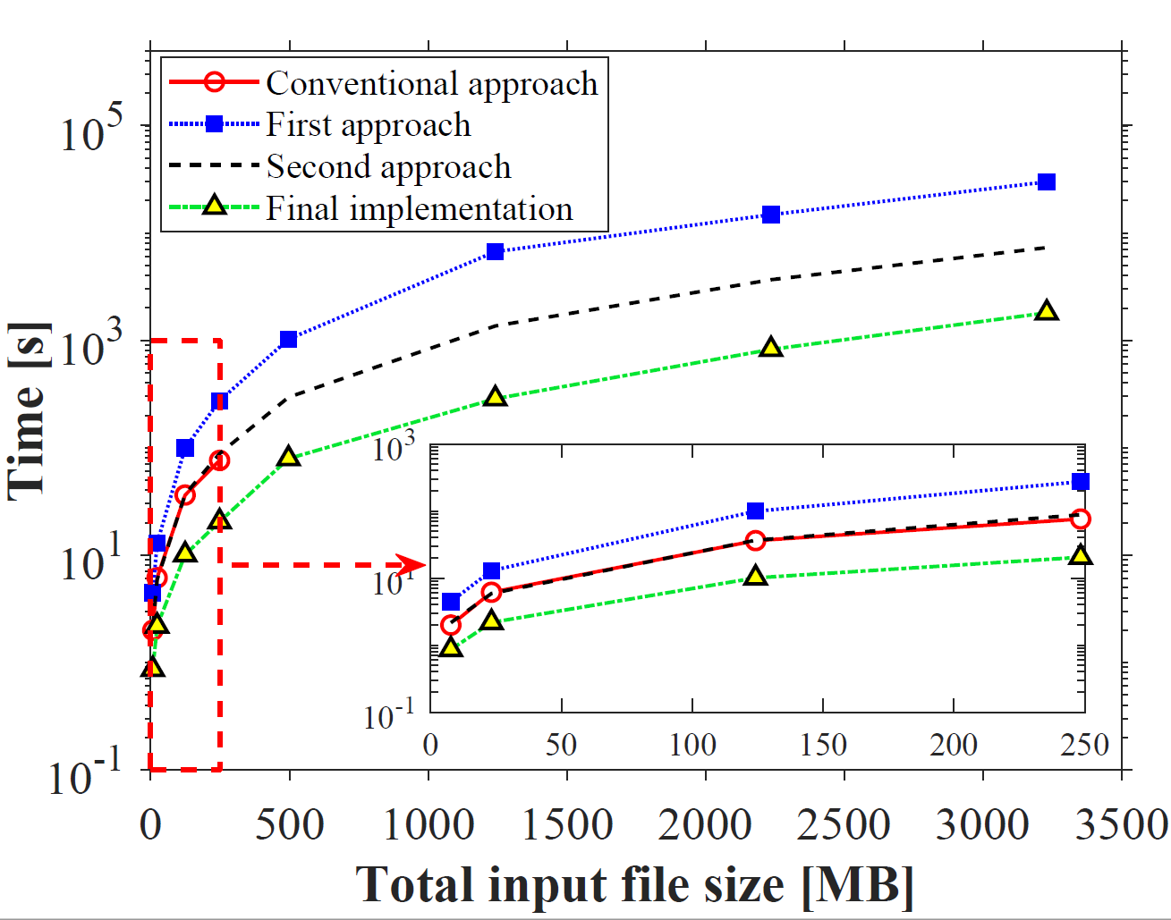
Development and Validation of Coincidence Analysis/Quantification
Software for Gamma-gamma Coincidence Counting
Manish Sharma, Jonathan Burnett
Pacific Northwest National Laboratory
P3.2-360
Multidetector Systems: Promising Application in Radionuclide (RN) Monitoring (in IMS)
Superior detection efficiency ; $γ$-$γ$ Coincidence signatures ; Operationally resilient
RN Stations utilize High-resolution Gamma Spectrometry for particulate radionuclides
Such as: ¹⁴⁰La, ¹⁴⁰Ba, ¹³⁴Cs, ¹³⁷Cs, etc.
Data analysis/quantification significantly complex
This work:
A Sophisticated coincidence analysis/quantification software
Development, optimization, validation of software
GUI of Coincidence Analysis Software
Windows
Python (3.7)
Genie-2000
Radionuclide |  | $$ε_{γγ}$$ |  | $Δ$ (%)
 |  | Experiment | Simulated
⁶⁰Co |  | 6.5E-4 | 6.3E-4 | 2.6
⁸⁸Y |  | 5.6E-4 | 5.6E-4 | 0.3
⁹⁹Mo |  | 3.7E-4 | 3.7E-4 | 0.8
¹³²Te |  | 3.3E-3 | 3.2E-3 | 1.2
¹⁴⁰Ba |  | 4.9E-4 | 4.9E-4 | 0.5
¹⁴⁰La |  | 2.6E-4 | 2.6E-4 | 0.3
¹⁰³Ru |  | 2.7E-5 | 2.8E-5 | 3.2
¹⁴³Ce |  | 1.1E-3 | 1.1E-3 | 1.2
¹⁴⁰La |  | 2.6E-4 | 2.6E-4 | 0.2
⁴²K |  | 6.8E-6 | 6.5E-6 | 4.2
⁹⁷Zr |  | 1.7E-5 | 1.7E-5 | 0.0
¹³²I |  | 2.2E-4 | 2.2E-4 | 0.2
¹³³I |  | 3.4E-5 | 3.3E-5 | 0.8
¹³¹I |  | 4.8E-4 | 4.9E-4 | 1.0
¹⁵³Sm |  | 7.0E-4 | 7.0E-4 | 0.4
Experimental Validation of Detection Probabilities
Performance Optimization

