Slide 1
Development and Validation of Coincidence Analysis/Quantification
Software for Gamma-gamma Coincidence Counting
Manish Sharma, Jonathan Burnett
Pacific Northwest National Laboratory
Multidimensional systems promising for IMS
A Sophisticated γ-γ Coincidence Analysis/Quantification Software developed at Pacific Northwest National Laboratory, USA
Advanced python libraries and strategies implemented
Experimental validation using underground γ-spectrometer
Probabilities simulated using PNNL’s Deception Supercomputer
Experimentally tested up to 120 GB experimental data
CTBT relevant radionuclides probabilities simulated
Coincidence probabilities validated: <5% for 15 radionuclides
Successful development and performance evaluation
Execution tested for CTBT relevant radionuclides
Experimental validation for 15 radionuclides
Place your QR Code here after removing this text box!
P3.2-360
Disclaimer: The views expressed here do not necessarily reflect the views of the United States Government, the United States Department of Energy, the National Nuclear Security Administration or the Pacific Northwest National Laboratory.

Slide 2
Abstract
Gamma-gamma coincidence techniques are known to improve the detection of particulate radionuclides relevant for Treaty monitoring purposes. To that end, Pacific Northwest National Laboratory (PNNL, USA) has developed a novel γ-γ coincidence analysis and radionuclide quantification software package. The software’s execution has been tested for radionuclides relevant to Comprehensive Nuclear-Test-Ban Treaty (CTBT) and other radionuclides with complex decay schemes. This presentation discusses software’s details, challenges encountered in its development, and its experimental validation. The validation was performed by experimentally measuring 15 radionuclides (including ¹⁴⁰Ba, ¹⁴⁰La, and ⁸⁸Y) using the Advanced Radionuclide Gamma-spectrOmeter (ARGO) located in the Shallow Underground Laboratory (SUL) at PNNL.
Place your QR Code here after removing this text box!
P3.2-360

Slide 3
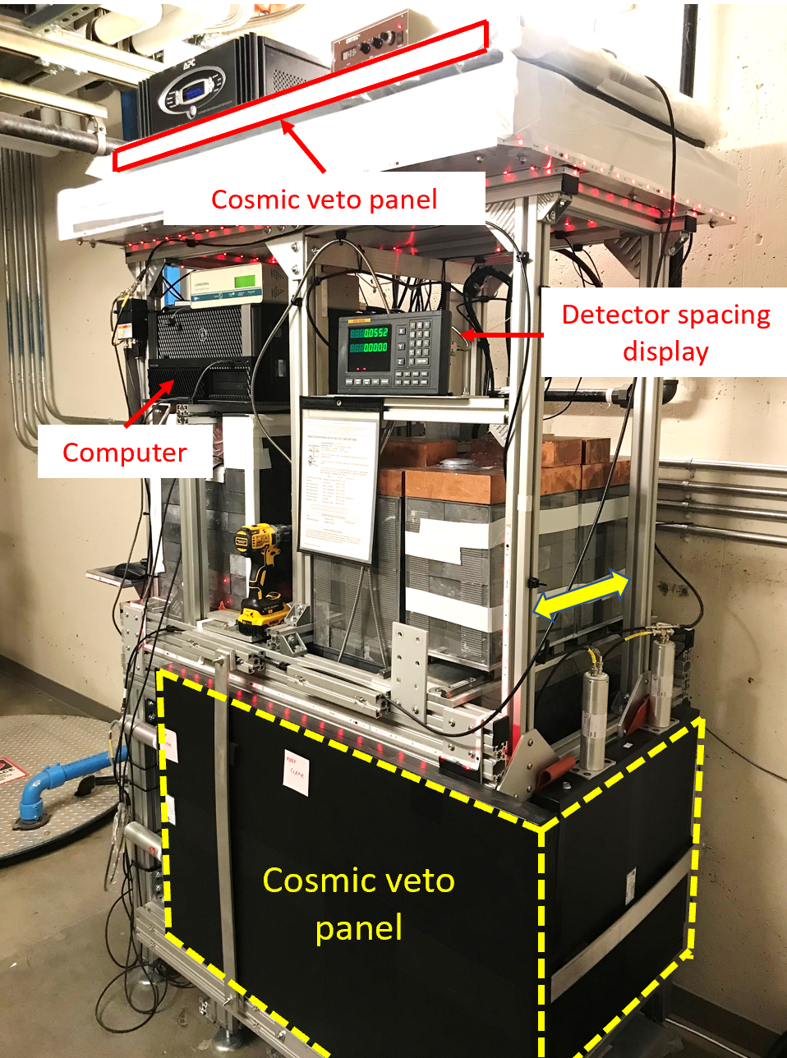
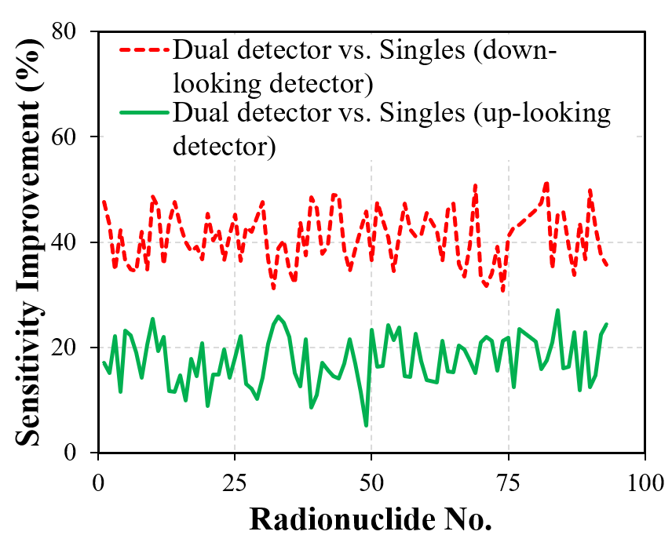
Introduction
Radionuclide (RN) monitoring: one of four verification technologies of the IMS
IMS: RN stations utilize high-resolution gamma spectrometry for particulate radionuclides
Such as: ¹⁴⁰La, ¹⁴⁰Ba, ¹³⁴Cs, ¹³⁷Cs, etc.
Multidetector systems promising for IMS:
Superior detection efficiency
$γ$-$γ$ Coincidence signatures
Operationally resilient
Additional detectors bring complexity
Data processing, analysis, and quantification $⇒$ sophisticated software
Mathematical operations, Nuclear Structure, Characterized source-detector geometry
M. Sharma et al., SnT-2021
Place your QR Code here after removing this text box!
P3.2-360

Slide 4
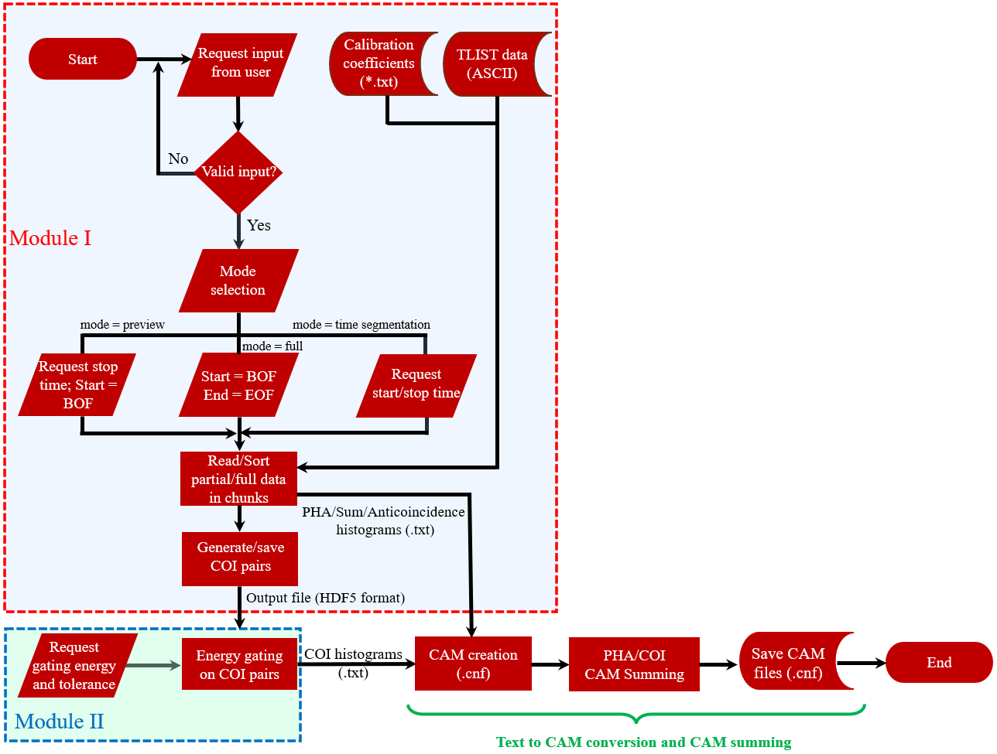
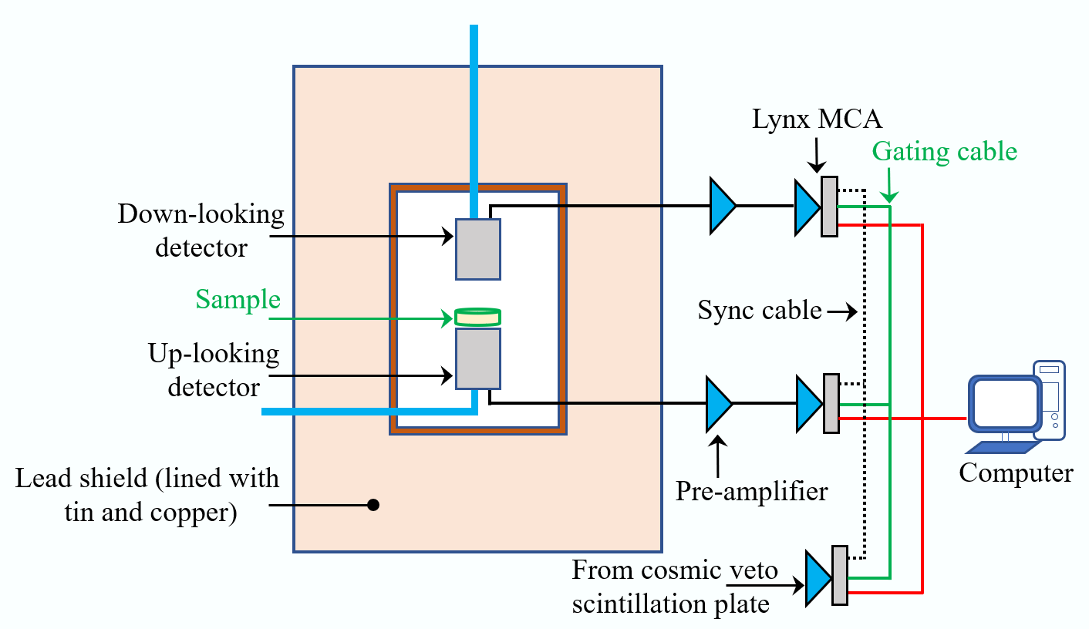
Software-I: Coincidence Analysis
Time delay AnaLysis using binAry SearcH (TALASH)
TALASH development constraints:
Implementation: Windows, Python, TLIST (Canberra)
Output: Genie-2000
Large data problem (high count rate/time)
M. Sharma, J. Burnett, “Development and Performance Evaluation of a Novel $γ$-$γ$ Coincidence Analysis Software,” NIM-A (2023, in press).
Place your QR Code here after removing this text box!
Schematic of a ‘dual-detector’ system
P3.2-360

Slide 5
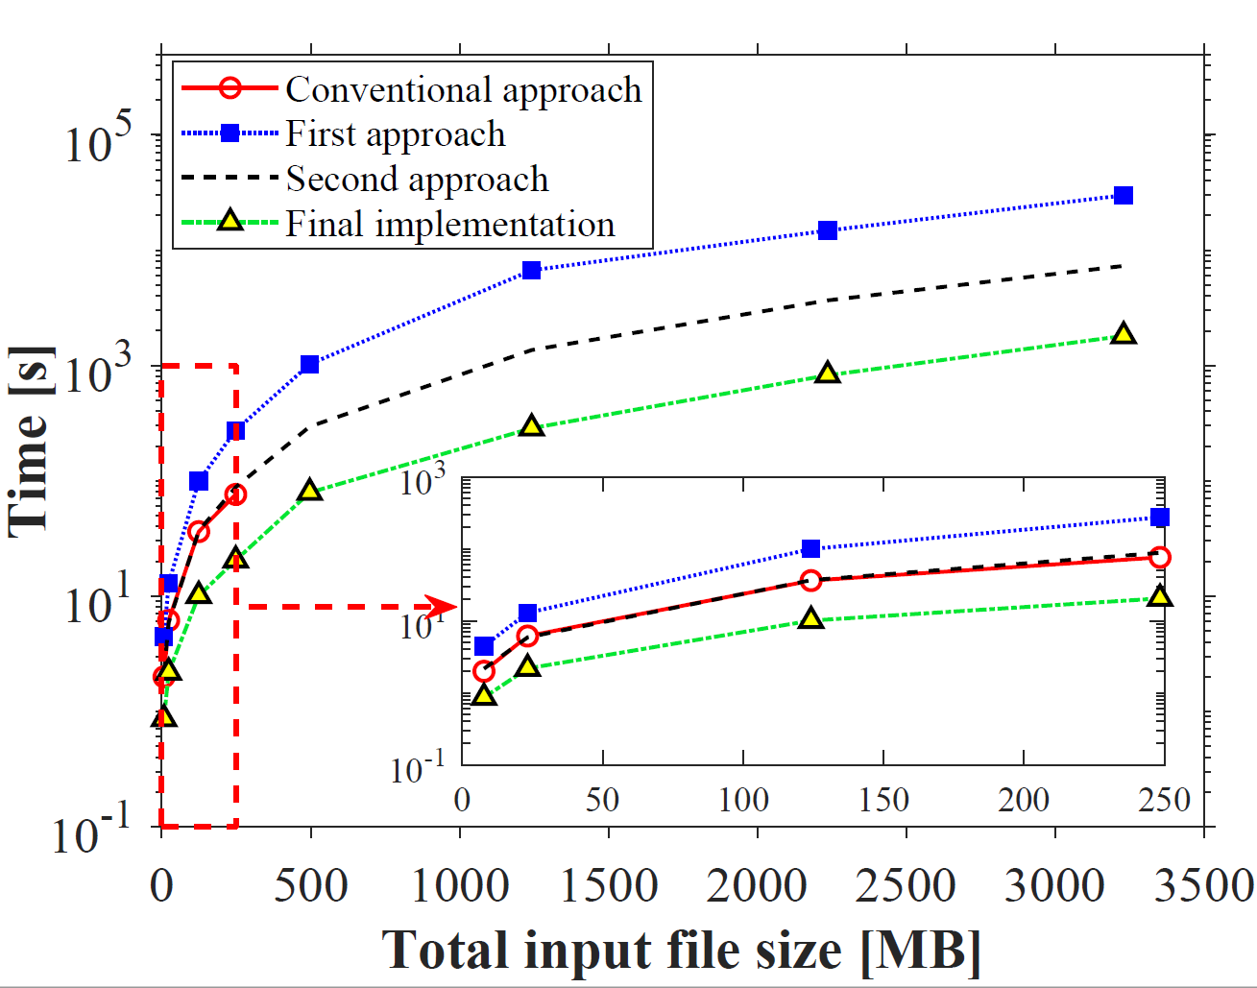
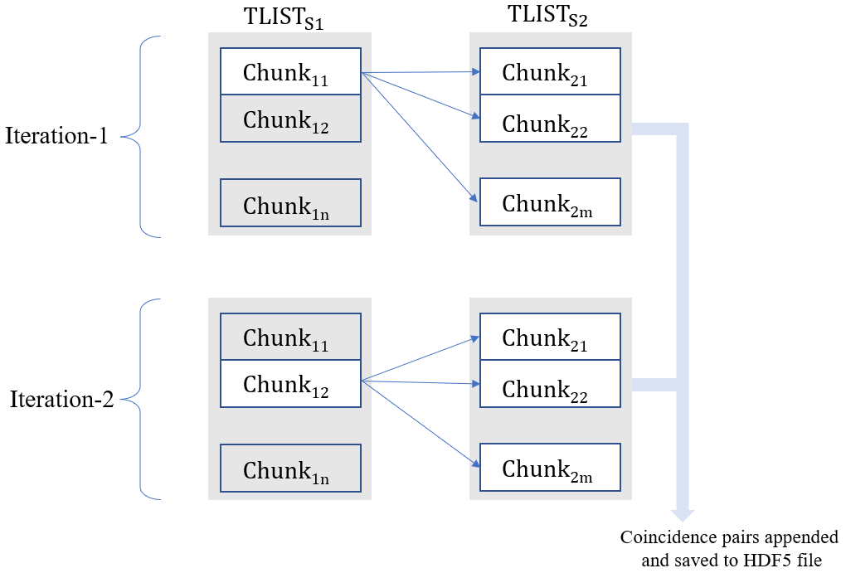
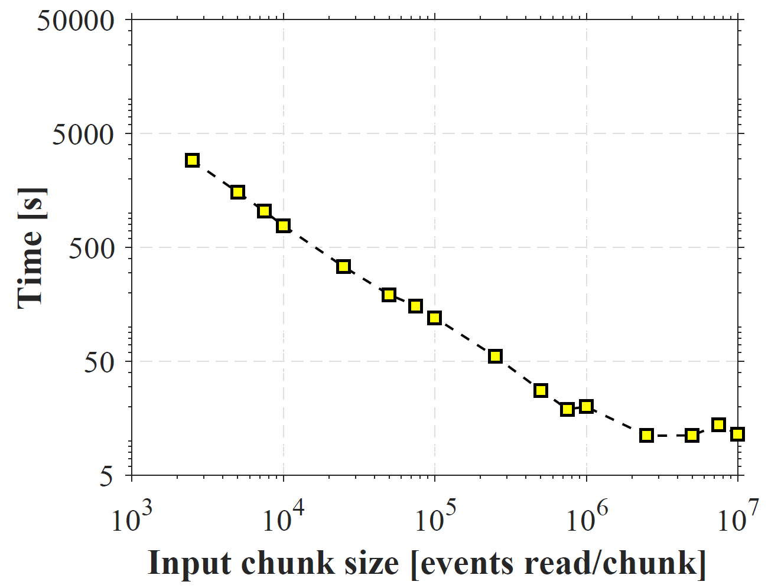
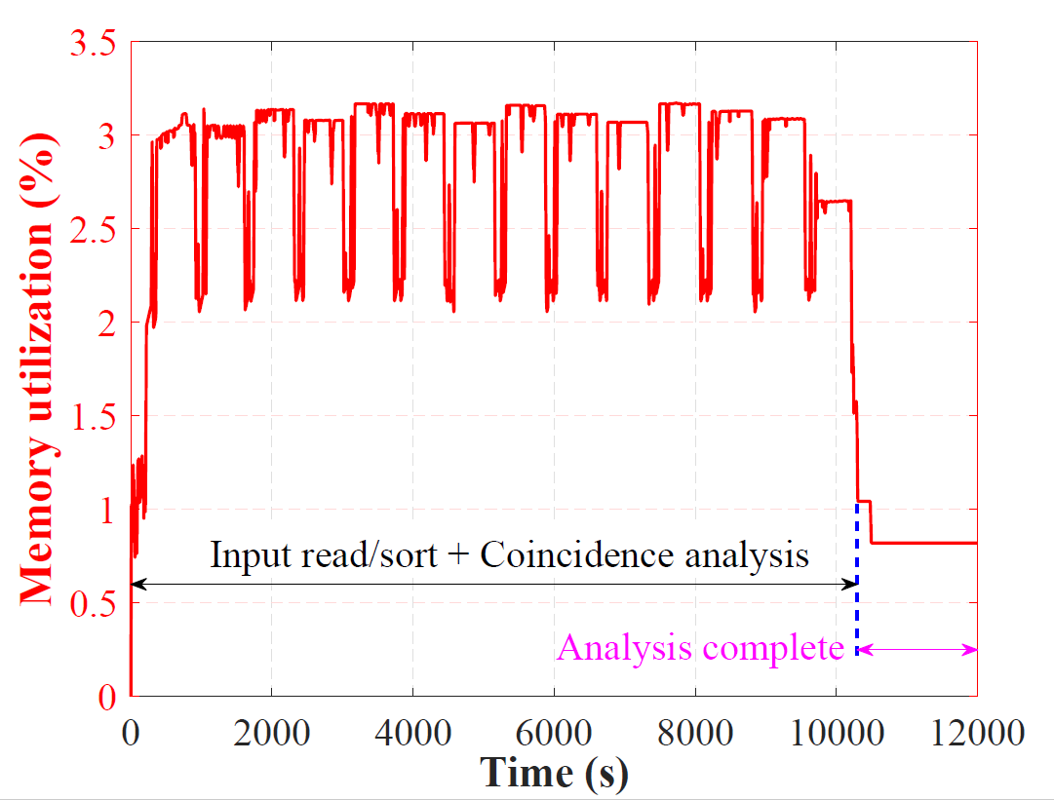
Software-I: Coincidence Analysis
Performance Optimization
Performance Optimization with Synthetic Data
Sophisticated Strategies
Large Data Chunking - optimization
Memory Utilization during Coincidence Search
Place your QR Code here after removing this text box!
P3.2-360
M. Sharma, J. Burnett, “Development and Performance Evaluation of a Novel $γ$-$γ$ Coincidence Analysis Software,” NIM-A (2023, in press).

Slide 6
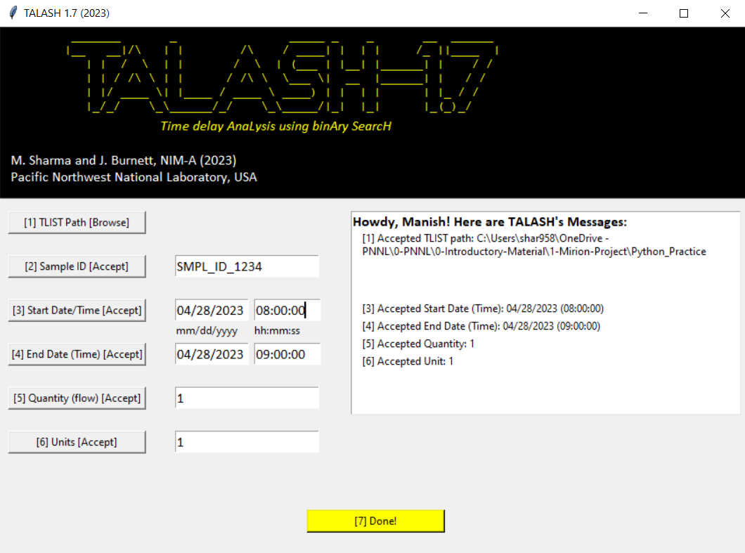
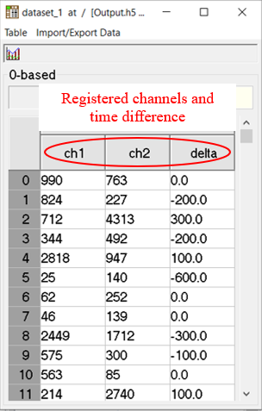
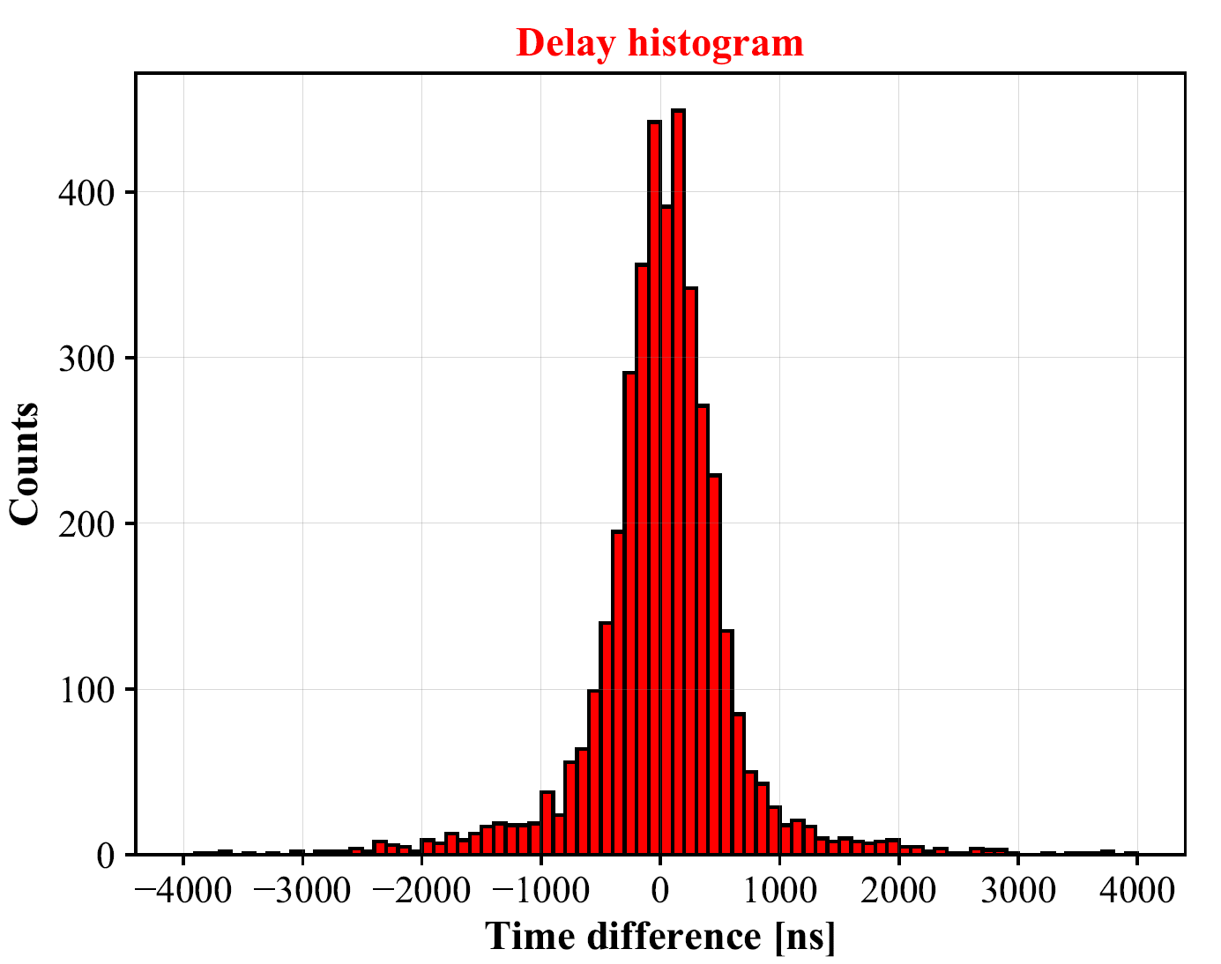
Software-I: Coincidence Analysis
TALASH: Output (GUI)
TALASH - GUI
TALASH – Output (HDF5)
TALASH – Sample Delay Histogram
In Progress!
TALASH Output
Coincidence pairs
Singles/Summed spectra
Coincidence spectra
Place your QR Code here after removing this text box!
P3.2-360
M. Sharma, J. Burnett, “Development and Performance Evaluation of a Novel $γ$-$γ$ Coincidence Analysis Software,” NIM-A (2023, in press).

Slide 7
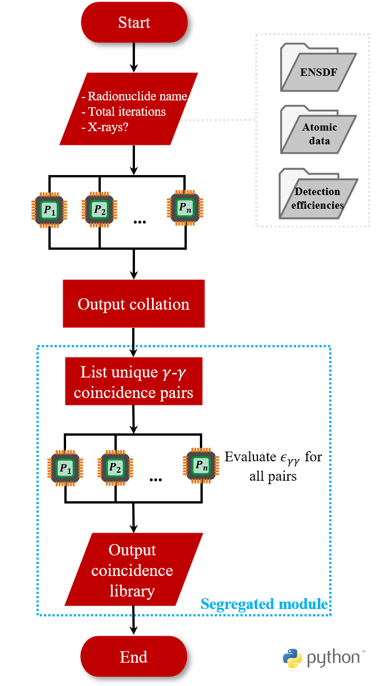
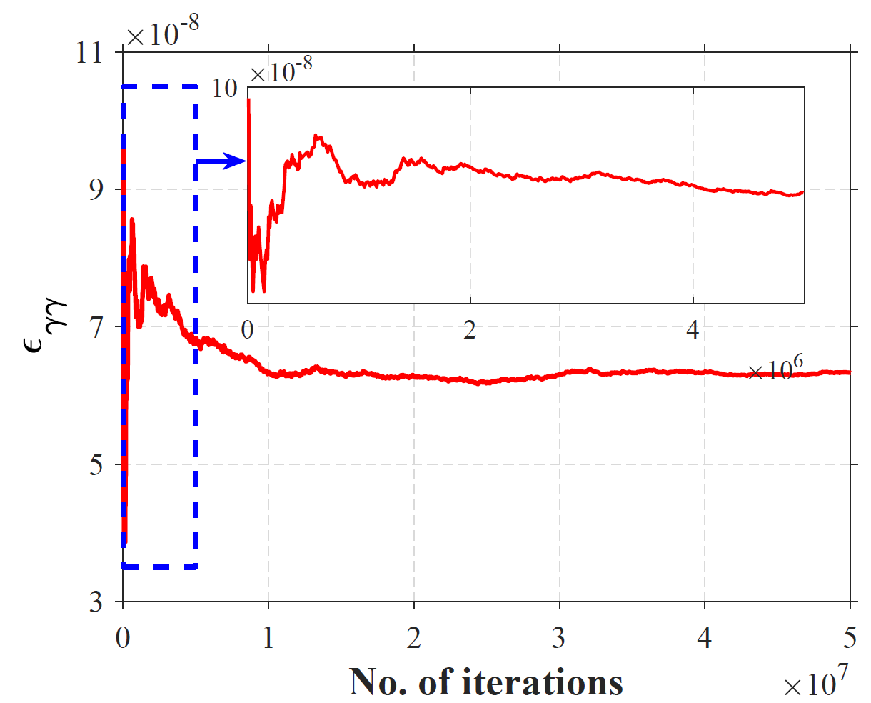
Software-2: Radionuclide Quantification using 𝜸-𝜸 Signatures
Overview and Modules
Strategies:
Python, multiprocessing implementation
Modular structure to reduce computational burden
Archived $γ$-$e^{−}$ cascades for CTBT-relevant radionuclides - PNNL’s Deception Supercomputer
Place your QR Code here after removing this text box!
P3.2-360

Slide 8
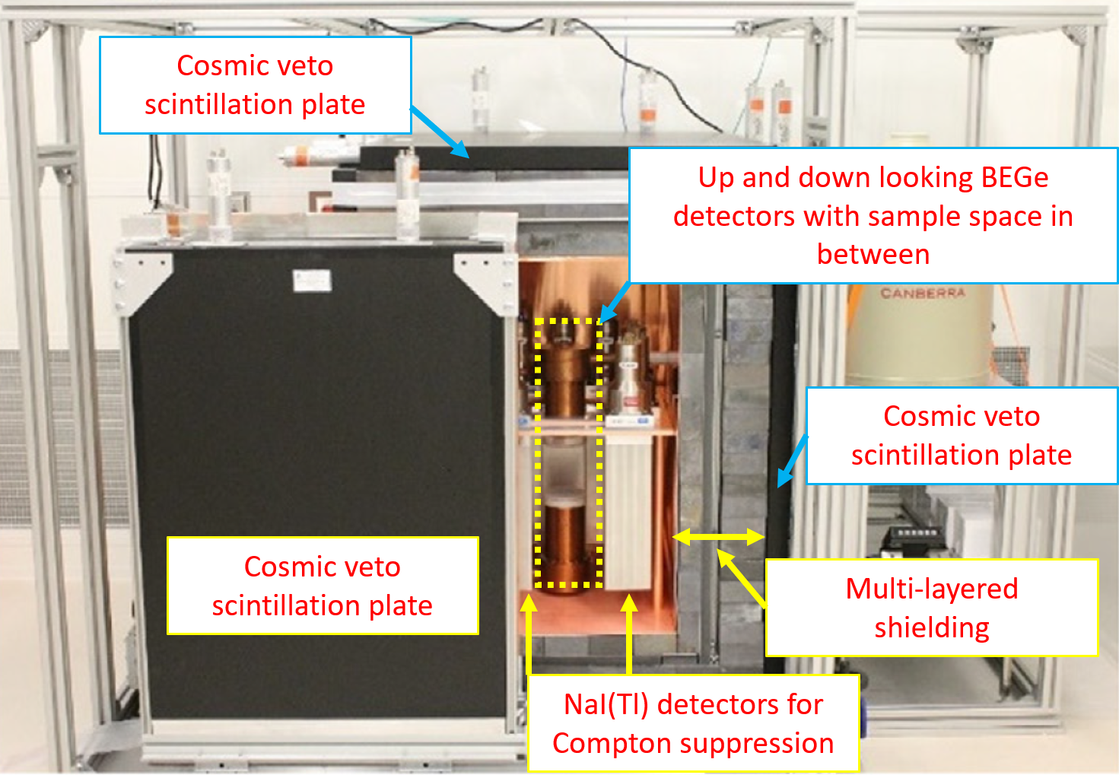
Validation Results
PNNL’s Advanced Radionuclide Gamma spectrOmeter-I
Validation of Detection Probabilities (Experiment vs Software)
Radionuclide | Coincidence Energy (keV) |  |  | $$ε_{γγ}$$ |  | $Δ$ (%)
 | Gated | Observed |  | Experiment | Simulated
⁶⁰Co | 1173.2 | 1332.5 |  | 6.5E-4 | 6.3E-4 | 2.6
⁸⁸Y | 1836.1 | 898.0 |  | 5.6E-4 | 5.6E-4 | 0.3
⁹⁹Mo | 181.1 | 739.5 |  | 3.7E-4 | 3.7E-4 | 0.8
¹³²Te | 228.2 | 49.7 |  | 3.3E-3 | 3.2E-3 | 1.2
¹⁴⁰Ba | 162.7 | 304.8 |  | 4.9E-4 | 4.9E-4 | 0.5
¹⁴⁰La | 1596.0 | 328.0 |  | 2.6E-4 | 2.6E-4 | 0.3
¹⁰³Ru | 53.3 | 557.1 |  | 2.7E-5 | 2.8E-5 | 3.2
¹⁴³Ce | 57.4 | 293.3 |  | 1.1E-3 | 1.1E-3 | 1.2
¹⁴⁰La | 1596.0 | 328.0 |  | 2.6E-4 | 2.6E-4 | 0.2
⁴²K | 1524.6 | 312.6 |  | 6.8E-6 | 6.5E-6 | 4.2
⁹⁷Zr | 254.2 | 1148.0 |  | 1.7E-5 | 1.7E-5 | 0.0
¹³²I | 522.7 | 772.6 |  | 2.2E-4 | 2.2E-4 | 0.2
¹³³I | 706.6 | 529.9 |  | 3.4E-5 | 3.3E-5 | 0.8
¹³¹I | 80.2 | 284.0 |  | 4.8E-4 | 4.9E-4 | 1.0
¹⁵³Sm | 103.2 | 69.7 |  | 7.0E-4 | 7.0E-4 | 0.4
Place your QR Code here after removing this text box!
P3.2-360

Slide 9
Conclusions
Development of sophisticated coincidence analysis/quantification software at PNNL
Performance evaluation and optimization
Software’s execution tested for CTBT relevant radionuclides (and complex decay radionuclides, ²³³U)
Validated with experimental measurement of 15 radionuclides (using calibration standards and irradiated samples)
What’s not discussed, but has been done:
Comparison with existing software (AWE’s RIMMER)
Impact of interferences (own/other emissions)
Convergence behavior for 15 radionuclides
Further details on experimental probability calculation and comparison
Place your QR Code here after removing this text box!
P3.2-360

Slide 10
Thank You!
Place your QR Code here after removing this text box!
P3.2-360

