Slide 1
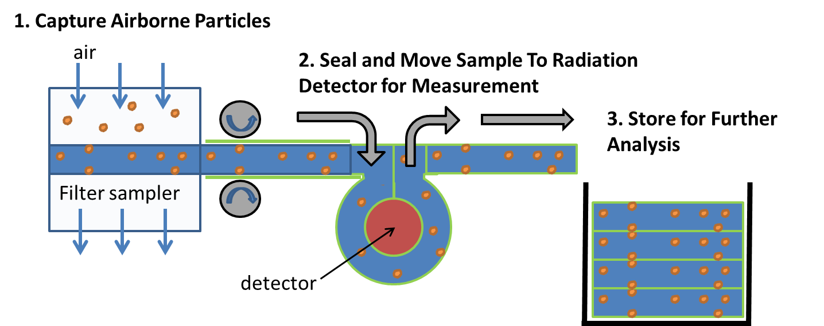
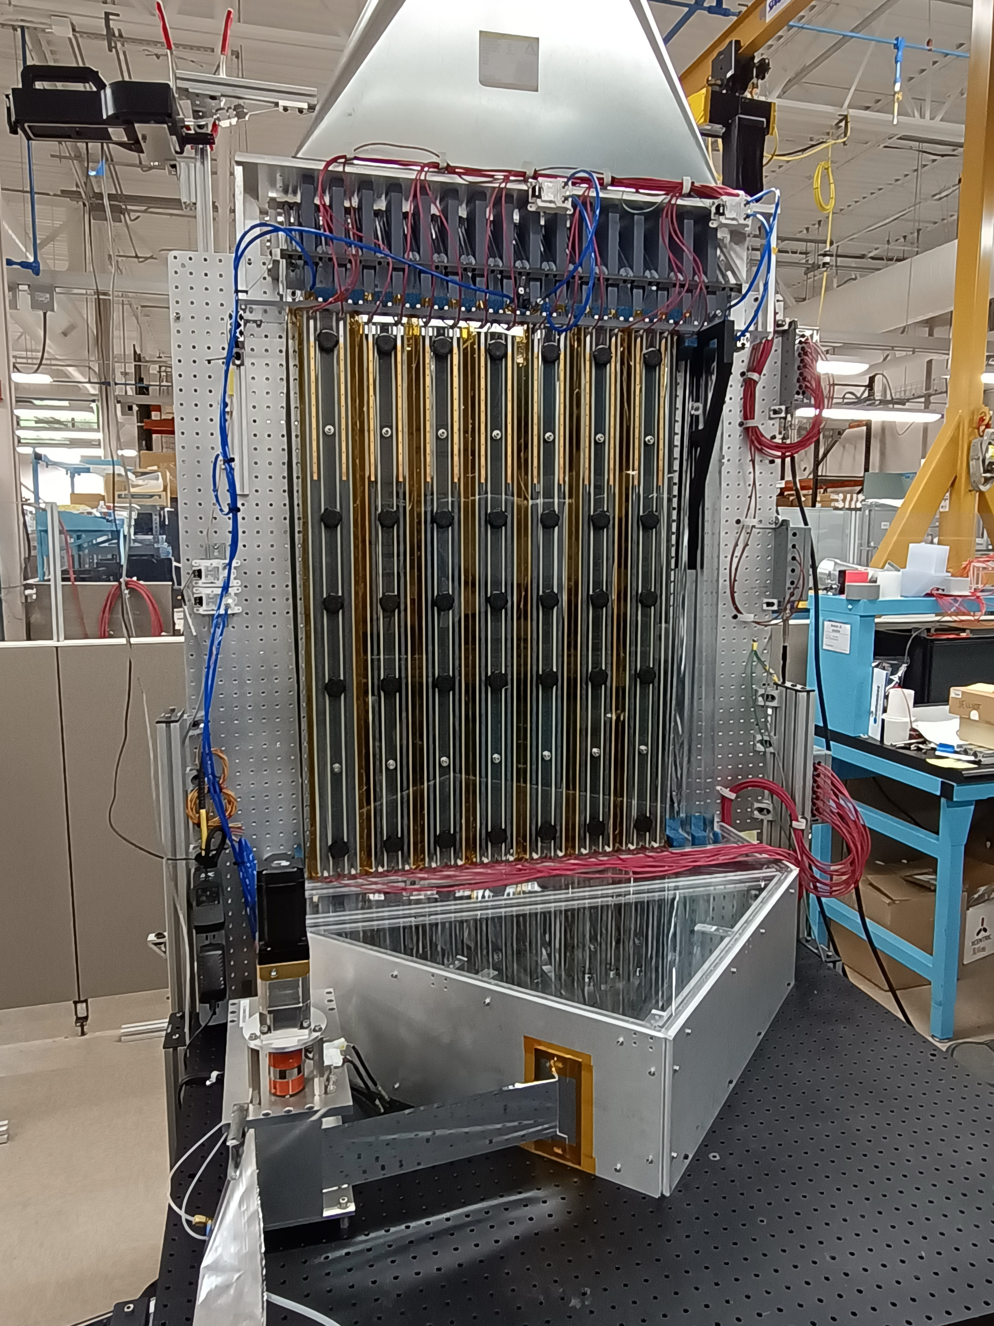
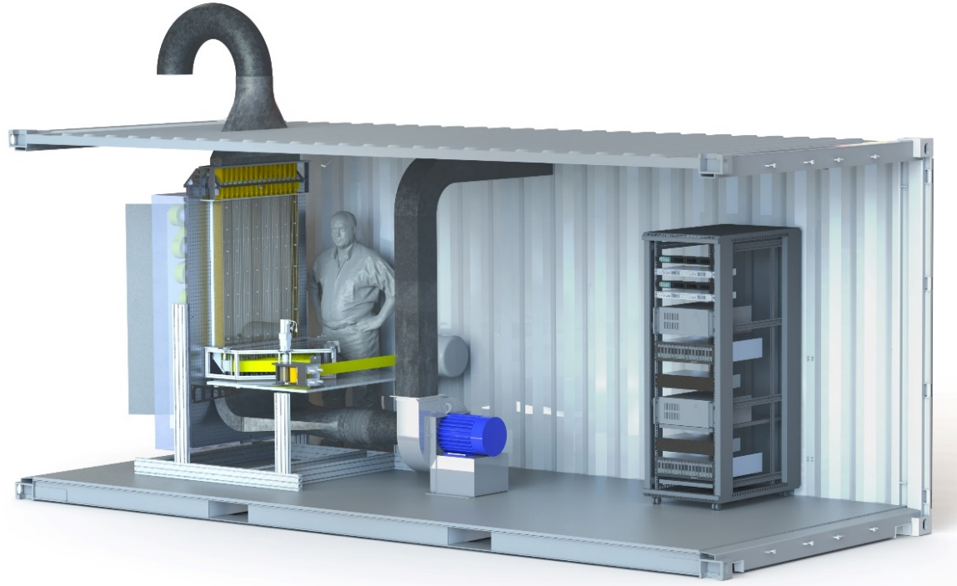
Advanced Electrostatic Precipitator (ESP) for Radionuclide Particle Collection for Integration into RASA 2.0
Michael E. Swanwick, Clive L. Devoy, Jessica M. Elliott, Katharine Fergusson, Sheldon D. Stokes, and Patrick J. Magari – Creare LLC
P3.2-746
Impact Filter Replacement
System Highlights
Flexible webs
Compatible with dual detectors
450 samples between reloading
Compact design
Prototype size: 2.7 m (8.9 ft) from floor to duct
Next Steps
Build and test ruggedized version of radionuclide collection system in support of RASA 2.0
RASA 1.0
Advanced ESP
Conceptual Sample Handler
Notional Detector (2x)
Take Up Spool
Conclusions
A lab-based full-size collection prototype has been built and tested
Sample compacting has started with design and component-level validation
Experimental Data
CTBT 80% Efficiency Requirement at 0.2 µm
Packaging System Spins
Detectors Move to the Sample Puck
This work is sponsored by U.S. Defense Threat Reduction Agency (DTRA)
SBIR Contract # HDTRA220C0013
DISTRIBUTION STATEMENT: Cleared for Release

