Slide 1
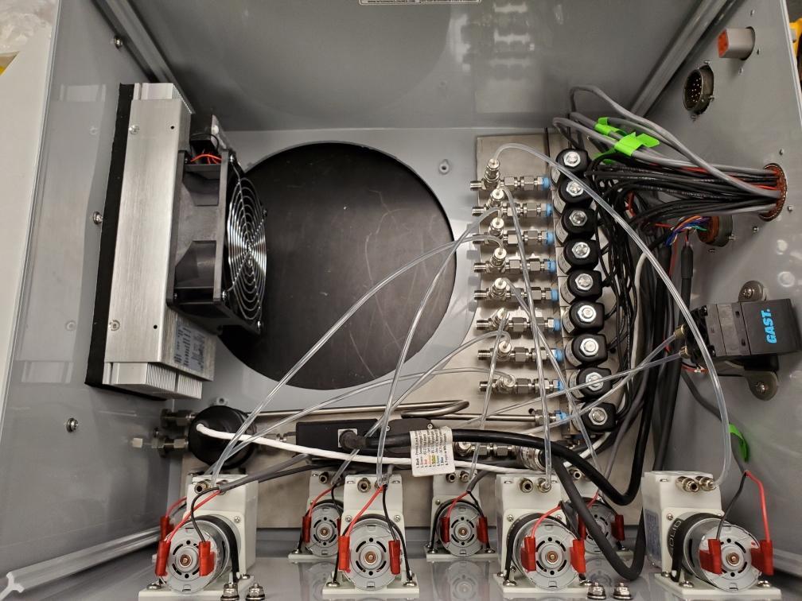
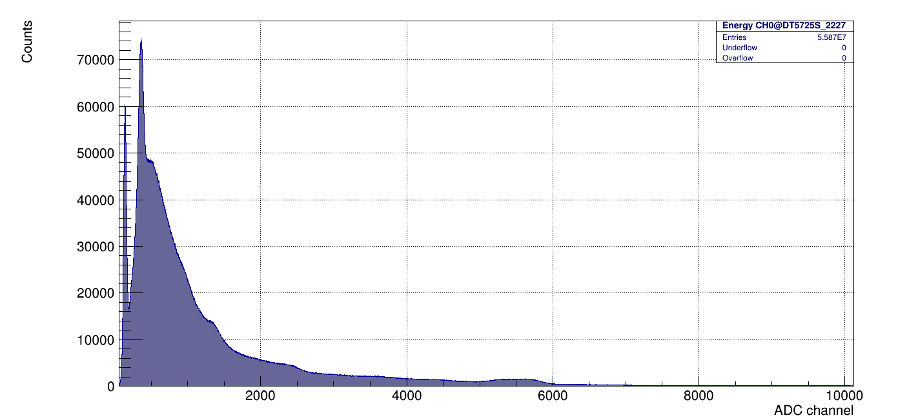
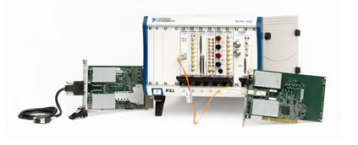
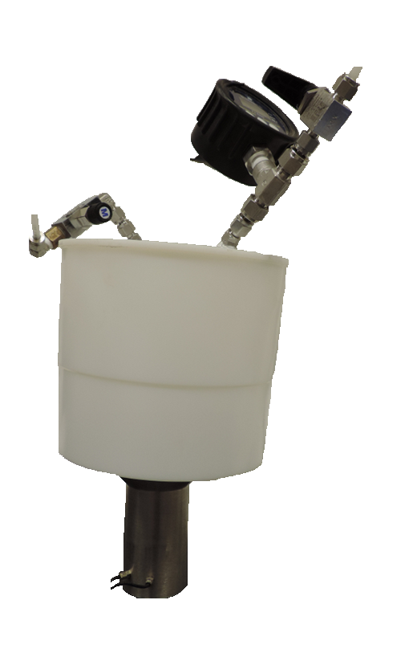
Development of a continuous field xenon detection system
Christine Johnson, Jacob Inman, James Knox, Justin Lowrey, Michael Mayer, Rose Perea, Franco Spadoni
Pacific Northwest National Laboratory, Richland, WA USA
P3.2-537
The Goal…
Fieldable, Continuous
Develop fieldable continuous flow whole-air detector systems utilizing NaI(Tl)
Optimize detector design to maximize ¹³³Xe detectability
Develop a method for automated gas collection and switching between multiple sampling locations
Manual, Point-Measurements
PNNL-SA-186145

