Slide 1
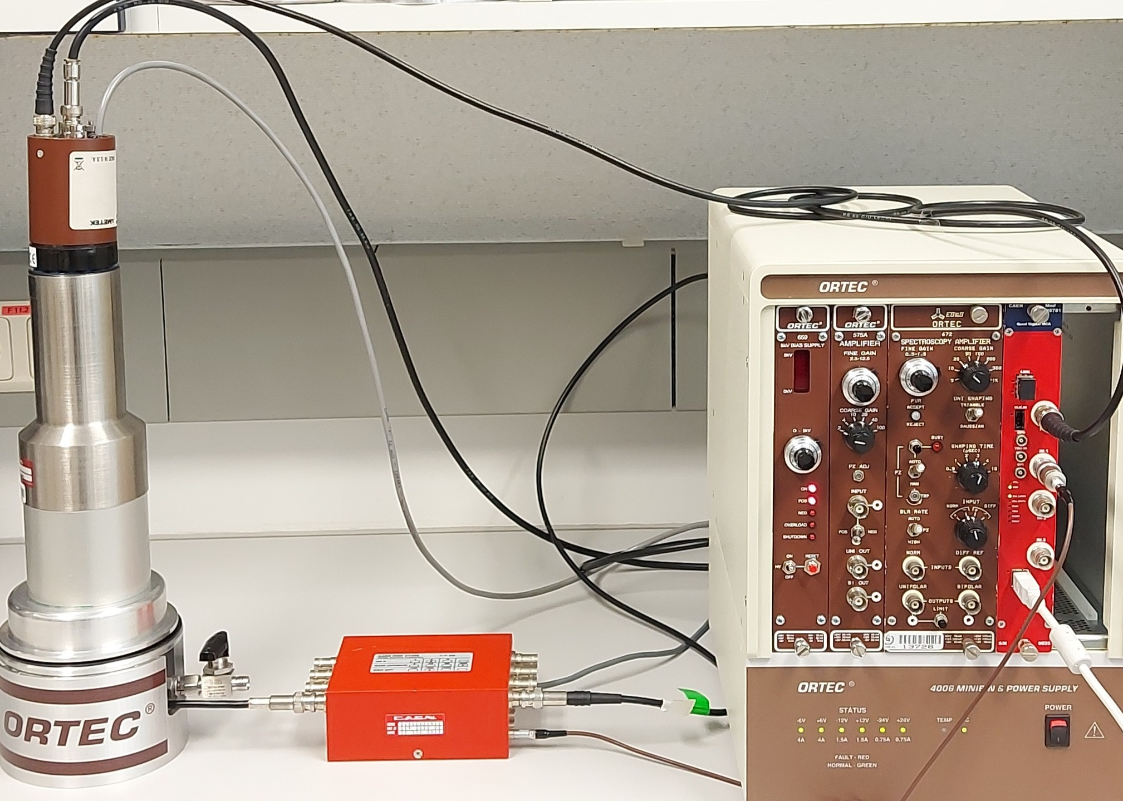
A new Prototype Detection System Based on the Beta-Gamma Coincidence Technique for Radioxenon Measurement
S. Azimi¹, H. Afarideh¹, Lucie Fiserova²
¹ Faculty of Energy Engineering and Physics, Amir Kabir University of Technology, Tehran, Iran
² NUVIA a.s., Prague, Czech Republic
P3.2-512
Detection and characterizing relevant CTBT radioxenon isotopes in the air are of interest to the CTBTO as might be indicative of an underground nuclear test.
To better detect nuclear experiments, improving sensitivity is necessary for radioxenon monitoring systems.
In this study, we develop a new radioxenon detection system based on beta-gamma coincidence using NaI(Tl) and silicon detectors.
A ^{166m}Ho source is employed for energy calibration and performance check of the PIPS detector.
The results demonstrate a good energy resolution for the discrimination of radioxenon isotopes, and provide a foundation for the development of operational systems with an optimized and compact geometry.

