Slide 1
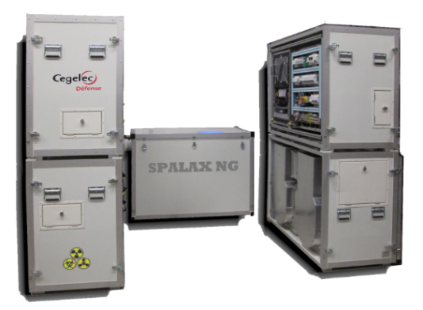
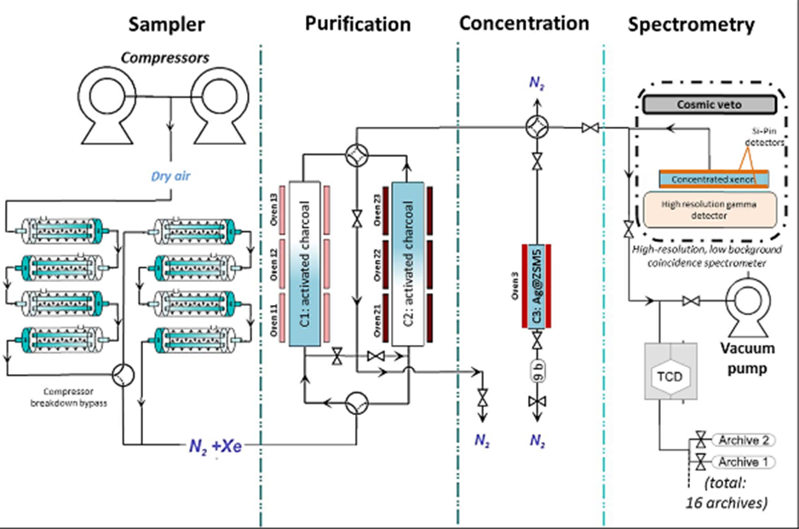
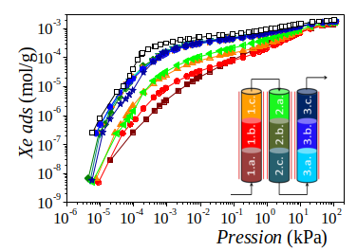
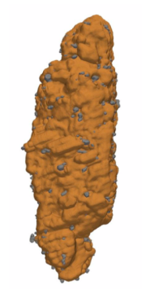
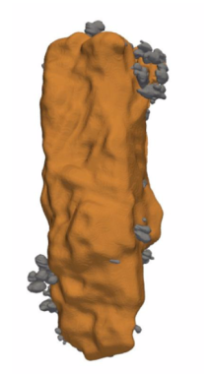
Study of Silver Exchanged Zeolite Stability for Noble Gas Processes
Celian Courtney^{[1,2]}, Gabriel Couchaux^{[1]}, Alain Tuel^{[2]}, Sylvain Topin^{[1]}, David Farrusseng^{[2]}
[1] CEA/DAM // [2] IRCELyon
P3.2-233
Silver exchanged zeolites are the most efficient materials for low-pressure xenon adsorption
They are currently used in the concentration step of the SPALAX NG
Next optimisation step : using Ag@Zeolites in the purification step
Issues :
The silver-doped zeolites lack stability when used in the process
Deactivation due to temperature and chlorated compounds
Not all Ag@ZSM-5 zeolites yield the same low-pressure Xe adsorption capacity
T
Cl
What is the relation between structure, adsorption capacity and stability?

