Slide 1
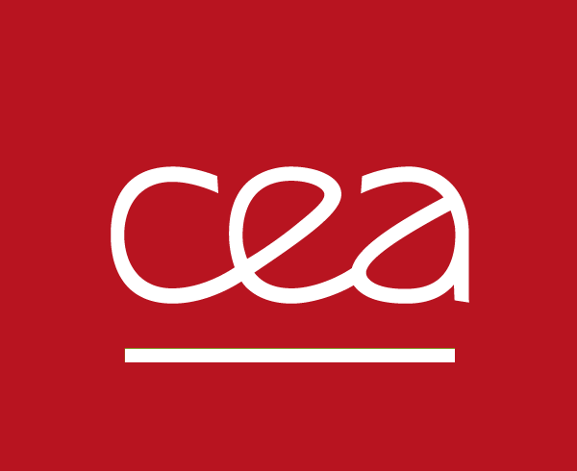
Study of Silver Exchanged Zeolite Stability for Noble Gas Processes
Celian Courtney^{[1,2]}, Gabriel Couchaux^{[1]}, Alain Tuel^{[2]}, Sylvain Topin^{[1]}, David Farrusseng^{[2]}
[1] CEA/DAM // [2] IRCELyon
There is a lack of understanding of relationship between the structure of the silver-doped zeolites and their low-pressure xenon adsorption. We aim to study the influence of several parameters on the low-pressure xenon adsorption capacity.
We selected seven sodium-form zeolites (4 ZSM-5, 2 BEA and 1 MOR) with various Si/Al ratios and aluminum coordination. We then fully exchanged them with silver, quantified the amount of silver inserted and measured their Xe adsorption isotherms.
The nature and strength of « strong sites » depends on the type of zeolite and the pressure range considered.
The highest Ag loading can be achieved only when the zeolite contains the highest concentration of framework aluminum.
Increase in cationic exchange sites = Increase in concentration of strong adsorption sites
Too much silver : pore blockage, nanoparticles agglomeration and coalescence
Aluminum coordination is a determinant parameter in silver loading and low-pressure xenon adsorption
Please do not use this space, a QR code will be automatically overlayed
P3.2-233

Slide 2
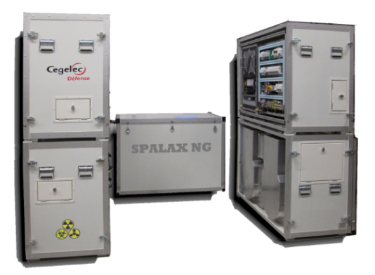
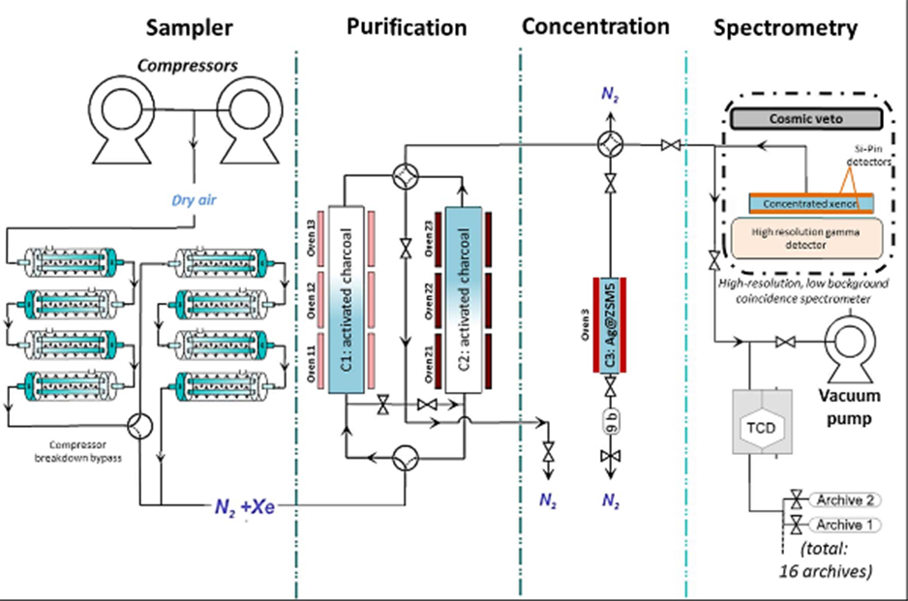
Introduction
For the past 20 years, CEA/DAM has worked on the development and improvement of the SPALAXTM, one of the systems used to monitor fission products released upon underground nuclear tests in the context of the CTBT^{[1]}. This system relies on the use of adsorbent materials in a Temperature Swing Adsorption (TSA) process to concentrate xenon from 0.087 ppm in the atmosphere to around 30% in the detection cell. Previous studies have shown that silver nanoparticles supported on ZSM-5 display an unmatched Xe/Kr selectivity and a Xe capture capacity more than an order of magnitude greater than typical activated carbons.^{[2,3,4]}
While Ag@ZSM-5 is already partly used in the SPALAX, its usage in the main purification step is prevented by deactivation phenomena observed in process conditions^{[5]}. Moreover, the differences in Xe adsorption capacity from one zeolite to another show the current lack of knowledge on the structure-property relationship in these materials
Please do not use this space, a QR code will be automatically overlayed
P3.2-233

Slide 3
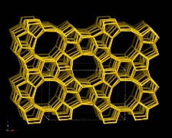
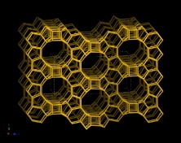
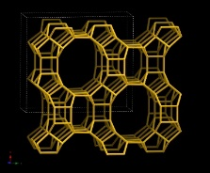
Hypotheses and objectives
Hypothesis : Increase in silver loading with high dispersion = increase in Xe adsorption at very low pressure
Can this be achieved by increasing the number of exchangeable cations, i.e. increasing the tetra-coordinated Al concentration of the zeolites ?
Hypothesis : Mordenite zeolite, also made of pentasil units, presents a lower Si/Al ratio than ZSM-5 and BEA (i.e. contains more aluminum). It could be an appropriate canditate in view of achieving a silver-exchanged zeolite with higher silver loading and isolated Ag⁺ adsorption sites
We chose various zeolites with different Si/Al ratios and tetra-coordinated aluminum proportions
Please do not use this space, a QR code will be automatically overlayed
MFI (ZSM-5)
Beta (BEA)
Mordenite (MOR)
P3.2-233

Slide 4
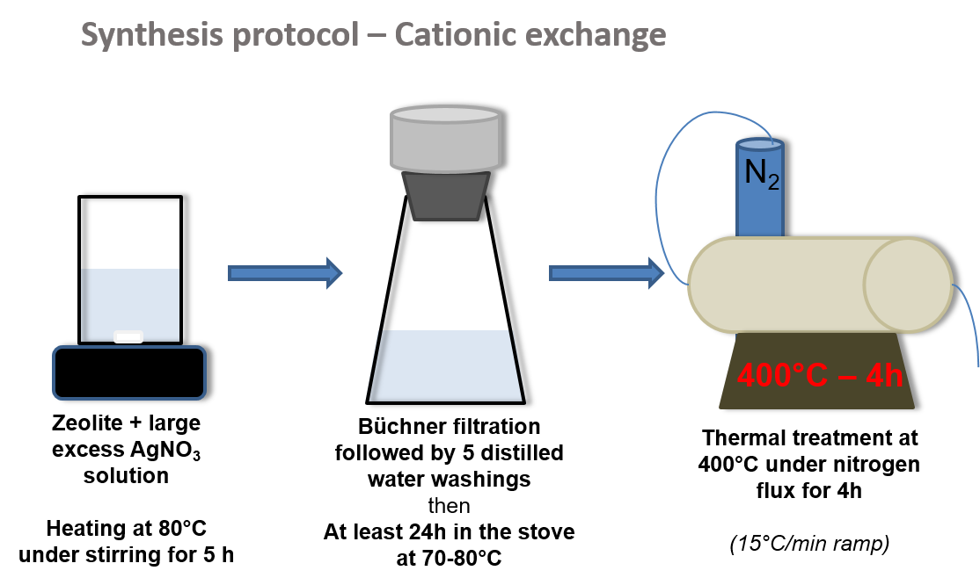
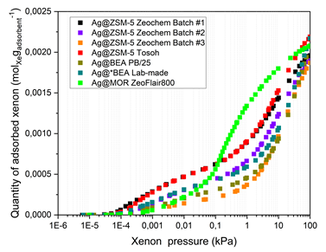
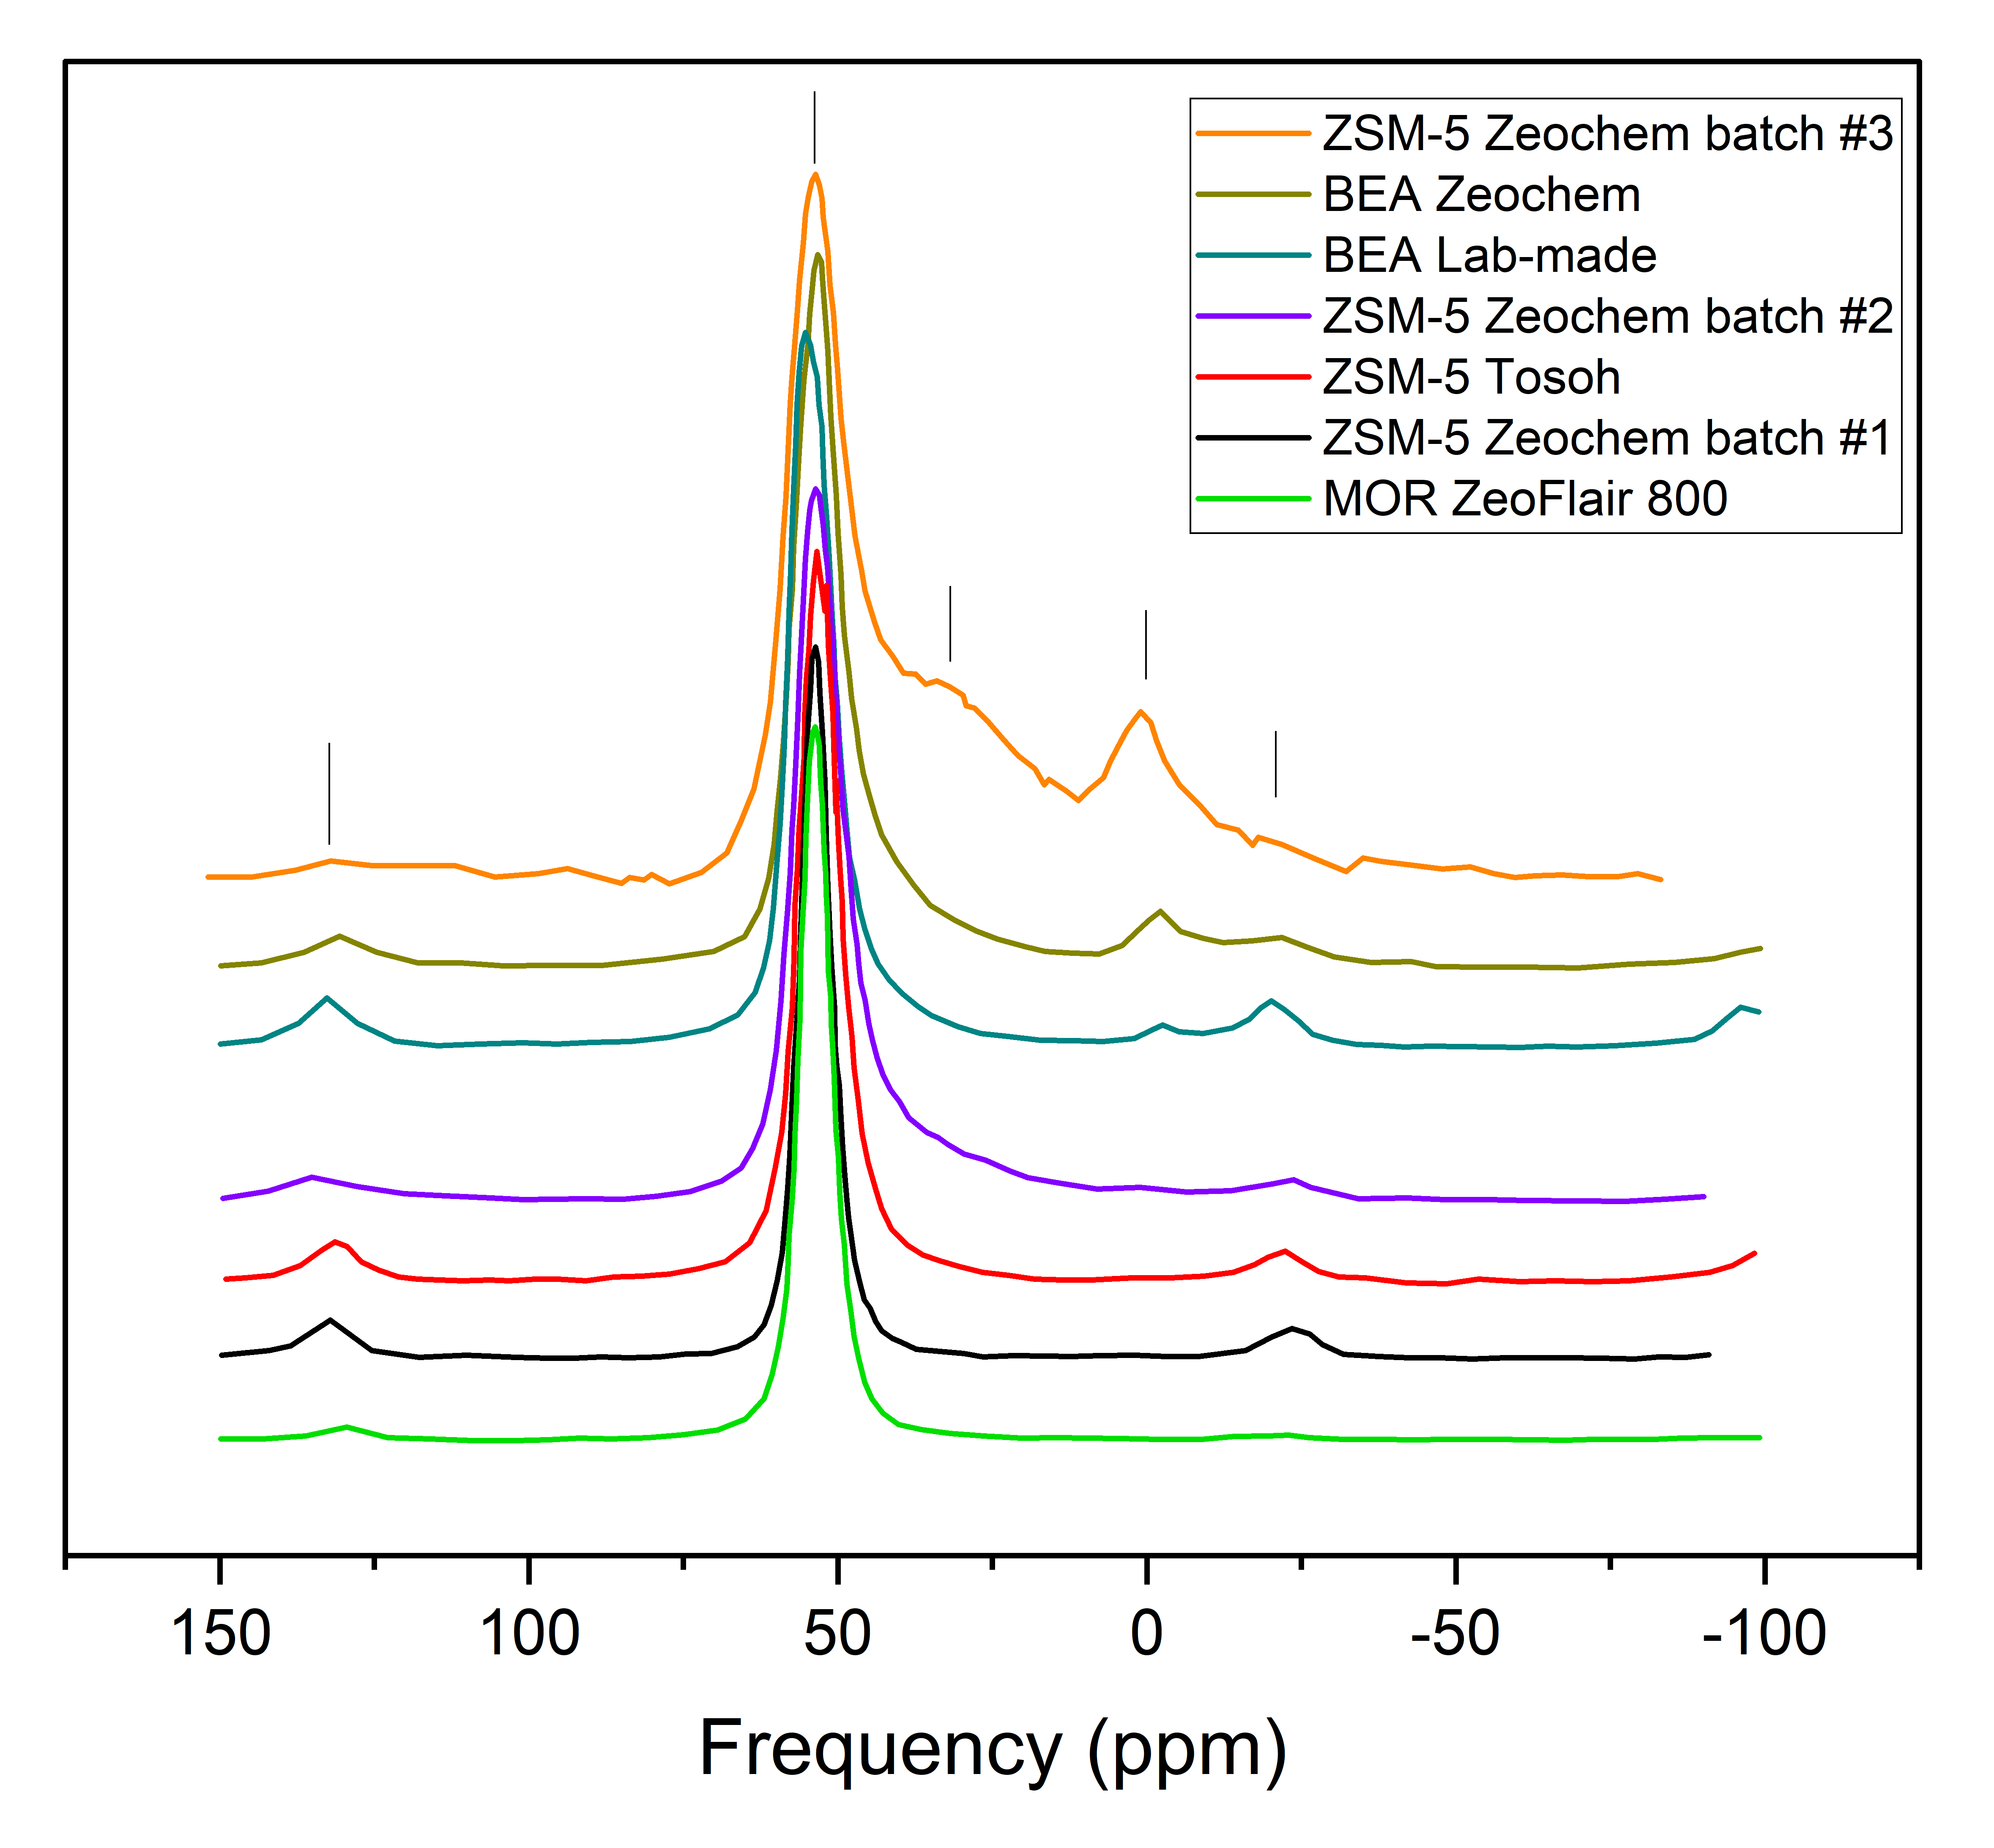
Methods & Data
Cationic exchange of Na-Zeolites to Ag@Zeolites
Measure of Xe adsorption isotherms at 25°C
Isotherms modelling using Double Site Langmuir-Freundlich (DSLF) model
$${q= q}_{1}+q_{2}= \\ N_{1}\frac{{\left(K\right.}_{1}P_{Xe})^{m_{1}}}{1+{\left(K\right.}_{1}P_{Xe})^{m_{1}}}+N_{2}\frac{{\left(K\right.}_{2}P_{Xe})^{m_{2}}}{1+{\left(K\right.}_{2}P_{Xe})^{m_{2}}}$$
q₁
« weak » sites
« strong » sites
q₂
Characterization of Al coordination by ²⁷Al NMR
Ag@Zeolite characterization summary
Zeolite | x_{R} | Ag loading (wt%) | Si/Al ratio | N₂ ≡ C_{SAS} (mmol g⁻¹) | Ag loading (wt%)
PZ-2/25 batch #1 | >0.95 | 8.4 | 14.4 | 0.49 | 0.87
PZ-2/25 batch #2 | 0.64 | 9.3 | 10.3 | 0.39 | 0.70
PZ-2/25 batch #3 | 0.35 | 4.9 | 10.6 | 0.21 | 0.36
Tosoh | >0.95 | 8.3 | 15.7 | 0.49 | 0.91
BEA PB/25 | 0.63 | 6.4 | 11.9 | 0.32 | 0.57
BEA Lab-made | 0.74 | 7.2 | 14 | 0.41 | 0.75
MOR ZeoFlair 800 | >0.95 | 18.7 | 6.3 | 0.30 | 0.99
x_{R} : proportion of tetra-coordinated Aluminum
$$x_{R}=\frac{55 ppm peak area}{\sum{peaks area}}$$
Please do not use this space, a QR code will be automatically overlayed
P3.2-233

Slide 5
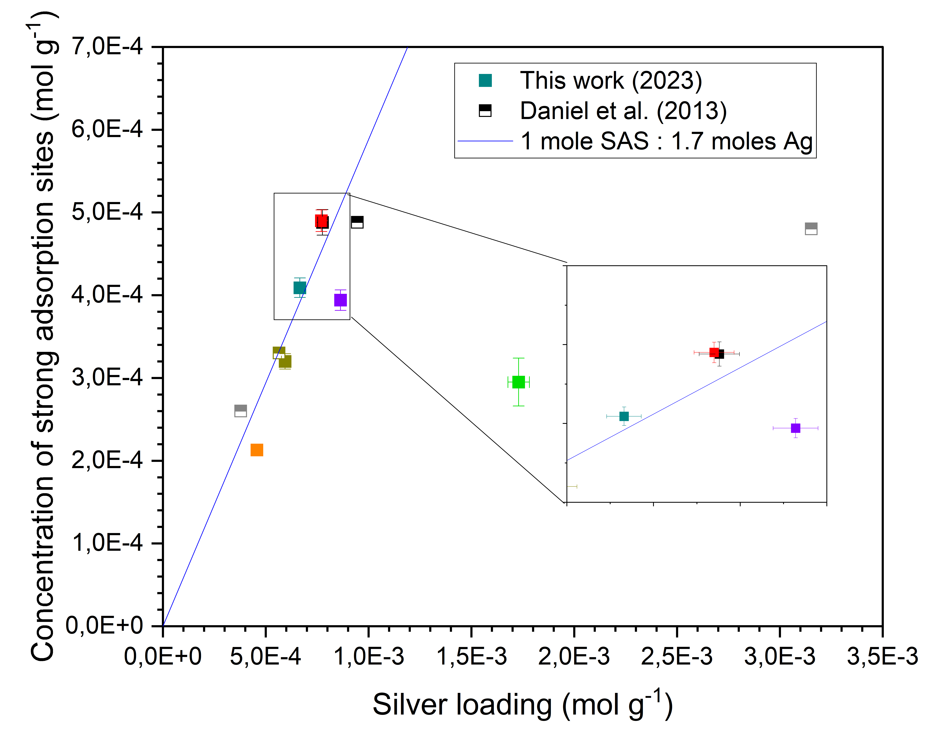
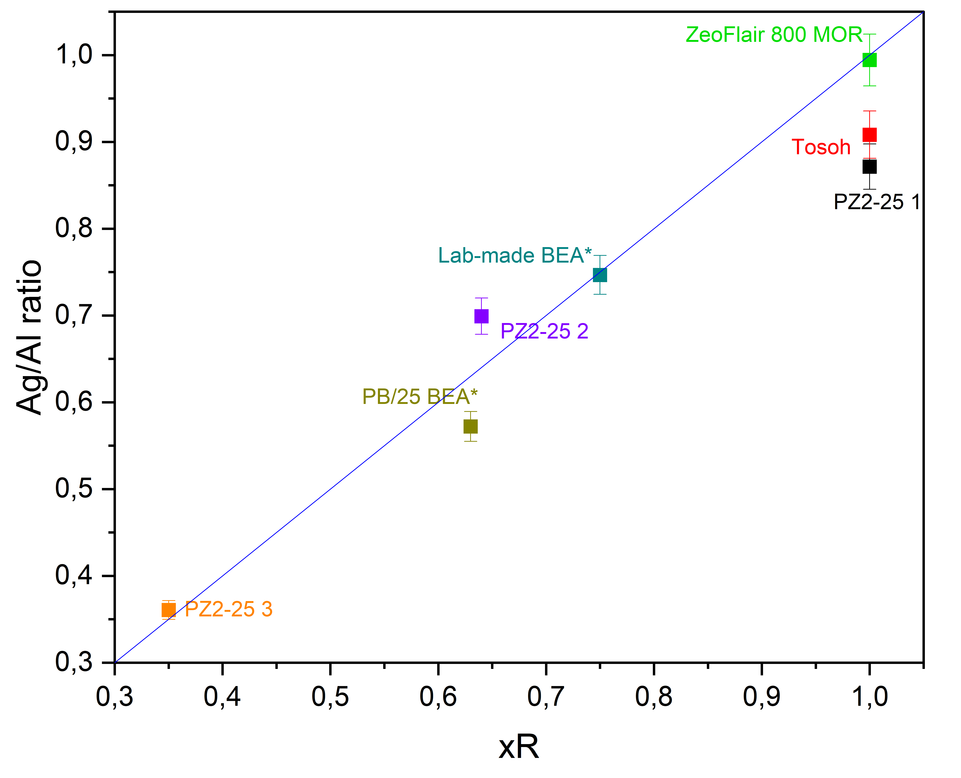
Results
Zeolite-specific strong adsorption sites
Exchange site – strong site correlation
Linear trend : 1 mole of strong adsorption site (SAS) for 1,7 mole of silver for ZSM-5 and BEA zeolites
Twice as much silver yet a much lower C_{SAS} value
➔ Silver in MOR yields another type of « strong site » in a different pressure range
Clear linear causality between the initial framework aluminum (x_{R}) concentration and the final silver concentration (C_{SAS})
Please do not use this space, a QR code will be automatically overlayed
The highest Ag loading can be achieved only when the zeolite contains the highest concentration of framework aluminum
The nature of « strong sites » depends on the type of zeolite and the pressure range considered
P3.2-233

Slide 6
Conclusion
Silver in ZSM-5 and BEA zeolites yields a different type of « strong adsorption site » than MOR zeolites ➔ Silver stabilized in a different state?
Increase in cationic exchange sites = Increase in concentration of strong adsorption sites
TRUE, but only up to a certain point
Too much silver : pore blockage, nanoparticles agglomeration and coalescence
Influence of silver loading on silver state?
Zeolite quality must be systematically verified, especially Aluminum coordination ➔ Determinant parameter in silver loading and low-pressure xenon adsorption
Please do not use this space, a QR code will be automatically overlayed
P3.2-233

Slide 7
References
[1] S. Topin et al.; J. Environ. Radioact. 2015, 149, 43-50
[2] C. Daniel et al.; J. Phys. Chem. C, 2013, 117, 15122-15129
[3] L. Delière et al.; J. Phys. Chem. C, 2017, 118, 25032-25040
[4] L. Delière et al.; Microp. Mesop. Mat. 2016, 229, 145-154
[5] A. Monpezat et al., ACS Nano, 2019, 2, 6452-6461
Please do not use this space, a QR code will be automatically overlayed
P3.2-233

