Slide 1
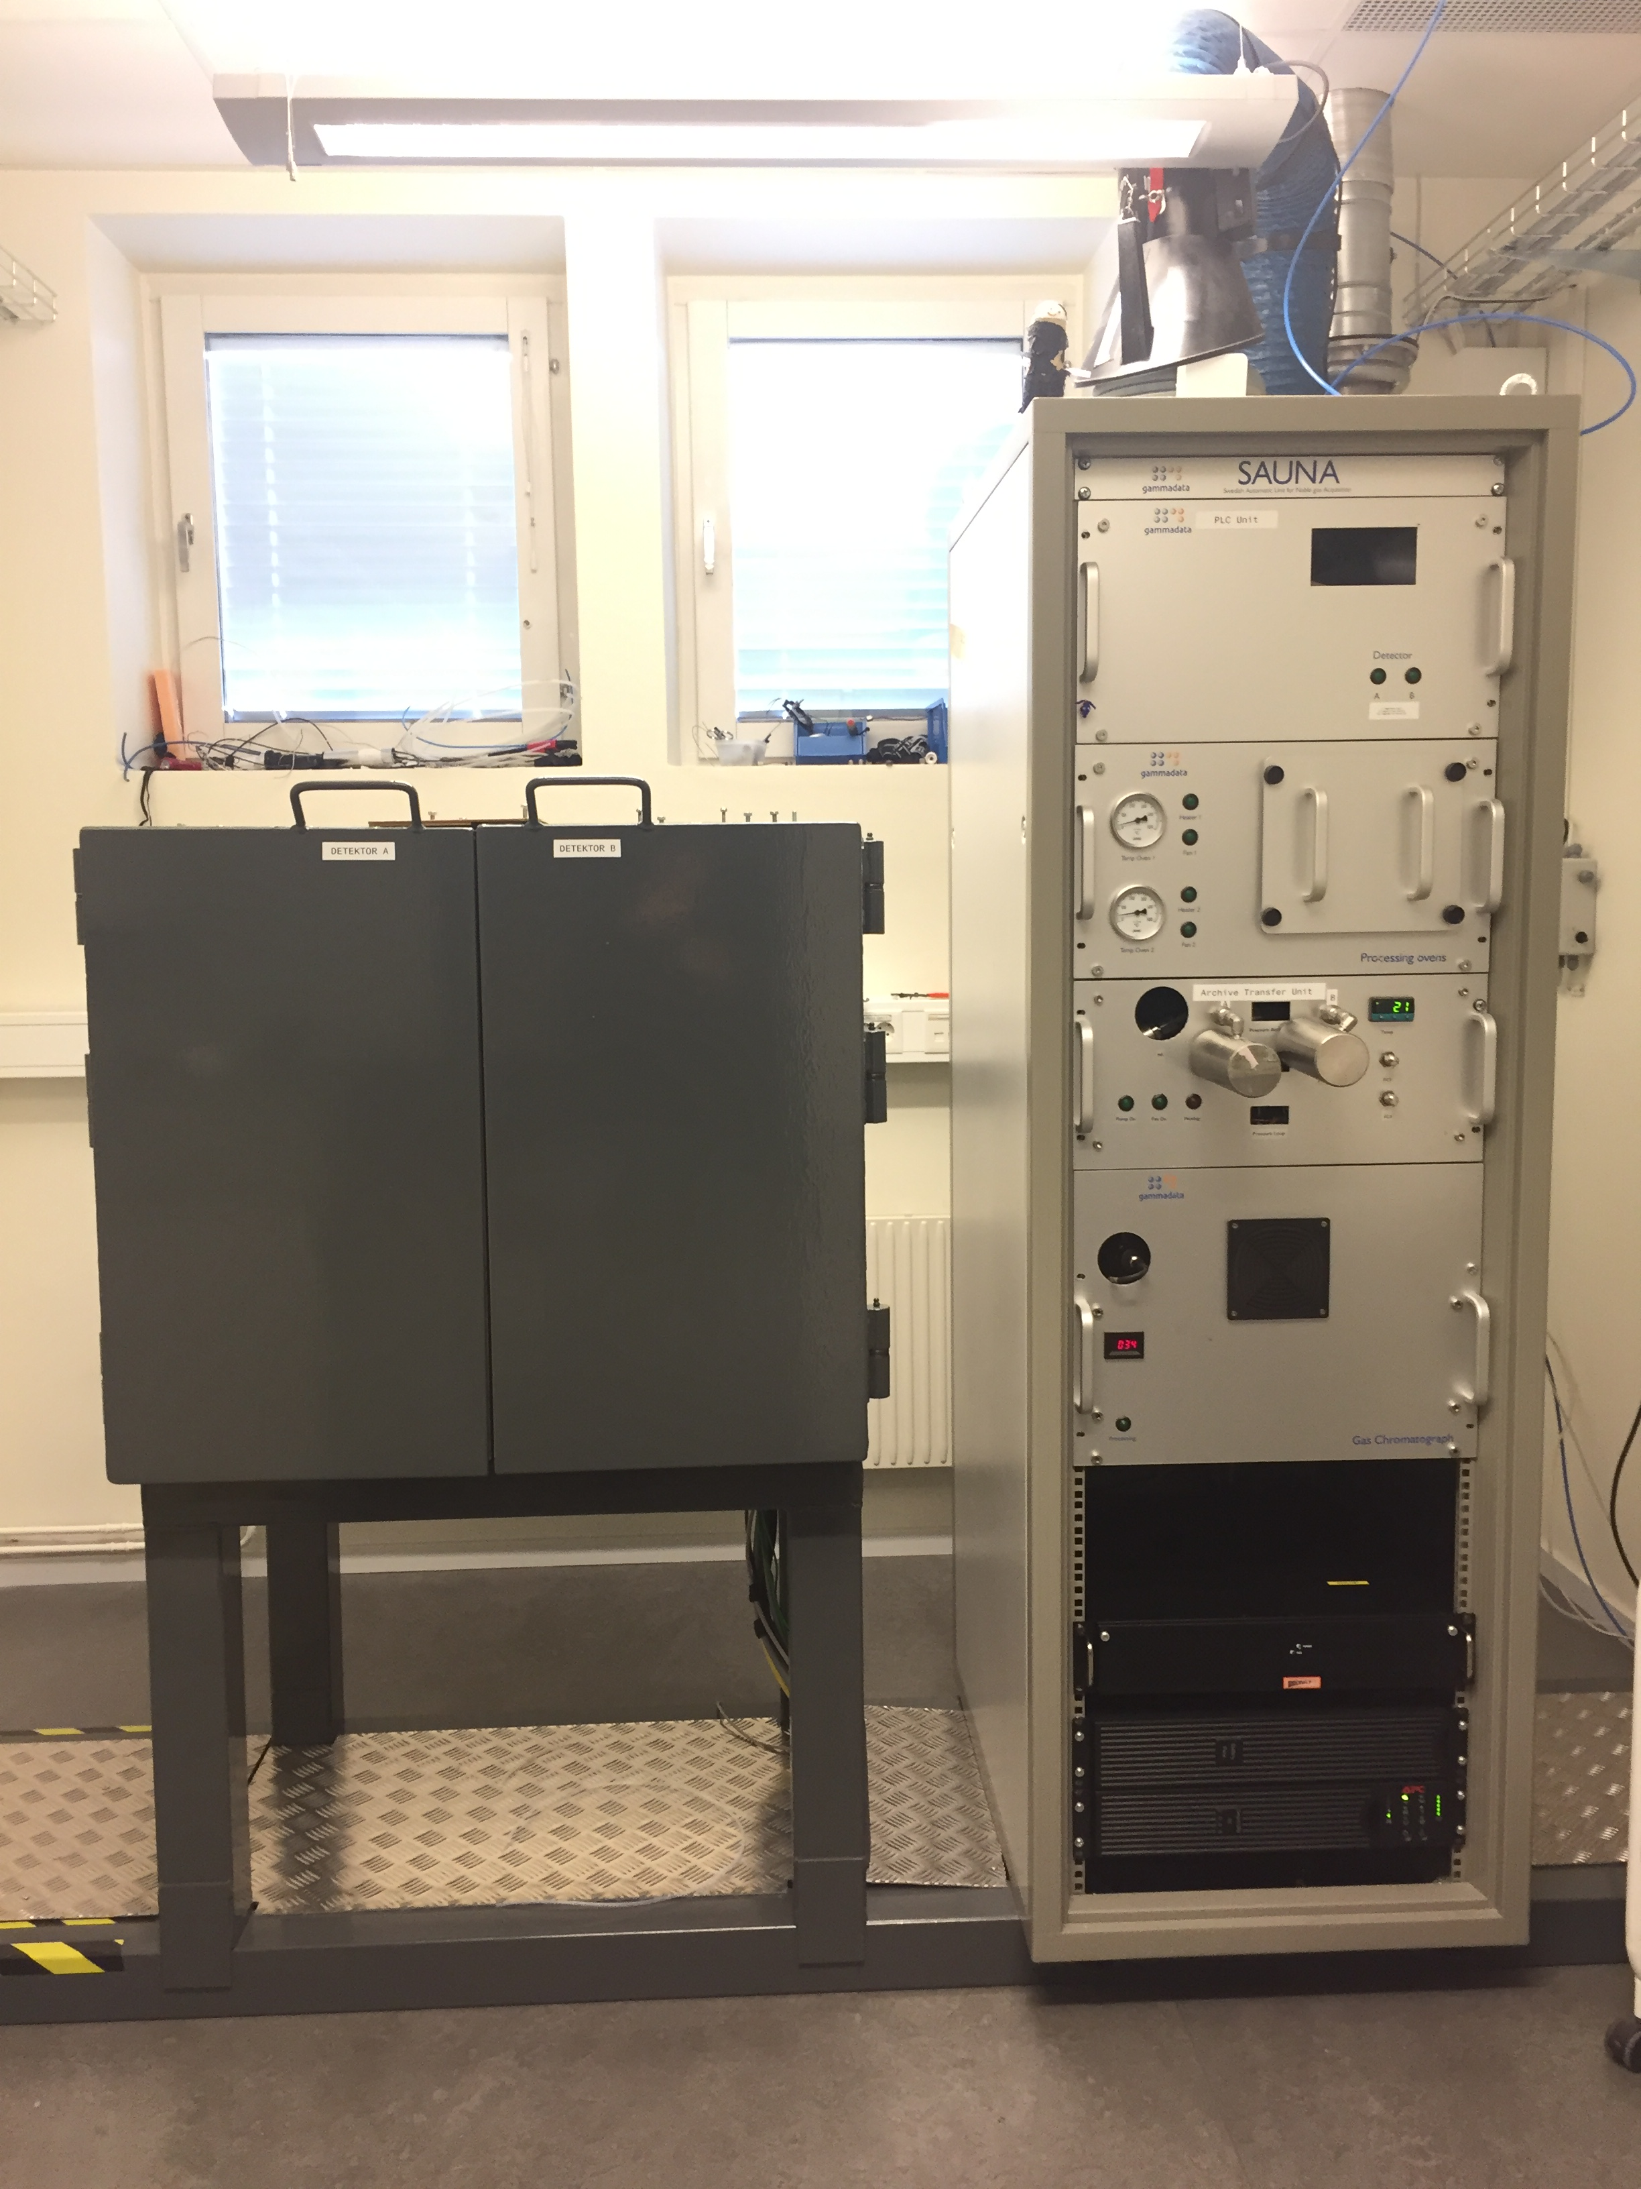
SEL63 – A SAUNA lab system for measurements of a high diversity of xenon samples
Catharina Söderström, Mattias Aldener and Tomas Fritioff
Swedish Defence Research Agency (FOI)
P3.2-463
The Swedish SAUNA LAB system has been characterized and calibrated to be able to measure xenon samples with xenon volumes from 0.2 ml up to 6 ml.
System performance has been verified by participation in PTE exercises and by re-measurement of IMS samples from SEX63.
Main system usage
Analysis of samples from SAUNA or SPALAX systems.
Analysis of samples from SAUNA Field system, i.e. sub soil samples.
Participation in PTE exercises and other intercomparison measurements.
Quality assurance during development and installation of new systems.
System process
Archive bottle
Xe quantification in GC
β- γ detector
Xe requantification
in GC
Archive bottle
T1
T2
T3
T4

