Slide 1
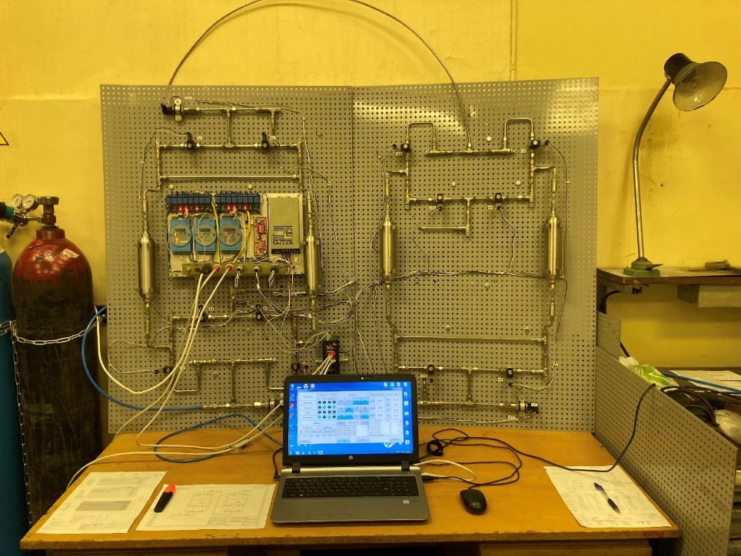
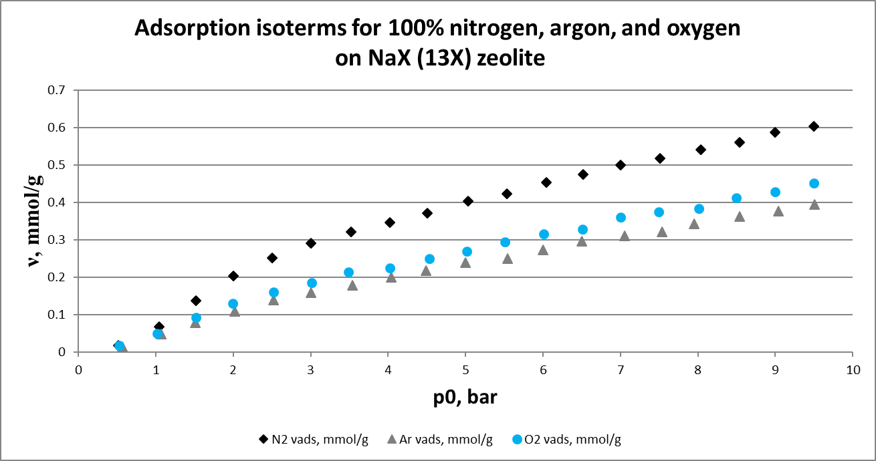
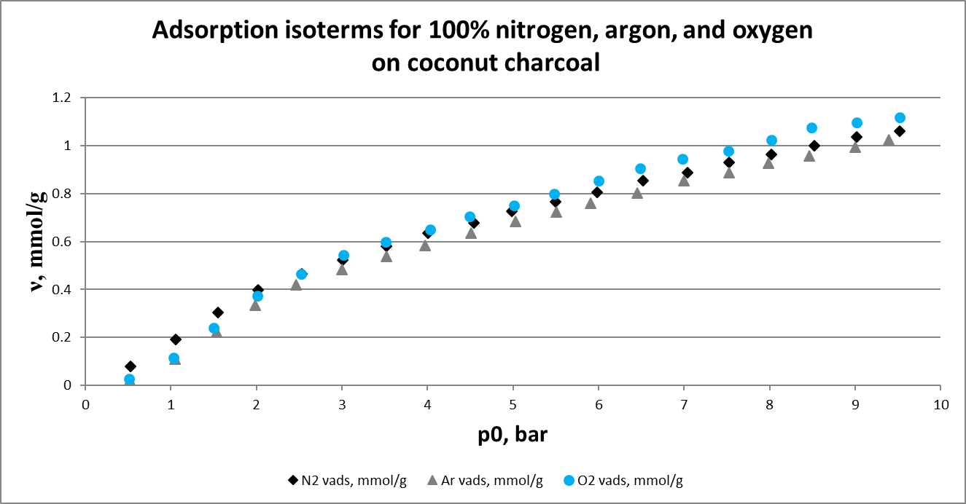
Obtaining Enriched Argon from an Air Mixture by Pressure Swing Adsorption Method
R.A. Aleksandrov, M.S. Orlov, D.V. Timofeev, O.V. Tkachev, D.E. Ergashev, and Yu.D. Arapov
Dukhov Automatics Research Institute (VNIIA)
P3.2-877
Characteristics of the studied sorbents
Sorbent | Manufacturer / Country | Bulk density, kg/l | Real density, kg/l
CaA (5A) | Hong Kong chemical corp. | 0,738 | 1,702
PSA/VPSA (13XHP) | Hong Kong chemical corp. | 0,658 | 1,538
NaX (13X) | Silkem | 0,607 | 1,525
ZSM-5 | China | 0,600 | 1,559
Ag-ZSM-5 | Riogen, USA | 0,755 | 1,799
Coconut charcoal | Sri Lanka | 0,453 | 1,273
Activated charcoal (SKT-3) | Russia | 0,470 | 1,269
Two-stage PSA system for obtaining enriched argon (the Scarstrom variant)
If you want to learn more about this, come see my e-poster during e-poster virtual session 2 on this date or access it online on the SnT2023 Conference platform!
Please do not use this space, a QR code will be automatically overlayed

