Slide 1
Obtaining Enriched Argon from an Air Mixture by Pressure Swing Adsorption Method
R.A. Aleksandrov, M.S. Orlov, D.V. Timofeev, O.V. Tkachev,
D.E. Ergashev, and Yu.D. Arapov
Dukhov Automatics Research Institute (VNIIA)
The work presents results of the development and experimental investigations of the sampling unit of the automated system for monitoring the ³⁷Ar content in the soil and the surface atmosphere.
The adsorption and separation characteristics of materials (CaA (5A), PSA/VPSA (13XHP) NaX (13X), ZSM-5, and Ag-ZSM-5 zeolites, coconut charcoal and activated charcoal) for air separation and argon extraction from an air sample using the volumetric method have been studied.
Adsorption isotherms of the main air components (Ar, N₂, O₂) on these sorbents at room temperature in the pressure range from 0 to 10 bar were obtained. Based on the study, a two-stage system of pressure swing adsorption (PSA) was created to obtain enriched argon.
A setup has been developed for investigation of the sorption and separation characteristics of materials.
The sorption and separation characteristics of materials have been studied.
A two-stage PSA system has been developed.
Please do not use this space, a QR code will be automatically overlayed
P3.2-877

Slide 2
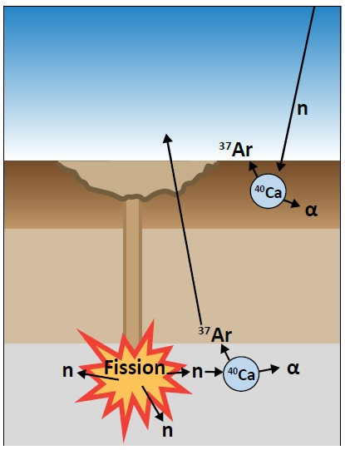
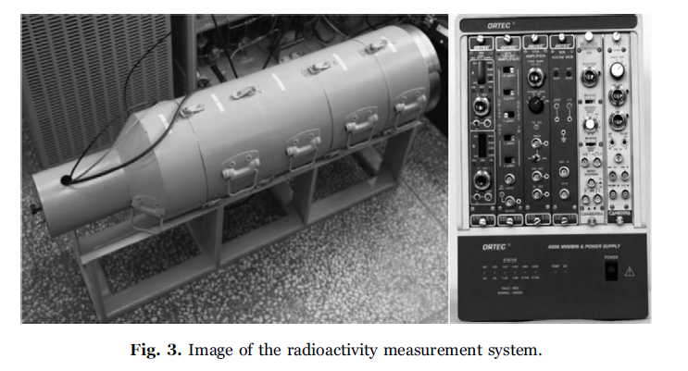
Introduction: Monitoring the content of ³⁷Ar radioactive isotope
Monitoring the content of ³⁷Ar radioactive argon isotope is one of the most important methods for detecting clandestine underground nuclear tests. For a number of years, work in this area supported by the Preparatory Commission for the Comprehensive Nuclear-Test-Ban Treaty Organization (CTBTO).
The ³⁷Ar radiation measurement method used by most monitoring stations is based on low-background proportional counters in which argon gas is a component of the working mixture (10% methane and 90% argon).
Radioactivity measurement system of MARDS [1]
The global atmospheric background level of ³⁷Ar is:
- 0,3 mBq/m³ [2]
- 1–5 mBq/m³ [3]
The underground background level of ³⁷Ar is about 100 mBq/m³ [2].
Please do not use this space, a QR code will be automatically overlayed
P3.2-877

Slide 3
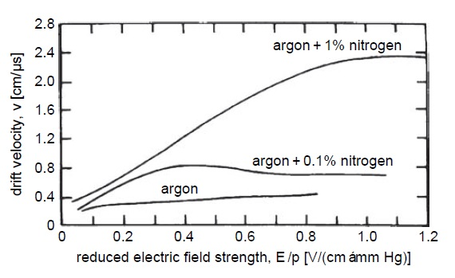
Introduction: Gas separation system
To ensure repeatability of measurements, nitrogen and oxygen must be completely removed from air samples during the argon extraction process. In this regard, an urgent task is to find an effective method for extracting argon from soil gas, concentrating and purifying it for the purpose of further analysis for radioactivity.
Sampling and concentration
Purification
Measurement
Sampling unit
Processing unit
Detection unit
Drift velocities of electrons in pure argon and in argon with minor additions of nitrogen [4]
The constancy of the electron drift velocity determines the stability of the signal from the proportional counter.
0,93% Ar (Vol.)
> 99,9% Ar (Vol.)
Advantages and disadvantages of methods for air separation and argon production
Method | Rectification [5] | Low temperature adsorption [6] | Pressure swing adsorption (PSA)
Simplicity of design
Low energy consumption
High specific productivity
-
+
+
-
-
Please do not use this space, a QR code will be automatically overlayed
+
+-
+-
+
P3.2-877

Slide 4
Objectives
1. Development of a setup for investigation of the sorption and separation characteristics of materials for argon extraction and processing.
2. Study of the sorption and separation characteristics of materials for air separation and argon extraction from an air sample in the pressure range from 0 to 10 bar at room temperature.
3. Development of a PSA system on its basis for obtaining enriched argon.
Please do not use this space, a QR code will be automatically overlayed
P3.2-877

Slide 5
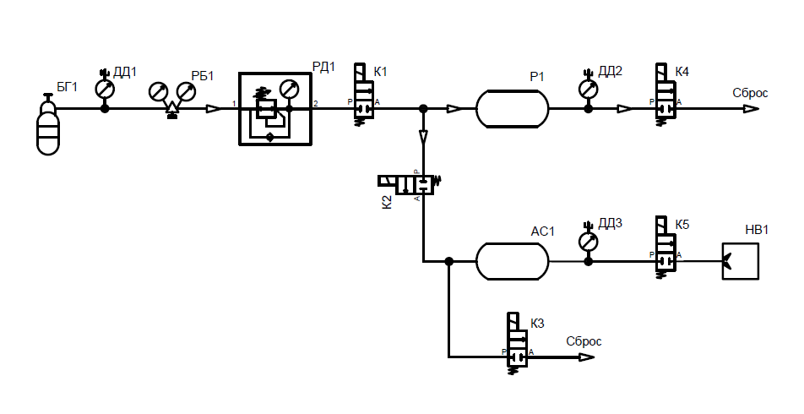
Volumetric method
The state equation [7]:
pV=νRT
where p is the gas pressure, V is the gas volume, ν is the number of moles of the substance, T is the absolute temperature, R is the universal gas constant (8.31 J/mole K).
p_{0,}V₀
p₀V₀=ν₀RT | (1)
p₁(V_{fr}+V*)=ν₁RT | (2)
Valve
Closed
p₁,V_{fr}+V*
where V* is the volume of the pipeline.
p₂(V_{fr}+V*+V₀)=ν₂RT | (3)
Due to the assumption of the absence of helium sorption in the system:
ν₂=ν₀+ν₁ | (4)
From formulas (1)-(4), an expression is obtained for the free volume V_{fr}:
$$V_{fr}=\frac{p_{2}−p_{0}}{p_{1}−p_{2}}V_{0}−V^{∗}$$
(5)
Valve
Open
p₂, V_{fr}+V*+V₀
The law of conservation of the amount of matter under the assumption of gas adsorption:
Please do not use this space, a QR code will be automatically overlayed
ν₀+ν₁=ν₂+ν_{ads} | (6)
Taking into account (1) – (3):
$$ν_{ads}=\frac{p_{0}V_{0}+p_{1}\left(V_{fr}+V^{∗}\right)−p_{2}(V_{fr}+V^{∗}+V_{0})}{RT}$$
(7)
P3.2-877

Slide 6
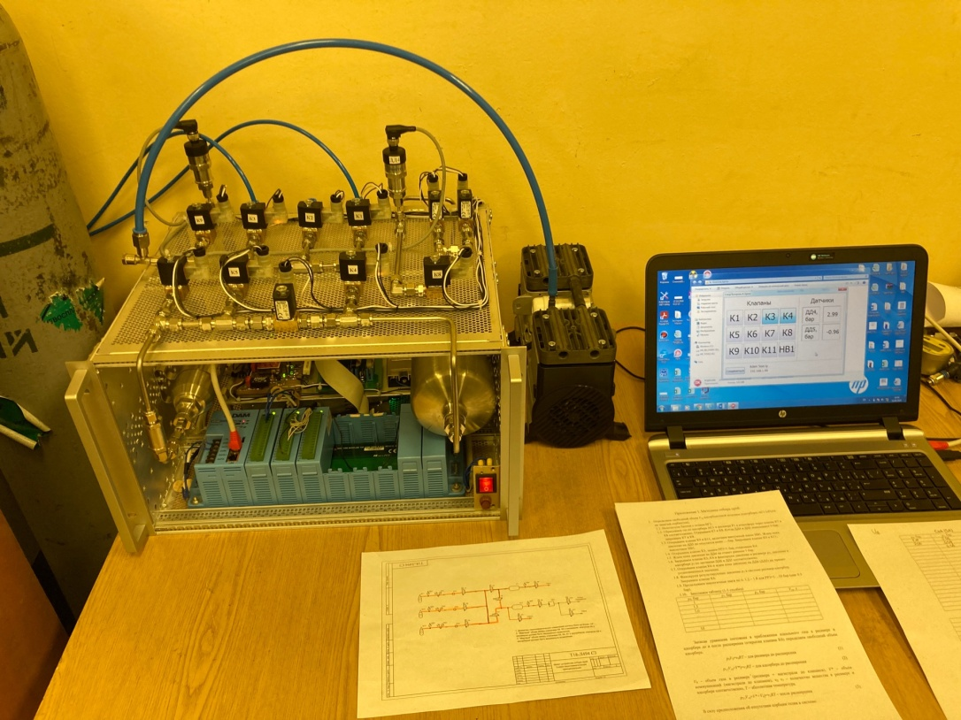
Results: Setup for investigation of the sorption and separation characteristics of materials
Characteristics of the studied sorbents
Sorbent | Manufacturer / Country | Bulk density, kg/l | Real density, kg/l
CaA (5A) | Hong Kong chemical corp. | 0,738 | 1,702
PSA/VPSA (13XHP) | Hong Kong chemical corp. | 0,658 | 1,538
NaX (13X) | Silkem | 0,607 | 1,525
ZSM-5 | China | 0,600 | 1,559
Ag-ZSM-5 | Riogen, USA | 0,755 | 1,799
Coconut charcoal | Sri Lanka | 0,453 | 1,273
Activated charcoal (SKT-3) | Russia | 0,470 | 1,269
Setup for investigation of the sorption and separation characteristics of materials
The setup is intended for gas sampling and investigation of argon (nitrogen, oxygen) adsorption processes in pure form or in mixtures with helium on various sorbents at pressures from 0 to 10 bar and at room temperature. The setup allows studying various sorption materials, as well as obtaining adsorption isotherms of gases. The setup also allows determining the real density of porous materials.
Please do not use this space, a QR code will be automatically overlayed
P3.2-877

Slide 7
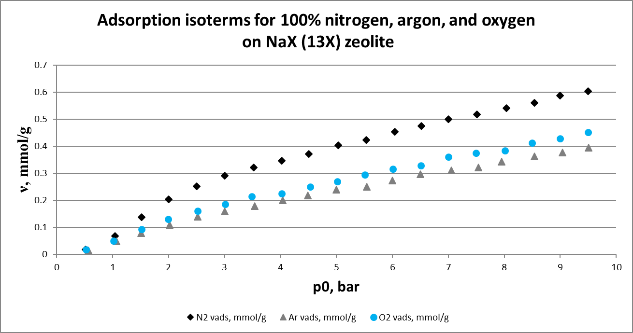
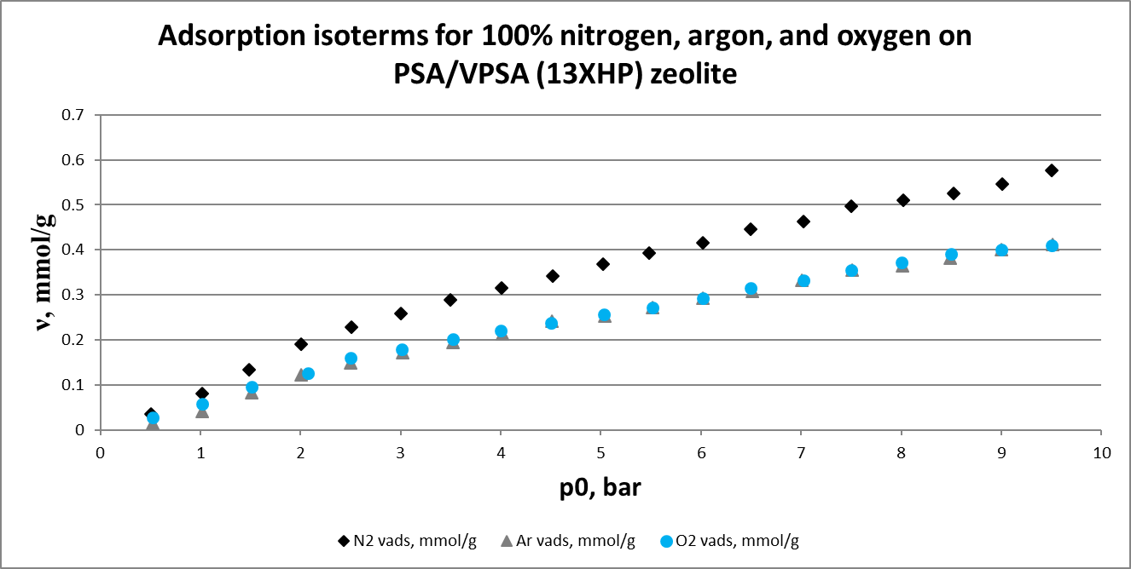
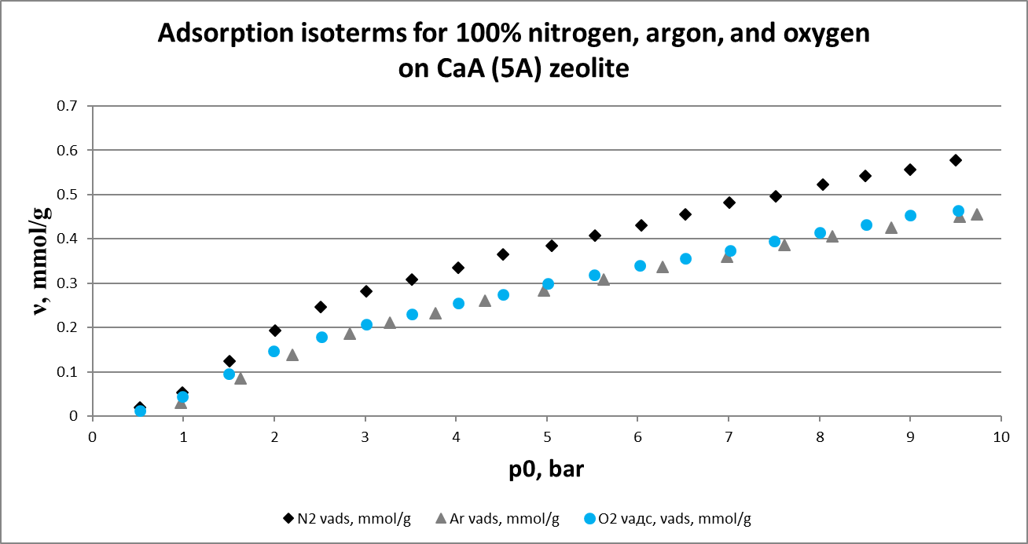
Results: Adsorption isotherms
It can be seen that the adsorption isotherms are almost linear at pressures of up to 2.5-3.0 bar. In this range, isotherms can be described by the Henry equation:
ν=Kp₀ | (8)
where K is Henry's constant.
NaX (13X), CaA (5A) and PSA/VPSA (13XHP) zeolites have high nitrogen selectivity.
The separation coefficients of the N₂-Ar mixture (at 5.0 bar) for NaX (13X) zeolite are 1.24 times higher than for CaA (5A) zeolite and 1.16 times higher than for PSA/VPSA (13XHP).
The separation coefficients of the N₂-O₂ mixture (at 5.0 bar) for the NaX (13X) zeolite are 1.16 times higher than for the CaA (5A) zeolite and practically coincide with PSA / VPSA (13XHP).
Please do not use this space, a QR code will be automatically overlayed
P3.2-877

Slide 8
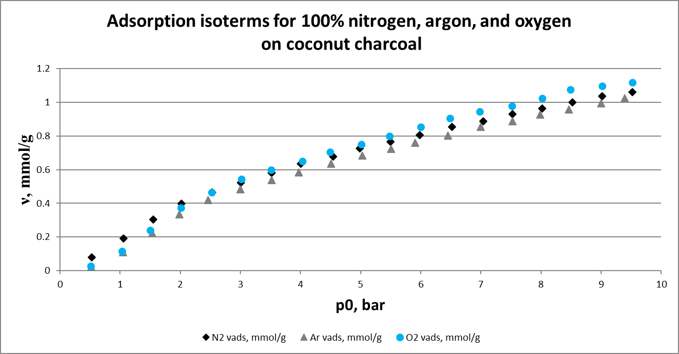
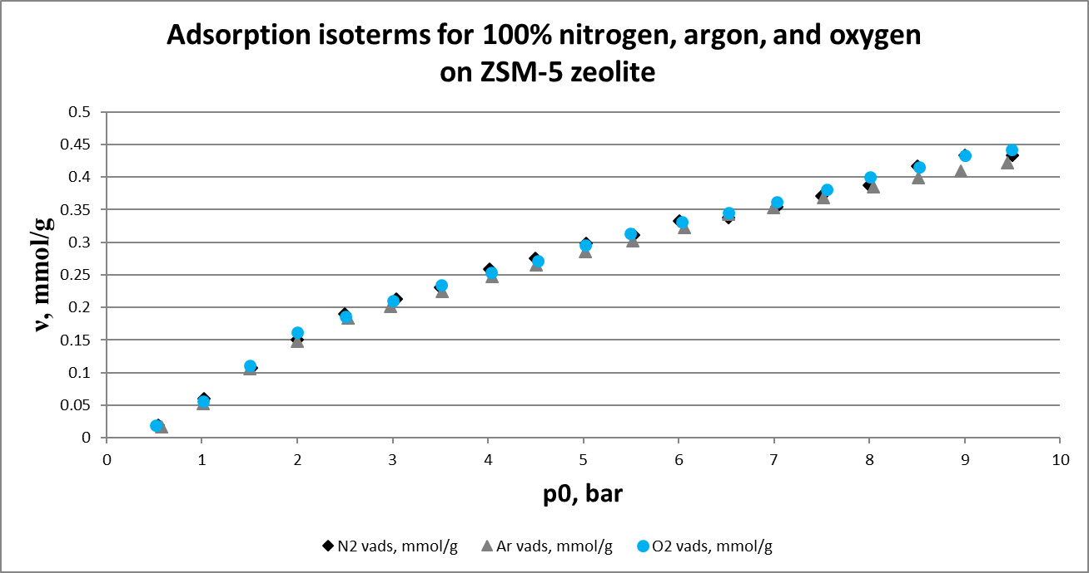
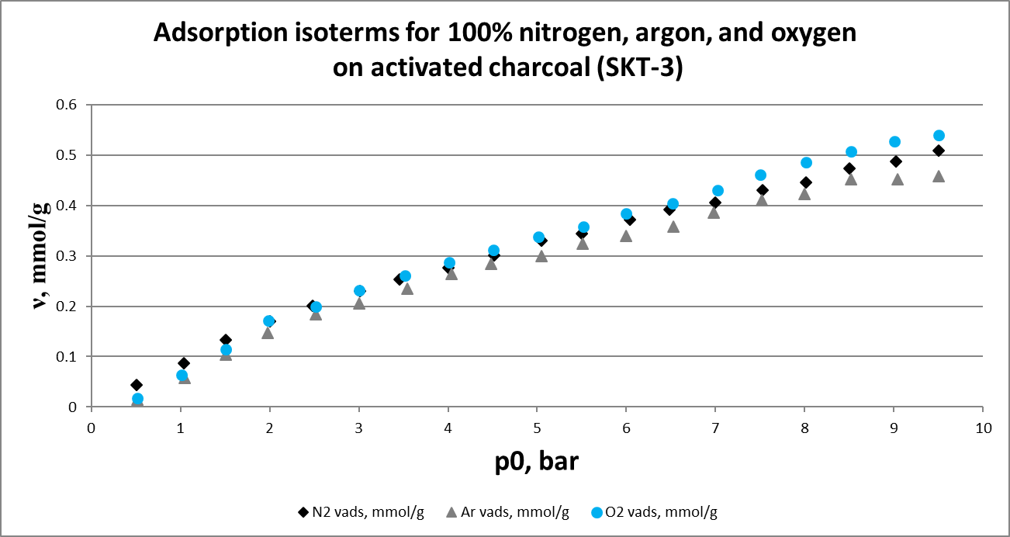
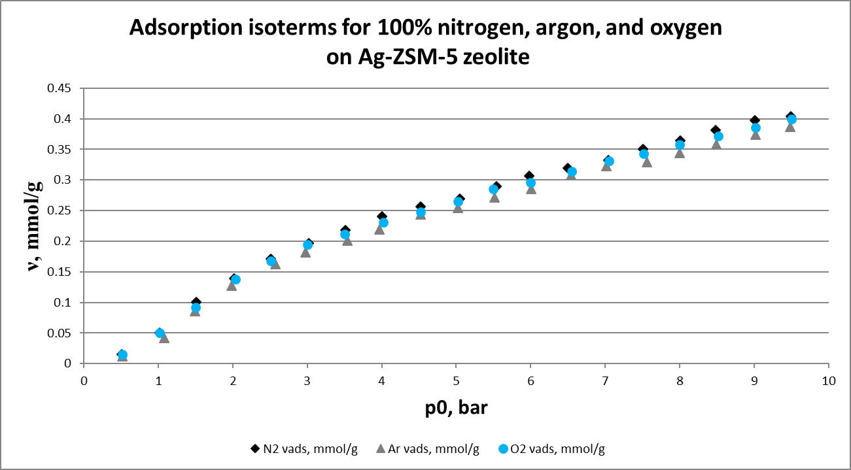
Results: Adsorption isotherms
Please do not use this space, a QR code will be automatically overlayed
P3.2-877

Slide 9
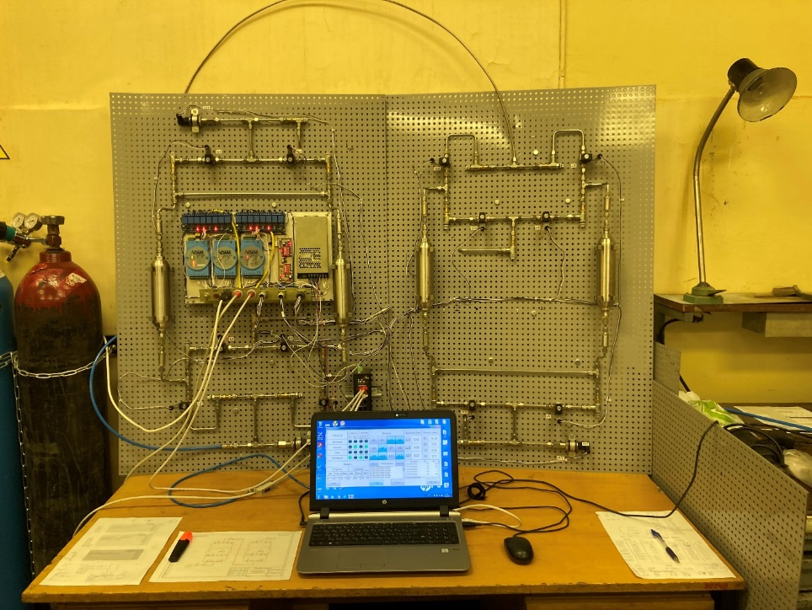
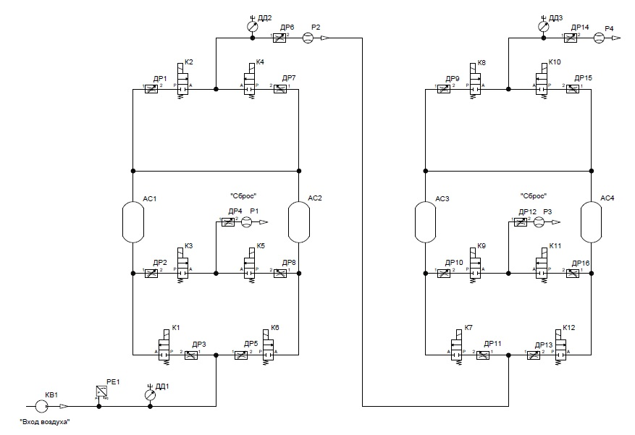
Results: Two-stage PSA system for obtaining enriched argon
Enriched Ar, > 20 % (Vol.)
Two-stage PSA system for obtaining enriched argon
The first stage adsorbers are filled with NaX (13X) zeolite, the second stage adsorbers are filled with coconut charcoal.
After the sampling unit, the argon-enriched mixture is sent to the processing (purification) unit. In this unit, enriched argon is purified of nitrogen and oxygen, as well as of other noble gases (Kr, Xe, Rn) using the preparative gas chromatography method.
Removal N₂
Removal O₂
Please do not use this space, a QR code will be automatically overlayed
Diagram of the two-stage PSA system for obtaining enriched argon (the Scarstrom variant)
P3.2-877

Slide 10
Conclusion
1. A setup has been developed for investigation of the sorption and separation characteristics of materials for argon extraction and processing.
2. The sorption and separation characteristics of materials for air separation and argon extraction from an air sample in the pressure range from 0 to 10 bar at room temperature have been studied.
3. A two-stage PSA system has been developed for obtaining enriched argon.
At the next stage of the work, we plan to study the dependence of the argon concentration in an enriched flow on the filling, blowing, discharge, and regeneration times, sorbent types, and adsorbers volumes.
Please do not use this space, a QR code will be automatically overlayed
P3.2-877

Slide 11
References
1. Liang Na, Discrimination of non-radiation backgrounds in the proportional counter of MARDS, Nuclear Instruments and Methods in Physics Research A, 2017, v. 848, pp. 99−105. https://doi.org/10.1016/j.nima.2016.12.052
2. Ivashkin N.V. Study of the background and yields of 133Xe and 37Ar during camouflage UNEs / N.V. Ivashkin. - Snezhinsk: RFNC Publishing House - VNIITF, 2002. - 21 p.
3. Riedmann R.A., Purtschert R. Natural ³⁷Ar Concentrations in Soil Air: Implications for Monitoring Underground Nuclear Explosions// Environmental Science & Technology. – 2011. – 45(20). – p. 8656-8664.https://doi.org/10.1021/es201192u
4. Grupen C. et al. Particle detectors. – Cambridge: Cambridge university press, 2008. – Т. 10.
5. Epifanova V.I., Axelrod L.S. (ed.). Air separation by deep cooling: Technology and equipment: In 2 volumes - 1973.
6. Riedmann R.A., Purtschert R. Separation of argon from environmental samples for Ar-37 and Ar-39 analyses// Separation and Purification Technology. – 2016. – 170. – p. 217-223. https://doi.org/10.1016/j.seppur.2016.06.017
7. J.O. Hirschfelder, Ch.F. Curtiss, and R.B. Bird. Molecular Theory of Gases and Liquids. New York, Wiley; London, Chapman and Hall, 1954.
Please do not use this space, a QR code will be automatically overlayed
P3.2-877

