Slide 1
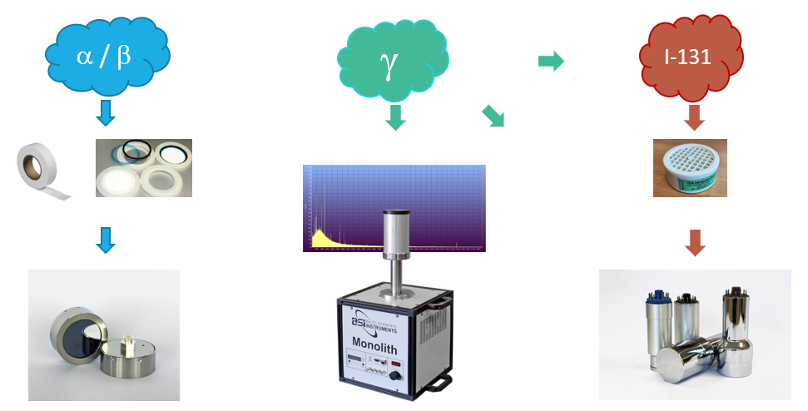
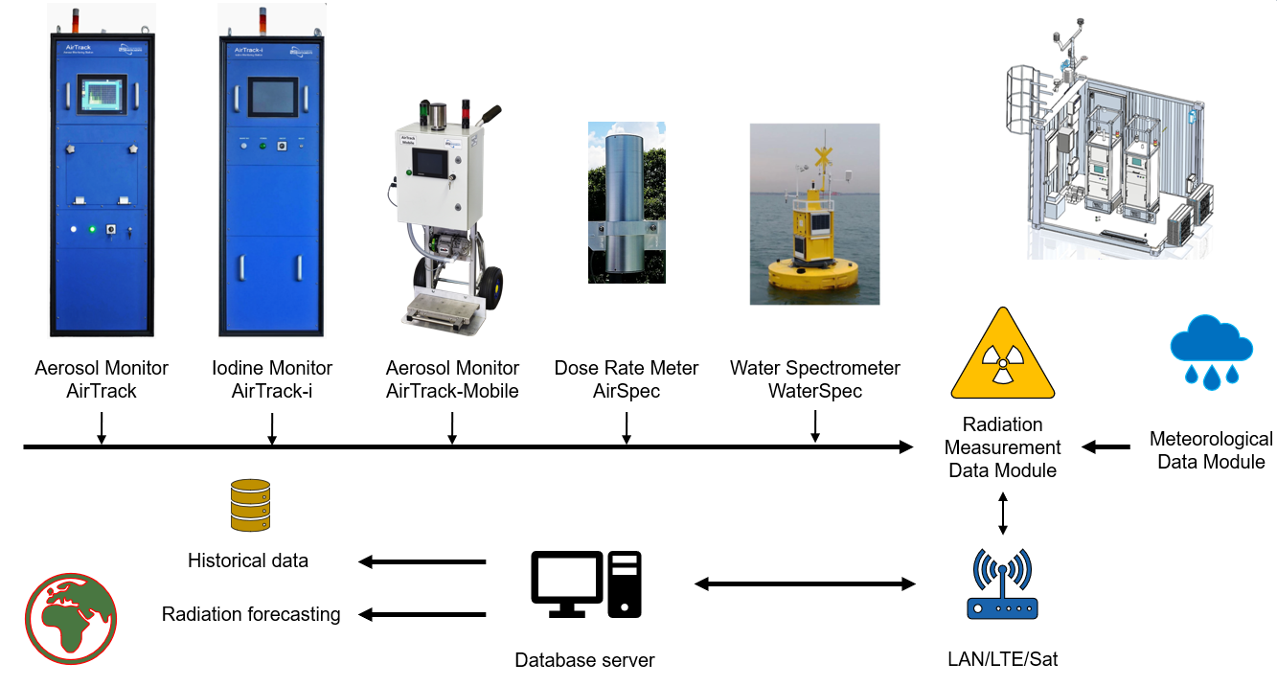
RADIATION MONITORING OF TERRITORIES USING
EARLY WARNING SYSTEMS
A. Vlasenko, V. Gostilo, V. Litvinsky, I. Krainukovs
Baltic Scientific Instruments (BSI)
P3.2-220
Main objectives of BSI Radiation Early Warning Systems:
To detect excess levels of natural ionizing radiation in the atmosphere due to the passage of a radioactive cloud
Control of the aquatic environment for the presence of radioactive discharge
Control of environment meteorological parameters
Transmit data of radionuclide concentration, dose rate and other information to the central control post
Forecast possible radiological consequences
If you want to learn more about BSI REWS, come see my e-poster during session 3.2 or access it online on the SnT2023 Conference platform!

