Slide 1
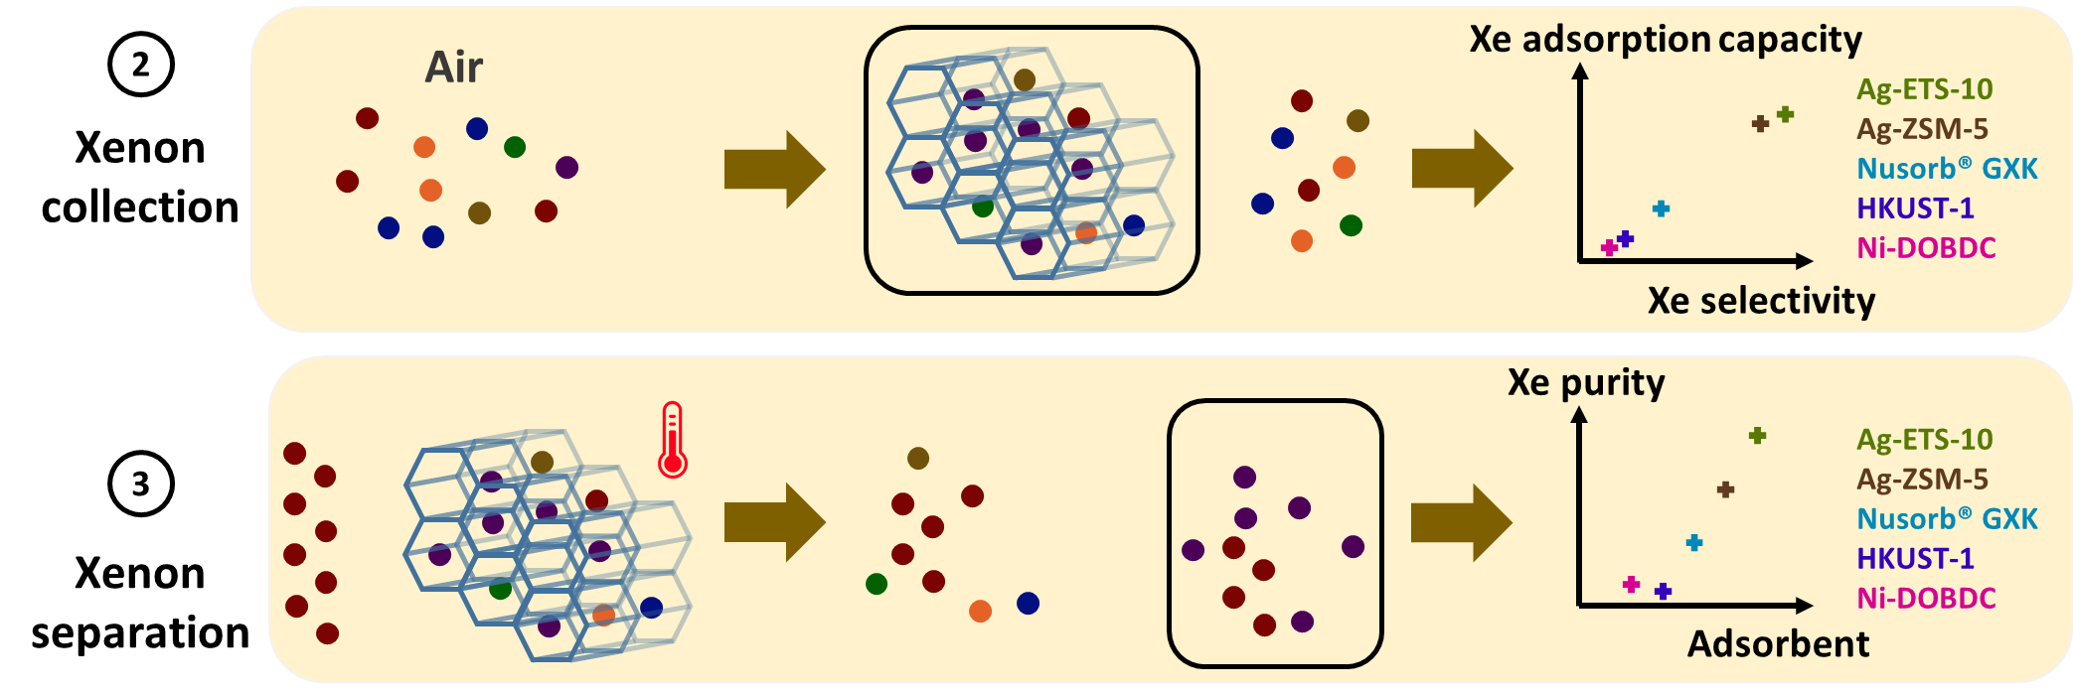
Xe collection and purification from air in three types of porous materials
C. Gueibe, J. Rutten, J. Camps, N. Hermanspahn, D. Moyaux, W. Schroeyers, D. Minta and S. Schreurs
P3.2-803
First time investigation into the use of AgZs and MOFs for the collection, at room temperature, and purification of Xe directly from atmospheric air to potentially simplify or reduce the power consumption of IMS noble gas monitoring systems.

