Slide 1
¹
Xe collection and purification from air in three types of porous materials
C. Gueibe^{1,2}, J. Rutten¹, J. Camps¹, N. Hermanspahn³, D. Moyaux⁴, W. Schroeyers², D. Minta⁵ and S. Schreurs²
²
³
⁴
⁵
More efficient and selective adsorbents for Xe collection and purification could provide new alternatives for noble gas monitoring in the IMS.
Silver-exchanged zeolites and metal-organic frameworks have never been investigated to collect and purify Xe directly from atmospheric air.
Comparison of Ag-exchanged Zeolites (AgZs), Metal-Organic Frameworks (MOFs) and Activated Carbon (AC)
Characterization by SEM/EDX, PXRD, TGA & N₂/CO₂ adsorption
Xe and air breakthrough
Thermal desorption
Highest ever reported Xe adsorption capacity in air on AgZs
Unprecedented Xe/air selectivity on AgZs
Decrease in Xe adsorption on AgZs in humid conditions
Highest Xe concentration thermally recovered on AgZs
Ag-exchanged zeolites are currently the most efficient and selective adsorbents to collect and purify xenon from atmospheric air.
They could be used as a single filter to collect and purify xenon from dry atmospheric air, which could simplify and reduce the power consumption of IMS noble gas systems.
Part of this research was funded by the EU through Council Decision 2018/298/CFSP.
Please do not use this space, a QR code will be automatically overlayed
P3.2-803

Slide 2
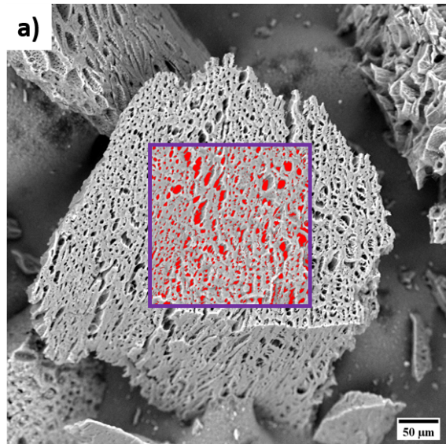
Introduction: porous adsorbents in IMS noble gas monitoring systems
Noble gas monitoring systems are a crucial component of the International Monitoring System (IMS) for the verification of the CTBT. They are monitoring the atmosphere for potential radioxenon releases originating from nuclear tests. The efficient collection and purification of trace levels of xenon in air (i.e. 87 ppb) on porous adsorbents is essential for their detection capability.
The first systems in the IMS used pre-purification techniques to remove moisture and CO₂ followed by AC columns to collect and further purify Xe. In some new systems, AgZs have replaced some of the AC columns, after the necessary pre-purification, due to their much higher Xe adsorption capacity at room temperature. The current systems require a complex and energy demanding purification process. More efficient and selective adsorbents could simplify the systems and reduce their power consumption. For instance, recent studies on a new class of porous materials, namely MOFs, have demonstrated high Xe selectivity over other gas components although in conditions different than for IMS applications.
No literature has been published about the investigation of AgZs or MOFs for the collection and purification of Xe directly, i.e. without pre-purification, from atmospheric air. Such a direct Xe collection and purification process could significantly simplify the systems and reduce their power consumption.
Activated carbon [1]
Ag-Zeolite [1]
Metal-Organic Framework
Please do not use this space, a QR code will be automatically overlayed
Metal node
P3.2-803
Organic linker

Slide 3
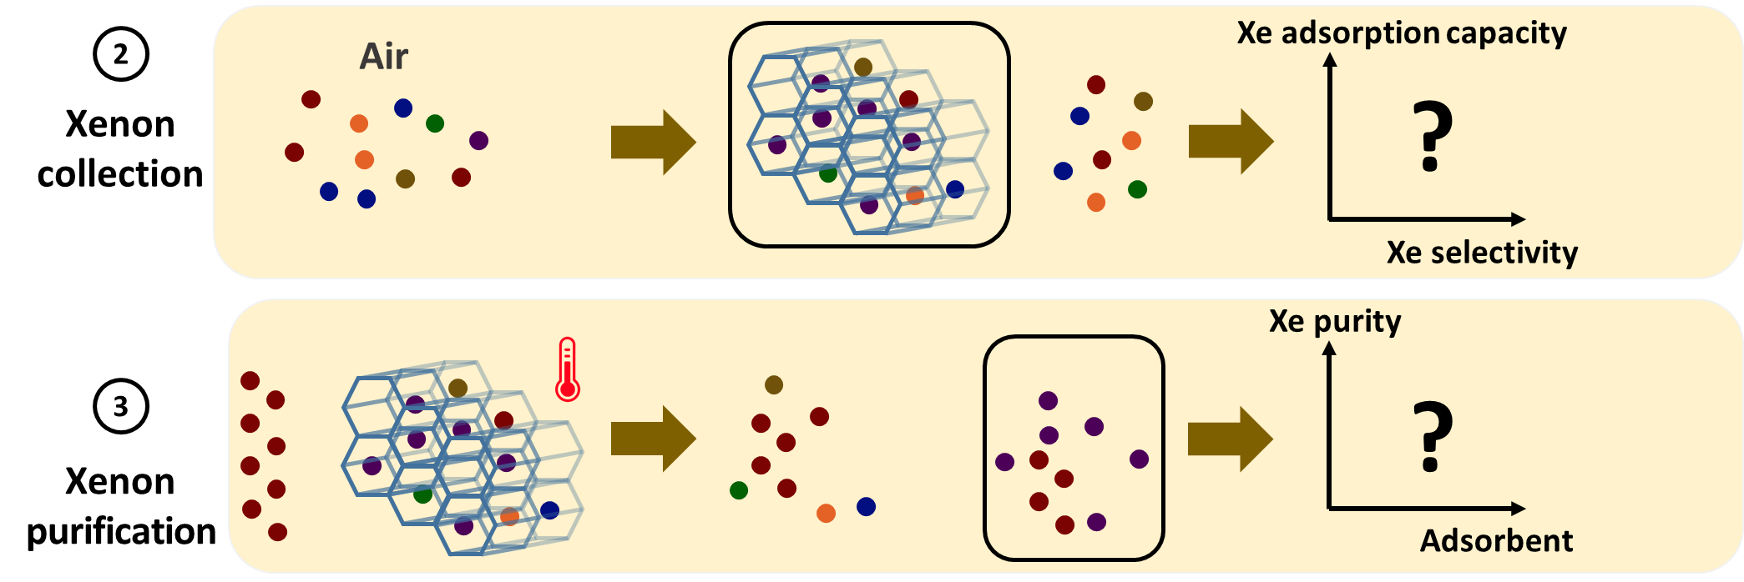
Objectives
First time investigation into the use of AgZs and MOFs for the collection and purification of Xe directly from atmospheric air to potentially simplify or reduce the power consumption of IMS noble gas monitoring systems. The aim is to answer the following questions:
Are the adsorbents, in pelletized or granulized form, acquired in this work in agreement with properties reported in the literature for the same adsorbents ?
How efficient and selective are MOFs and AgZs, compared to AC, in collecting Xe from atmospheric air ?
How easy and in which purity can we thermally recover the collected Xe from the adsorbents ?
Please do not use this space, a QR code will be automatically overlayed
P3.2-803

Slide 4
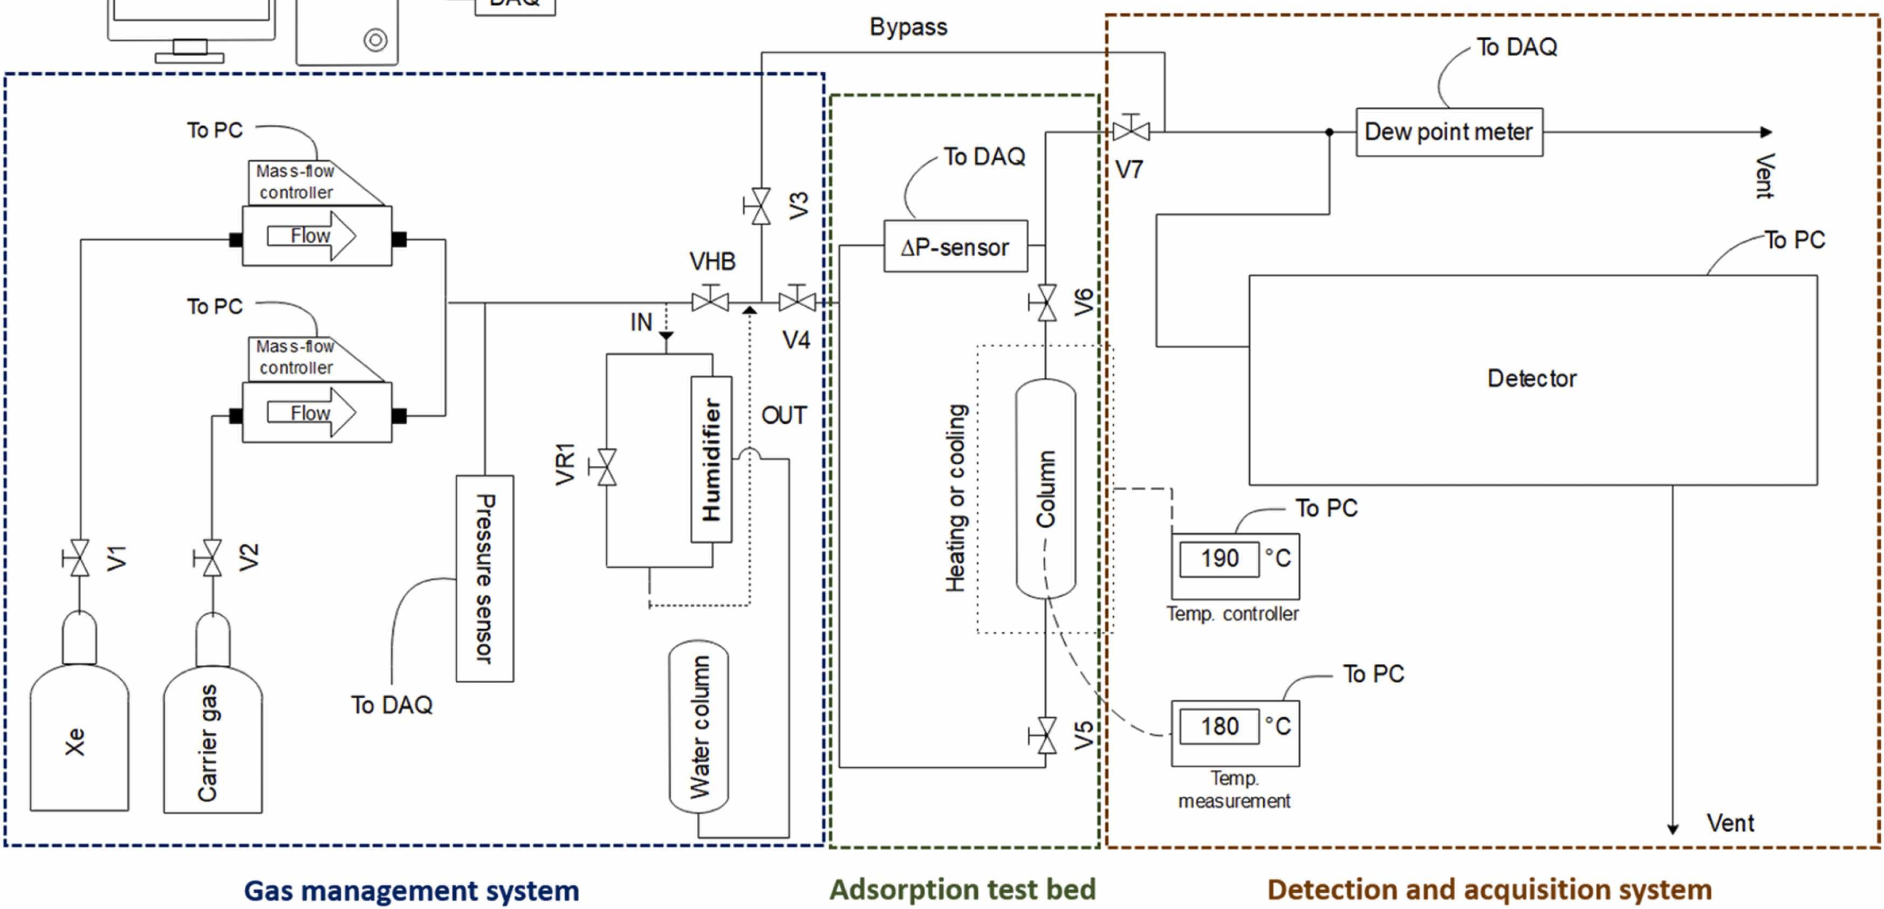
Methods
Selection of adsorbents based on commercial availability
Silver-exchanged zeolites (AgZs): Ag-ETS-10 and Ag-ZSM-5
Activated Carbon (AC): Nusorb® GXK
Metal-Organic Frameworks (MOFs): HKUST-1 and Ni-DOBDC
General characterizations of the acquired samples
Morphology and composition by SEM/EDX, crystallinity by PXRD and thermal stability by TGA-MS
Microporosity by N₂ adsorption isotherm at 77 K and CO₂ adsorption isotherm at 273 K
Investigation of Xe collection at room temperature
250 ppm Xe in N₂ breakthrough in dry and humid (5% and 50% R.H.) conditions
100 ppb Xe in N₂ & air breakthrough
Investigation of Xe purification
Thermal desorption under N₂ after air adsorption (without Xe breakthrough)
Thermal desorption under N₂ after adsorption of 250 ppm Xe in nitrogen spiked with Rn-222
Please do not use this space, a QR code will be automatically overlayed
Experimental setup for breakthrough and thermal desorption experiments [2]
P3.2-803

Slide 5
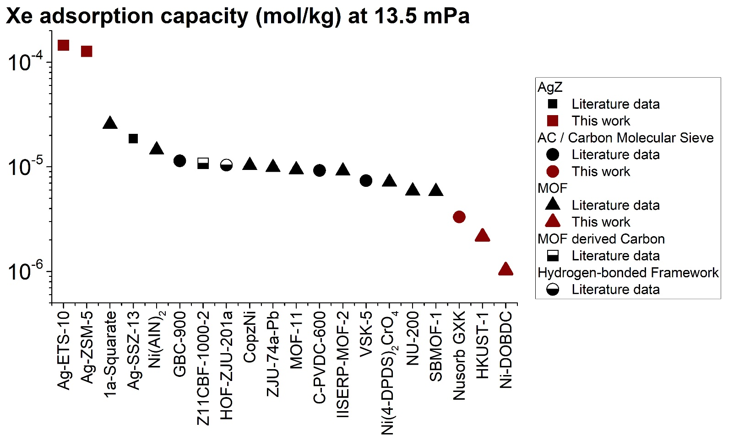
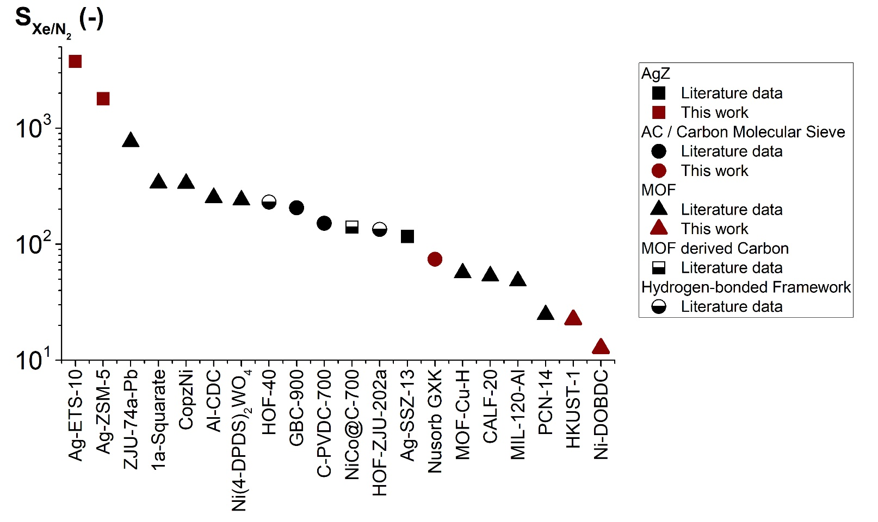
Results: xenon collection from air
Figure 1: Decrease in Xe adsorption capacity on AgZs by a factor 30 in 50% R.H. compared to dry conditions
Figure 2: Significantly higher Xe adsorption capacity (at 100 ppb Xe in N₂) on both AgZs (■) compared to literature data
Similar capacity in air (not shown here)
Figure 3: Significantly higher Xe/N₂ selectivity in air on both AgZs (■) compared to literature data
Figure 1 – Xe adsorption capacity as a function of relative humidity on the five adsorbents.
Please do not use this space, a QR code will be automatically overlayed
Figure 2 – Xe adsorption capacity (100 ppb Xe in N₂) on the adsorbents in this work compared to the literature.
Figure 3 – Xe/N₂ selectivity in air on the adsorbents in this work compared to the literature.
P3.2-803

Slide 6
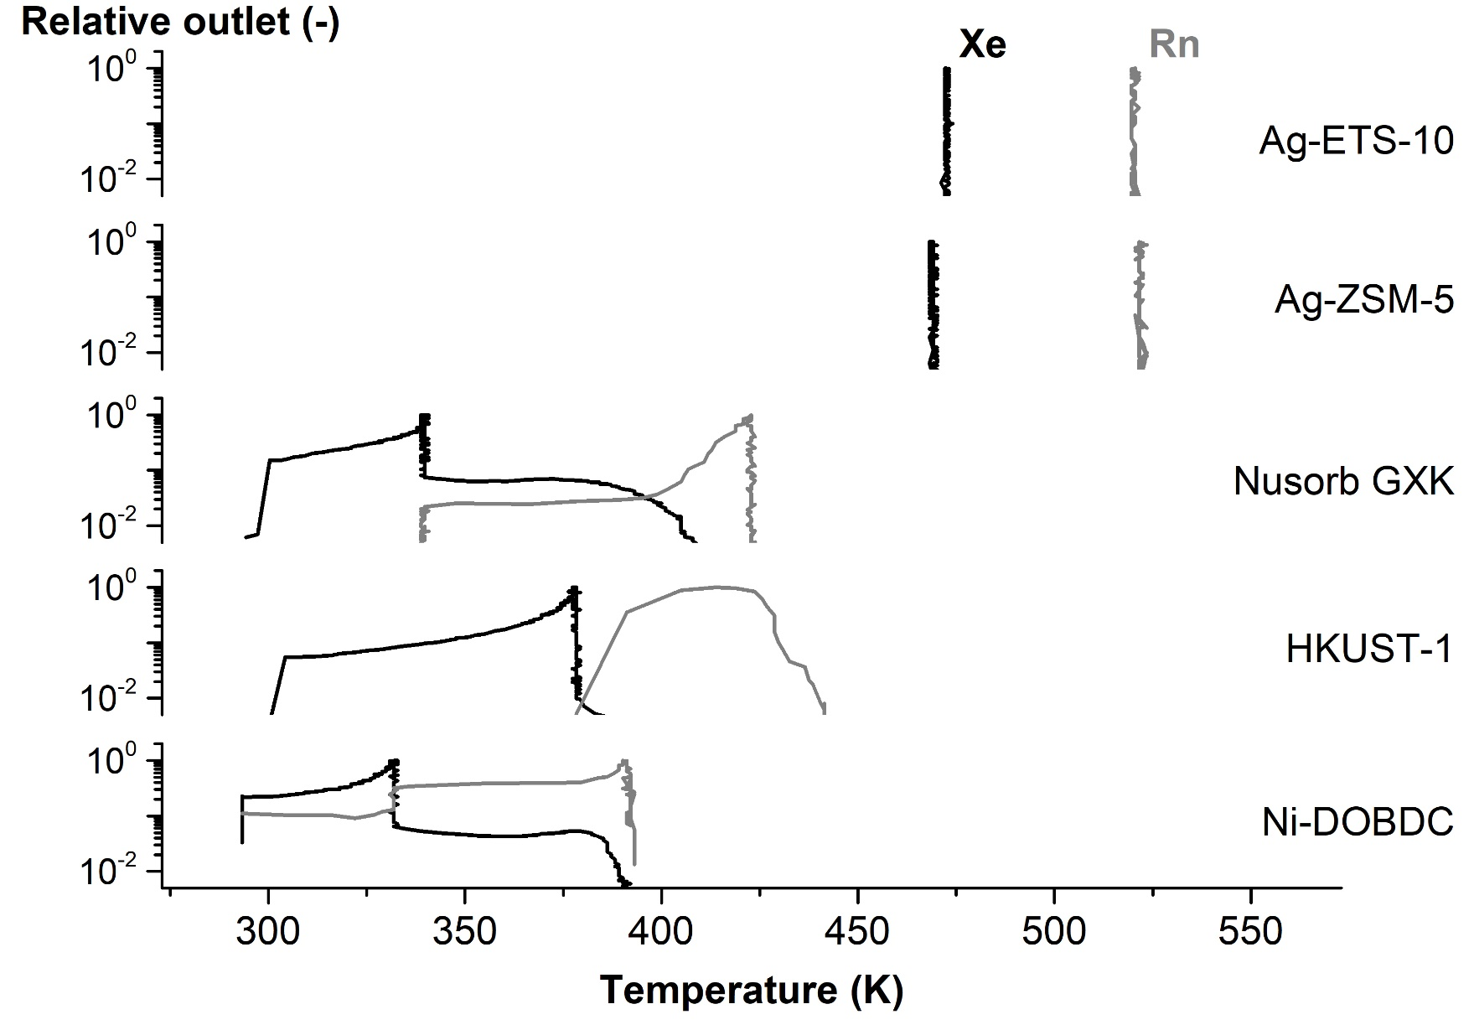
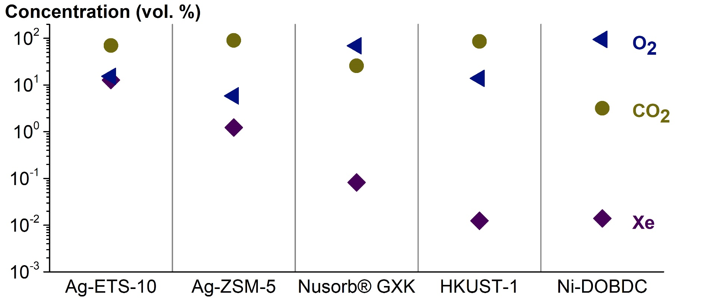
Results: xenon purification from dry air
Figure 4: Significantly higher Xe concentration (◆) after a single thermal desorption cycle with 13 vol. % Xe in the gas recovered on Ag-ETS-10
Figure 5: Impressive Xe/Rn thermal separation in both AgZs BUT it requires higher temperatures than MOFs/AC
Figure 5 – Xe/Rn separation during a thermal desorption on all five adsorbents. The AgZs have a very sharp desorption profile with regard to temperature.
Please do not use this space, a QR code will be automatically overlayed
Figure 4 – Comparison of the Xe, O₂ and CO₂ concentration in the recovered gas (containing 90% of the collected Xe in air) after a single thermal desorption cycle.
P3.2-803

Slide 7
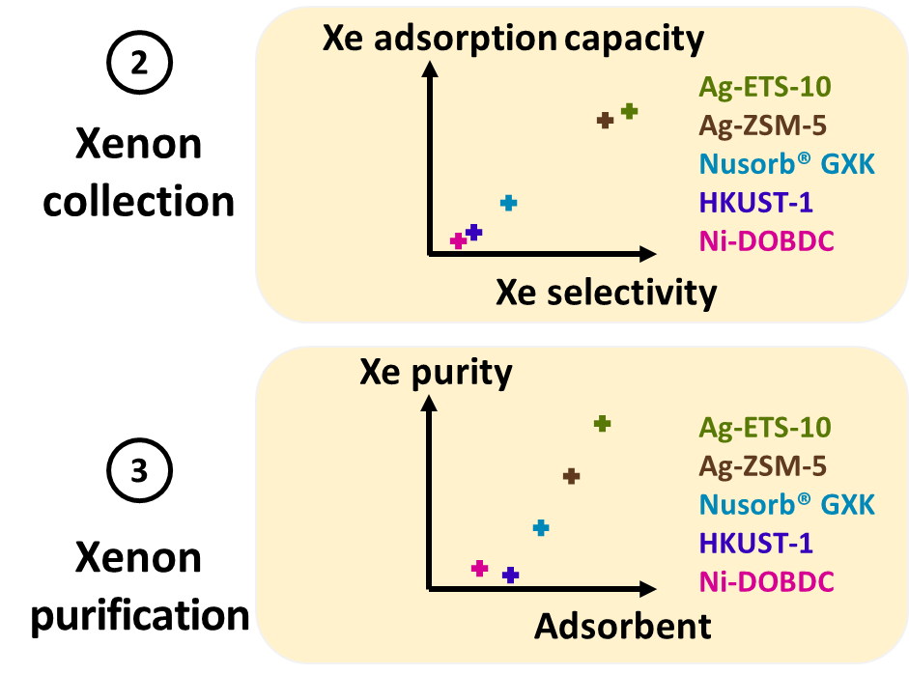
Conclusions and future work
The morphology, composition, crystallinity, thermal stability and microporosity of the adsorbents acquired in this work are in very good agreement with reported data.
Xe adsorption & selectivity in air: values on AgZs are significantly higher than literature data
BUT in humid conditions, the Xe adsorption capacity decreases significantly on AgZs !
The thermally recovered Xe (90% yield) from dry air has the highest Xe concentration using AgZs
AgZs are very efficient for Xe/Rn separation
BUT more energy required than for MOFs/AC
➔ AgZs are promising as single filter in dry air
Future work
Further investigate the purity of the recovered Xe gas over multiple cycles
Investigate the durability of the adsorbents
Investigate other, currently non-commercial, promising adsorbents
Please do not use this space, a QR code will be automatically overlayed
P3.2-803

Slide 8
References
[1] C. Gueibe, J. Rutten, J. Camps, D. Moyaux, W. Schroeyers, M. Auer, S. Schreurs. Application of silver-exchanged zeolite for radioxenon mitigation at fission-based medical isotope production facilities. Process Saf Environ, 158 (2022), 576-588. https://doi.org/10.1016/j.psep.2021.12.031
[2] C. Gueibe, J. Rutten, J. Camps, D. Moyaux, W. Schroeyers, R. Plenteda, N. Hermanspahn, M. Daria, S. Schreurs. Xenon Collection and Separation from Atmospheric Air in Silver-Exchanged Zeolites, Activated Carbon and Metal-Organic Frameworks. Preprint available at SSRN. https://dx.doi.org/10.2139/ssrn.4442283
References used in figures 2 & 3
Li et al., Micropor Mesopor Mat, 330 (2022) 111631.
Li et al., J Am Chem Soc, 141 (2019) 9358-9364.
Chakraborty et al., Chem-Eur J, 26 (2020) 12544-12548.
Gong et al., J Mater Chem A, 6 (2018) 13696-13704.
Guo et al., Ind Eng Chem Res, 61 (2022) 7361-7369
Kang et al., J Mater Chem A, 10 (2022) 24824-24830.
Liu et al., Angew Chem Int Edit, 61 (2022) e202117609.
Zhao et al., Sep Purif Technol, 302 (2022) 122074.
Liu et al., Chem Eng J, 453 (2023) 139849.
Pei et al., J Am Chem Soc, 144 (2022) 3200-3209.
Chen et al., Sci China Chem, 66 (2022) 601–610.
Magomedbekov et al., J Chem Eng Data, 68 (2022) 282–290.
Zheng et al., Angew Chem Int Edit, 61 (2022) e202116686.
Yu et al., J Mater Chem A, 6 (2018) 11797-11803.
Gong et al., J Am Chem Soc, 144 (2022) 3737-3745.
Zhu et al., Sep Purif Technol, 274 (2021) 119132.
Gong et al., Nano Res, 15 (2022) 7559-7564.
Chen et al., Angew Chem Int Edit, 60 (2021) 2431-2438.
Xiong et al., J Mater Chem A, 6 (2018) 4752-4758.
Wei et al., Rsc Adv, 12 (2022) 18224-18231.
Zhang et al., J Chem Eng Data, 65 (2020) 4018-4023.
Perry et al., J Phys Chem C, 118 (2014) 11685-11698.
Please do not use this space, a QR code will be automatically overlayed
P3.2-803

