Slide 1
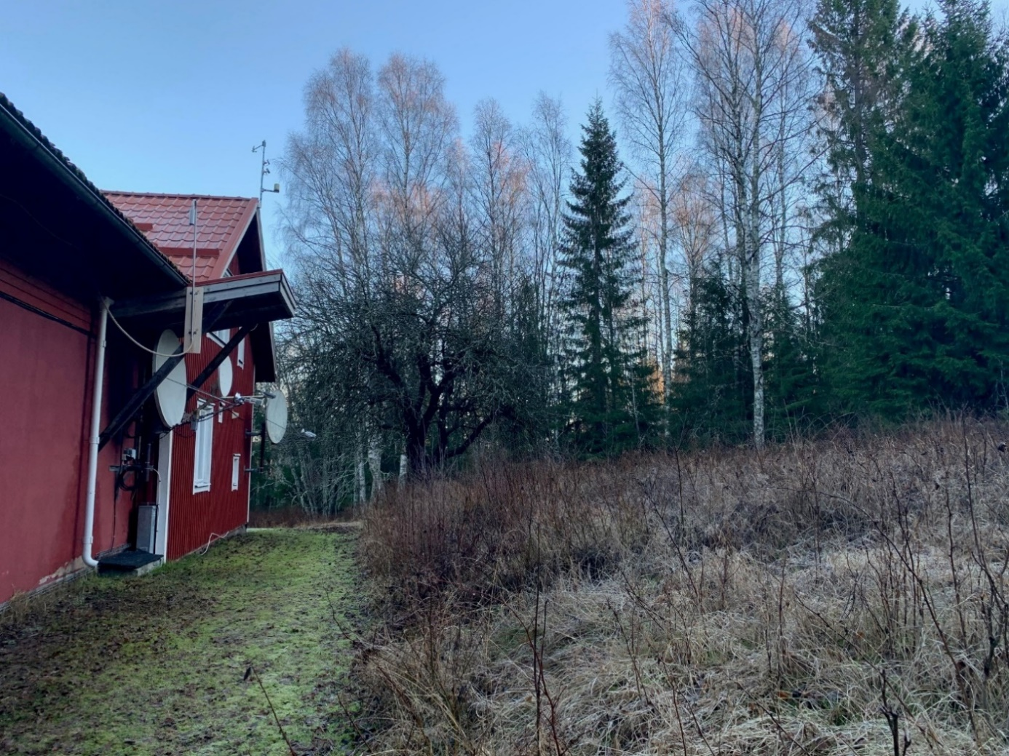
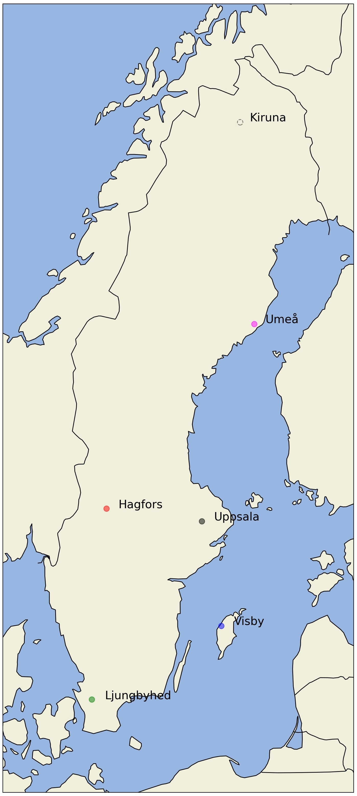
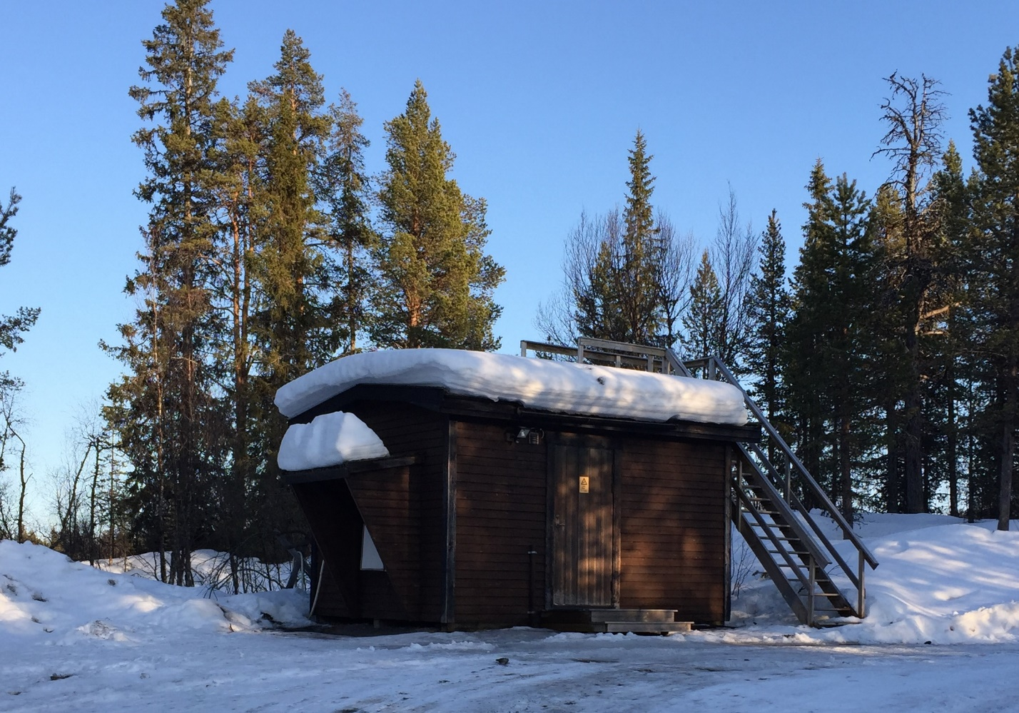
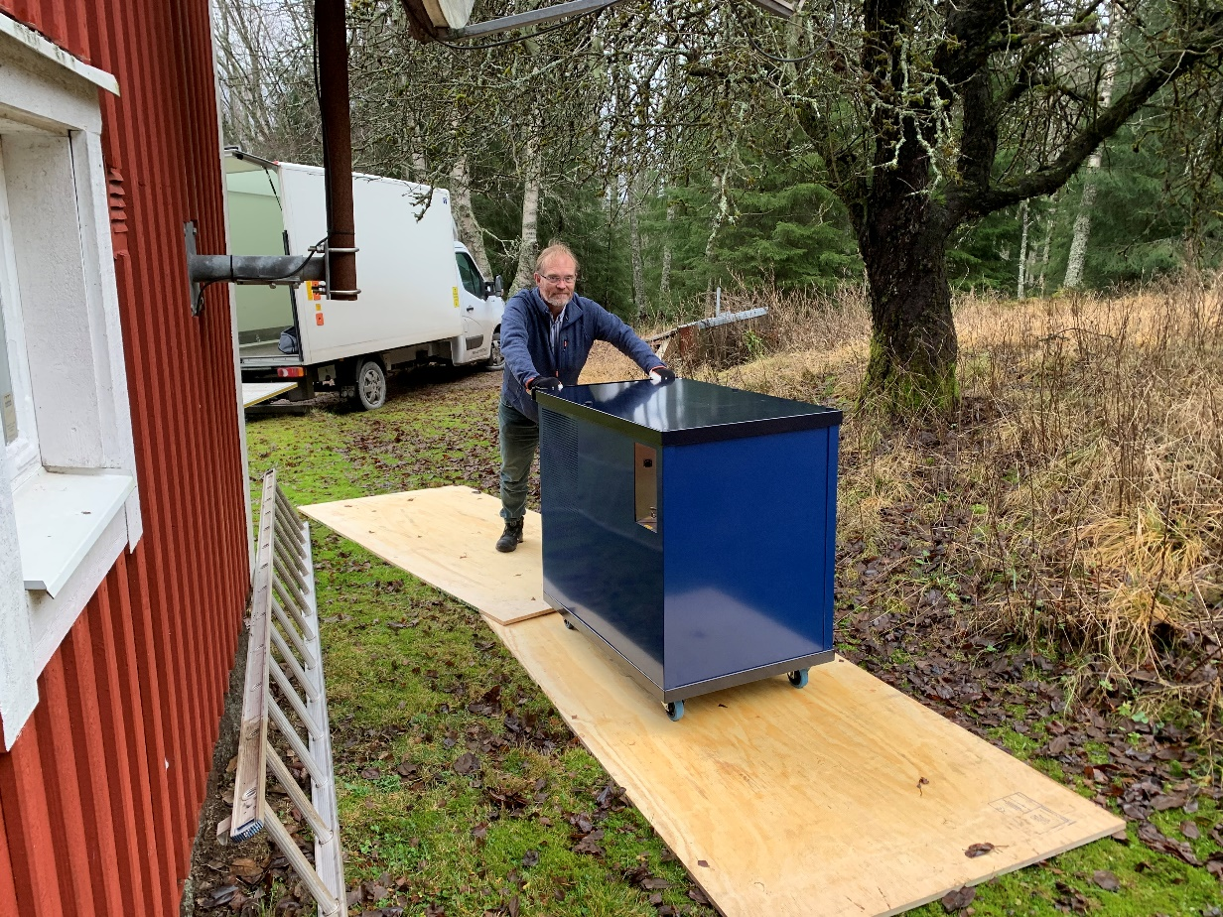
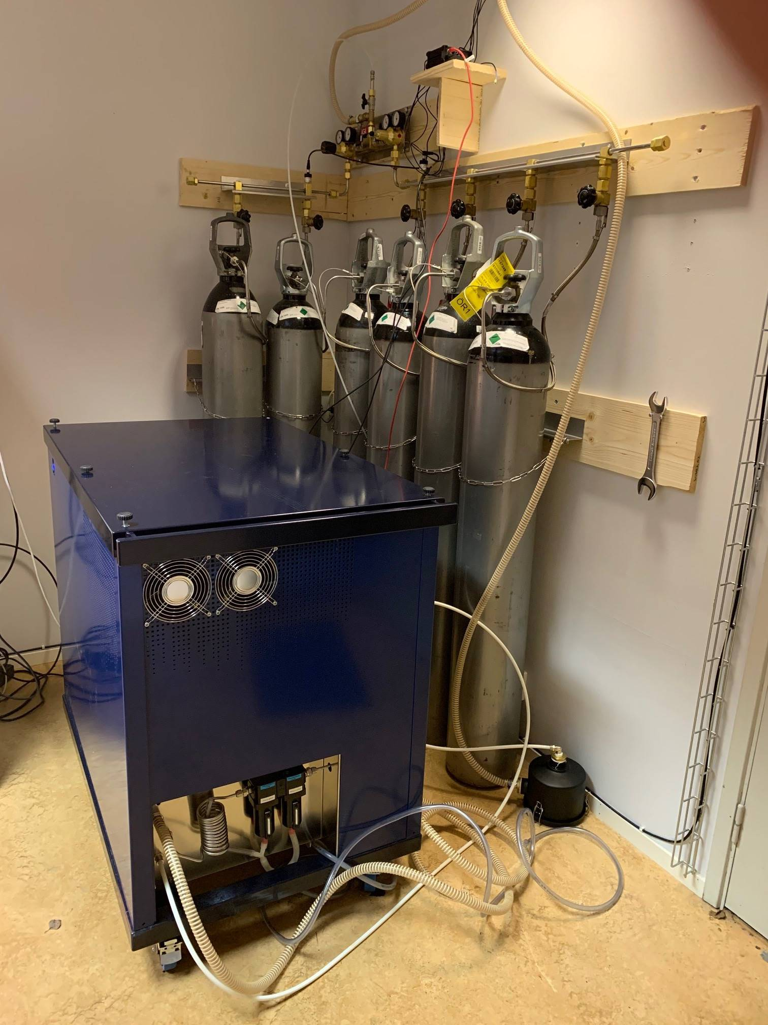
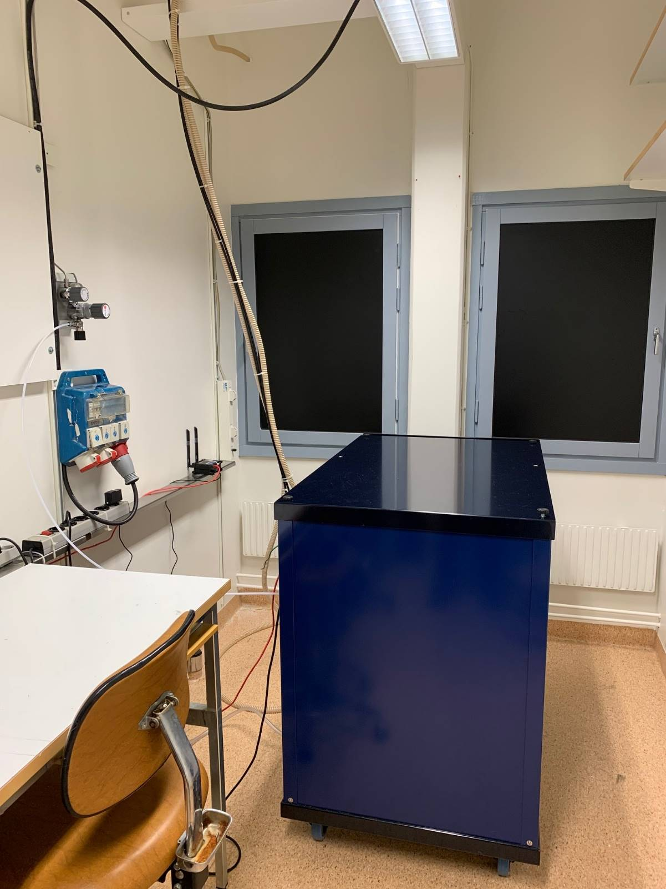
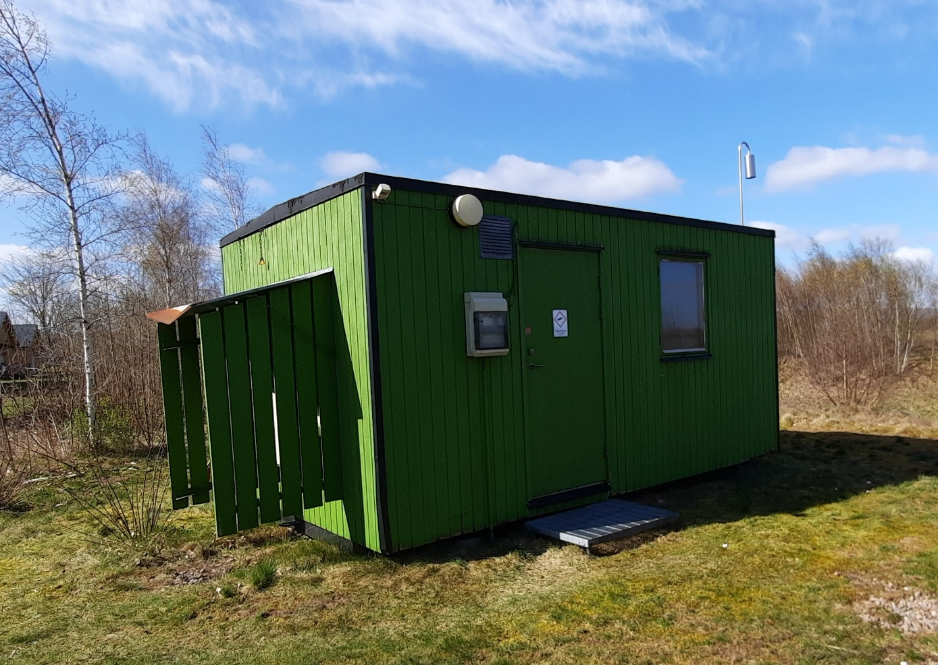
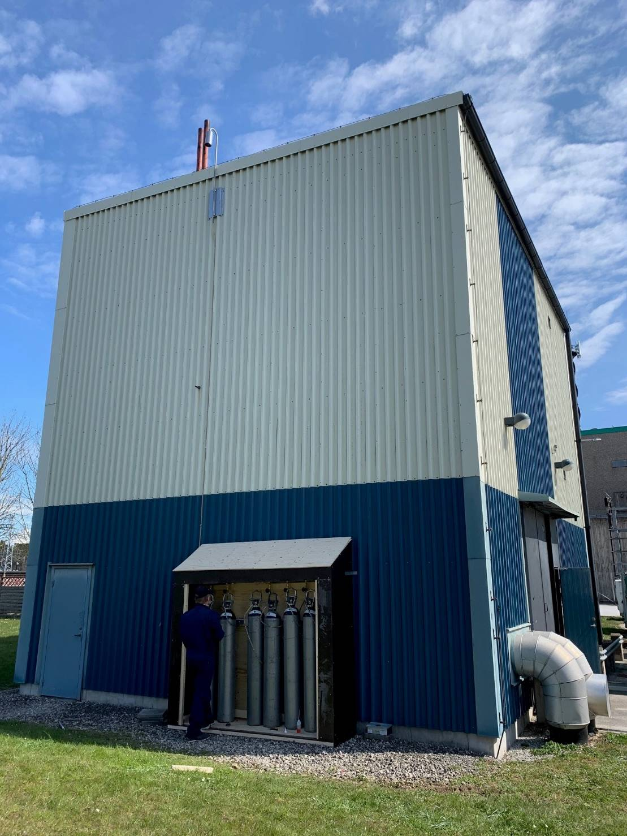
SAUNA Q_{b} - Performance of the National Radioxenon Array in Sweden
Lindsay Karlkvist, Tomas Fritioff, Klas Elmgren, Johan Kastlander,
Henrik Olsson, Mattias Aldener, Anders Ringbom
Swedish Defence Research Agency (FOI)
P3.2-781
Kiruna
In progress
Hagfors
November 2020
An array of SAUNA Q_{b} units
Lower cost
Easy to install
Evaluation
Operation
Challenges
Umeå
February 2021
Stockholm
Visby
April 2021
Ljungbyhed
April 2021

