Slide 1


Comparison of ¹²⁷Xe Measurements
Troy Robinson,¹ Matthew Goodwin,² Matthew Watrous¹
¹Idaho National Laboratory (USA), ²Atomic Weapons Establishment (UK)
¹²⁷Xe can interfere with Nuclear Explosion Monitoring causing false positive hits.
Training detection systems to recognize and quantify ¹²⁷Xe may reduce this problem.
¹²⁷Xe was produced by neutron irradiation and quantified using HPGe and beta-gamma detectors.
Attenuation correction was developed for the HPGe analysis.
Results between INL (HPGe) and AWE (β-γ) show good agreement
INL
0.998 ± 0.040 (1σ)
AWE
0.967 ± 0.099 (1σ)
Methods of quantification of ¹²⁷Xe were demonstrated through a laboratory intercomparison exercise.
Recommendations for implementation of ¹²⁷Xe quantification in the IMS are suggested
Please do not use this space, a QR code will be automatically overlayed
Px.x-xxx

Slide 2
Introduction (1 of 2)
¹²⁷Xe interference in Nuclear Explosion Monitoring
Non-fission product xenon radionuclides were recently observed during air-sampling equipment testing in Tennessee, USA¹
  Radionuclides identified were: ¹²²Xe, ¹²⁵Xe, and ¹²⁷Xe
Presence of these non-fission product xenon radionuclides resulted in a significant number of false positive detects of traditionally monitored fission product xenon radionuclides (^{131m}Xe, ¹³³Xe, ^{133m}Xe, ¹³⁵Xe)
  ¹²⁷Xe contributes coincidence counts in the ROIs for fission product radionuclides²
Prudence dictates that samplers monitoring the traditional four radionuclides would benefit from training to identify the presence of other xenon radionuclides such as ¹²⁷Xe to avoid reporting false positive detections
Fig 1. ¹²⁷Xe counts overlap the 7-ROIs used for detection of fission product xenon radionuclides. Figure is from Klingberg et al.²
Please do not use this space, a QR code will be automatically overlayed
T3.2-779

Slide 3
Introduction (2 of 2)
Challenges to ¹²⁷Xe Detection
¹²⁷Xe (along with ¹²⁵Xe and ^{129m}Xe) have never been detected in 20 years of IMS monitoring³
  Detecting these radionuclides is unlikely to occur without more sensitive systems³
    Xenon International and SAUNA-III systems offer improved sensitivity that may lead to more detections
Training systems to detect ¹²⁷Xe is challenging due to the following:
  Calibration sources³
  Memory effect for non-coated beta cells
  Increased uncertainty in all radionuclides under analysis because of the inclusion of a larger number of interference terms³
T3.2-779

Slide 4
Objectives (1 of 1)
Produce ¹²⁷Xe by neutron irradiation
Develop/employ purification of ¹²⁷Xe from ¹²⁵I by-product
Perform ¹²⁷Xe detector calibration
Develop self-attenuation correction for ¹²⁷Xe quantification
Develop container that enables sampling gas both by syringe or by expansion
Quantitatively dilute and share sample with a partner laboratory for an intercomparison test
Please do not use this space, a QR code will be automatically overlayed
T3.2-779

Slide 5
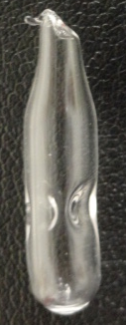
Methods/Data (1 of 4)
¹²⁷Xe Production
Isotopically-enriched ¹²⁶Xe obtained from ISOFLEX USA (San Francisco, USA)
Two quartz ampoule were sealed with 0.5 cm³ of ¹²⁶Xe
Ampoules were analyzed by XRF to verify integrity of ampoules
Ampoules were irradiated by Washington State University (USA) 10 MW Triga reactor
Isotopic Enrichment of ¹²⁶Xe gas (from ISOFLEX Certificate)
Isotope | ¹²⁴Xe | ¹²⁶Xe | ¹²⁸Xe | Other Xe
Content (%) | 0.024 | 99.94 | 0.014 | 0.003
Please do not use this space, a QR code will be automatically overlayed
T3.2-779

Slide 6
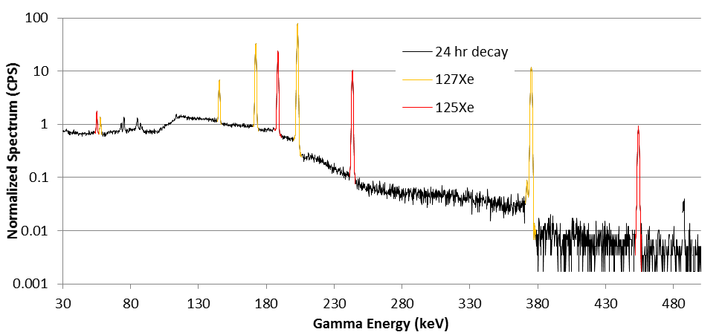
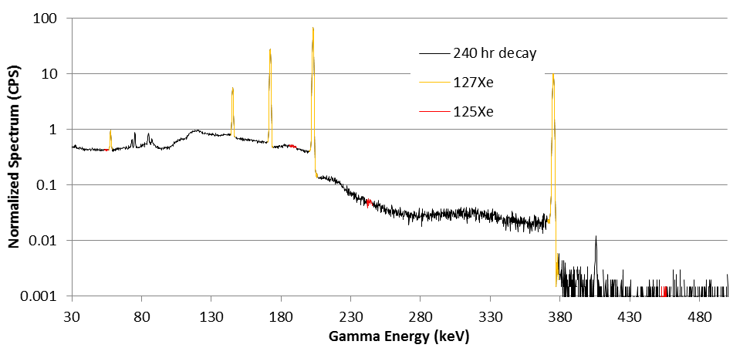
Methods/Data (2 of 4)
¹²⁷Xe Purification
Irradiation of ¹²⁶Xe results in production of two isotopes:
  ¹²⁷Xe (T_{1/2} = 36.346 days)
  ¹²⁵Xe (T_{1/2} = 16.9 hr)
Targets were aged for 10 days to allow decay of ¹²⁵Xe → γ + ¹²⁵I
Radioiodine is separated from radioxenon using a dry-ice/ethanol slurry cooled trap
  Iodine is retained and xenon flows through the trap
Gamma Spectra of received ¹²⁷Xe. ¹²⁵Xe is present after 24 hours of decay, but absent following 240 hours of decay.
T3.2-779

Slide 7
Methods/Data (3 of 4)
¹²⁷Xe Quantification
High Purity Germanium (HPGe) well detectors calibrated using a simulated gas multi-energy gamma standard (Eckert and Ziegler, USA) in a borosilicate flame sealed ampoule geometry at 24cm
¹²⁷Xe isolated in a borosilicate flame sealed ampoule was quantified at 24cm
The quantified ¹²⁷Xe was then used as a calibration source at geometries closer than 24cm (12cm, 4cm, 0cm and in the well) to obtain detector efficiencies
  Some of these closer geometries are expected to experience cascade and random summing
  These summing losses are not corrected for, but are wrapped up in the observed detector efficiency
24cm
12cm
4cm
0cm
Well
HPGe
T3.2-779

Slide 8
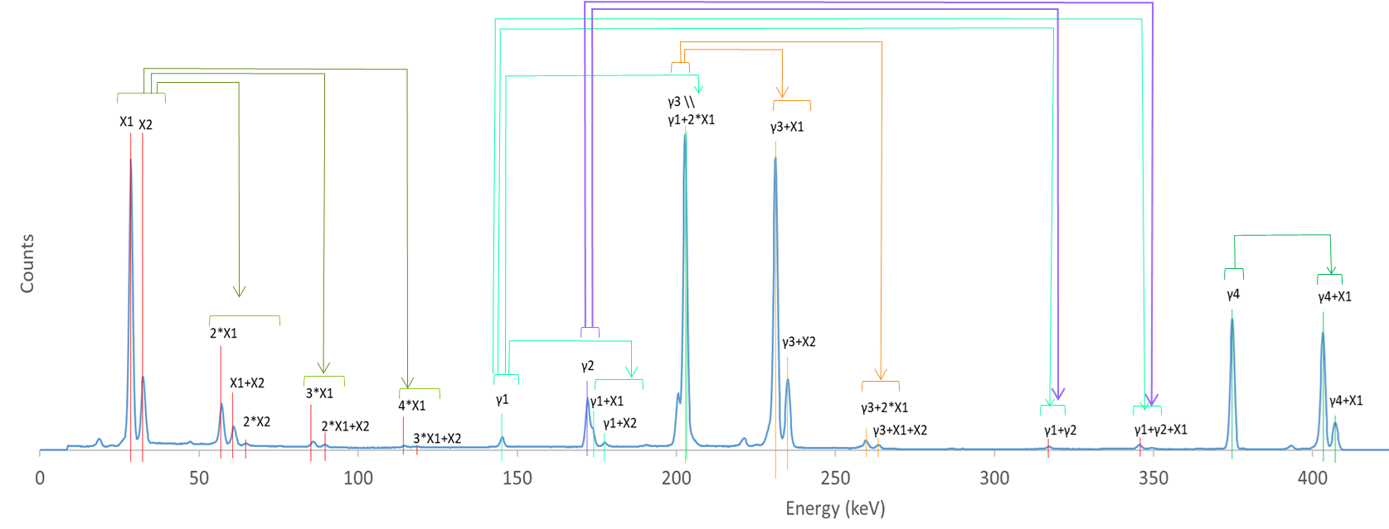
Methods/Data (4 of 4)
Well Detector Summing in Gamma Spectroscopy
Decay Emission Data for ¹²⁷Xe⁴
High Purity Germanium (HPGe) well detectors experience summing due to:
  High detector geometric efficiency
  ¹²⁷Xe coincident gamma and x-ray emissions
Peak Type | Energy (keV) | Intensity (%)
X ray (X1) | 28.3, 28.6 | 25.2, 46.5
X ray (X2) | 32.2, 32.3, 33.0 | 4.33, 8.35, 2.47
Gamma (γ1) | 145.25 | 4.31
Gamma (γ2) | 172.13 | 25.7
Gamma (γ3) | 202.86 | 68.7
Gamma (γ4) | 374.99 | 17.3
T3.2-779

Slide 9
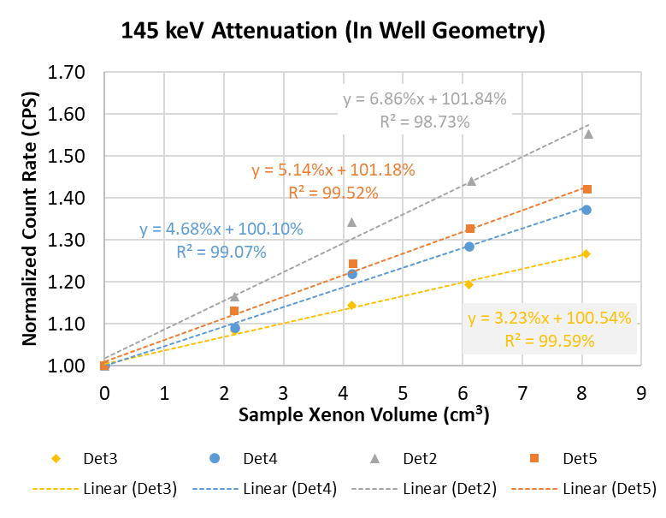
Results (1 of 4)
Surprising Attenuation Correction Findings
An experiment to determine the effect of added xenon gas on self-attenuation of the detected counts was performed
A ~0.002 cm³ sample of ¹²⁷Xe was assayed
The sample was then mixed with ~2.0 cm³ of natural xenon and re-assayed to determine the attenuation effect
The addition of 2.0 cm³ and assay sample was repeated until the total sample volume was equal to just over 8.0 cm³ total volume
An increase in count rate was observed as more xenon was added to the sample
  Added xenon was attenuating x-rays that caused a reduction in summing losses in the gamma ray energy ROIs
Please do not use this space, a QR code will be automatically overlayed
T3.2-779

Slide 10
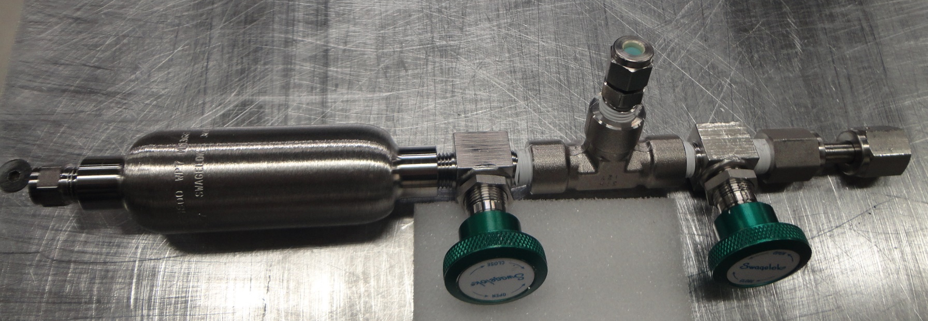
Results (2 of 4)
New Shipping Container
A new shipping container was employed with hybrid sampling capability:
  Conventional manual valve closure to tank
  Expansion Tee with septum for gas syringe sampling
T3.2-779

Slide 11
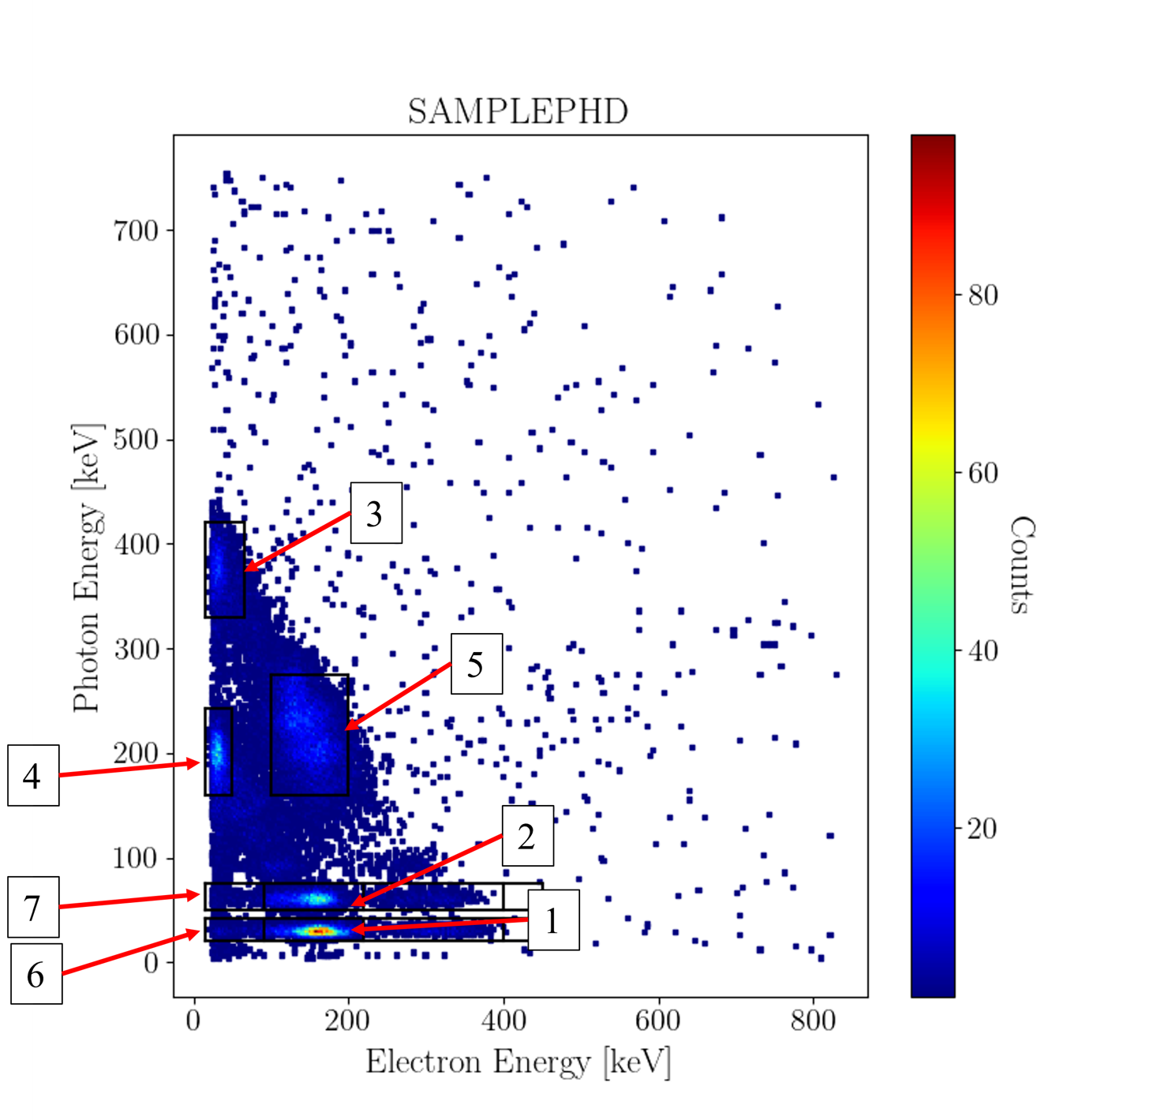
Results (3 of 4)
Beta-Gamma Quantification Development
A seven ROI method was used for quantifying ¹²⁷Xe in the beta—gamma system
A variety of gas compositions (xenon gas volume ranged from 1-7 cm³; Volume quantified by GC) with a total gas pressure of just below 1 bar were used for assays
A decrease in efficiency was observed as total xenon volume increased
  ROI 3 and 4 dropped by approximately 65% over the range
Because of the overlap of ROI 1 with the ROIs used in quantification of ^{133m}Xe and ^{131m}Xe, it may be possible to calculate the efficiency of ¹²⁷Xe from the ^{133m}Xe and ^{131m}Xe efficiencies (without calibrating the system).
  Perhaps this lends itself to a bootstrap calibration method
  This could also be used as a QA check gas for ^{133m}Xe and ^{131m}Xe calibration that has a shelf-life
T3.2-779

Slide 12
Results (4 of 4)
Comparison Results
A sample of ¹²⁷Xe gas was prepared at Idaho National Laboratory (USA) and shipped to Atomic Weapons Establishment (UK) using the new hybrid sampling shipping container
Target concentration for this sample was 1.0 Bq/cm³
INL performed the analysis using HPGe detectors in the “bean” borosilicate counting geometry
AWE performed the analysis using beta-gamma coincidence counting
Laboratory | Reported Concentration (Bq/cm³)
INL | 0.998 ± 0.040 (1σ)
AWE | 0.967 ± 0.099 (1σ)
T3.2-779

Slide 13
Conclusion (1 of 2)
Summary
A sample of ¹²⁷Xe gas was prepared at Idaho National Laboratory (USA) and shipped to Atomic Weapons Establishment (UK)
Overlap between ¹²⁷Xe beta-gamma spectrum with ^{133m}Xe and ^{131m}Xe could enable:
  a use of ¹²⁷Xe as a QA check material that has a shelf-life for ^{133m}Xe and ^{131m}Xe
  Known ^{133m}Xe and ^{131m}Xe could be used in a boot-strap calibration for 127Xe quantification without ever calibrating the system.
Results show good agreement and indicate that ¹²⁷Xe is a radionuclide that can be used for intercomparison exercises
Radioxenon monitoring systems would benefit from being able to identify ¹²⁷Xe when present
  Although not a fission product, ¹²⁷Xe can be present in the environment as an activation product
  ¹²⁷Xe if present creates false positive hits for all 4 xenon radionuclides of interest (^{131m}Xe, ¹³³Xe, ^{133m}Xe, ¹³⁵Xe)
Please do not use this space, a QR code will be automatically overlayed
T3.2-779

Slide 14
Conclusion (2 of 2)
Recommendations for ¹²⁷Xe Analysis in IMS
In agreement with Ely et al.³ it is recommended that higher sensitivity radioxenon monitoring systems be trained to recognize ¹²⁷Xe presence in a sample (Xenon International, SAUNA III or similar capable systems). Legacy systems likely don’t have the sensitivity to measure atmospheric levels of ¹²⁷Xe.
Due to the potential introduction of excessive uncertainty in the analysis of the four xenon radionuclides of interest³ (^{131m}Xe, ¹³³Xe, ^{133m}Xe, ¹³⁵Xe), ¹²⁷Xe should not be incorporated in the analysis unless it is detected. Positive hits for the 4 xenon radionuclides of interest should be screened for the presence of ¹²⁷Xe.
Only systems that have coated cells should undergo ¹²⁷Xe calibration and training to avoid extended long-lived ¹²⁷Xe residue that would interfere with normal monitoring operations.
T3.2-779

Slide 15
References (1 of 1)
Eslinger et al. “Determining the source of unusual xenon isotopes in samples” J Environ Radioact (2022) 247:106853.
Klingberg et al. “¹²⁷Xe coincidence decay analysis in support of CTBT verification” J Radioanal Nucl Chem (2015) 305:225-232.
Ely et al. “First observations of environmental ¹²⁵Xe, ¹²⁷Xe, and ^{129m}Xe” CTBTO SnT 2021 O2.4-138 (Oral presentation).
NuDat 2.8 obtained through https://www.nndc.bnl.gov/nudat3/chartNuc.jsp (accessed on 4/28/2023). [Nuclear Data Sheets 112, 1647 (2011).
Please do not use this space, a QR code will be automatically overlayed
T3.2-779

