Slide 1
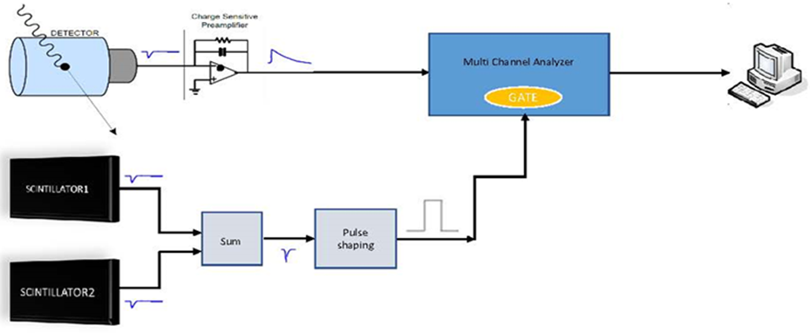
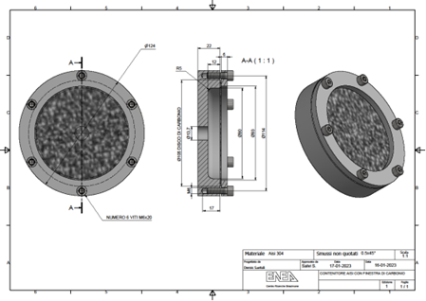
Lowering the High Purity Germanium Background Measurement at the Italian ENEA Noble Gas Laboratory
S. Salvi*, F. Cicconi*, A. Rizzo*, C. Telloli*, H. Mubashir**
* ENEA, FSN-SICNUC-TNMT, ** Bologna University - Electrical Engineering Department
P3,2-764
Trends evaluation of noble gases in the atmosphere is an important element for an early acquisition of data about anthropogenic activities related to different sectors such as nuclear energy production, radioactive waste repository, radiopharmaceutical industry, and for the CTBT verification.
The main goal of our work is correctly evaluate the value and the trend of the environmental background of Radioxenon in our country, in order to detect an anomalous contamination in case of a nuclear accident.
Due to the low concentrations of radioactive noble gas in the atmosphere, our efforts have been directed mostly at the reduction of the MDA of our measurement system, trying to improve the sensitivity and reduce the background noise.
If you want to learn more about this, come see my e-poster during session 3.2 on this date or access it online on the SnT2023 Conference platform!

