Slide 1
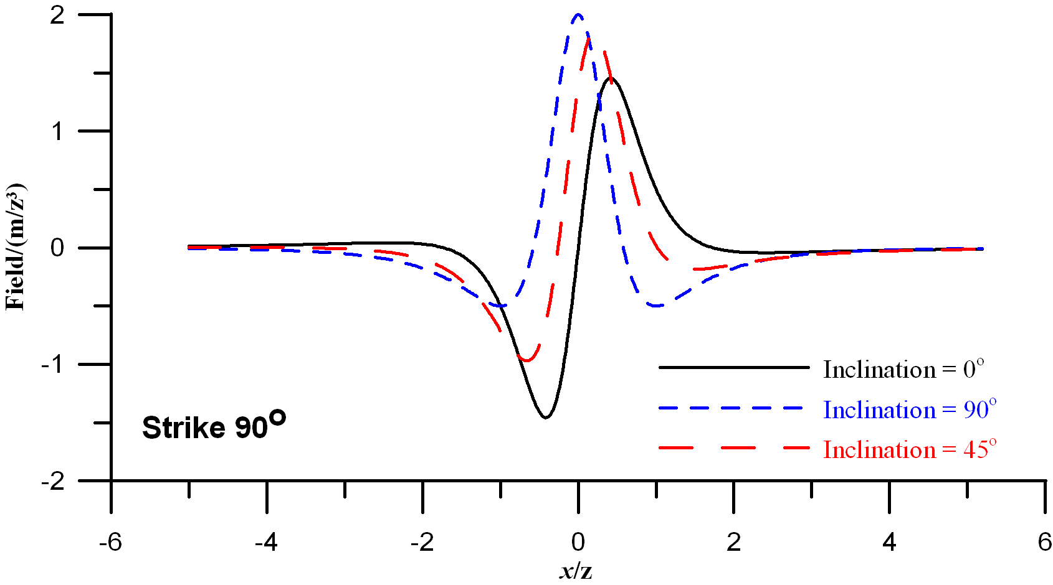
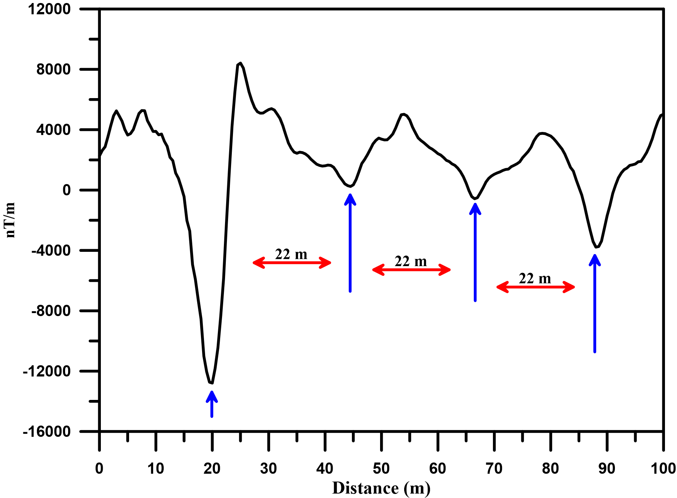
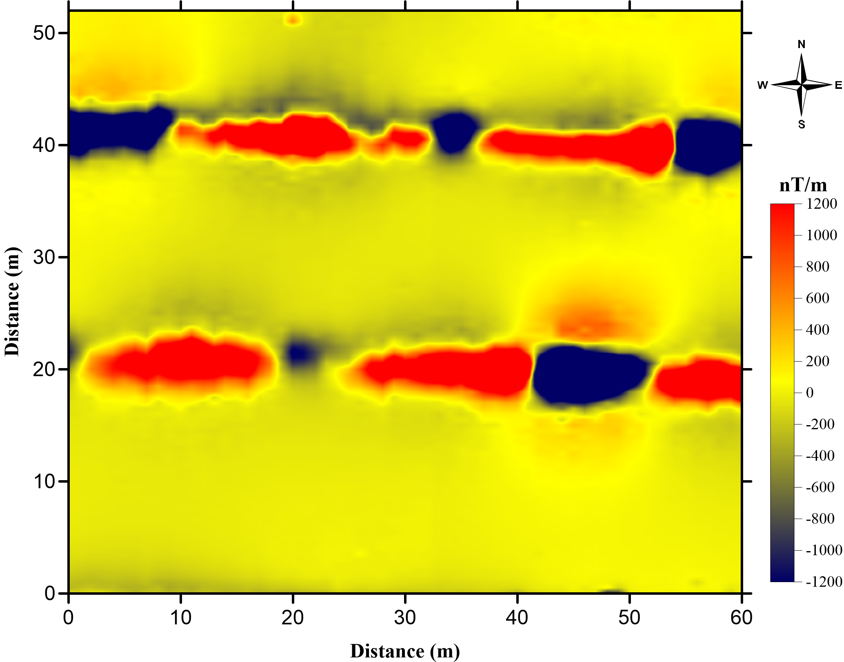
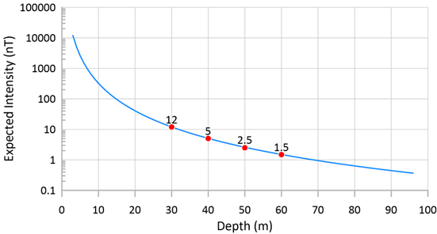
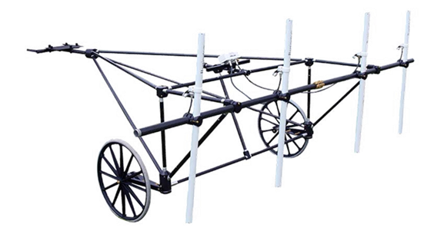
Magnetic Field Measurement Applications in the Context of On-Site Inspection
Ahmed Lethy
National Research Institute of Astronomy and Geophysics (NRIAG)
P3.3-257
A UNE is unlikely to produce significant magnetic anomalies that can be detected from the ground surface. However, the preparations for the UNE are more likely to have significant magnetic anomalies.
Theoretical and practical models are used to give insight to the qualitative information obtained from magnetic measurements. Also, it shows the advantages and limitations of the different types of magnetometers.

