Slide 1
Use of Remotely Controlled Platforms for On-Site Inspection Near Surface Surveys
Aled Rowlands¹, Luis R. Gaya-Pique¹, Massimo Chiappini², Roberto Carluccio ², Stefano Chiappini ², Iacopo Nicolosi ², Peter Labak¹
1. CTBTO, 2. Istituto Nazionale di Geofisica e Vulcanologia
As part of the OSI Programme of Work, a project is on-going to understand the relative merits of remotely controlled platforms (RCP) in an on-site inspection
A series of dedicated field tests have been performed focussing on command and control of platforms, operational support tasks and inspection related data gathering tasks.
For a demonstration using a near-surface platform and a magnetic sensor in Italy, the target object was clearly detected at a ground clearance of 10m
For the example provided, it was concluded that the remotely controlled platform offered an efficient alternative to the conduct of ground magnetic surveys – faster & safer
Please do not use this space, a QR code will be automatically overlayed
P3.3-308

Slide 2
Introduction: Background to the use of Remotely Controlled Platforms for On-Site Inspection Near Surface Surveys
A desk study conducted within the framework of the OSI action plan for 2016-2019 identified a spectrum of advantages and limitations associated with remotely controlled platforms in an OSI context. It concluded that such platforms do not offer a panacea to OSI operations, but they do offer the potential of enabling the inspection team to perform more safely and efficiently, while also respecting the rights of the inspected State Party. It offered three potential routes for further investigation:
• Maintain technological awareness;
• Assess the impact of regulatory requirements and general operational limitations;
• Perform a series of comparative practical demonstrations involving a range of different platforms and sensors as may be relevant for OSIs.
In the current OSI Programme of Work for 2022-2023, a further project has been initiated with the aim of delivering a technical report that outlines the findings of two key components:
• The advantages and limitations of deploying unmanned platforms (or remotely controlled platforms, RCP) in an OSI for support purposes as well as a platform for OSI relevant sensors, and
• The review of current legal aspects associated with the operation of such systems within the remit of the CTBT including their use in different jurisdictions.
P3.3-308
Please do not use this space, a QR code will be automatically overlayed

Slide 3
Objectives
The objectives of this poster are to:
Introduce work being done to understand the relative merits of remotely controlled platforms in an on-site inspection
Provide a case study of a demonstration on the use of a remotely controlled platform, performed in collaboration with Istituto Nazionale di Geofisica e Vulcanologia (INGV), Italy
Highlight the fact that near-surface platforms can operate at a ground clearance similar to what an inspector carrying the same sensor would
P3.3-308
Please do not use this space, a QR code will be automatically overlayed

Slide 4
Methods
Through the use of ground based and near surface unmanned commercial off the shelf as well as research on experimental platforms, a series of dedicated field demonstrations have been performed focussing on command and control of platforms, operational support tasks and inspection related data gathering tasks.
The aim has been to engage with commercial operators and States Signatories to perform demonstrations in different settings to gain as clearer picture as possible of the strengths and limitations of such platforms.
The following field demonstrations were initially planned to be conducted:
• Unmanned ground based and near-surface for H&S assessment;
• Unmanned ground based for:
− low resolution energy resolution analysis;
− geophysical site characterization;
• Unmanned near-surface surveys for:
− optical imagery;
− low resolution energy resolution analysis;
− magnetic field mapping.
P3.3-308
Please do not use this space, a QR code will be automatically overlayed

Slide 5
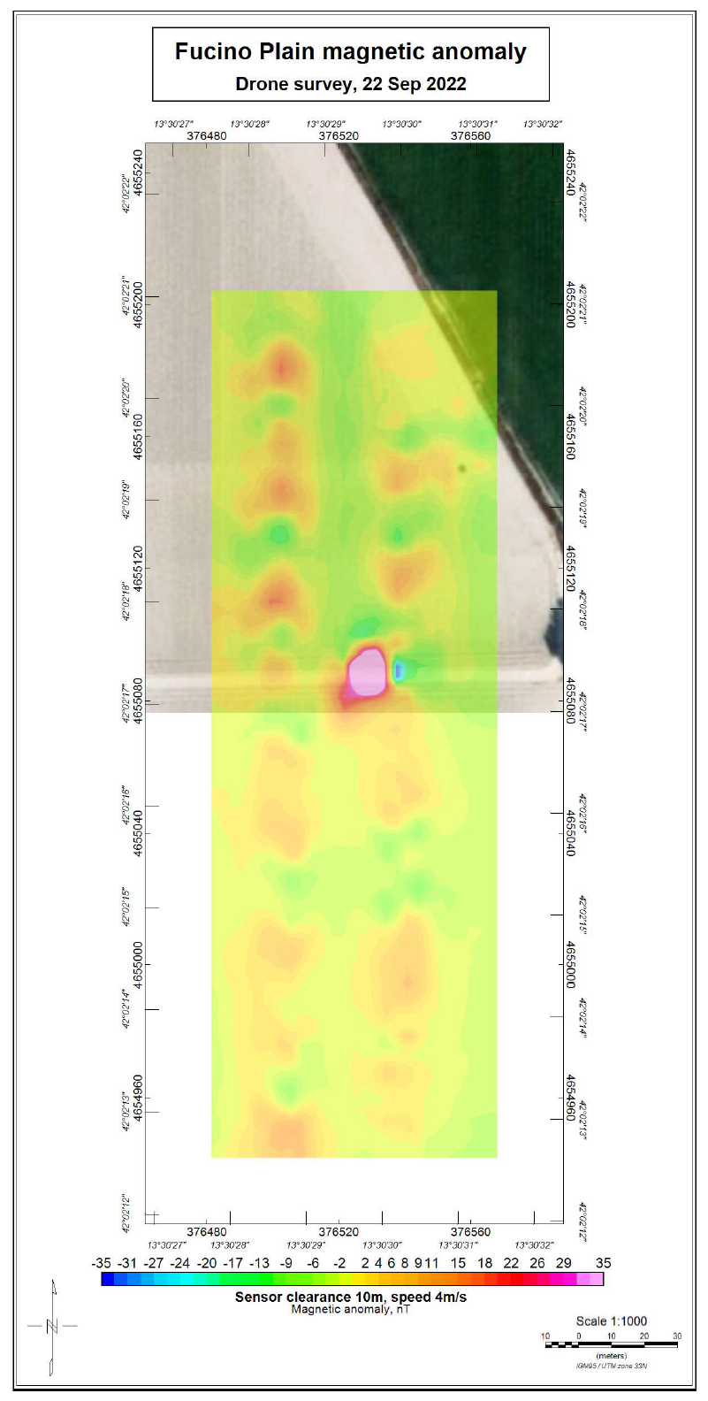
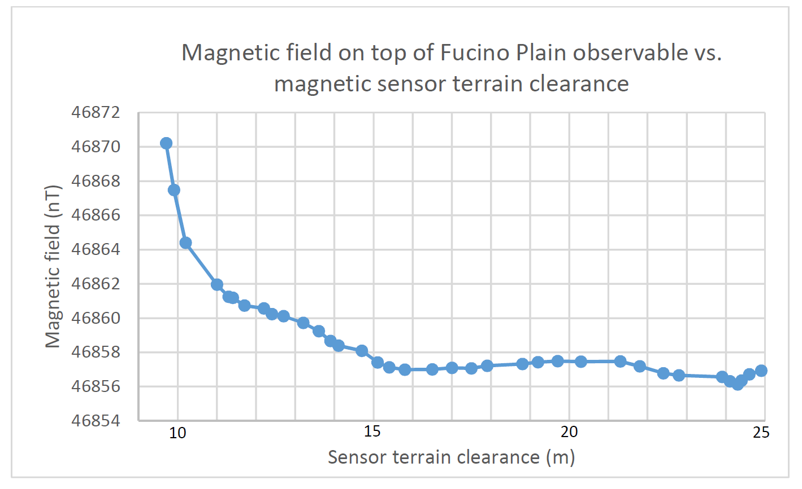
Results:
Demonstration of a magnetic sensor on a near-surface platform
As part of the project a demonstration of a near-surface remotely controlled platform supporting a magnetic sensor was held in Italy in September 2022 in collaboration with INGV.
The event also served as a means of validating the results of a project related to magnetic field forward modelling (for further details about this aspect of the case study see poster 3.3-310).
The demonstration involved the use of a a DJI M300 remotely controlled platform with a sensor payload comprising of a Q-spin rubidium scalar magnetometer housed within an aerodynamic bird developed at MARIS-INGV.
The sensor was flown at different clearance heights over a target and the magnetic anomaly computed.
Target object for the demonstration: a reinforced concrete with a metal pipe
Magnetic field as detected by the sensor at different ground clearance heights above the target
P3.3-308
Please do not use this space, a QR code will be automatically overlayed
Sensor clearance above the ground: 10m, speed: 4m/s. Magnetic anomaly nT

Slide 6
Conclusions
Interim findings
For the demonstrations performed to date, near-surface remotely controlled platforms can be considered as an expansion of a ground survey – this is particularly the case for magnetic survey, where conducting a survey using OSI equipment deployed on a RCP operating at two meters ground clearance is no different from a ground survey conducted by an inspector carrying the same sensor on a pole at the same height.
In the context of a magnetic survey, the use of RCP for near-surface magnetic surveys is an efficient alternative to the conduct of ground magnetic surveys – faster & safer.
The findings are similar for near-surface optical and low resolution energy resolution analysis surveys – albeit with greater ground clearance for optical sensors.
P3.3-308
Please do not use this space, a QR code will be automatically overlayed
Under the current Programme of Work, the PTS is continuing demonstrations of RCPs and will focus in 2023 on ground-based platforms.

