Slide 1
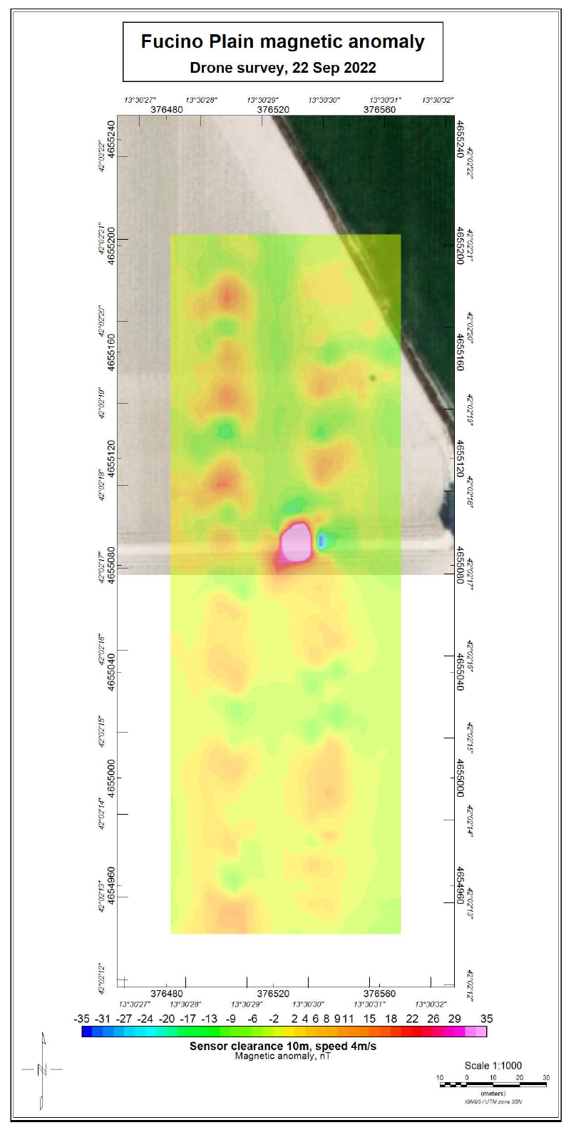
Use of Remotely Controlled Platforms for On-Site Inspection Near Surface Surveys
Aled Rowlands¹, Luis R. Gaya-Pique¹, Massimo Chiappini², Roberto Carluccio ², Stefano Chiappini ², Iacopo Nicolosi 2, Peter Labak¹
1. CTBTO, 2. Istituto Nazionale di Geofisica e Vulcanologia
P3.3-308
Are there any advantages to the use of remotely controlled platforms in an OSI?
Demonstration of a magnetic near-surface survey

