Slide 1
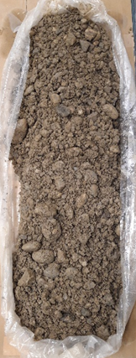
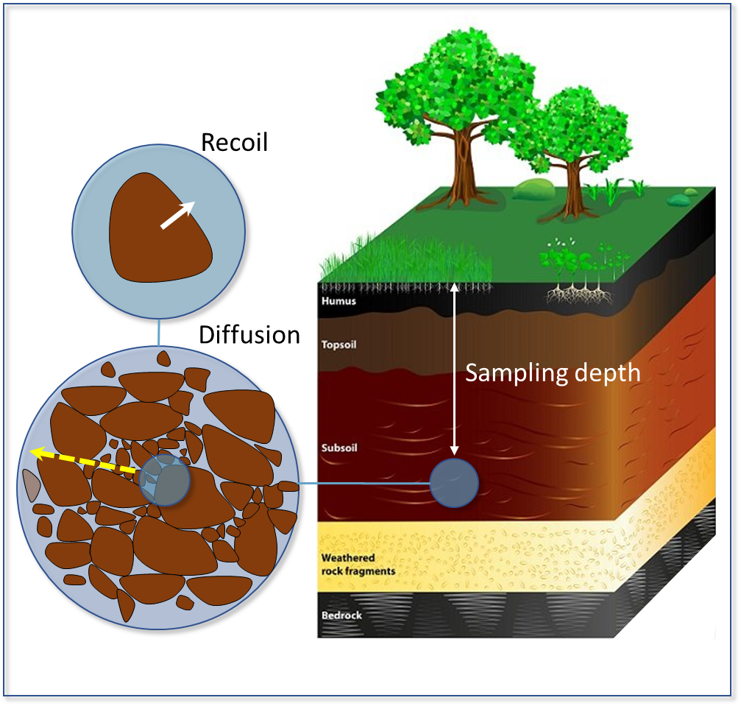
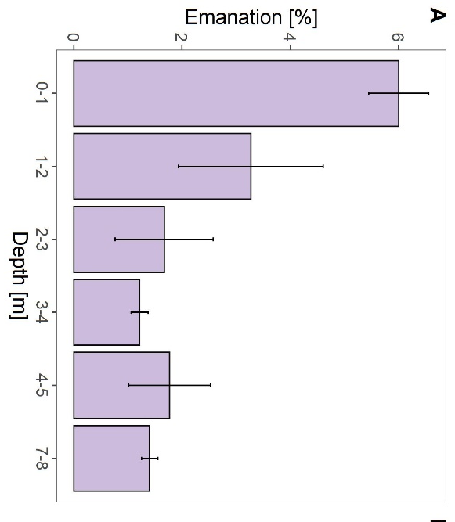
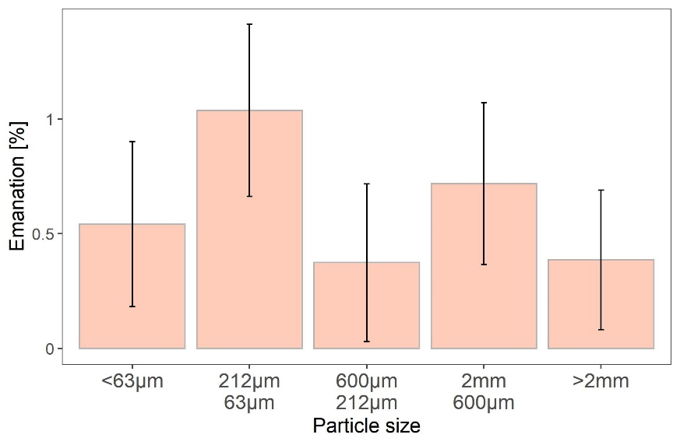
Emanation rates of Ar-37 in natural soils
Roland Purtschert & Stéphanie Musy
University of Bern
P3.3-454
Objectives:
Determination of the fraction of ³⁷Ar that escapes from the soil grain to the air-filled pore space as function of:
Emanation process (Recoil vs. Diffusion)
Soil type and grain size
Dept below surface
Water saturation
a
50 cm
b
5 cm
Depth Dependance
Effect of grain size

