Slide 1
Emanation rates of Ar-37 in natural soils
Roland Purtschert & Stéphanie Musy
Climate and Environmental Physics and
Oeschger Center for Climate Change Research,
University of Bern, Sidlerstrasse 5, 3012, Bern, Switzerland
Knowledge about the natural background of
Ar-37 in the top few meters of the soil column is crucial for the interpretation of measurements carried out in the course of an OSI.
Natural soil samples were collected from a drill core in an alluvial valley in Switzerland. The samples were irradiated with a known neutron flux and the emanation fraction of Ar-37 was determined
The emanation fractions were mostly < 1% with a weak dependence on the grain size. More pronounced is a decrease with depth over almost an order of magnitude.
Ar-37 emanation rates in soils are not constant as function of depth. This needs to be considered in predictive OSI models
Please do not use this space, a QR code will be automatically overlayed
P3.3-454

Slide 2
Introduction
Ar-37 is foreseen as an indicator of clandestine underground nuclear explosions (UNE) during on-site inspections (OSI) under the Comprehensive Nuclear Test-Ban Treaty (CTBT) [1]
Ar-37 is produced by neutron activation of calcium through the reaction ⁴⁰Ca(n,α)³⁷Ar in the cavity melt and in the rocks surrounding an UNE [2].
Activity concentrations in subsurface gas exceeding natural background levels can thus be interpreted as a signal of a nuclear test
The exponentially attenuated cosmogenic particle flux (i.e. neutrons and muons) with depth leads to a decreasing natural Ar-37 production rate in the soil column. However, Ar-37 concentrations in soil air also depend on the gas exchange rate with the atmosphere and the rate at which Ar-37 escapes from the soil grain into the air-filled pore space [3,4]. .
The latter is not well understood and needs to be investigated in more detail [5,6]
Natural soil samples were collected from a drill core from an alluvial valley in Switzerland. The samples were irradiated with a known neutron flux and emanated Ar-37 was determined
Please do not use this space, a QR code will be automatically overlayed
P3.3-454

Slide 3
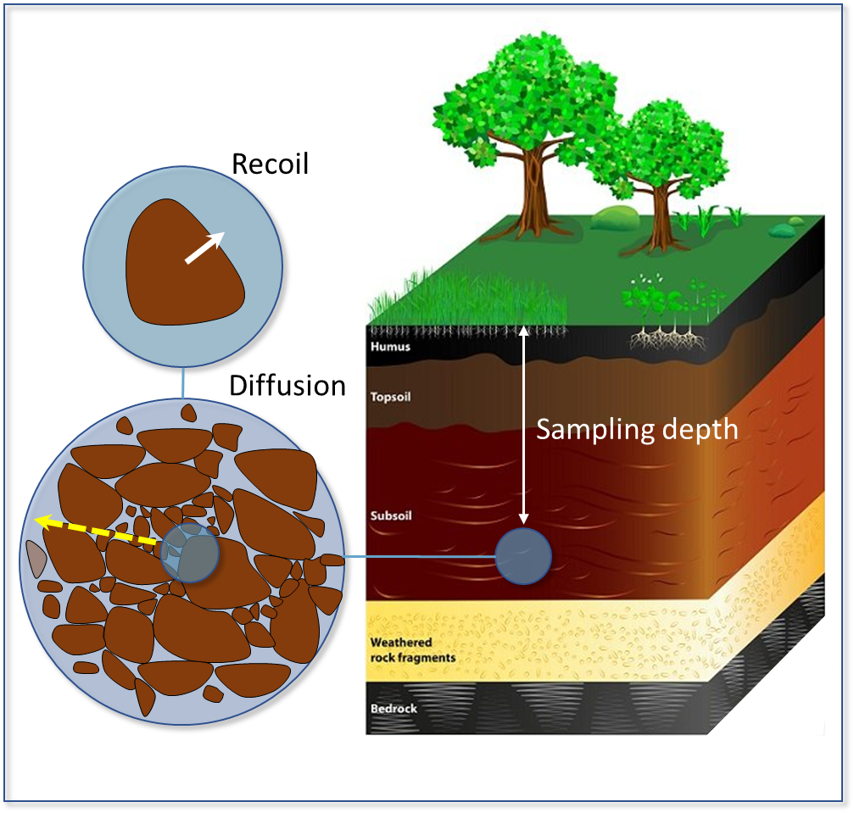
Objectives
Determination of the fraction of ³⁷Ar that escapes from the soil grain to the air-filled pore space as function of:
Emanation process (Recoil vs. Diffusion)
Soil type and grain size
Water saturation
Dept below surface
³⁷Ar
Please do not use this space, a QR code will be automatically overlayed
P3.3-454

Slide 4
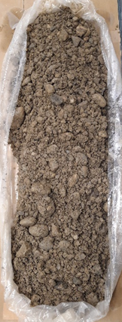
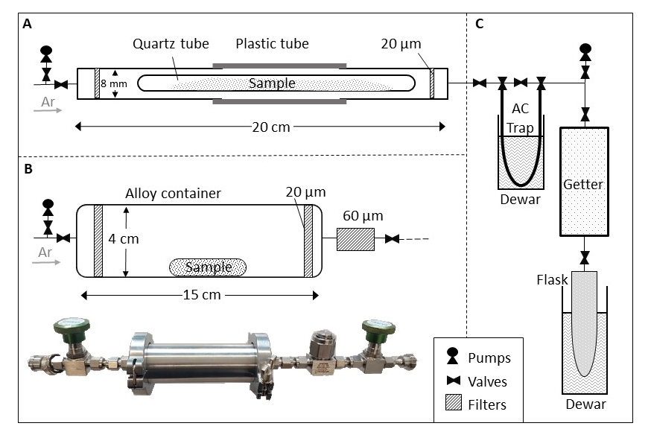
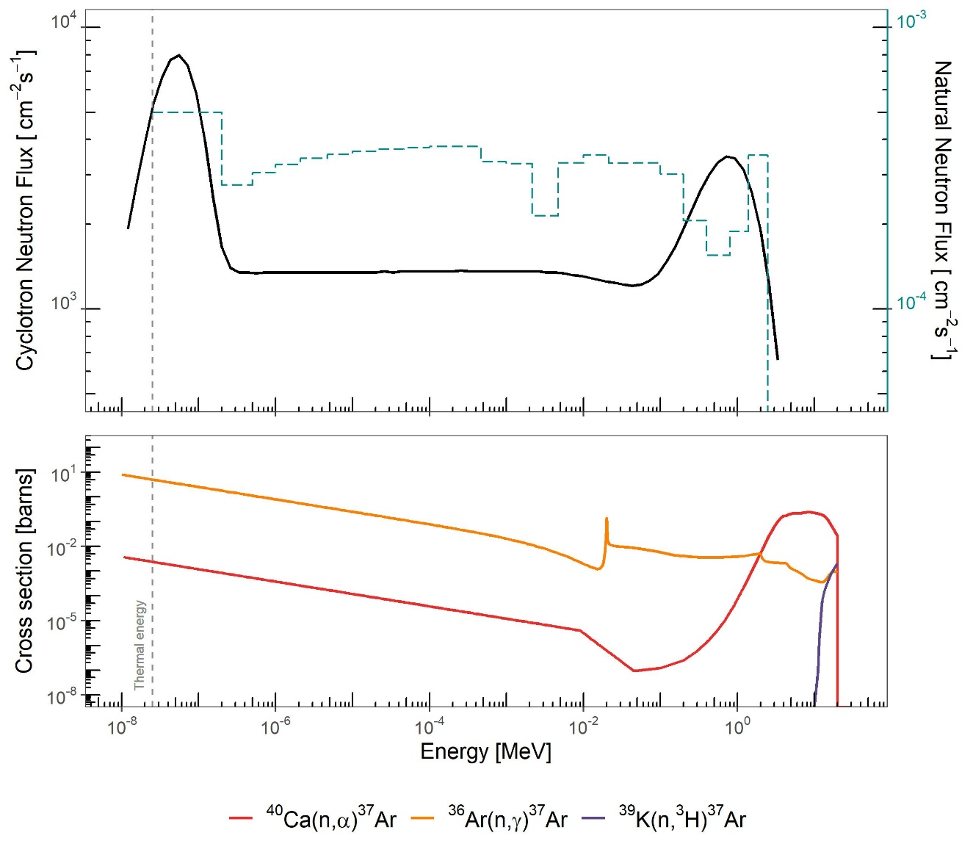
Methods
Sample selection and collection
Preparation
Irradiation
Gas extraction and Ar-37 measurement
a
D
50 cm
b
5 cm
Sample selection
Pulverized rock samples
Soil samples from a drilling core (a)
Selected macroscopic rock samples (b)
Irradiation containers
Fused quartz tubes for smaller fragments and powders (A) filled with He
Evacuated alloy container for larger fractions and rocks (B)
Irradiation
By neutrons produced in an 18 MeV medical cyclotron
Neutron energy range: thermal-2 MeV (C)
Ar-37 detection
Gas collected by flushing with Ar-37 free carrier gas
Purification over a getter (C)
Ar-37 was measured by Low-Level-Counting in 50-100 cm³ counters
Repeated Measurement
After the first gas extraction the samples were stored several weeks
The delayed emanation was then measured
Please do not use this space, a QR code will be automatically overlayed
P3.3-454

Slide 5
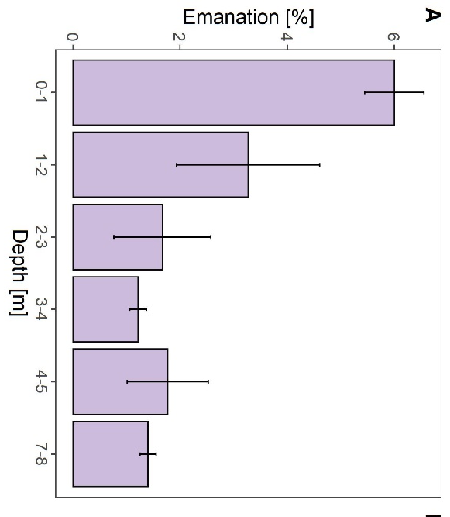
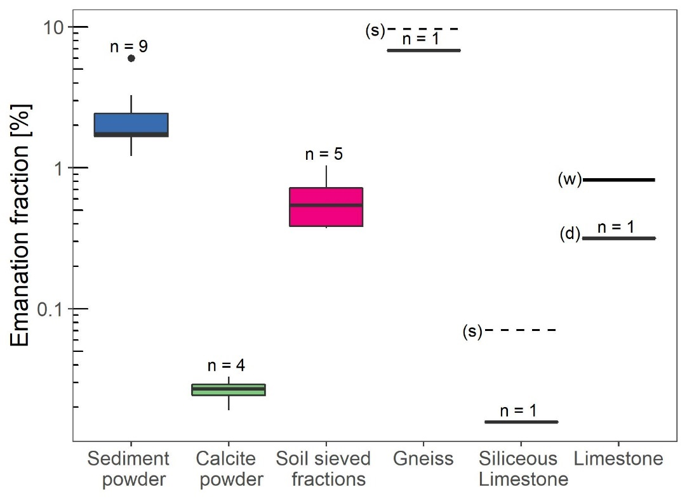
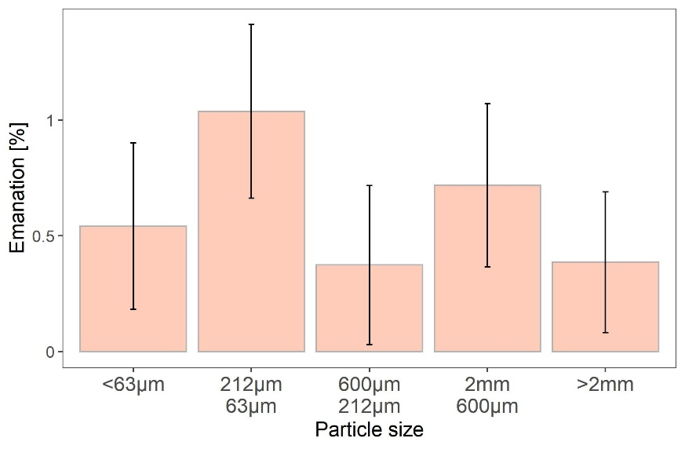
Results
Recoil (ε_{R}) and diffusion emanation (ε_{D})
Depth Dependance
Ar-37 emanation in soil is highest in the top first meter and
decreases with depth
Effect of grain size
ε_{R} < 0.1% for Calcite powder (Ø∼17 um)
ε_{R} ≈ 1% for pulverized natural soil sediment (Ø∼2 um)
ε_{R} ≤1% for natural soil sediment (63 um < Ø < 2mm)
Significantly delayed diffusive emanation ε_{D} for macroscopic samples that were stored over weeks (s)Ø
No significant dependence of emanation on particle size for samples from differently sieved fractions.
Please do not use this space, a QR code will be automatically overlayed
P3.3-454

Slide 6
Conclusions and References
In natural soils, ³⁷Ar escapes at fractions of a few % from soil particles
Highest emanation rates are observed in the shallow depth, where the soil is most weathered.
Emanation fractions from sieved soil fractions are rather independent of particle size what points the existence to internal sub-particle size nano pores.
Emanation from larger soil particles and rocks is a serial process of recoil and diffusive transport, both of which should be considered in the context of an OSI.
References
[1] Aalseth, C.E., Day, A.R., Haas, D.A., Hoppe, W.W., Hyronimus, B.J., Keillo, M.E., Mace, E.K., Orrel, J.L., Seifert, A. and Woods, V.T. (2010) Measurement of ³⁷Ar to support technology for On-site Inspection under the Comprehensive Nuclear-Test-Ban Treaty. Nucl. Instru. Meth.
[2] Haas, D. (2010) The science case for ³⁷Ar as a monitor for underground nuclear explosions. PNNL.
[3] Riedmann, R. and Purtschert, R. (2011) Natural ³⁷Ar Concentrations in Soil Air: Implications for Monitoring Underground Nuclear Explosions. Environmental Science and Technology 45, 8656-8664
[4] Guillon, S., Sun, Y., Purtschert, R., Raghoo, L., Pili, E. and Carrigan, C.R. (2016) Alteration of natural ³⁷ Ar activity concentration in the subsurface by gas transport and water infiltration. Journal of Environmental Radioactivity 155, 89-96.
[5] Musy, S., Casolaro, P., Dellepiane, G., Berger, A., Braccini, S. and Purtschert, R. (2022) Quantification of ³⁷Ar emanation fractions from irradiated natural rock samples and field applications. Journal of Environmental Radioactivity 251-252, 106966.
[6] Johnson, C., Lowrey, J.D., Alexander, T., Mace, E. and Prinke, A. (2021) Measurements of the emanation of ³⁷Ar and ³⁹Ar from irradiated rocks and powders. Journal of Radioanalytical and Nuclear Chemistry 329, 969-974.
Please do not use this space, a QR code will be automatically overlayed
P3.3-454

