Slide 1
Multisample holders for On Site inspection:
efficiency calculation and experimental set up
A. Rizzo, S. Salvi, N. Falsini, F. Borgognoni, G. Ottaviano, C. Telloli, E. Nava, S. Lo Meo ENEA (Italian National Agency for New Technologies, Energy and Sustainable Economic Development)
During OSI, screening out any anomaly by analysing multiple samples at the same time may assist to narrow down the search zone
ENEA has designed and built a multi-sample holder with two separate layers, for the purpose of analyzing simultaneously up to 13 samples.
Spiked samples put in different positions of the holder have been compared.
The relative efficiency of different positions on the multi-sample holder has been measured.
The characterization has shown that the positions in the multisample holder exhibit different efficiency.
Ganging strategy can be applied during OSI lab gamma measurements.
Please do not use this space, a QR code will be automatically overlayed
P3.3-850

Slide 2
Introduction
Please do not use this space, a QR code will be automatically overlayed
Our task force is spread over two locations, both in Emilia-Romagna Region (central Italy) and in the Bologna district: one in the city and the other 50 km away (Research Centre Brasimone)
P3.3-850

Slide 3
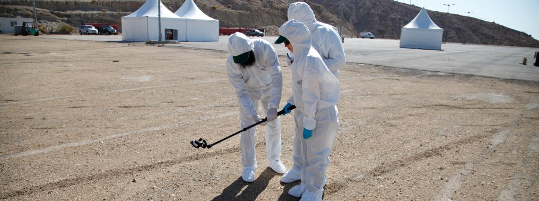
Objectives
During an On-Site Inspection (OSI), the collection of samples, such as air, soil, vegetation and water, for analysis in the field laboratory is crucial to determine if any relevant radioactive isotopes are present;
The number of samples collected during an OSI from the same area could be big as they could come from different areas of interest;
“Ganging” a group of samples represents an efficient methodology to achieve a good throughput of analyses to support effectively the search logic;
The grouping methodology could be related to the location of the samples, to the type or to the field mission.
Please do not use this space, a QR code will be automatically overlayed
P3.3-850

Slide 4
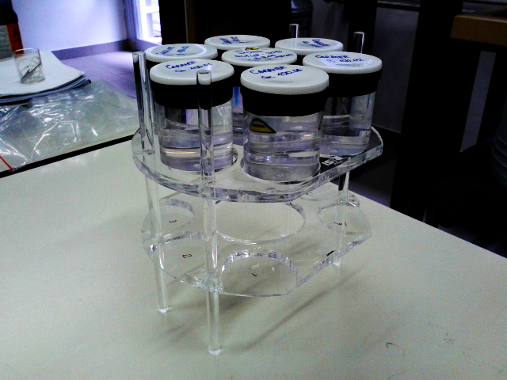
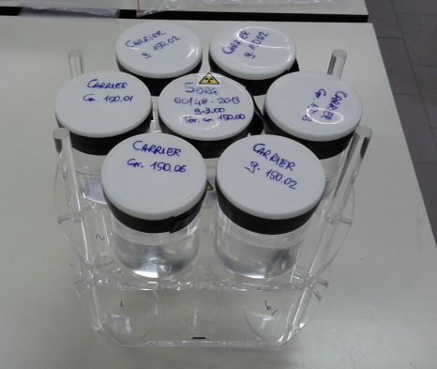
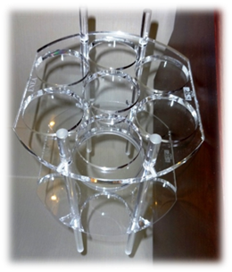
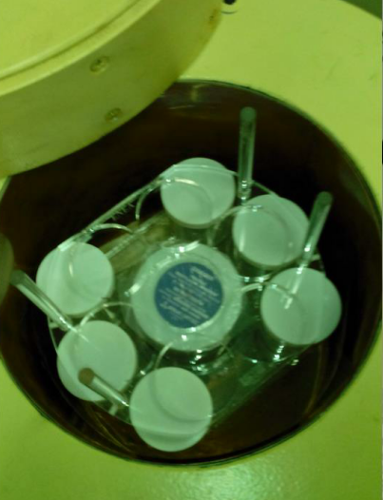
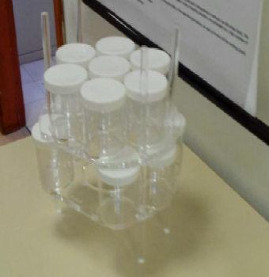
Methodology
ENEA plastic multisample holder with 13 possible positions
Characterization at ENEA laboratory (IT-NDC)
7 positions in the top side
6 positions in the bottom side.
each sample holder can have a maximum capacity of 150-160 ml
The central hole is designed to fit the size of the crystal.
The multisample holder is placed into a low background gamma/X spectrometer with type (n) Germanium detector.
Energy range 10 keV - 5 MeV.
Position 1
Position 2
Please do not use this space, a QR code will be automatically overlayed
Position 3
P3.3-850

Slide 5
Results
The relative efficiency referred to positions 1-3 and to the central position without sample holder.
Please do not use this space, a QR code will be automatically overlayed
P3.3-850

Slide 6
Conclusion
ENEA has designed, implemented and tested a plastic sample holder for the gamma spectrometry measurement of multiple samples.
The characterization has shown that the positions in the multisample holder exhibit different efficiency .
The side lower and side upper position has the same efficiency
The central position is the best option for a single measurement
The side position should be used in the lower plate
These observations should be taken into consideration when the “ganging” strategy is applied during OSI lab measurement and can be inserted In the working instructions for gamma measurement
Please do not use this space, a QR code will be automatically overlayed
P3.3-850

