Slide 1
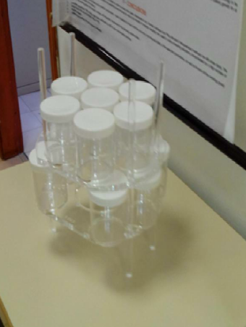
Multisample holders for On Site inspection:
efficiency calculation and experimental set up
A. Rizzo, S. Salvi, N. Falsini, F. Borgognoni, G. Ottaviano, C. Telloli, E. Nava, S. Lo Meo ENEA (Italian National Agency for New Technologies, Energy and Sustainable Economic Development)
P3.3-850
Position 1
Position 2
Position 3
ENEA has designed, built and tested a plastic sample holder for the measurement of multiple samples.
The characterization has shown that the positions in the multisample holder exhibit different efficiency

