Slide 1
GPR Robot Solution to OSI
Qisong Jia¹, Dong He¹, Hui Zhang², Yuemeng Yin³, Xinghua Shi³, Jing Yang⁴, Peng Li⁴
1. Sichuan Central Inspection Technology Inc.; 2. Beijing Institute of Radio Measurement; 3. China Research Institute of Radio Wave Propagation; 4. HOPE Investment Development Co. Ltd.
Scope of this work
Three-dimensional images can be synthesized through multiple testing data
Expected features of the GPR robot
The GPR robot can be suitable for the development of concept of operations during future IFEs and OSI trainings
Please do not use this space, a QR code will be automatically overlayed
P3.3-89

Slide 2
Introduction
Based on the lessons learned during the past OSI activities, remotely controlled ground platform-based geophysics detection systems, due to the practical application to hazard challenging conditions, would have their significance both for the future real OSI activities and trainings of current stage. This work has put forward a remotely controlled GPR robot based on the commercial off the shelf GPR system demonstrated during SnT2021.
The remotely controlled platform applies integrated-inertial /GNSS/high-precision-RTK positioning and navigation, so as to locate the position of GPR in real time. At the same time, advanced motion control algorithms have been developed to achieve the automatic movement of the platform once the scope and spacing of detection have been input into the control system. Meanwhile, the 2D and 3D GPR data acquisition could be achieved and integrated with the RTK positioning data. 2D, 3D and horizontal scanning data displaying mode could increase the target recognition accuracy and reduce the false alarm and target missing rate.
Please do not use this space, a QR code will be automatically overlayed
P3.3-89

Slide 3
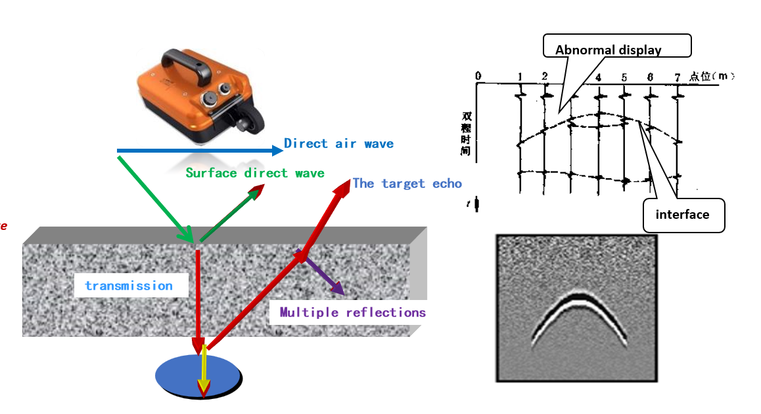
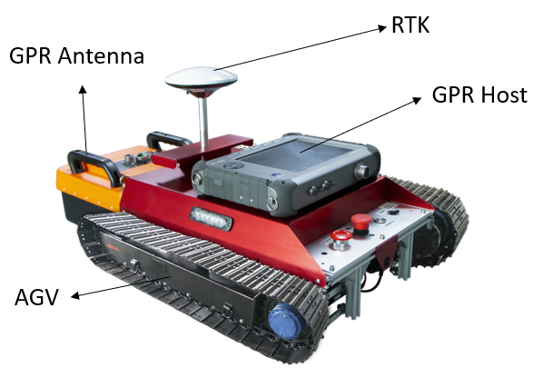
Objectives
The GPR robot would have the following functions:
Remote communication: Operators can stay away from the tested area.
Automation: Built-in automatic algorithms reduce the workload of operators.
Lightweight: Being light and small, making it easy to carry and transport.
Expandable: Antennas with different frequencies can be replaced.
Remote video: The built-in camera can transmit real-time video.
GPR Theory
GPR Robot
Please do not use this space, a QR code will be automatically overlayed
P3.3-89

Slide 4
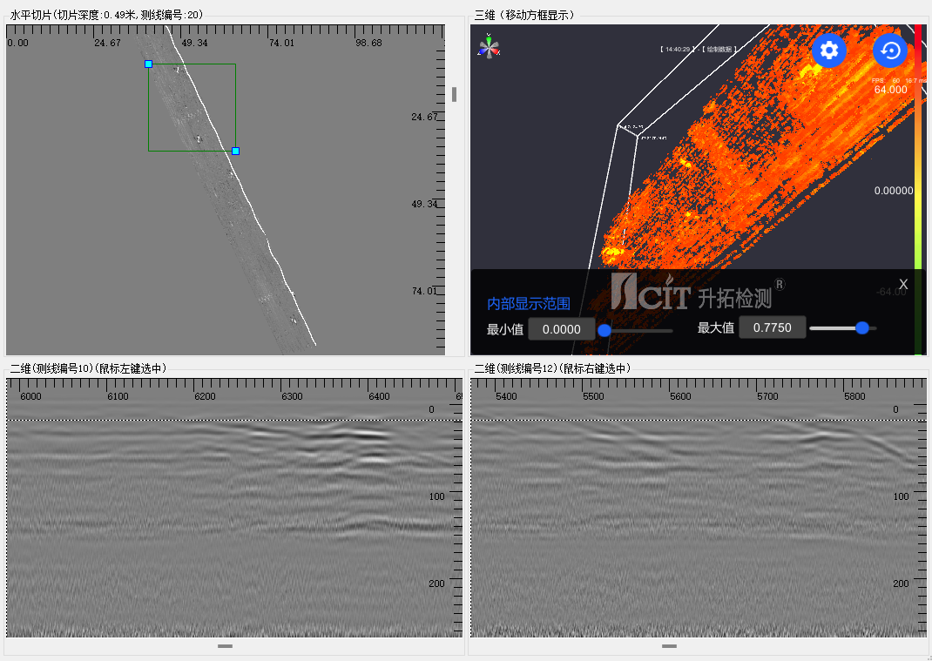
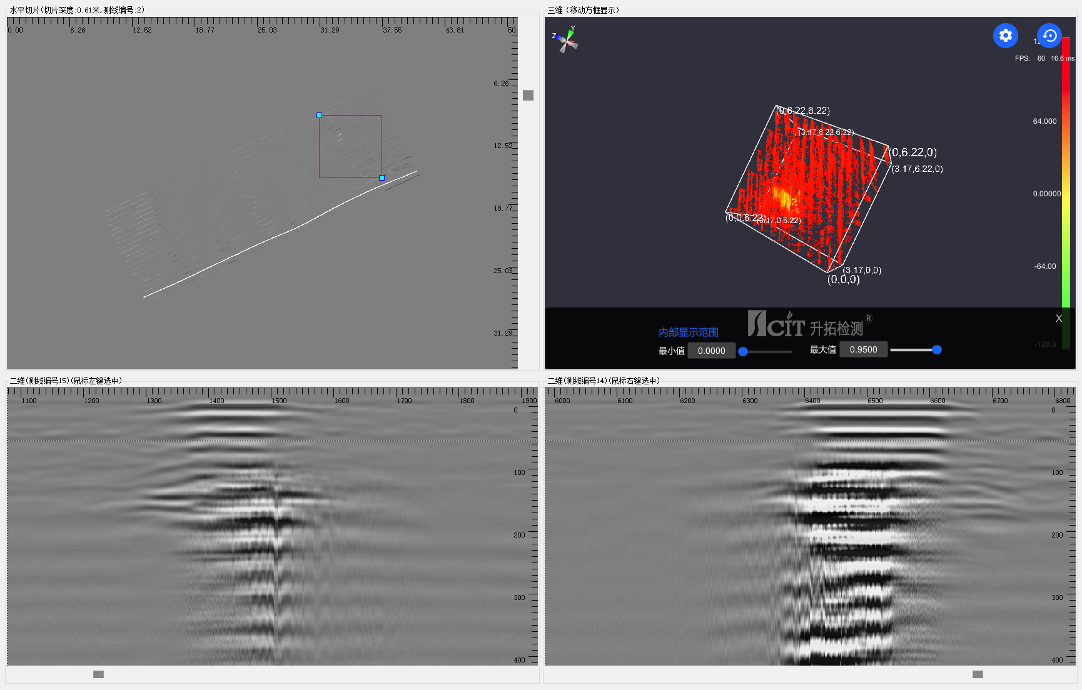
Methods/data
GPR data for road survey:
Three-dimensional images can be synthesized through multiple testing data
Please do not use this space, a QR code will be automatically overlayed
P3.3-89

Slide 5
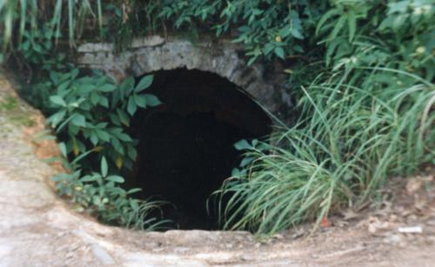
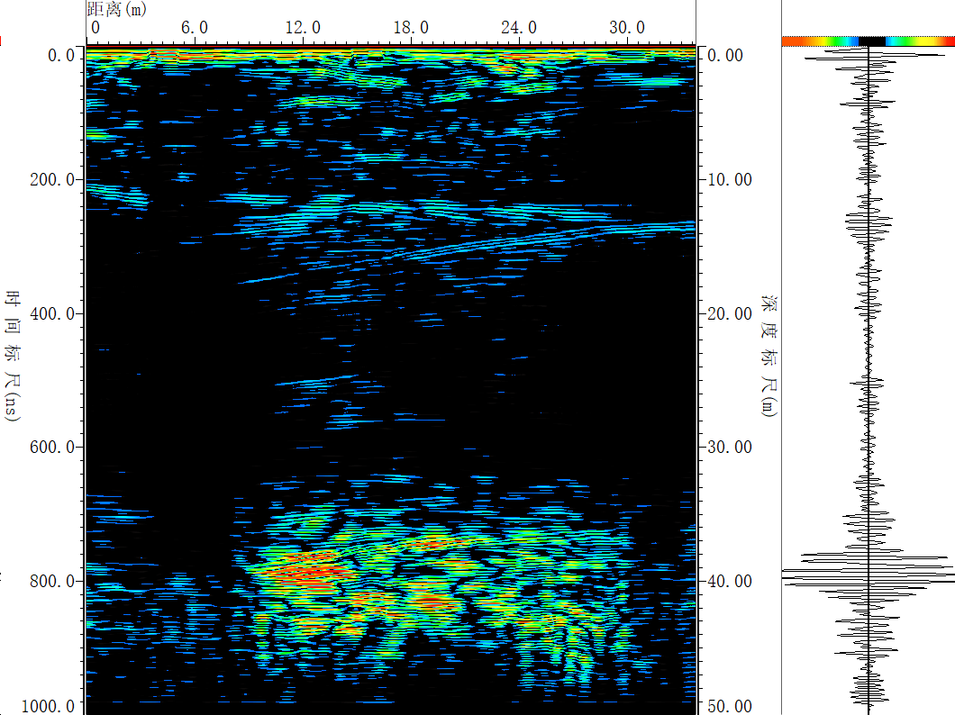
Results
Features and specifications:
Underground facility
Efficient, Accurate, Reliable, H&S of IT assured.
Maximum detection depth is up to 50 meters for different underground targets.
Comprehensive detection by integrating position and image information.
Please do not use this space, a QR code will be automatically overlayed
P3.3-89

Slide 6
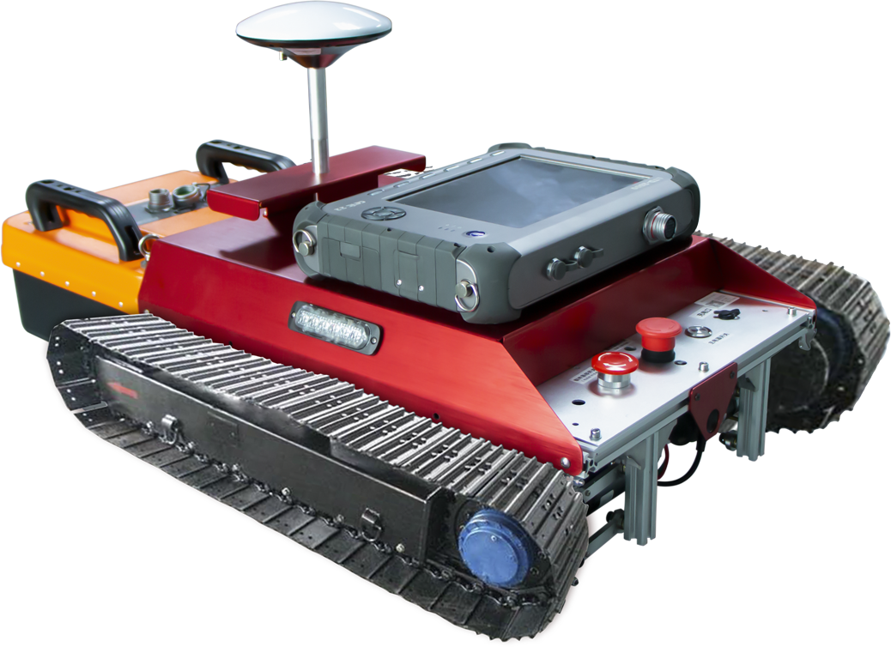
Conclusion
Acknowledge and Outlook
This system has been tested and verified in field.
Automatic, comprehensive and reliable subsurface object detection can be expected.
The adaptability to OSI scenarios needs further customized and optimized.
The system can be suitable for the development of concept of operations during future IFEs and OSI trainings.
Please do not use this space, a QR code will be automatically overlayed
P3.3-89

Slide 7
References
Amalberti, Julien, et al. "Effective GPR detection of land mines through landmine-shaped object extraction." IEEE Transactions on Geoscience and Remote Sensing 54.6 (2016): 3147-3158.
Al-Faraj, Fawwaz A., et al. "Applications of ground penetrating radar in civil engineering: A review." Journal of Environmental Engineering and Landscape Management 27.3 (2019): 204-215.
Please do not use this space, a QR code will be automatically overlayed
P3.3-89

