Slide 1
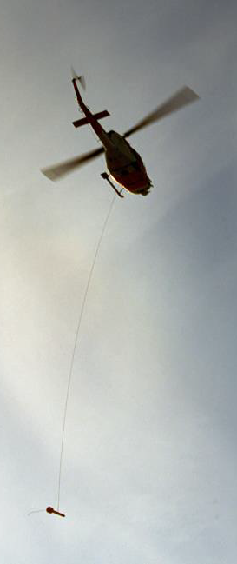
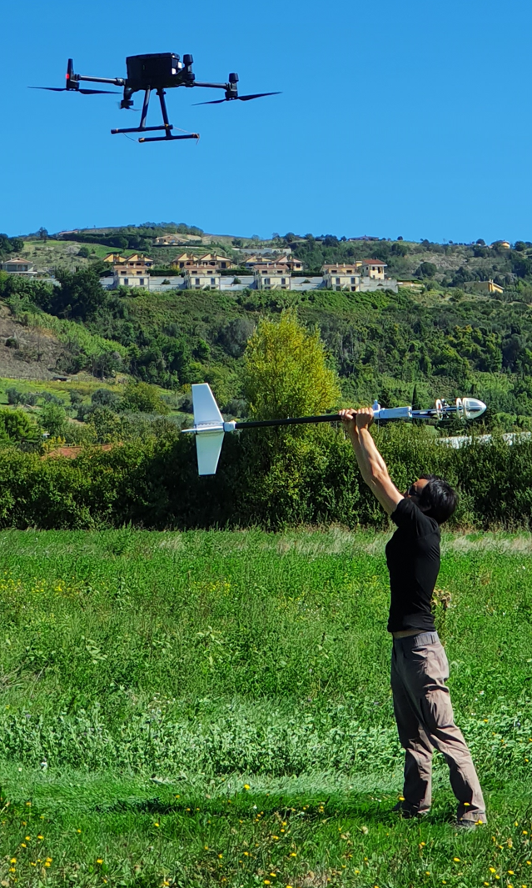
Use of Magnetic Field Mapping for On-Site Inspections: Lessons from Forward Modelling and Multilevel Field Surveys
Luis R. GAYA PIQUE (OSI/EP, CTBTO)
Co-authors: M. CHIAPPINI, I. NICOLOSI, A. PIGNATELLI (INGV); A. ROWLANDS, P. LABAK, E. KOIVISTO (OSI/EP, CTBTO)
P3.3-310
Airborne magnetic surveys may contribute to the detection of underground nuclear explosion observables, but with many caveats.
The use of remotely controlled platforms for near-surface surveys is a valid alternative. Such surveys would be equivalent to conducting a MAG ground survey by an inspector carrying the sensor over the head, but more efficiently and minimizing potential safety risks.
Explore with us the results of a joint project CTBTO-INGV for the further development of magnetic surveys for OSI purposes.

