Slide 1
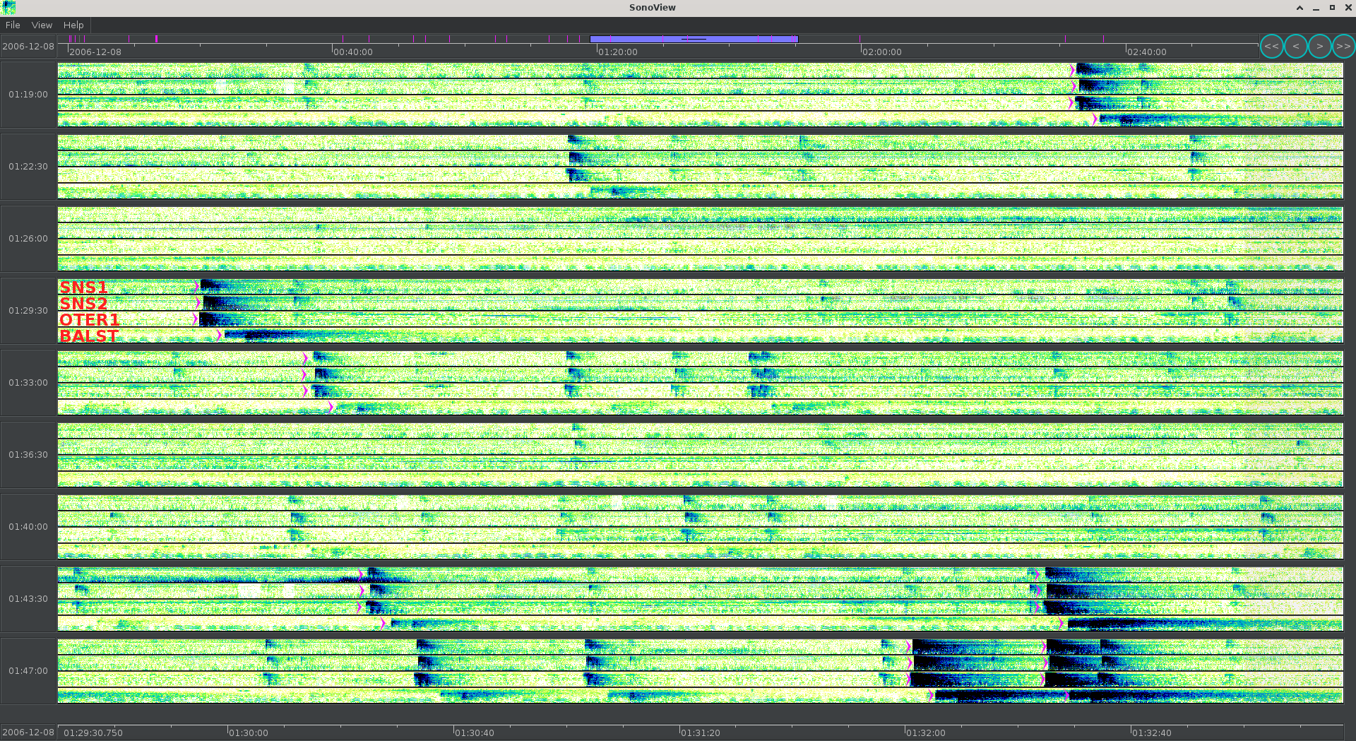
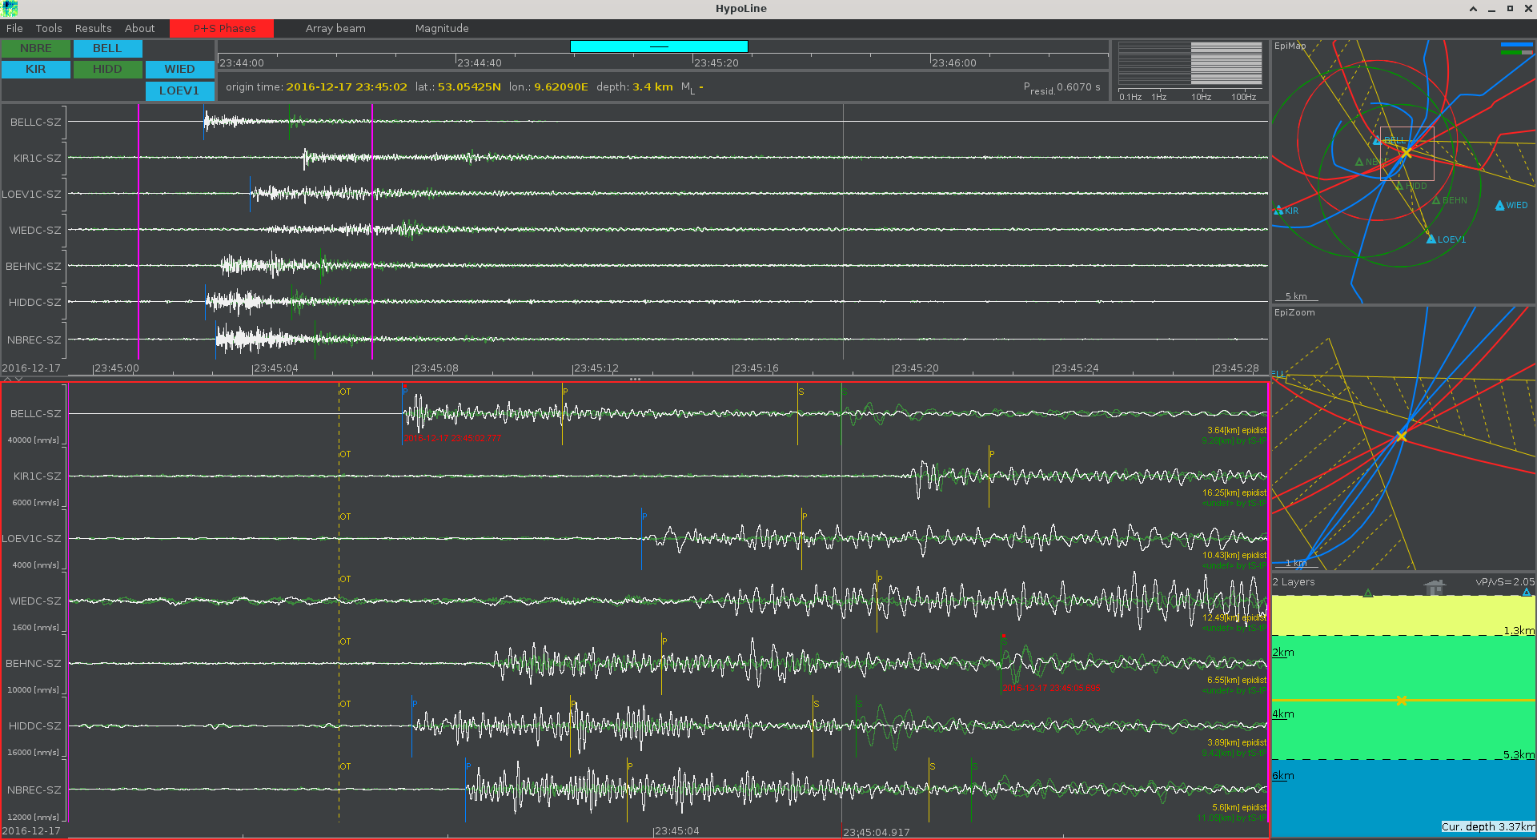
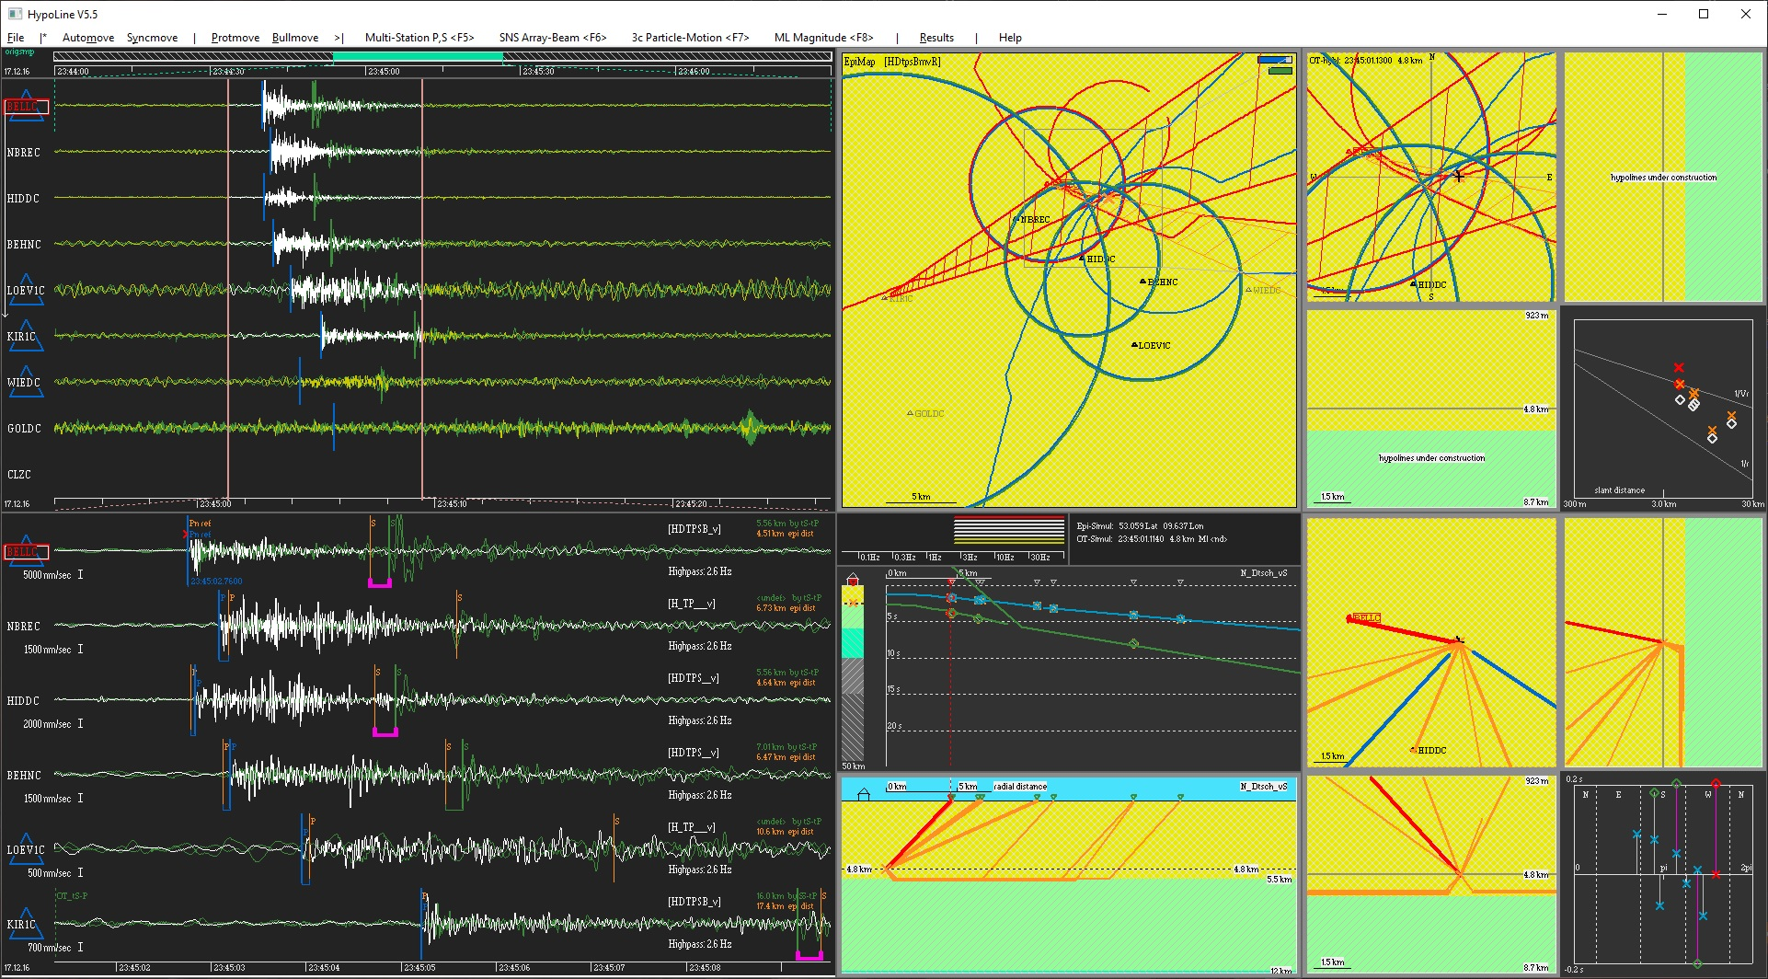
Forensic Seismology for On-Site Inspection and Basic Research:
The Concept of Nanoseismic Monitoring
Joswig, M., M. Walter & R. Häfner
Sonicona GbR, Tübingen, Germany
P3.3-466
Forensic Seismology: Find the unknown, unexpected, non-seismic, …
… by the three software modules of Nanoseismic Monitoring:
SonoView for event detection
HypoLine for event location
HypoLineexpert for in-depth analysis

