Slide 1
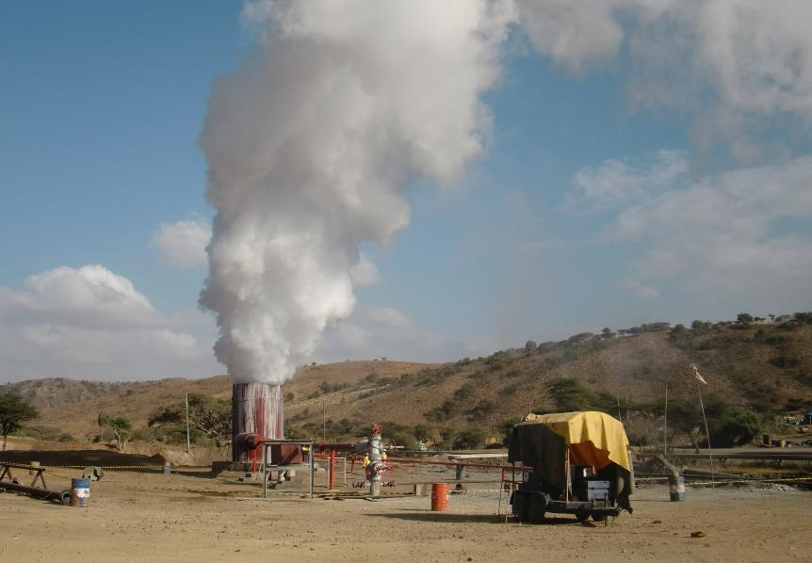
Implications of Geothermal Reservoir Modelling
for On-Site Inspection Drilling
Valentine Wangari, Emilia Koivisto
Dedan Kimathi University of Technology, Kenya; CTBTO, Austria
P3.3-413
Geothermal reservoir modelling is essential for successful development of geothermal fields. By leveraging comprehensive subsurface data, a geothermal reservoir model is used to facilitate informed decision-making, optimization of drilling plans and to ensure safe operations.
Drilling in an OSI setting is largely influenced by time and safety concerns which require drilling to be efficiently planned with accurate target selection.
This poster presents lessons learnt from geothermal reservoir modelling that could be used to aid data-driven decision-making and optimization of the OSI drilling plan.
See Poster P3.3-413

