Slide 1
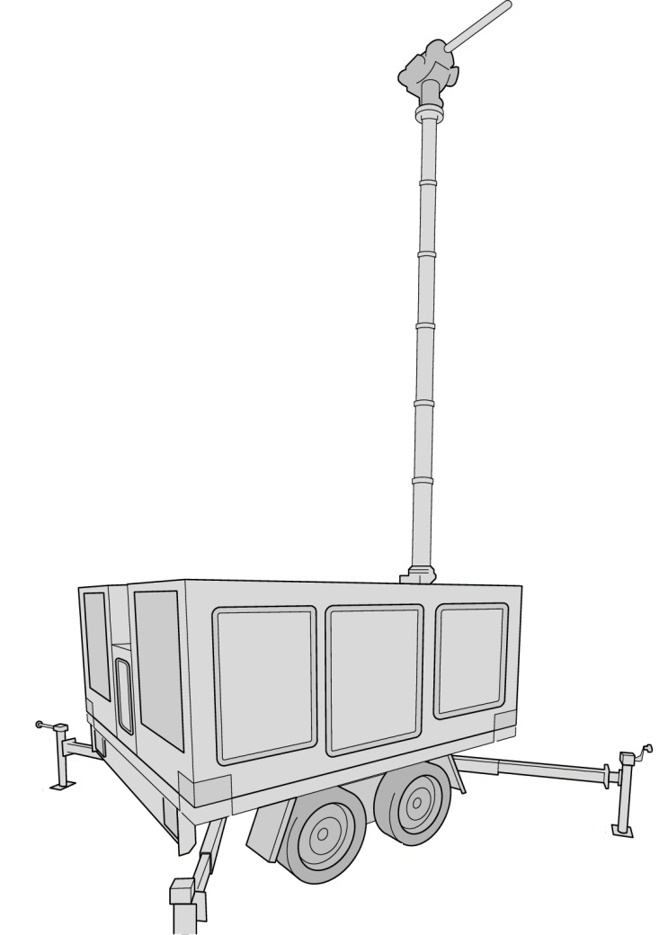
Data Transmission System for On-Site Inspection
Rémi Colbalchini, Aled Rowlands, Emilia Koivisto, Robin Riedmann and Peter Labak
OSI Division, EP Section, CTBTO
P3.3-428
Rapid LTE Network deployment solution with EPC, one eNodeB, multi-suscribers, long transmission coverage
Field robust trailer with mast, housing for equipment
Inspection equipment transmitting data, via modem and SIM-cards
Uninterruptible power supply composed of diesel generator, solar panels, batteries pack
Saving time in data collection and analysis and human resources, crucial parameters of an On-Site Inspection
Visit poster P3.3-428
to find out more!

