Slide 1
Mathematical and Numerical Modeling of the Transient ElectroMagnetic Method
Abdelhalim ZAOUI, ENST, Algiers, Algeria
Fatima KHARROUBI, ENP, Algeria
The Time Domain EectroMagnetics (TDEM) technique is one of the geophysical techniques used in continuation period in On Site Inspection (OSI). This work focuses on the mathematical and numerical modeling of this technique in the aim of computer simulation.
The method is based on the mathematical modeling of the physical phenomenon involved. It is an electrometric model based on Maxwell's equations which describes the propagation of electric currents induced in the ground.
The response calculated as the voltage induced is similar to the response measured in the experiment. In addition, an inversion algorithm is proposed which allows to find the parameters of the sub ground according to the response of the sensor.
The numerical simulation made it possible to predict the response of the sensor. With the treatment of several underground configurations, the expert can acquire a good experience of data interpretation, which is very difficult in the case of a real situation
Please do not use this space, a QR code will be automatically overlayed
P3.3-141

Slide 2
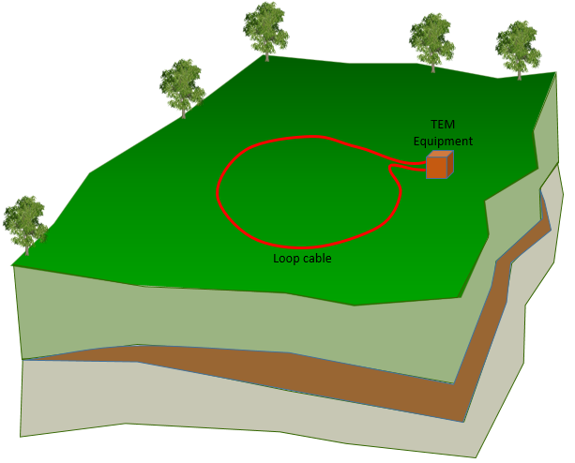
Introduction
Principal of the method :
The Time Domain EectroMagnetics (TDEM) technique is one of the geophysical techniques used in continuation period in On Site Inspection (OSI).
This method uses the phenomenon of scattering of a transient electromagnetic field to determine the electrical resistivity of land as a function of depth.
This transient electromagnetic field is created by the sudden interruption of a current flowing in a transmitter coil placed on the ground.
The transient response is measured by a receiver coil during cutoff.
The depth of investigation, which depends on the geometry used (from the order of one meter to ten kilometers), increases with the time during which the secondary field is measured after the primary field has been cut off.
P3.3-141
Please do not use this space, a QR code will be automatically overlayed

Slide 3
Objectives
This work focuses on the mathematical and numerical modeling of this technique.
Once the mathematical model has been developed, the most appropriate numerical method is chosen to solve the equations of the model.
The numerical simulation made it possible to predict the response of the sensor.
If the simulated model of this technique is inserted into an inversion algorithm based on several test iterations (trial/error), we can find the characteristics of the subsoil according to the response measured in the field.
With the treatment of several underground configurations, the expert can acquire a good experience of data interpretation, which is very difficult in the case of a real situation.
Mathematical and numerical modeling provide great support for the interpretation phase. In the real case, where the inspector has a confusion in the interpretation of the inspection data, he can use the computer simulation to check if his interpretation proposal is correct.
P3.3-141
Please do not use this space, a QR code will be automatically overlayed

Slide 4
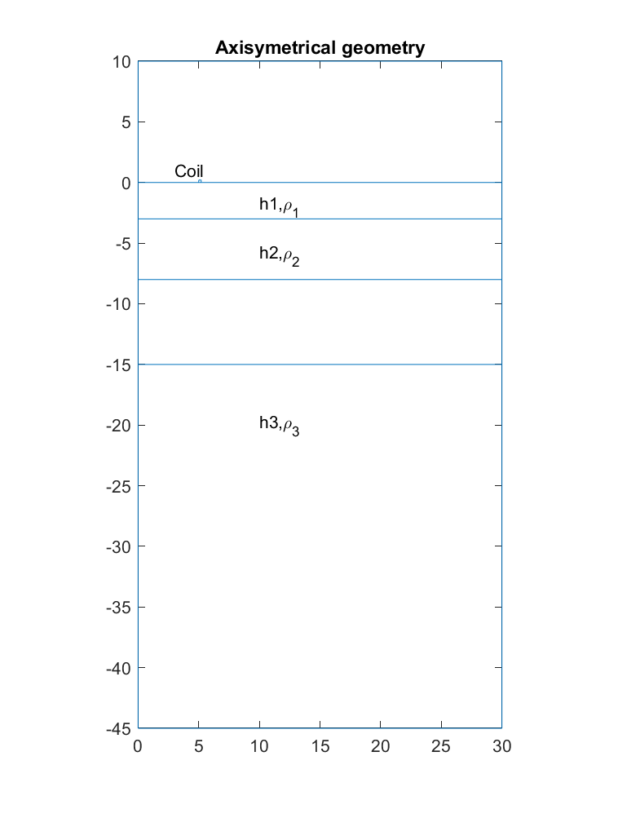
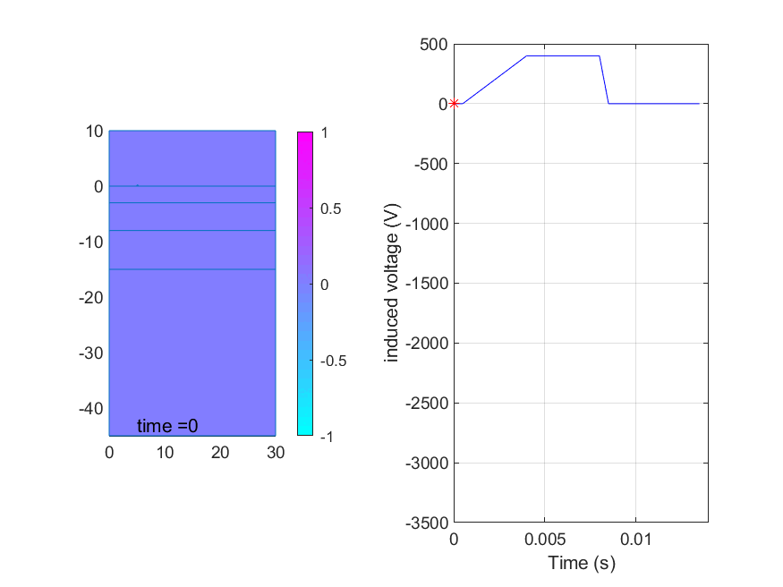
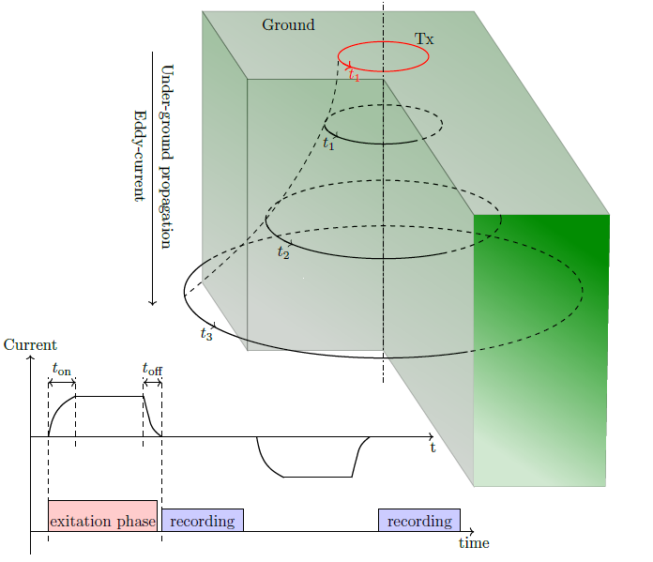
Numerical Simulation Using Finite Element Method
The numerical modeling method is based on the use of the finite element method for the resolution of Maxwell's equation, This method is based on the discretization of the calculation domain into a triangular mesh.
For the simplicity of the problem, the geometry is taken under its cylindrical symmetry which makes it possible to make the problem in two-dimensional.
The data of the problem are the heights and the electrical resistivity of all the underground layers.
Underground Eddy current propagation
P3.3-141
Please do not use this space, a QR code will be automatically overlayed

Slide 5
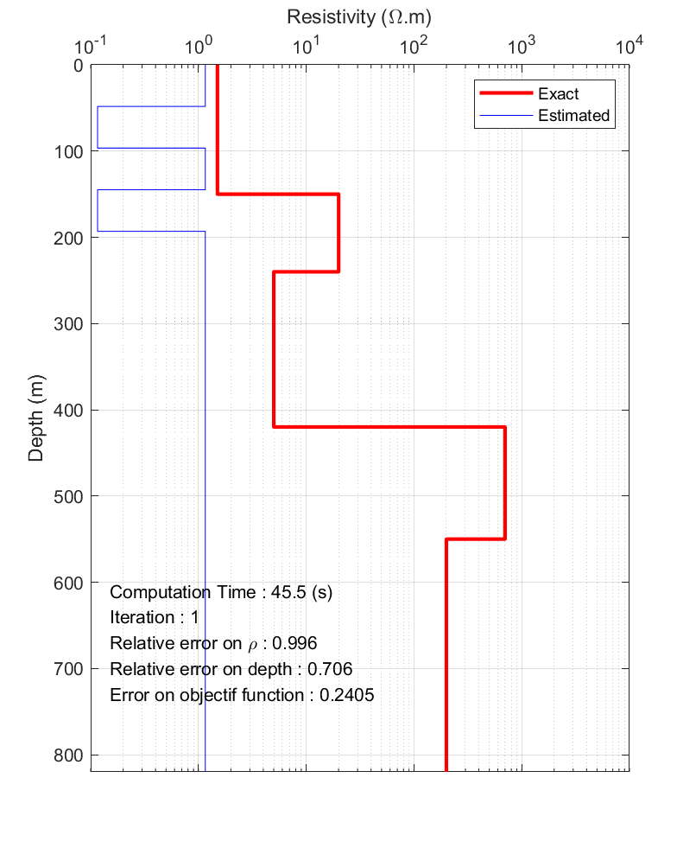
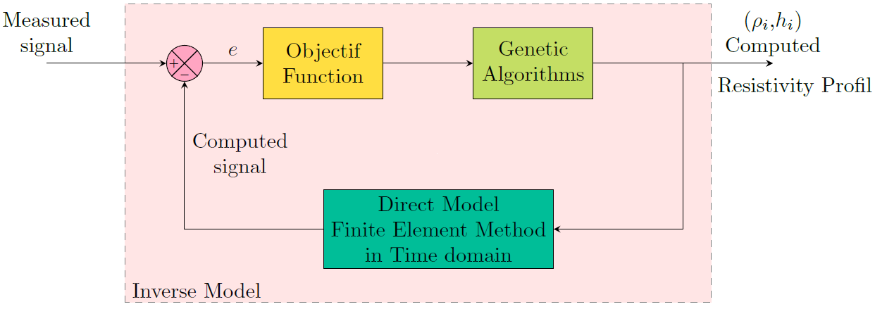
Inverse Model Based on Genetic Algorithms
The inverse model consists in finding the geometric and physical parameters of the soil.
The model is based on an iterative use of the direct model by adjustment of the solution proposals based on genetic algorithms.
The best choice of the underground configuration can be reached after several trials.
P3.3-141
Please do not use this space, a QR code will be automatically overlayed

Slide 6
Conclusion & Perspectives
Conclusion:
Numerical modeling of the physical device a makes it possible to visualize the propagation of induced current in the ground.
The model made it possible to predict the response of the sensor (induced voltage at the terminals of the transmission/reception coil)
This model makes it possible to study the effect of the ground property on the sensor response at a lower cost, thus in the case of OSI it makes it possible to investigate the effect of having a covert underground infrastructure on the sensor response.
The inversion model made it possible to find, from the response measured in the field, the geometric and physical data of the different ground layers.
Perspectives :
Validate the direct model by real measurements
Validated the inversion model refinement of the mathematical model to take into account all the physical aspects of the soil.
The study of the different configurations of the TDEM technique (sensor with separate function transmitter / receiver, mono transmitter / multi receiver,...).
P3.3-141
Please do not use this space, a QR code will be automatically overlayed

Slide 7
References
Nyboe.N.S, Jorgenen.F, «Increased Penetration Depth in TDEM Measuring Using a Segmented receiver coil setup », Near Surface Geophysics, 2009.
Beddou. A, « Apport des méthodes géophysiques dans la caractérisation des sols », Université Aboubekr BELKAID – Tlemcen, Juillet 2012.
Djeddi.M, «cours de prospection Magnétotellurique et électromagnétique» Département de Géophysique (FHC), Université M’Hamed Bougara de Boumerdes. Algérie.04/2015.
McNeill. J. D, « Use of electromagnetic methods for groundwater studies. Ward, S», Geotechnical and Environmental Geophysics: Society of Exploration Geophysicists, IG5 1, pp. 191–218.1990
Benhadda.N, « Modélisation des Capteurs Inductifs à Courants de Foucault ». Mémoire de Magister, Université El Hadj Lakhdar Batna, Septembre 2006.
Sabonnadiere.J.C, Coulomb. J.L, « Calcul des champs électromagnétiques » .Techniques de l’Ingénieur, Ecole Nationale Supérieur d’Ingénieurs Electriciens de Grenoble, France, 1984, (D 3 020-1-20).
Bjerkan. E, «High frequency modeling of power transformers stresses and diagnostics» Doctoral Thesis for the degree of Doctor Ingenior, NTNU Norwegian University of Science and technology, Trondheim, May 2005
P3.3-141
Please do not use this space, a QR code will be automatically overlayed

