Slide 1
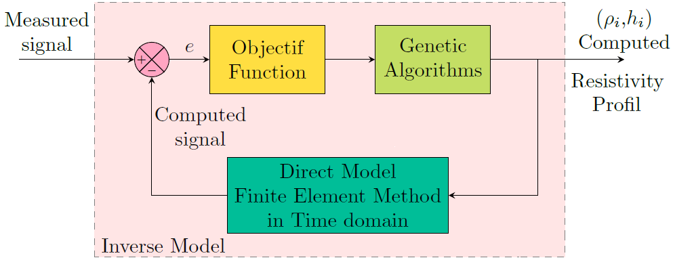
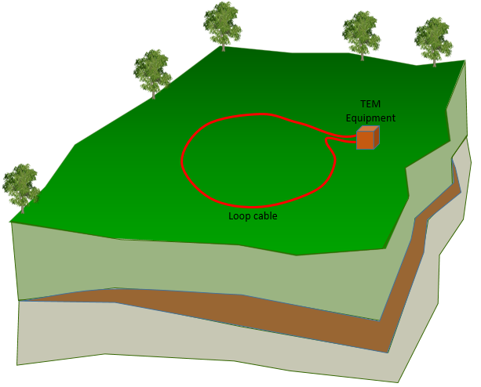
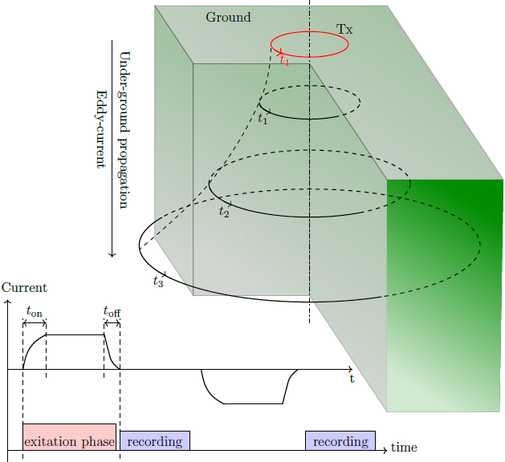
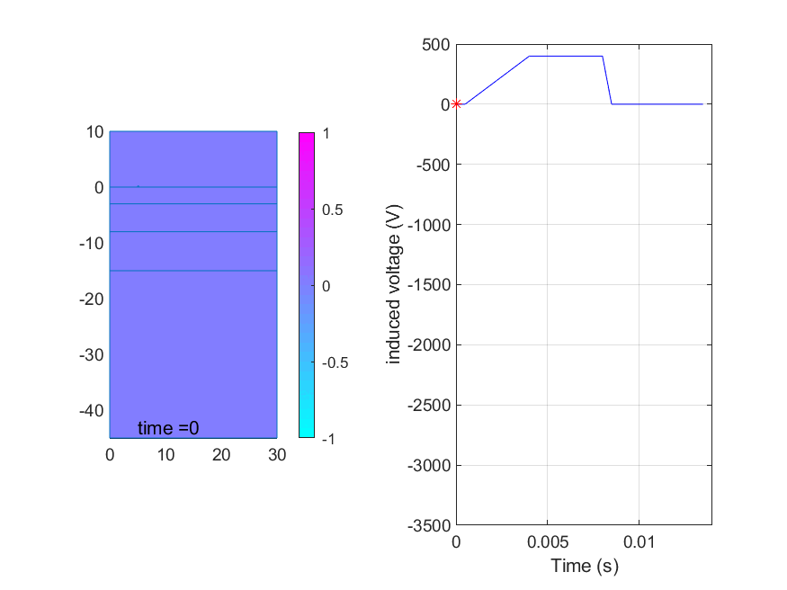
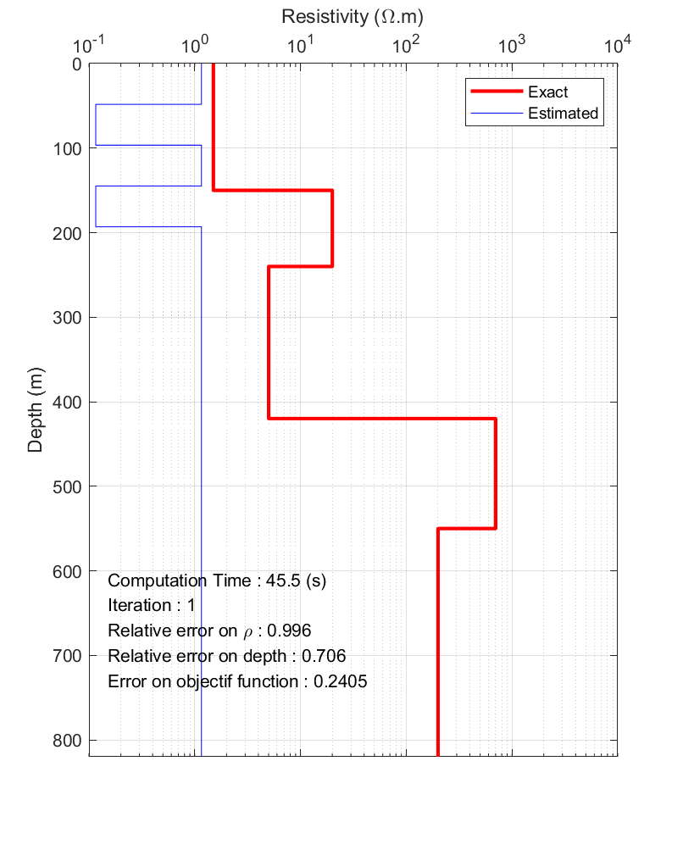
Mathematical and Numerical Modeling of the Transient ElectroMagnetic Method
Abdelhalim ZAOUI, ENST, Algiers, Algeria
Fatima KHARROUBI, ENP, Algeria
P3.3-141
The Time Domain EectroMagnetics (TDEM) technique is one of the geophysical techniques used in continuation period in On Site Inspection (OSI).
This work focuses on the mathematical and numerical modeling of this technique.
Underground Eddy current propagation
If the simulated model of this technique is inserted into an inversion algorithm based on several test iterations (trial/error), we can find the characteristics of the subsoil according to the response measured in the field.
With the processing of several underground configurations, the expert can gain good experience in interpreting the data, which is very difficult, very expensive and time-consuming in the case of a real situation.

