Slide 1
Algorithm-based Approach in Support of Satellite Imagery Analysis for Countering Nuclear Proliferation : Considerations and Challenges
Jae-Jun Han, Gayeon Ha, Minsoo Kim
Korea Institute of Nuclear Nonproliferation and Control
This study presents the implications of applying the algorithm-based approach to analyzing satellite imagery—lessons learned from the Korean national R&D program
Considerations and challenges cover:
Acquisition of satellite imagery (practical availability)
Change detection on computer vision
Interpretation of infrared thermal imagery
Typically one vendor provides less than three images per month available for an area of interest
Change detection is vulnerable due to the off-nadir angle of the satellite, the height of the target
Algorithm-based approach necessarily requires a threshold for defining candidates for targets changed
Integrated (or novel) approach restrictively reduces the burden of analysis work as semi-automatic; however, human interpretation is an essential process for concluding true changes
Temperature information on nuclear-related facilities needs to be organized as reference database
Due to the lack of available images and analysts, a global initiative for jointly interpreting potential nuclear activities is required for countering proliferation activities
Please do not use this space, a QR code will be automatically overlayed
P3.3-839

Slide 2
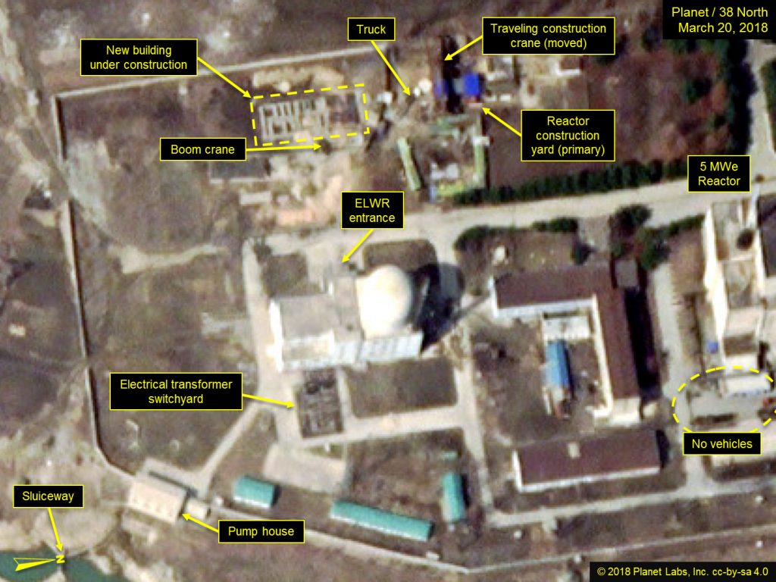
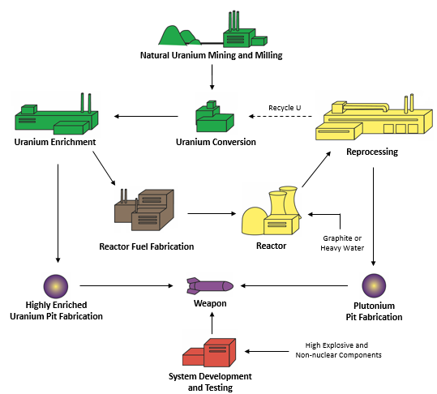
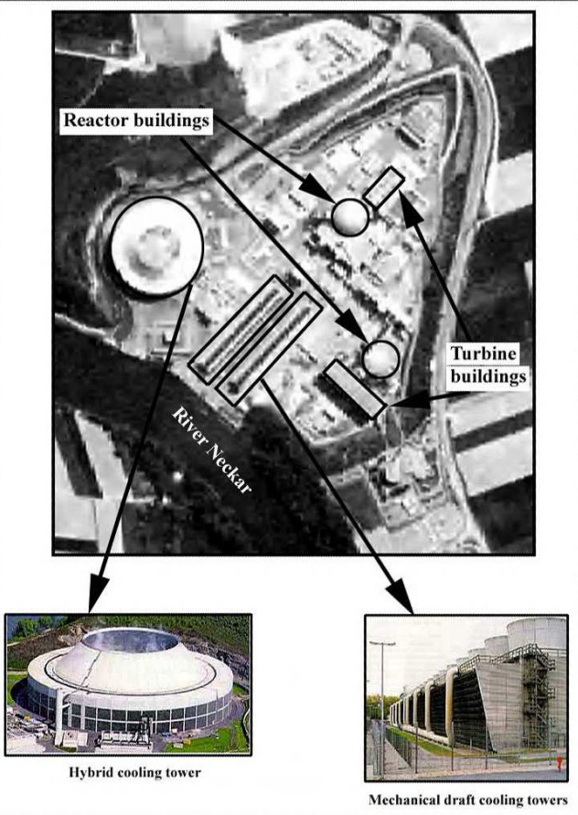
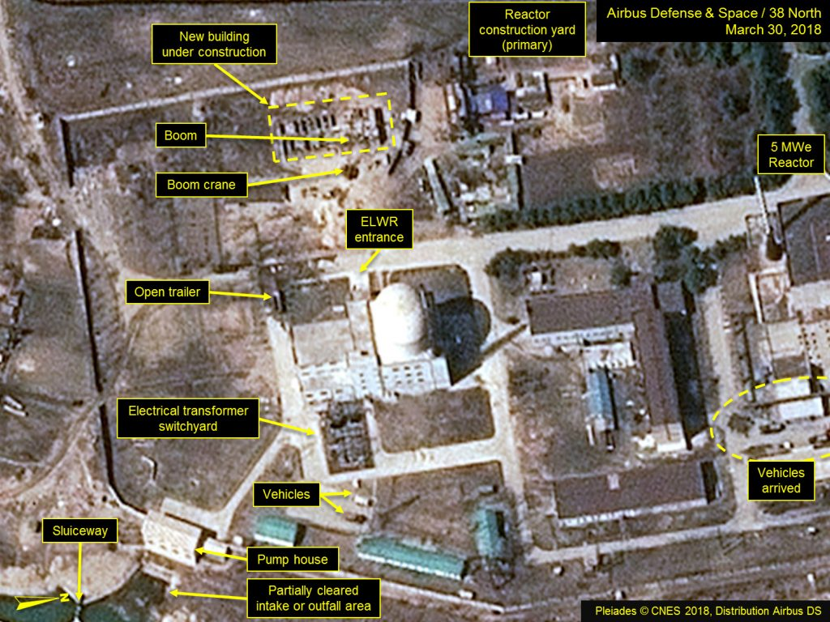
Introduction/Objectives: Satellite Imagery Analysis and Algorithm
Satellite Imagery Analysis for Countering Nuclear Proliferation
For identifying potential nuclear-related activities in restricted access areas, satellite imagery enables to provide information visualization (e.g., electro-optical, thermal)
The imagery analysts who are proficient in the nuclear fuel cycle process and remote sensing are understandably small in number
Algorithm-based approach is required to support the imagery interpretation
Please do not use this space, a QR code will be automatically overlayed
P3.3-839
B Jasani et al, Springer (2009)
KINAC/INSA Training Material (2018)
Excerpt from the 38 North article (4 April 2018)

Slide 3
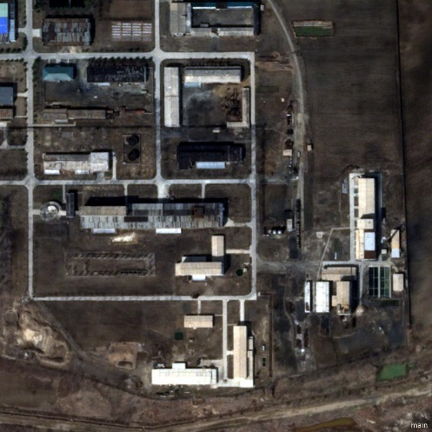
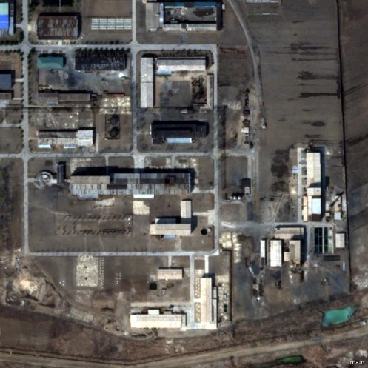
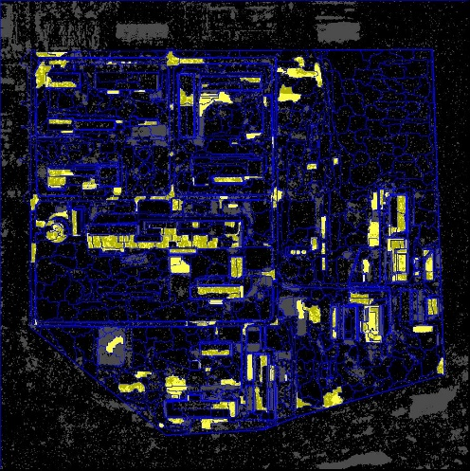
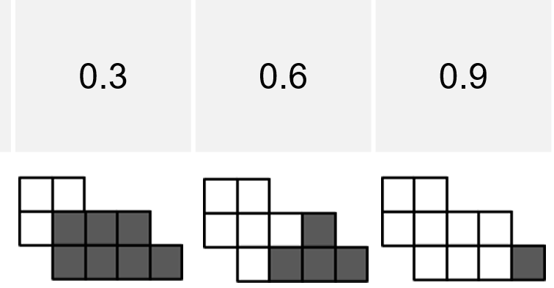
Methods/Data: Image Acquisition and Change Detection
Image Acquisition (electro-optical)
As increasing satellites w/ high spatial resolution (<50cm), satellite observation frequency can be ideally less than 24 h (Ref: I Moric, Science & Global Security 2022)
However, in practical, available images from a vendor at a target area (nuclear-related facility) vary from 1 to 6 per month*, due to the acquisition scheduling and climate conditions
* Derived from Jan 2023 to June 2023 with Maxar, Planet Labs and KARI
Algorithm-based Change Detection
To provide candidates for target change on computer vision, pixel on the screen has to be investigated; pixel change detection is difficult for analysts to identify the changes (so-called salt and pepper effect) → grouping pixels for objects, so-called segmentation, is effective to figure out the potential changes
Ratio of overlapping pixels (threshold) required
Please do not use this space, a QR code will be automatically overlayed
P3.3-839
Time 1
Time 2
Pixel Changes btw 1 & 2
(salt and pepper noise)
w/ Segmentation Algorithm

Slide 4
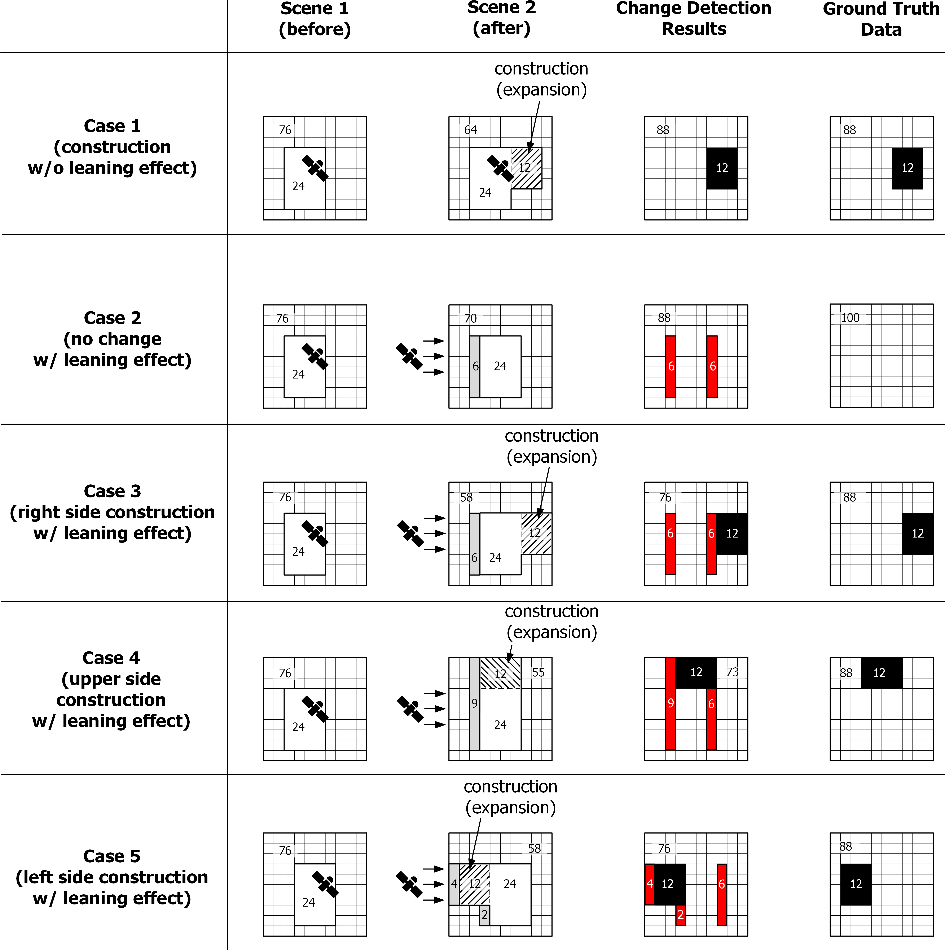
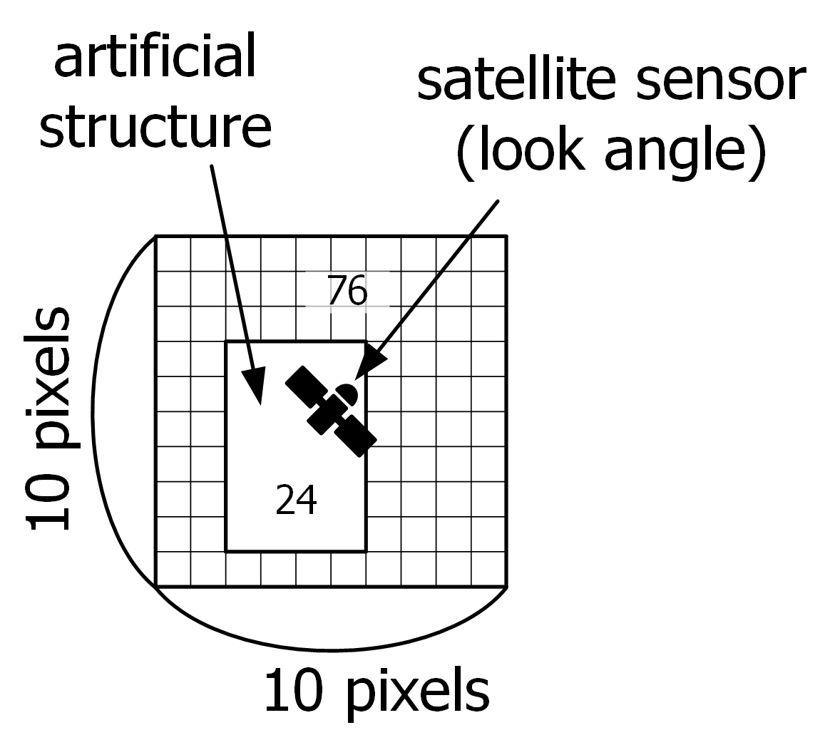
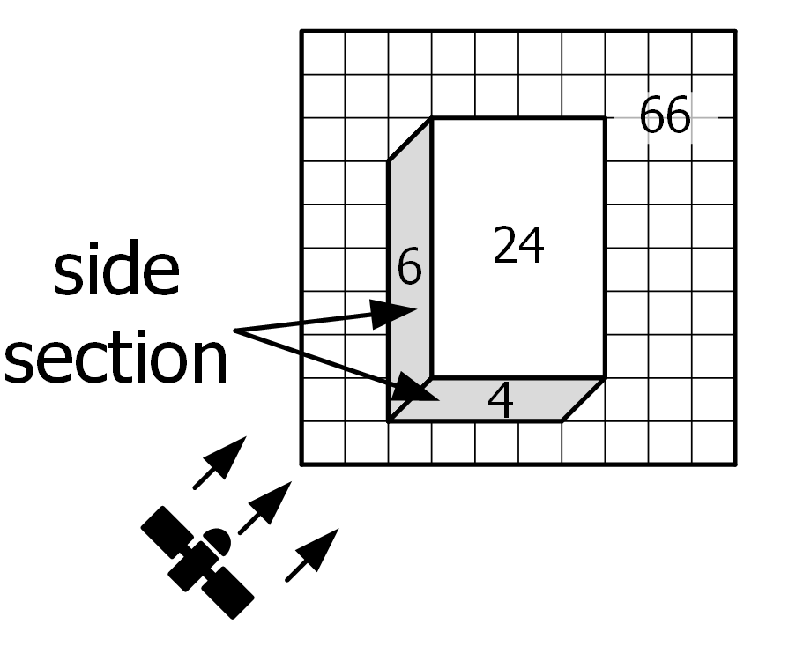
Results: Challenges for Change Detection w/ High Resolution
Structure leaning Effect on Computer Vision
As increasing spatial resolution, the observable scale can be specified; simultaneously, side effects become dominant → minimizing it by SOLI (skeleton-based object linearity index)
true orthoimage (off-nadir angle = 0º)
oblique image (off-nadir angle ≠ 0º)
 | Overall accuracy | Precision (positive predictive value) | Recall (true positive rate) | Fall-out (false positive rate)
Case 1 | 1.00 | 1.00 | 1.00 | 0.00
Case 2 | 0.88 | 0.00 | - | 1.00
Case 3 | 0.88 | 0.50 | 1.00 | 0.50
Case 4 | 0.85 | 0.44 | 1.00 | 0.56
Case 5 | 0.92 | 0.60 | 1.00 | 0.40
Please do not use this space, a QR code will be automatically overlayed
P3.3-839

Slide 5
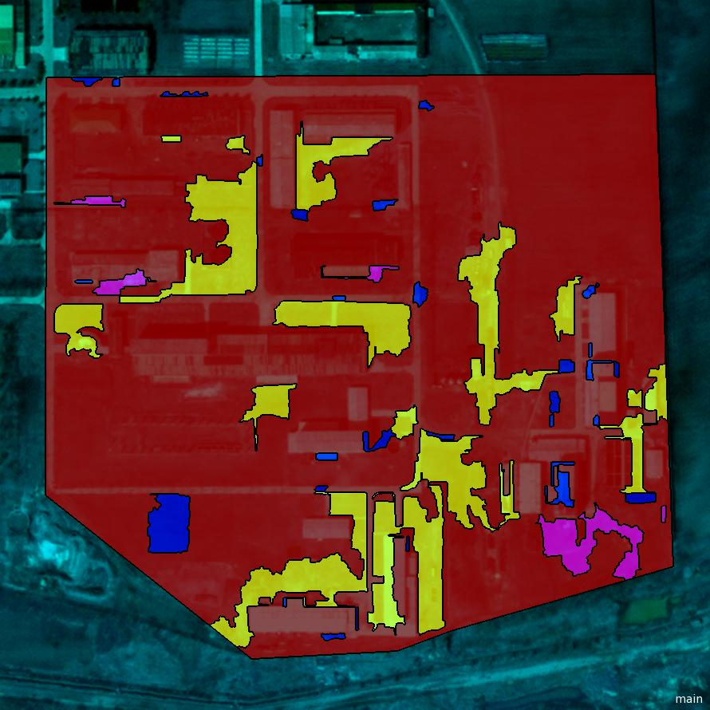
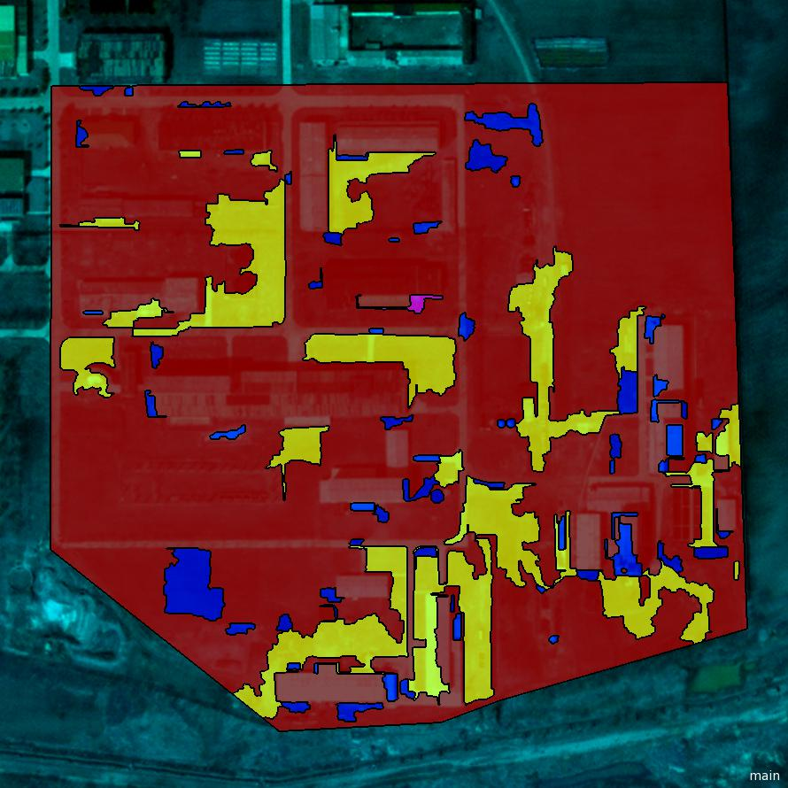
Results: Considerations for the Optimal Algorithm
Optimal Algorithm for Change Detection
(Finding the best threshold)
Legend
 | TP |  | FP
 | FN |  | TN
Correct finding ( ) contains true changes; false detection ( ) and missing changes ( ) are contradictory
The key is how to minimize the number of detected areas ( ) which don’t have pixel(s) of actual change → Never missing changes ( → ), but reducing the redundancy
Complementary methods (e.g., SOLI, SH) were embedded in the algorithm; still for the objective ‘Never missing changes’ comes together ‘redundancy’
Currently available technologies were investigated to develop the optimal change detection system and post-processing is indispensable
It is worth noting that the change detection algorithm provides the visual changes calculated from spectral information and does not correlate potential nuclear activities with the visual changes
Thus, the role of the algorithm is not to replace imagery analysts but to support analysts’ interpretation
High Threshold
Please do not use this space, a QR code will be automatically overlayed
P3.3-839
Low Threshold

Slide 6
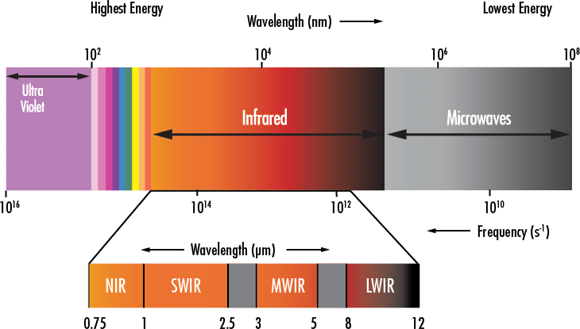
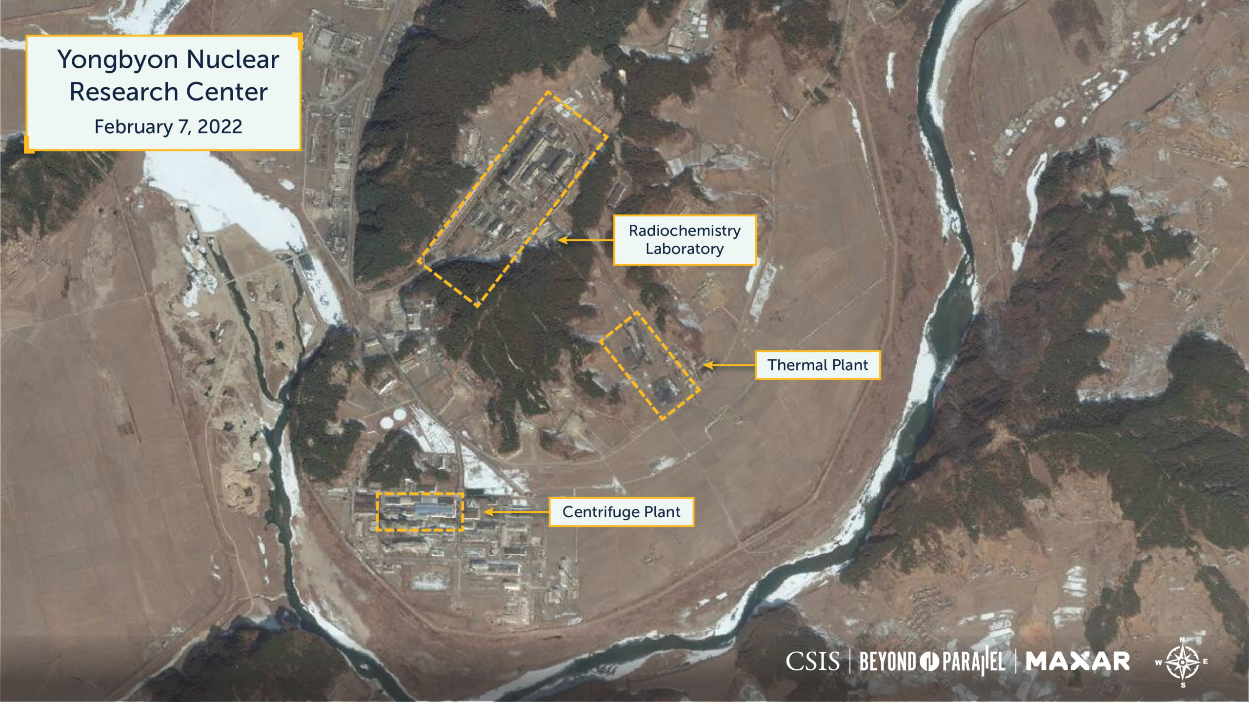
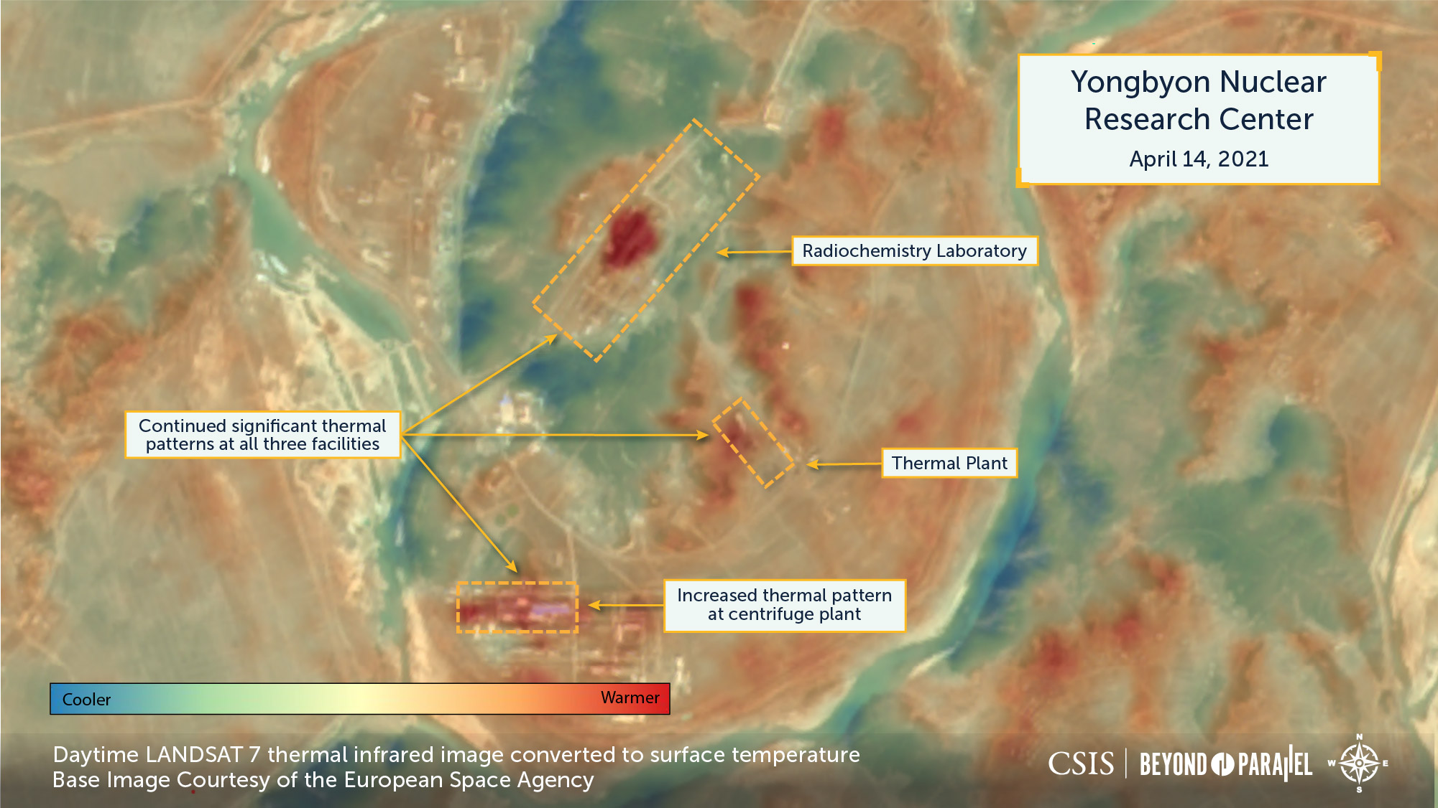
Results: Considerations for the Thermal Imagery Analysis
Reference Temperature Data Required
Source: www.edmundoptics.com
For countering proliferation, for facilities in restricted access areas, all-source analysis (or all-source intelligence) is being carried out which is to utilize all available information to identify unknown phenomena and activities.
Thermal infrared (TIR) satellite imagery provides a useful indicator for identifying potential nuclear activities due to containing temperature information, even though the spatial resolution is lower than electro-optical imagery.
The TIR imagery analyses sometimes refer to figures qualitatively showing higher temperatures than surroundings without reasonable guidelines on whether the nuclear-related facility is operational. They are occasionally cited in the major news media, implying that there is potential nuclear proliferation.
(a)
(b)
Please do not use this space, a QR code will be automatically overlayed
(a) an electro-optical image and (b) a thermal infrared image transparently overlapped with (a) (excerpt from CSIS Beyond Parallel)
P3.3-839

Slide 7
Conclusions
The integrated change detection algorithm, which currently available technology on computer vision was investigated, restrictively reduces the burden of analysis work with implications
Algorithm-based change detection inevitably provides both correct ones (true positive) and redundancy (false positive) due to the off-nadir angle
Thus, human interpretation is an essential process for concluding true changes
Temperature information on nuclear-related facilities needs to be organized as the reference database
In terms of the heat sources, internal to external structures, and materials of the nuclear fuel cycle facilities, reference information (e.g., graphs or lookup tables of external temperature) shall be established by the heat transfer analyses
Since design information for restricted access facilities may not be obtainable, heat source, structure and material information need to be obtained by all-source analysis, determining a range of upper and lower bounds of the temperatures, which can provide a technical baseline.
To sum up, due to the lack of available images and analysts, a global initiative for jointly interpreting potential nuclear activities is required for countering proliferation activities
Please do not use this space, a QR code will be automatically overlayed
P3.3-839

