Slide 1
Improved Design of the On-Site Inspection Field Laboratory
Robin Riedmann, Ashley Davies, Astrid Winkler, Mohamed Ali Nasri, Richard Britton, Xavier Blanchard
CTBTO, Austria; AIT, Austria
This poster addresses improvements for the OSI field laboratory and we present an improved design of the new generation OSI field laboratory proposed for future exercises.
Thermal tests with 30 thermocouples were planned and conducted in 2022 to assess the temperature performance of the prototype flight pods
A large set of temperature profiles at different locations inside and outside the pods and their temporal evolution was obtained and is partly presented here
to achieve a ±2 [°C] maximum temperature fluctuation/variation within 24 hours in the pod(s) rigorous design changes would be required.
Please do not use this space, a QR code will be automatically overlayed
P3.3-634

Slide 2
Introduction
In 2021 the first layout and design of the next generation on-site inspection (OSI) field laboratory was presented (Poster 3.2 -691). It highlighted the requirements, the status and future improvements of the OSI field laboratory for the development of its capability to be rapidly deployed during a CTBT OSI. Here we present some of the improvements for the OSI field laboratory, notably for the installation of the joined two-pod laboratory component setup, insulation of the containers and results of the operation of a SAUNA system inside to process and analyse gas samples for their xenon content.
P3.3-634
Please do not use this space, a QR code will be automatically overlayed

Slide 3
Objectives
To improve the thermal characteristics inside the pods, more information was desired.
For obtaining this information thermal tests were planned and conducted in Q4 2022
P3.3-634
Please do not use this space, a QR code will be automatically overlayed

Slide 4
Methods/Data
two-pod configuration: Thermal test with 30 thermocouples
one-pod configuration: Thermal test with 25 thermocouples in
P3.3-634
Please do not use this space, a QR code will be automatically overlayed

Slide 5
Results
Large thermal fluctuations inside the pods
The floor is of special concern for heat losses
P3.3-634
Please do not use this space, a QR code will be automatically overlayed

Slide 6
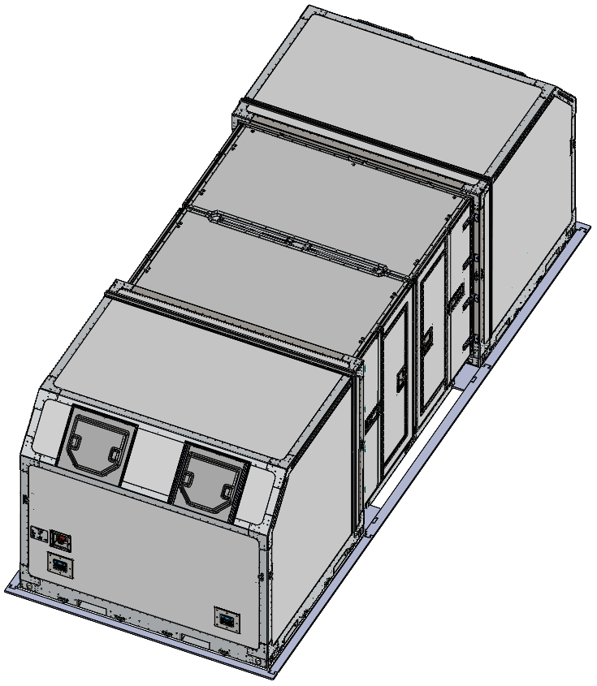
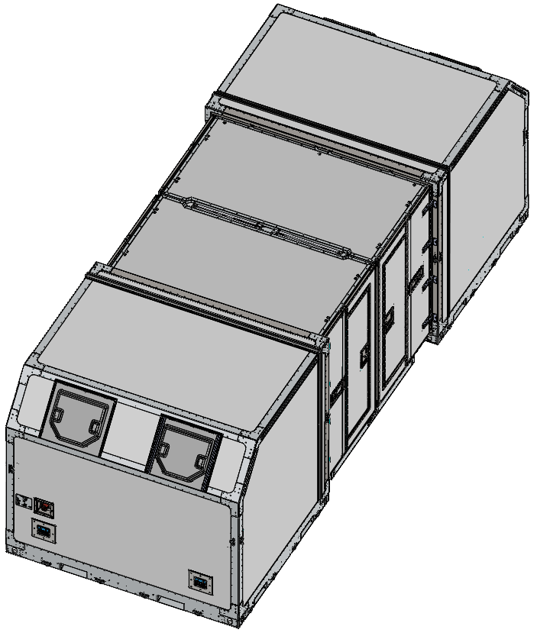
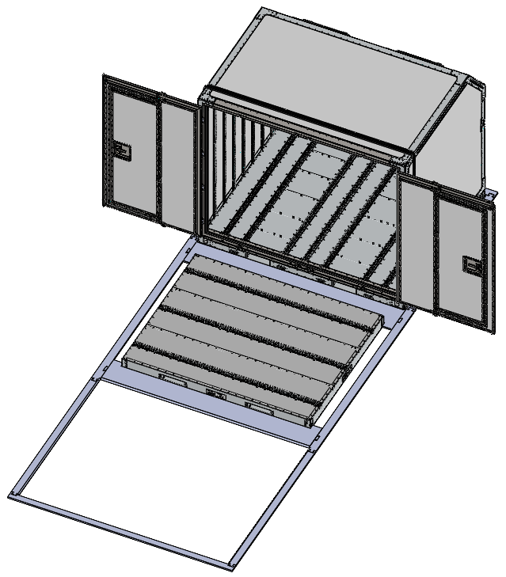
Conclusions - Design
P3.3-634
Please do not use this space, a QR code will be automatically overlayed
guidance pieces will allow easier placement
position 2nd container with door- and roof already opened/deployed.
remove guide pieces

Slide 7
Conclusions
to achieve a ±2 [°C] maximum temperature fluctuation/variation within 24 hours in the pod(s) rigorous design changes will be required
If the ±2 [°C] maximum variation requirement cannot be made less strict, more rigorous changes will be required to the container. Such as:
  Significant improvements required to the control system of the AC. Such as the implementation of a proportional heating/cooling power control, instead of only on/off switching of the AC.
  Much higher airflow rate [m3/h] pumped through the container.
  Ensuring adequate mixing of the air everywhere in the container to ensure uniform temperature.
  Floor and or wall cooling using radiators integrated in the floors and or walls.
  Much better insulation of the floor.
  For the extendibility configuration: much better insulation of the areas that currently are only insulated by the cover
It is recommended that air circulation through the AC and hoses is stopped when cooling/heating is stopped.
P3.3-634
Please do not use this space, a QR code will be automatically overlayed

Slide 8
References
[1] VRR, “CTBTO On-site support report,” 2021.
[2] Demcon, “Test and Analysis Specification 1743.04, CTBTO meeting, version 1.0,” 2021.
[3] FOI, “Upgrade and Further Development of SAUNA Field Report 2 - Definition of infrastructure requirements,” 2018.
[4] Dantherm, “AC-M18 with Heating Service manual Rev. 4.0”.
[5] Zentralanstalt fur Meteorologie und Geodynamik (ZAMG), “Messtationen Zehnminutendaten Seibersdorf,” [Online].
Available: https://data.hub.zamg.ac.at/group/stationsdaten.
[6] Dantherm, RE: Technical questions airconditioning CTBTO containers, Jun 2022.
[7] VRR, “Thermal tests on the DBJ containers of CTBTO”, Oct 2022
[8] VRR, Improvement DBJ containers for CTBTO, Jan 2023
P3.3-634
Please do not use this space, a QR code will be automatically overlayed

