Slide 1
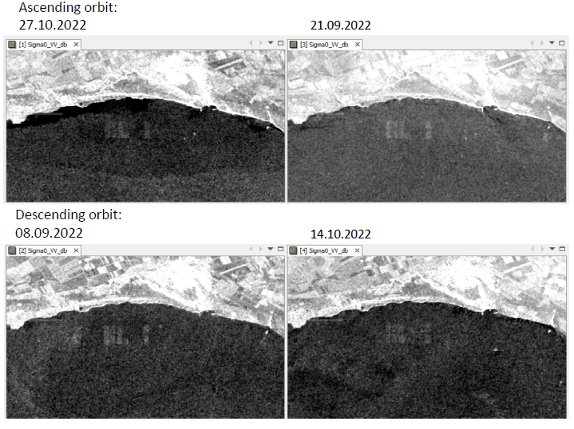
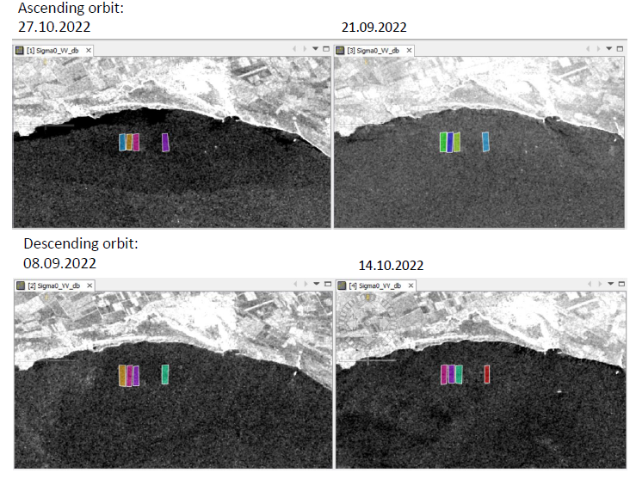
A Quantitative Method for Object Comparison on Synthetic Aperture Radar Satellite Images for Ocean Applications
Irina Gancheva and Elisaveta Peneva
Sofia University St. Kliment Ohridski
P3.3-778
In this study we present a quantitative method for comparing objects, identified on satellite images acquired by Synthetic Aperture Radar.
The method is based on calculation of the Hu image moments.
From the Hu image moments a similarity coefficient can be calculated, which gives a quantitative value for the similarity of different objects (values closer to zero reveal greater similarity).
It is useful for tracking the dispersion of pollution in auqtic areas, such as algae blooms or oil spills when consecutive satellite images of the polluted area are available.
If you want to learn more about this, come see my e-poster during session P3.3-778 on 22 Jun 2023, 10:00 or access it online on the SnT2023 Conference platform!

