Slide 1
A Quantitative Method for Object Comparison on Synthetic Aperture Radar Satellite Images for Ocean Applications
Irina Gancheva and Elisaveta Peneva
Sofia University St. Kliment Ohridski / Faculty of Physics / Department Meteorology and Geophysics
In this study we present a quantitative method for comparing objects, identified on satellite images acquired by Synthetic Aperture Radar.
The method is based on calculation of the Hu image moments.
The satellite images are from the Sentinel-1 mission and are processed with SNAP.
The definition of the Hu moments is given.
The Hu image moments are calculated with the Python library OpenCV.
The 7 Hu image moments are calculated for a set of underwater structures visible on the sea surface. The similarity coefficients between each set of structures, or the distance are calculated.
The presented methodology provides a quantitative objective method for shape comparison.
Please do not use this space, a QR code will be automatically overlayed
P3.3-778

Slide 2
Introduction
Pollution on the sea surface (such as oil spills, algae blooms close to sea surface and other) dampens the natural capillary waves and can become visible on SAR satellite images .
When the pollution is detected on the sea surface we can track the change of its shape by modelling its movement with Lagrangean particle models.
If on another image acquired at later period the pollution is still detectable, we can verify the modelled shape with the actually detected shape.
For this study we propose an objective quantitative method for comparison of detected objects based on the calculation of the Hu image invariants.
As test objects we use four rectangular shapes visible on the sea surface close the Varna bay, in the Western Black Sea region.
The objects are compared by determining a similarity coefficient, calculated from the Hu image moments.
The Hu image moments are set of 7 values, invariant to translation, scale, rotation and reflection. The 7th moment changes its sign for image reflection.
Please do not use this space, a QR code will be automatically overlayed
P3.3-778

Slide 3
Objectives
Aim of this study is to present an objective quantitative method for shape comparison.
We apply the presented methodology on objects detected on SAR satellite images on the sea surface.
The methodology can be extended to other areas, e.g. for pollution monitoring and tracking in marine and aquatic applications; for tracking the change and comparison of land surface objects detected on satellite images; for monitoring of urban areas.
Please do not use this space, a QR code will be automatically overlayed
P3.3-778

Slide 4
Methods and data
The SAR satellite images are from the Sentinel-1 mission and the preprocessing is done with the software SNAP (Sentinel Applications Platform).
The change of the position of the dark objects is determined by calculating the 7 Hu invariants. The invariant values are calculated with the Python library OpenCV
Image moments give a weighted average of image pixel intensities and can be generally calculated as (*) where i and j are positive integers (0, 1, 2,…) and I(x,y) gives the image pixel intensity at position (x,y).
The centroid of a binary (black and white) image gives the center of mass of the image object and they can be calculated with
The central moments of a binary image are similar to the image moments given in equation *, but are defined using the image centroid
i
Please do not use this space, a QR code will be automatically overlayed
P3.3-778

Slide 5
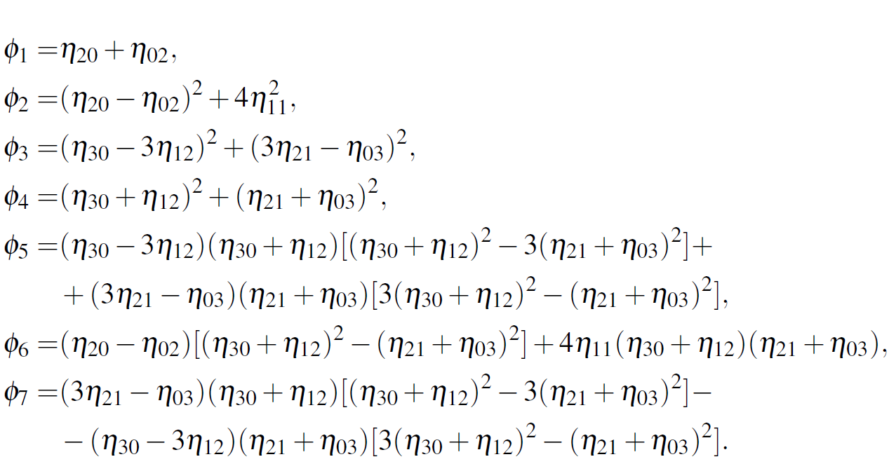
Methods and data
The defined central moments are translation invariant and to make them invariant to scale we should use the normalized central moments:
The seven Hu moments are given by the following formulas, as Hu, 1962:
Please do not use this space, a QR code will be automatically overlayed
Hu, Ming-Kuei. "Visual pattern recognition by moment invariants." IRE transactions on information theory 8.2 (1962): 179-187.
P3.3-778

Slide 6
Methods and data
Using the Hu moments ${\text{ϕ}}_{i}$ we can calculate the logarithmic value Φ_{i} = −sign(${\text{ϕ}}_{i}$) log|${\text{ϕ}}_{i}$|
Based on the 7 Hu moments we can calculate a similarity coefficient, or a distance:
Here A and B stand for the two different sets of structures, which we are comparing and Φ_{i} gives the logarithmic transformed of each of the seven Hu moments.
Values of the similarity coefficient, or distance closer to zero reveal greater similarity between the objects.
Please do not use this space, a QR code will be automatically overlayed
P3.3-778

Slide 7
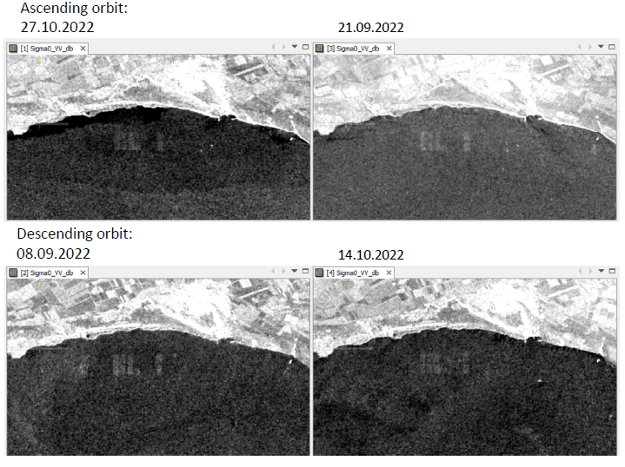
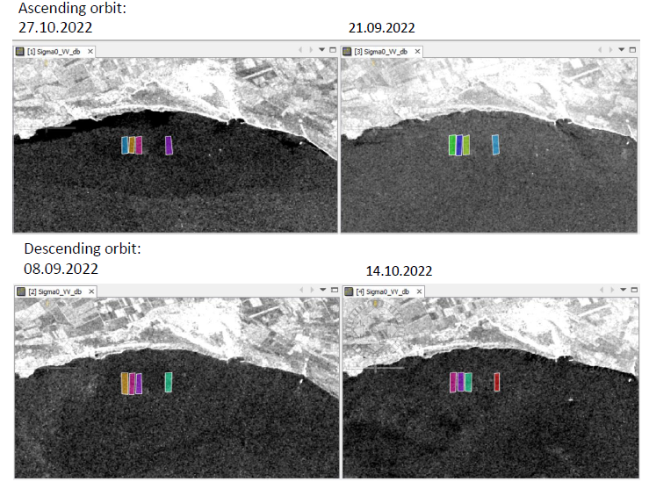
Results
Presented are the images from 4 dates, two acquired in ascending and two in descending orbit. The are structures visible on the sea surface on all 4 images and their boundaries are marked in polygons.
Please do not use this space, a QR code will be automatically overlayed
P3.3-778

Slide 8
Results
The 7 Hu image moments are calculated for all 4 images and the similarity coefficient is calculated for the 6 possible image pairs.
Image date | Hu 1 | Hu 2 | Hu 3 | Hu 4 | Hu 5 | Hu 6 | Hu 7
27.10.2022 | 3.042 | 6.844 | 11.73 | 11.344 | 23.43 | 14.852 | 22.899
21.09.2022 | 3.019 | 6.807 | 11.258 | 10.886 | 22.156 | 14.345 | 22.071
16.08.2022 | 3.041 | 6.818 | 11.542 | 11.025 | 22.504 | 14.484 | 22.423
17.06.2022 | 3.01 | 6.761 | 10.757 | 10.908 | 22.565 | 14.476 | 21.745
Image pairs | Similarity coefficient
27.10.2022 - 21.09.2022 | 0.00762
27.10.2022 - 16.08.2022 | 0.00052
27.10.2022 - 17.06.2022 | 0.01061
21.09.2022 - 16.08.2022 | 0.00715
21.09.2022 - 17.06.2022 | 0.00302
16.08.2022 - 17.06.2022 | 0.0101
Please do not use this space, a QR code will be automatically overlayed
P3.3-778

Slide 9
Conclusion
A methodology for quantitative object comparison is presented. It is based on the Hu image moments, which describe shape transformations, such as translation, scale, rotation and reflection.
Based on the Hu moments we calculate a similarity coefficient, or a distance. The closer the value to zero, the more similar two objects are.
We observe a set of structures detected close the to shoreline of the Western Black Sea basin. The objects are underwater structures which become visible under certain conditions.
We track the change of the underwater structures calculating the Hu image invariants.
The results suggest that there is no significant change over time. The differences are caused by the varying sea conditions.
The calculation of the similarity coefficient suggests that the two acquisitions on 27.10.2022 and 16.08.2022 are most similar. The similarity coefficient for these two study cases is 0.00052.
Please do not use this space, a QR code will be automatically overlayed
P3.3-778

Slide 10
References and acknowledgment
References:
Hu, Ming-Kuei. "Visual pattern recognition by moment invariants." IRE transactions on information theory 8.2 (1962): 179-187.
Acknowledgments
This study is funded by ’Ministry of Education and Science’ of Republic of Bulgaria, project ’Young Scientists and Postdoctoral Researchers’, part 2.
Please do not use this space, a QR code will be automatically overlayed
P3.3-778

