Slide 1
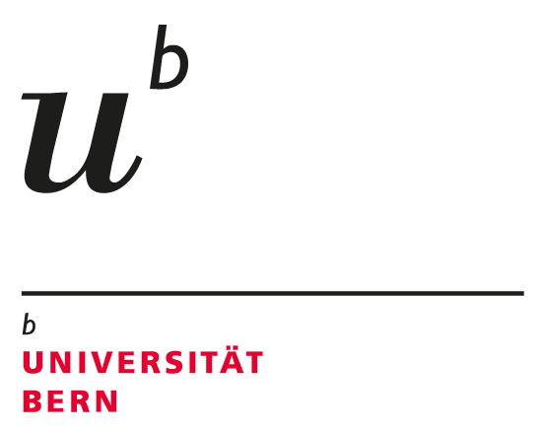
Natural and artificial Ar-37/Ar-39 signatures in the underground
Roland Purtschert & Stéphanie Musy
Climate and Environmental Physics and
Oeschger Center for Climate Change Research,
University of Bern, Sidlerstrasse 5, 3012, Bern, Switzerland
In the case of a UNE, ³⁹Ar and ³⁷Ar are produced by activation reactions on rocks. Because of their different half-lives, the ³⁷Ar/³⁹Ar ratio is a function of the timescale of production (pulsed vs. continuous), the depth-dependent production mechanisms, and the Ca/K ratio of the rocks.
³⁷Ar and ³⁹Ar measurements of 80 groundwater samples in different lithologies were compiled [1]. The measured ratios were compared with theoretical calculations including neutron and muon reactions [2]
Calculated production - and measured ³⁷Ar/³⁹Ar activity ratios for different rock types agree reasonably well, indicating secular production-decay-equilibrium. Pulsed UNE production would result in activity ratios that are three orders of magnitude higher.
³⁷Ar and ³⁹Ar measurements of 80 groundwater samples in different lithologies were compiled [1]. The measured ratios were compared with theoretical calculations including neutron and muon reactions [2]
³⁷Ar/³⁹Ar activity ratios after an UNE in different rock types can now be better estimated and assessed.
Please do not use this space, a QR code will be automatically overlayed
P3.3-458

Slide 2
Introduction
In the case of a UNE, ³⁷Ar and ³⁹Ar are produced in the rock matrix by neutron activation of Ca and K, respectively [1].
The natural ³⁷Ar and ³⁹Ar production rates in rocks are dominated by the same reactions but are also affected by muon-induced reactions. They depend therefore on the depth below the surface [2].
Calculated ³⁷Ar/³⁹Ar natural activity ratios were compared to ratios measured in groundwater samples [3] in different rock formations
The ³⁷Ar/³⁹Ar ratio in the subsurface is a function of the timing of the production (i.e. pulsed vs. continuous), production mechanisms, and the rock composition (mainly Ca/K ratio)
The ³⁷Ar/³⁹Ar ratio can therefore be used as a conclusive indicator of whether a measured ³⁷Ar/³⁹Ar signature is from a recent or ancient UNE, or is from natural origin.
Natural soil samples were collected from a drill core from an alluvial valley in Switzerland. The samples were irradiated with a known neutron flux and emanated Ar-37 was determined
Please do not use this space, a QR code will be automatically overlayed
P3.3-458

Slide 3
Objectives
Characterisation of natural ³⁷Ar/³⁹Ar signatures in different rocks as function of depth underground
Verification of the calculated ³⁷Ar/³⁹Ar ratios by means of measured ratios
Comparison and differentiation of natural ³⁷Ar/³⁹Ar ratios with expected UNE signatures
Please do not use this space, a QR code will be automatically overlayed
P3.3-458

Slide 4
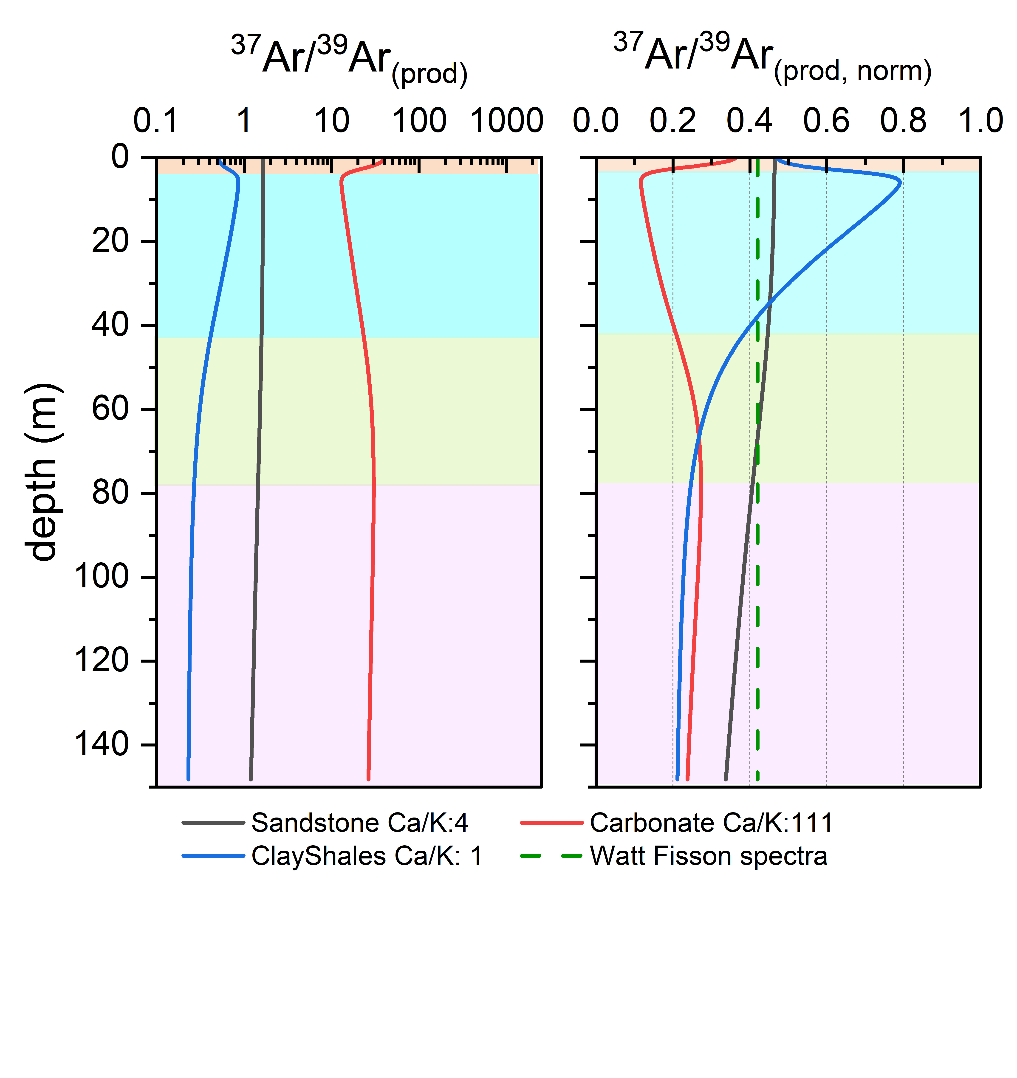
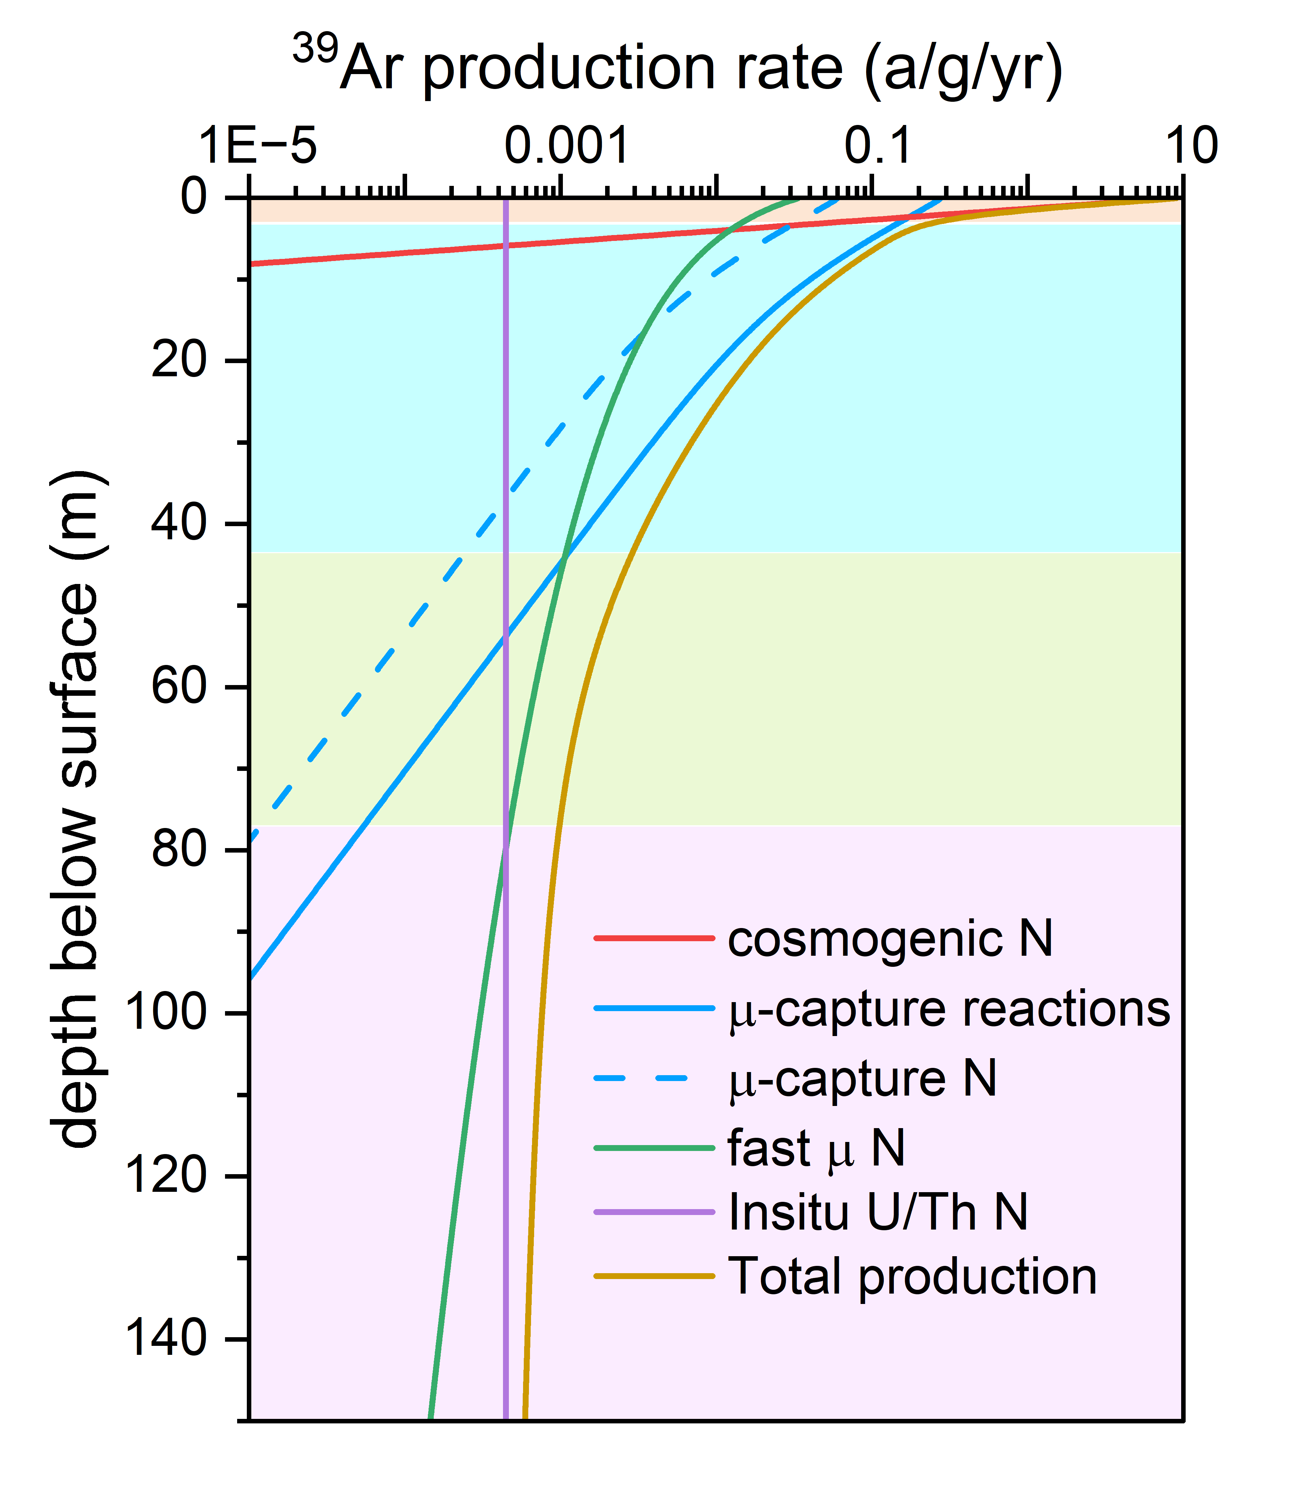
39Ar production in a Sandstone as function of depth for the production reactions considered (Left side).
Methods
Dominance of
Relevant production reactions:
³⁹Ar in sandstone as an example
Depth depended production ratios
b) The Ca/K normalized natural production ratios:
-vary mostly where μ⁻ capture reactions are relevant
are relatively uniform in greater depths (0.2-0.5)
are similar to ratios resulting from a Watt neutron spectra
Stopping μ⁻ reactions
a)
b)
Fast μ induced neurons
[4]
³⁹Ar | ³⁷Ar
Neutron (N) activation reactions
³⁹K(N,p)³⁹Ar | ⁴⁰Ca(N,α)³⁷Ar
⁴²Ca(N,α)³⁹Ar | ³⁹K(N,P2N)³⁷Ar
Muon capture reactions
⁴⁰Ca(µ⁻,p )³⁹Ar | ³⁹K(µ⁻,2N)³⁷Ar
³⁹K(µ⁻,γ)³⁹Ar | ⁴⁰Ca(µ⁻,p2N)³⁷Ar
Please do not use this space, a QR code will be automatically overlayed
a) The production ratios ³⁷Ar/³⁹Ar_{(prod)} depend on rock composition and vary as function of depth. Colours indicate main production reaction vs. depth
P3.3-458

Slide 5
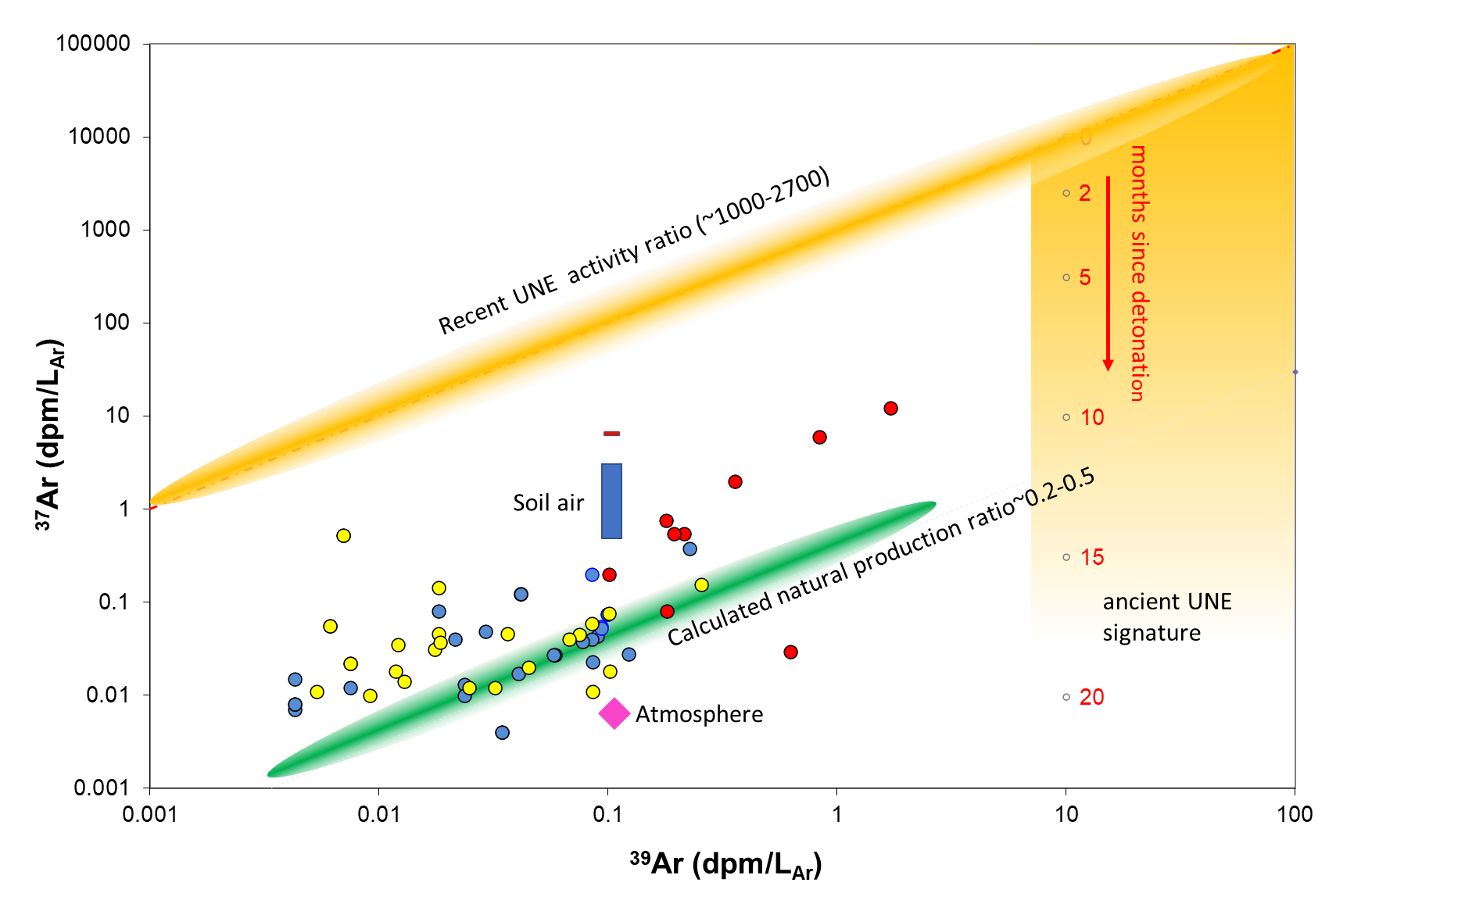
Results
Comparison with data from groundwater
Measured ³⁷Ar/³⁹Ar activity concentrations in old groundwater samples agree reasonably well with the calculated productions activities (i.e. production-decay equilibrium due to the prolonged residence- and production time underground)
The highest natural ³⁹Ar activities observed in groundwater are about 5 dpm/L_{Ar}
Pulsed production (i.e. UNE) results in ³⁷Ar/³⁹Ar activity ratios three order of magnitude higher (factor λ₃₇/λ₃₉)
UNE ³⁷Ar/³⁹Ar activity ratios decay to natural values as a function of time but with residual ³⁹Ar compared to natural levels (> 5dpm/L_{Ar})
³⁷Ar/³⁹Ar activity ratios that are above natural ratios at sites with elevated ³⁹Ar activities inform about the timing of the test carried on.
High-Ca rocks (Limestones)
Sandstones
Crystalline rocks
Please do not use this space, a QR code will be automatically overlayed
³⁷Ar -³⁹Ar activity concentrations (decays per min per L Argon) measured in deep ( > 100 m) groundwaters. Green area: calculated production ratios [2] ; Orange area: elevated activity concentration after a UNE as a function of time (red labels).
P3.3-458

Slide 6
Conclusions and References
Natural ³⁷Ar/³⁹Ar production rate ratios in different rock types and as a function of depth have been calculated
The results are in accordance with activity ratios values measured in gas extracted from old groundwater
Activity ratios after a UNE are expected to be three orders of magnitude higher than natural levels (i.e. ~5000), depending on the rock type surrounding the cavity.
The comparison of measured ³⁷Ar/³⁹Ar ratios and ³⁹Ar activity concentrations with calculated values might be a diagnostic tool for OSI measurements.
References
[1] McIntyre, J.I., et al., (2017) Measurements of Argon-39 at the U20az underground nuclear explosion site. Journal of Environmental Radioactivity 178-179, 28-35.
[2] Musy, S. and Purtschert, R. (2023) Reviewing Ar-39 and Ar-37 underground production in shallow depths with implications for groundwater dating. Science of The Total Environment, 163868.
[3] Purtschert, R. and Althaus, R. (2012) Ar-39 dating of groundwater: How limiting is underground production?, Goldschmidt Conference, Montreal, p. p22f.
[4] Šrámek, O., Stevens, L., McDonough, W.F., Mukhopadhyay, S. and Peterson, R.J. (2017) Subterranean production of neutrons, Ar-39 and Ne-21: Rates and uncertainties. Geochimica et Cosmochimica Acta 196, 370-387.
Please do not use this space, a QR code will be automatically overlayed
P3.3-458

