Slide 1
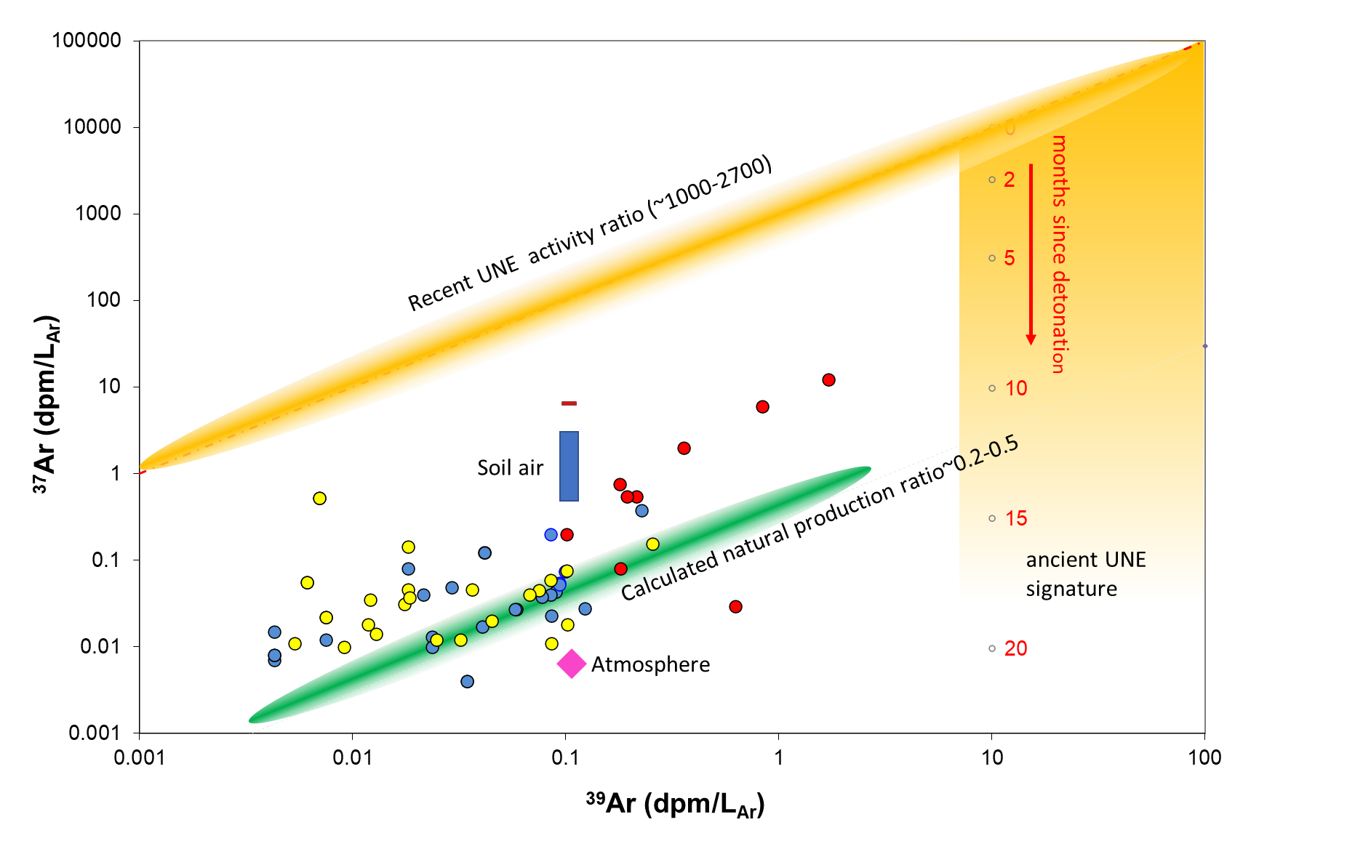
Natural and artificial Ar-37/Ar-39 signatures in the underground
Roland Purtschert & Stéphanie Musy
University of Bern
P3.3-458
Objectives
Characterisation of natural ³⁷Ar/³⁹Ar signatures in different rocks as function of depth underground
Verification of the calculated ³⁷Ar/³⁹Ar ratios by means of measured ratios
Comparison and differentiation between natural ³⁷Ar/³⁹Ar ratios with expected Une signatures

