Slide 1
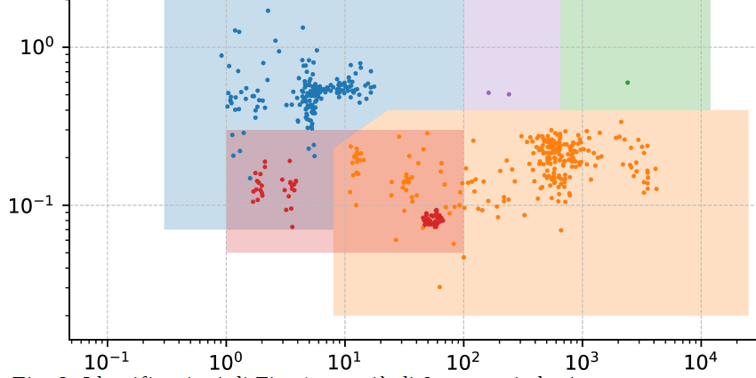
Novel Portable Radioisotope Identification Device for Special Nuclear Material Detection and Characterization
M. Corbo, G. Mangiagalli, M. Morichi, I. Bonesso
CAEN SpA, Italy
P3.3-471
NEUTRONS identification (FAST NEUTRONS) was not implemented until today
NEUTRON SOURCE IDENTIFICATION
Different conditions:
Moderated
Shielded
Masked
Am/Be (red) area is discriminated through a 3rd parameter
UNIQUE CAPABILITIES
Identification of mainly n emitting SNM (WGPu in a lead box) + common gamma masking source (I-131)
International Patent Pending
PCT/IB2021/056349
FAST ASSAY
PROMPT PREPARATION TO ACTION IN CASE OF SNM DETECTION

