Slide 1
Novel Portable Radioisotope Identification Device for Special Nuclear Material Detection and Characterization
M. Corbo, G. Mangiagalli, M. Morichi, I. Bonesso
CAEN SpA, Italy
NUCLEAR SECURITY
AND INSPECTION
TECHNOLOGY OVERVIEW
NEUTRON IDENTIFICATION
CAPABILITIES
EXCEEDING THE REFERENCE
STANDARD
USE CASE SCENARIOS
Please do not use this space, a QR code will be automatically overlayed
P3.3-471

Slide 2
INTRODUCTION: NUCLEAR SECURITY
AND INSPECTION
Passive detection systems are needed for nucelar security use, to maintain safety conditions and to avoid any interference with working procedures:
Fast response and short time measurement
Versatile and simple to use
Gamma detection/counting is the minimum requirement
Gamma Spectroscopy identification is an added value
Neutron detection/counting is a plus
Neutrons identification (Fast Neutrons) was not implemented until today
Please do not use this space, a QR code will be automatically overlayed
P3.3-471

Slide 3
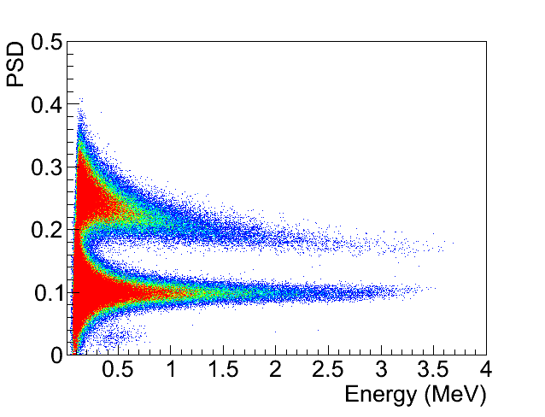
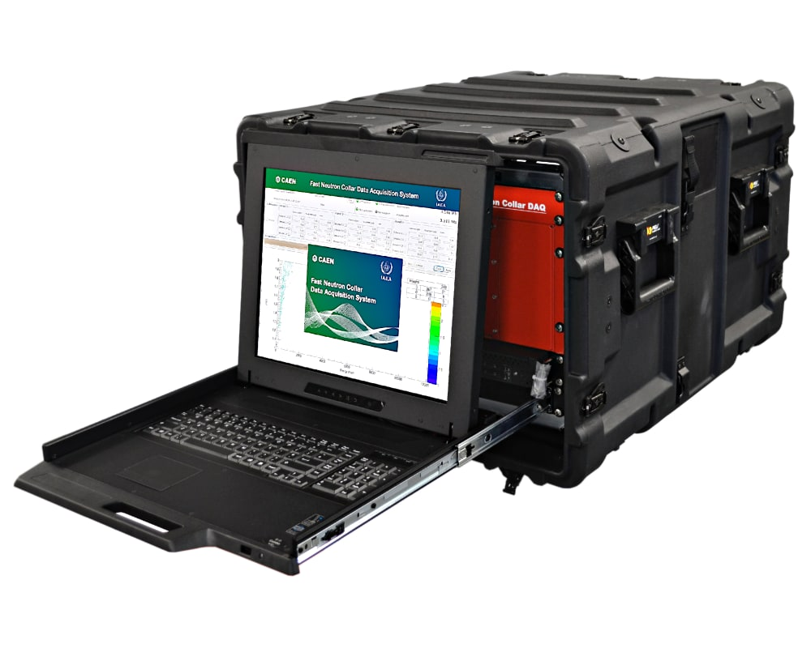
OBJECTIVES: TECHNOLOGY OVERVIEW
Passive detection systems used for security control in safety conditions and to avoid any interference with working procedures:
Fast response and Short time measurement
Versatile and simple to use
GAMMA detection/counting is the minimum requirement
GAMMA Spectroscopy identification is an added value
NEUTRON detection/counting is a plus
GAMMA SPECTROSCOPY
Equipped with mid-resolution (<4,0% @662 keV) gamma detector
Peaks search in the spectrum to identify gamma nuclides
GAMMA/NEUTRON COUNTING
High-efficiency gamma/neutron organic detector
Pulse Shape Discrimination algorithm
Gamma peak search is used also in neutron source identification algorithm
Enhance/correct the SNM identification
Enrichment level estimation
NEUTRONS identification (FAST NEUTRONS) was not implemented until today
** same Pulse Shape Discrimination (PSD) implemented in the IAEA Fast Neutron Collar Monitor (fresh fuel verification) [2]
Please do not use this space, a QR code will be automatically overlayed
P3.3-471

Slide 4
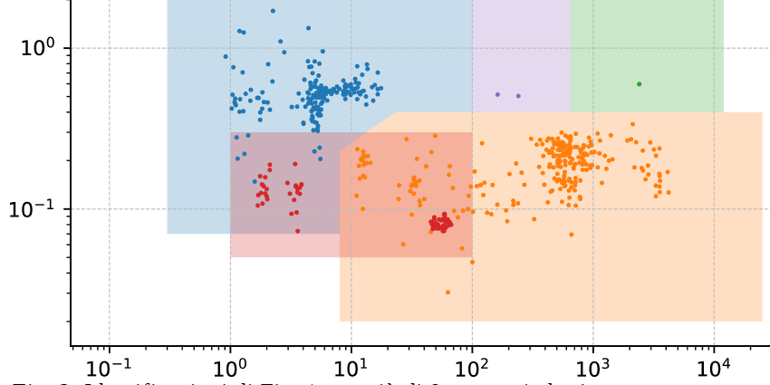
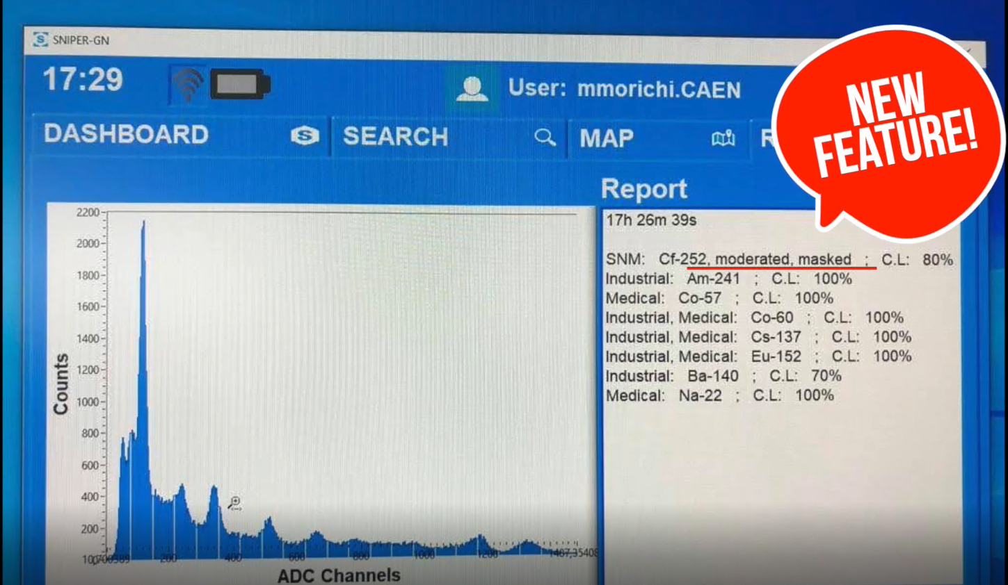
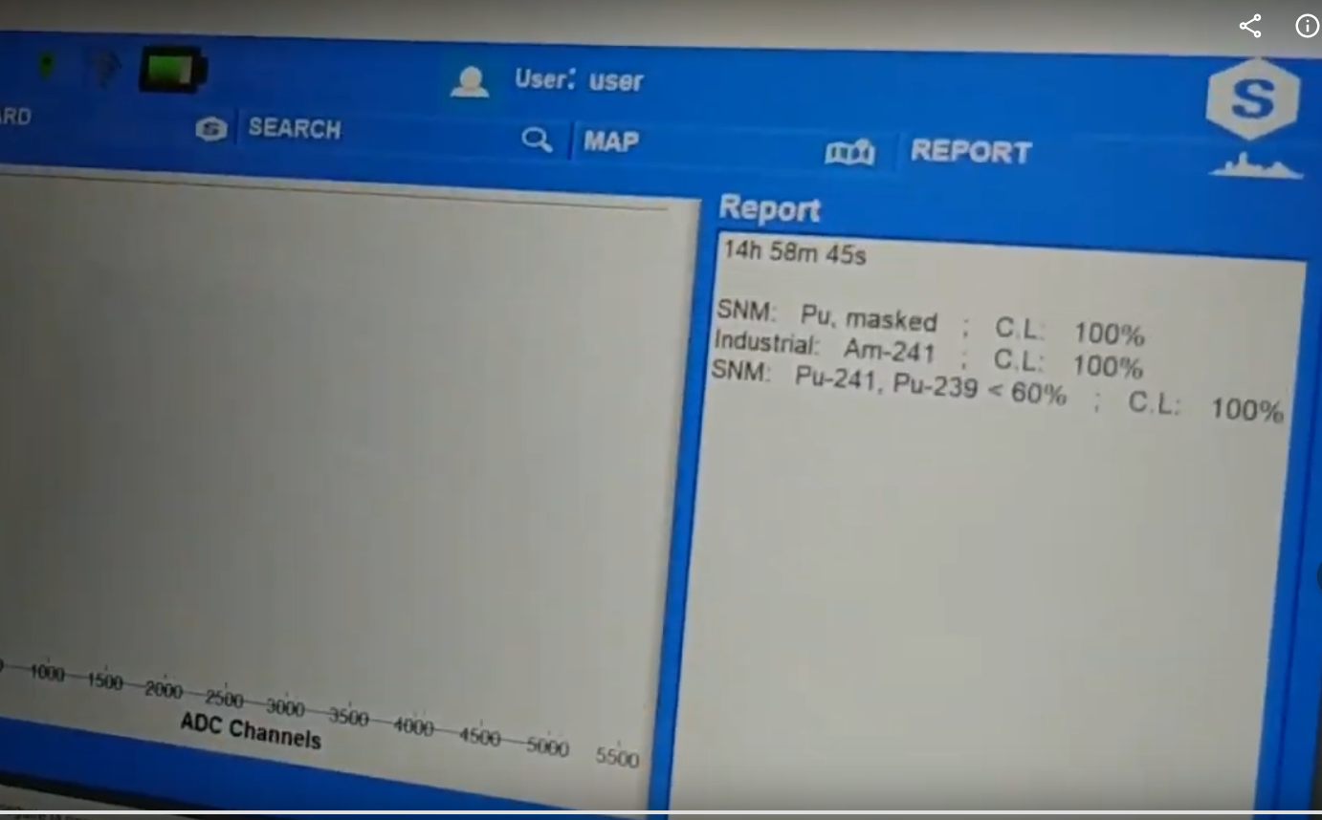
METHODS: NEUTRON IDENTIFICATION
CAPABILITIES
NEUTRON SOURCE IDENTIFICATION
Different conditions:
Moderated
Shielded
Masked
Am/Be (red) area is discriminated through a 3rd parameter
Passive detection systems used for security control in safety conditions and to avoid any interference with working procedures:
Fast response and Short time measurement
Versatile and simple to use
GAMMA detection/counting is the minimum requirement
GAMMA Spectroscopy identification is an added value
NEUTRON detection/counting is a plus
International Patent Pending
PCT/IB2021/056349
Identification of mainly n emitting SNM (WGPu in lead box) + common gamma masking sources
NEUTRONS identification (FAST NEUTRONS) was not implemented until today
Please do not use this space, a QR code will be automatically overlayed
P3.3-471

Slide 5
RESULTS: EXCEEDING THE REFERENCE
STANDARD
ANSI N42.53 – 2013
Backpack Based Radiation Detection Systems Used for Homeland Security
gamma alarm (4 ± 5%) photons/(cm²s) moving at 1,2 m/s @ 1m)
2 s for neutron alarm (²⁵²Cf 20.000 n/s) moving at 1,2 m/s @1,5 m
1 min or anything stated by the manufacturer to ID isotopes (GAMMA ONLY)
NEUTRON SOURCES: Cf-252, Am-Be
NEUTRON SOURCES: PU-239 75% ENRICHED
Please do not use this space, a QR code will be automatically overlayed
See reference [1]
P3.3-471

Slide 6
CONCLUSION: USE CASE SCENARIOS
UNIQUE CAPABILITIES
Identification of mainly n emitting SNM (WGPu in a lead box) + common gamma masking source (I-131)
SCENARIOSES
Orphan source characterization
Search and ID of SNM in industrial facilities
Characterization of suspicious goods Characterization of legacy samples for destructive analysis
FAST ASSAY
PROMPT PREPARATION TO ACTION IN CASE OF SNM DETECTION
Please do not use this space, a QR code will be automatically overlayed
P3.3-471

Slide 7
REFERENCES
[1] Special Nuclear Material Identification Through One-Minute Measurement with a New Backpack Radiation Device in Real Scenario Conditions, https://doi.org/10.18280/ijsse.110416
[2] Beaumont, J.S., Lee, T.H., Mayorov, M. et al. A fast-neutron coincidence collar using liquid scintillators for fresh fuel verification. J Radioanal Nucl Chem 314, 803–812 (2017). https://doi.org/10.1007/s10967-017-5412-x
Please do not use this space, a QR code will be automatically overlayed
P3.3-471

