Slide 1
Investigation of Nuclear Test Sites by Satellite Imagery
Enton Bedini
Email: bedini07607@itc.nl
&
Satellite imagery is a powerful tool to monitor compliance of States Parties with the Comprehensive Nuclear-Test Ban Treaty (CTBT). Satellite imagery can be used by the States Parties as one of the national technical means of CTBT verification.
In this study, satellite imagery of a number of sites of underground nuclear tests that have been carried out by USA, ex-USSR, China, India, Pakistan, and People's Republic of Korea are analyzed.
The moderate spatial resolution imagery accurately detected areas of surface disturbance due to the nuclear tests.
However, low yield tests may not produce surface expression detectable by the satellite imagery. In these cases, high spatial resolution imagery is useful to monitor activities that may be related to a nuclear testing event.
Please do not use this space, a QR code will be automatically overlayed
P3.3-144

Slide 2
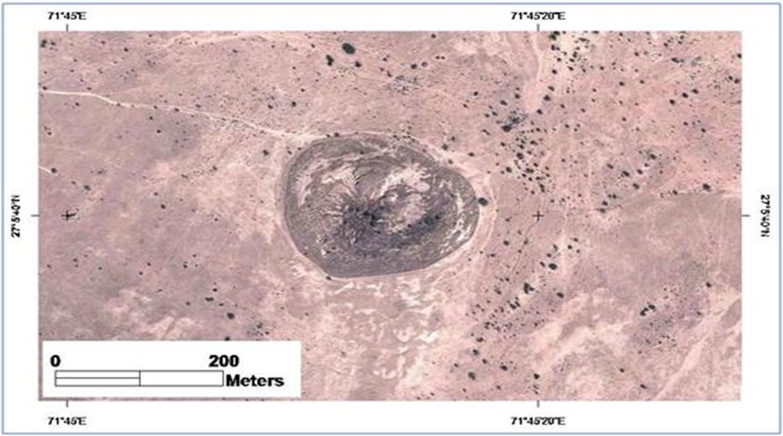
Introduction
The Comprehensive Nuclear-Test-Ban Treaty (CTBT) that has not yet entered into force, recognizes the use of remote sensing technology for the CTBT verification as part of the National Technical Means and during On-Site Inspection activities.
Very high spatial resolution satellite imagery is usually used to investigate an area of an alleged nuclear test explosion. However, because the precise location of this area may not be known, the use of medium spatial resolution imagery could initially be helpful for a wider "view".
Pokhran I was a single underground nuclear test conducted by India on May 18, 1974. The crater created by the explosion is still visible today on high spatial resolution satellite imagery.
Please do not use this space, a QR code will be automatically overlayed
P3.3-144

Slide 3
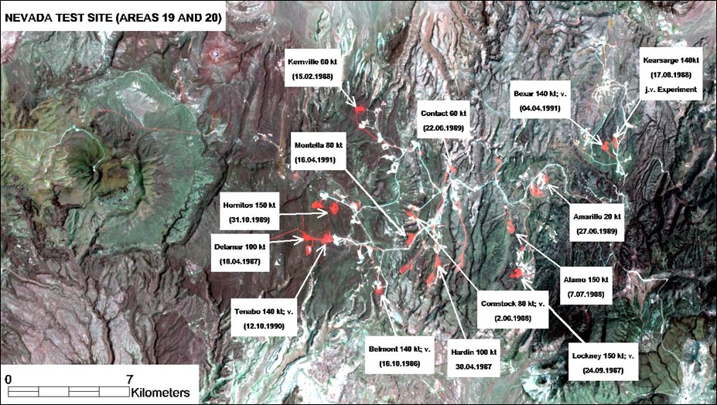
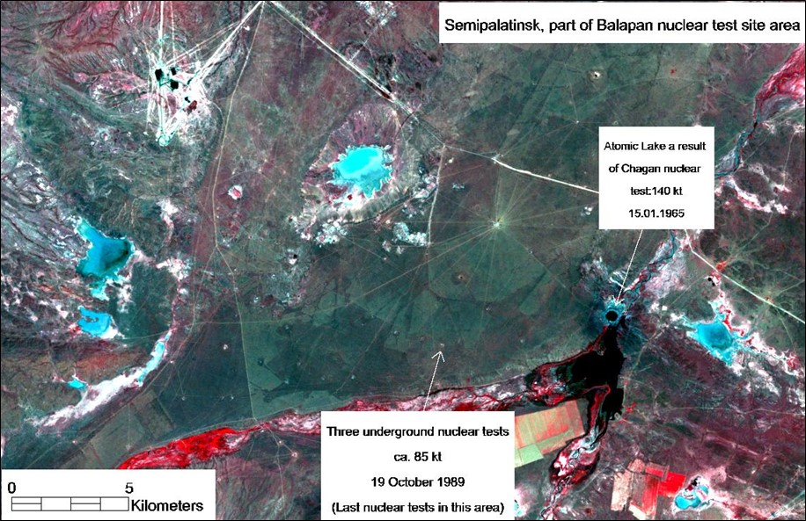
Results (1): examples of Landsat images of USA and ex-USSR nuclear test sites
Color composite of Landsat TM images acquired on 26 June 1985 and 22 August 1991 over Nevada Test Site, Areas 19 and 20. The Landsat bands color composite shows in red color the zones of major surface disturbance related to the nuclear tests or to the preparation for the nuclear tests between the time span covered by the two images (1985-1991). Note that not all nuclear tests are indicated.
Color composite of Landsat TM imagery (bands 432 = RGB) acquired on 6 August 1993 over part of Balapan, Semipalatinsk, Kazakhstan, ex-USSR former nuclear test site.
Please do not use this space, a QR code will be automatically overlayed
P3.3-144

Slide 4
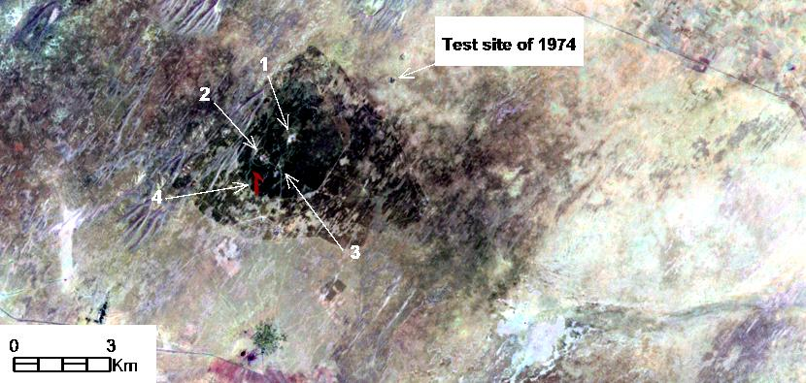
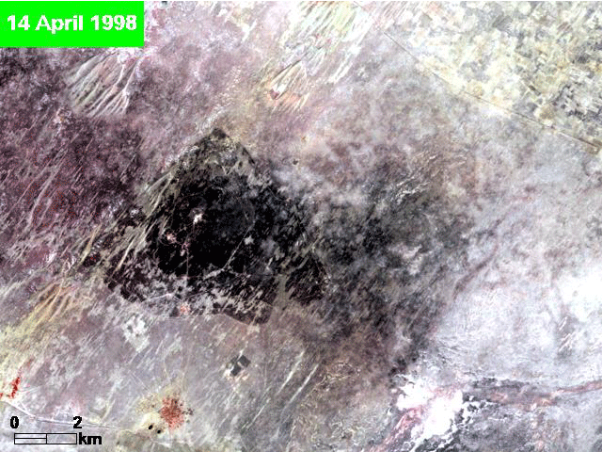
Results (2): Landsat images before and after Indian Pokhran II nuclear tests
Pokhran II was a group of underground nuclear tests conducted by India on 11 May and 13 May 1998.
Color composite of Landsat TM bands (752=RGB) of the Landsat scenes acquired on April 14, 1998 (before the nuclear tests) and on May 16, 1998 few days after the nuclear tests event. Arrows (1-3) show locations of surface disturbance presumably linked with the nuclear testing. Arrow (4) indicates a surface feature which was not in the previous image. It may convey a message to image interpreters!
Animation using the same Landsat images acquired over the the area before and after the nuclear tests event.
Please do not use this space, a QR code will be automatically overlayed
P3.3-144

Slide 5
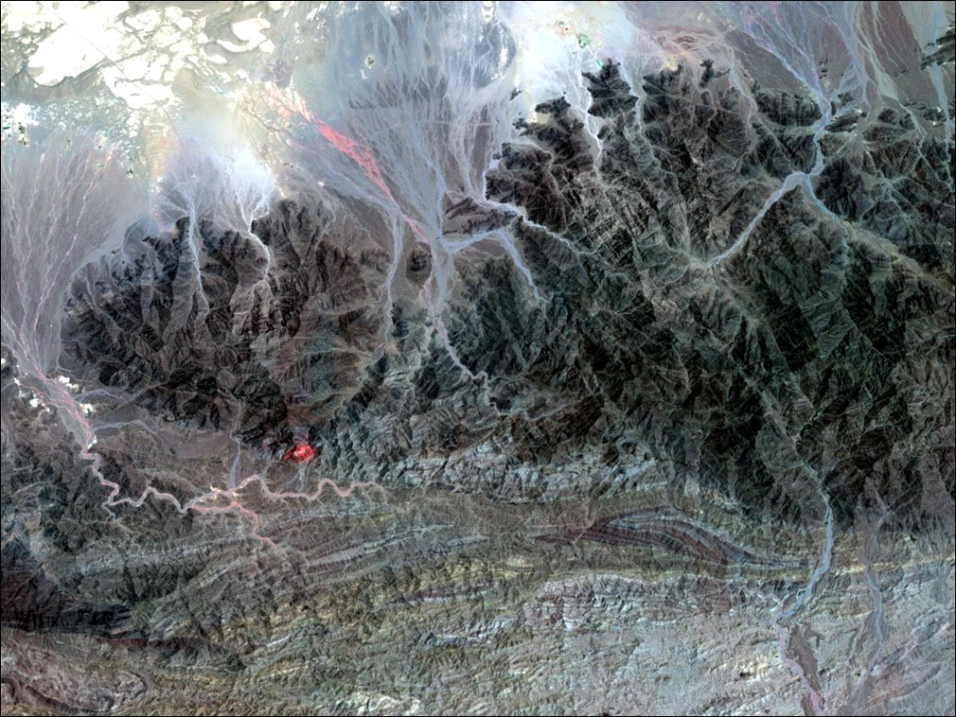
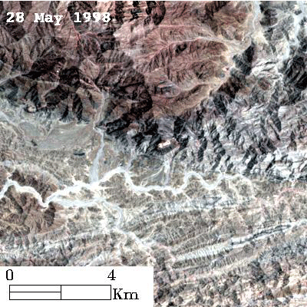
Results (3): Landsat images of Pakistan Chagai-1 underground nuclear test
Color composite of Landsat TM imagery acquired few hours before (May 28, 1998) and after the event (June 13, 1998) arranged in a way to better visualize (red colour) the surface disturbance produced by the Pakistan Chagai-1 nuclear test explosion carried out on May 28, 1998.
Animation using the same Landsat images acquired over the the area before and after the Chagai-1 underground nuclear test.
Please do not use this space, a QR code will be automatically overlayed
P3.3-144

Slide 6
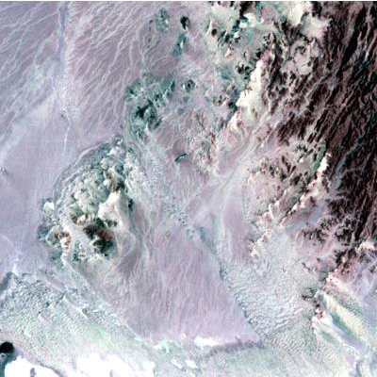
Results (4): Landsat images animation of Pakistan Chagai-2 underground nuclear test (continued..)
Chagai-II is the name assigned to the second atomic test conducted by Pakistan on May 30, 1998 in the Kharan Desert in Balochistan Province of Pakistan.
Animation of Landsat images of May 19, and June 4, 1998 over parts of Kharan Desert, Pakistan, acquired before and after the Chagai-2 underground nuclear test that occurred on May 30, 1998.
Can you find the presumed location of the nuclear test in the animation image?
Please do not use this space, a QR code will be automatically overlayed
P3.3-144

Slide 7
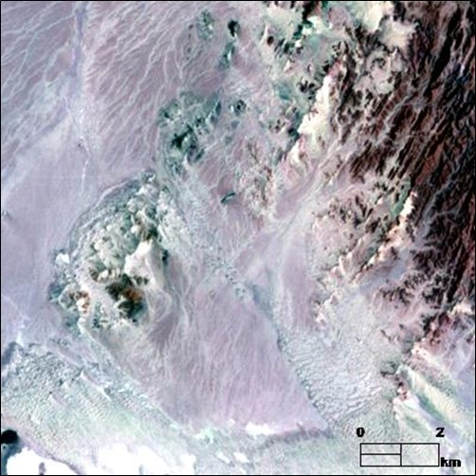
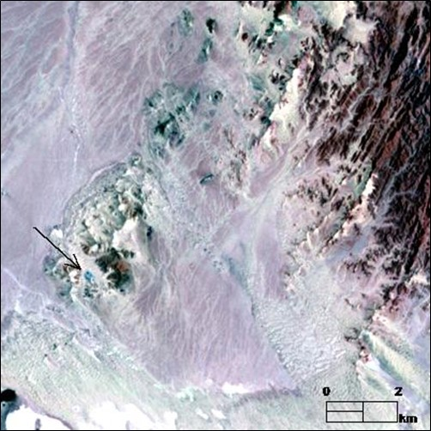
Results (4): Landsat images of Pakistan Chagai-2 underground nuclear test
Chagai-II is the name assigned to the second atomic test conducted by Pakistan on May 30, 1998 in the Kharan Desert in Balochistan Province of Pakistan.
The location of the nuclear test shown by the arrow
Please do not use this space, a QR code will be automatically overlayed
Color composites (bands 543=RGB) of Landsat scenes of 19 May 1998 (left) and of 4 June 1998 (right) over parts of Kharan Desert, Pakistan. In the latter image shown by the black arrow the presumed site of the nuclear test. Note the changes on the earth surface in this area in the image of 4 June 1998 when compared with the image of 19 May 1998.
P3.3-144

Slide 8
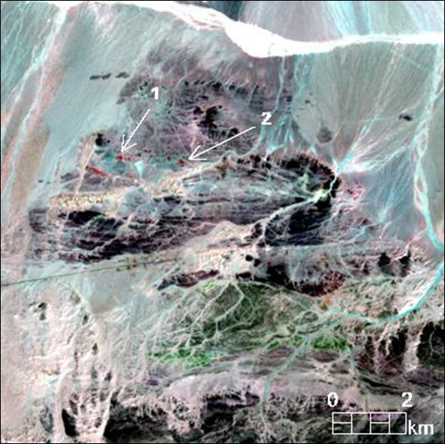
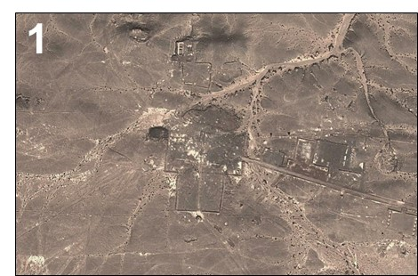
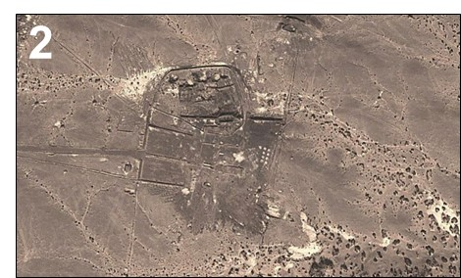
Results (5): Lop Nor nuclear test site, People's Republic of China
Colour composite of a Landsat image of August 1994 (band 7 = red) and of a Landsat image of September 1998 (bands 7, 5 = green, blue) over Area C of Lop Nor nuclear test site, China. Arrow number (1) indicates the location of the nuclear test of 8 June 1996 of at least 50 kt yield. Arrow number (2) indicates a location showing a similar anomaly, although no nuclear test has been reported in this location between 1994-1998. The respective localities (1, 2) are shown in recent high spatial resolution imagery in the right. The anomalies may indicate surface preparations for an underground nuclear test.
Please do not use this space, a QR code will be automatically overlayed
P3.3-144

Slide 9
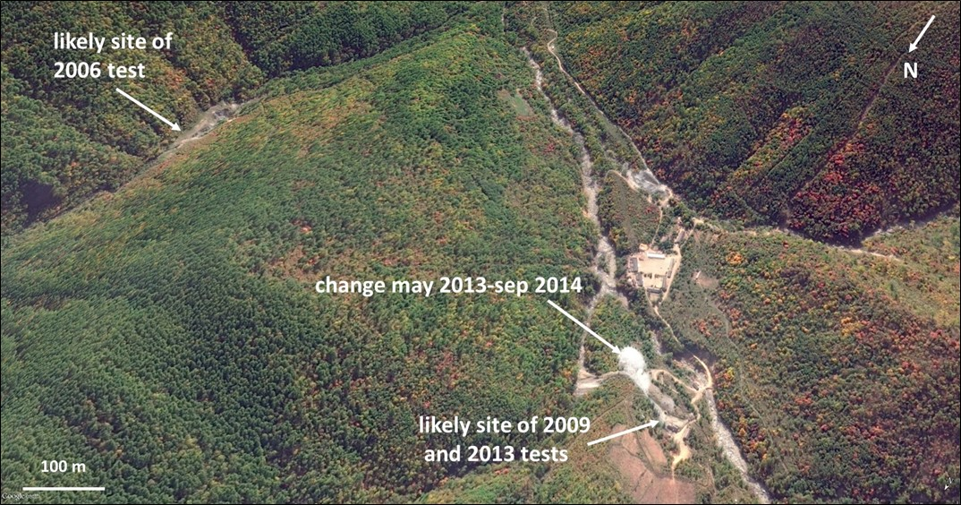
Conclusions
The moderate spatial resolution imagery can accurately detect areas of surface disturbance due to the nuclear tests, especially for tests carried out in desert regions.
However, low yield tests may not produce surface expression detectable by the satellite imagery. In these cases, high spatial resolution imagery is useful to monitor activities that may be related to a nuclear testing event.
High spatial resolution satellite imagery of North Koreas’s Punggye-ri nuclear test site. The probable locations of 2006, 2009 and 2013 tests are indicated. This is an example when the low to moderate spatial resolution Landsat imagery will not be useful, and high spatial resolution imagery is needed.
Please do not use this space, a QR code will be automatically overlayed
Acknowledgment: All the satellite data used in this poster are open source imagery. The Landsat data were obtained from USGS Global Visualization Viewer website. The high spatial resolution imagery is from Google Earth.
P3.3-144

