Slide 1
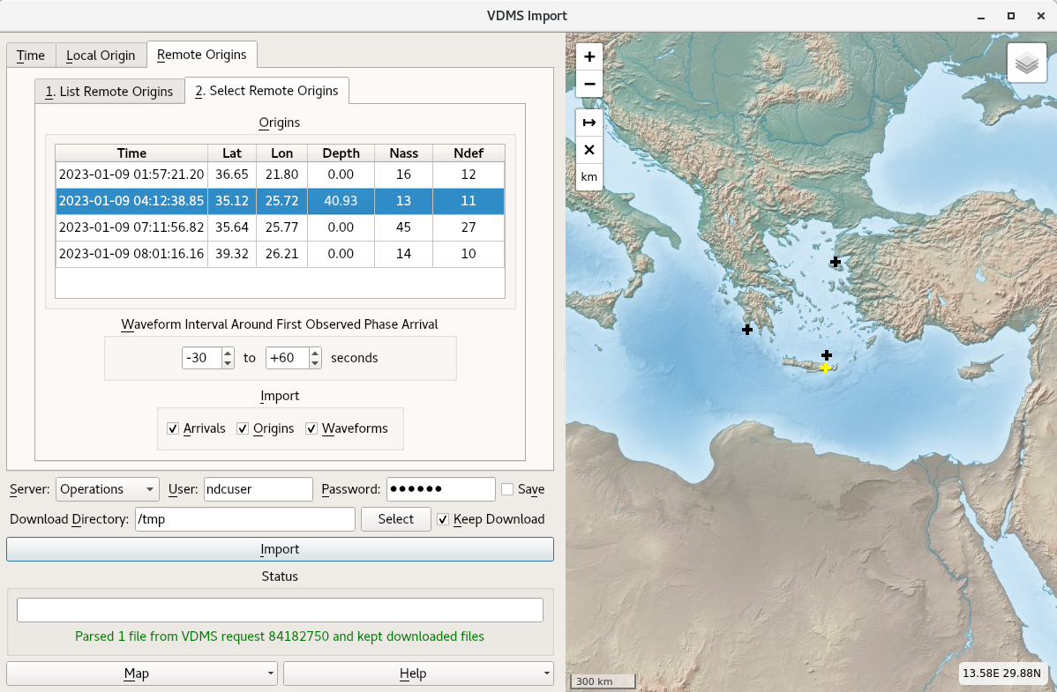
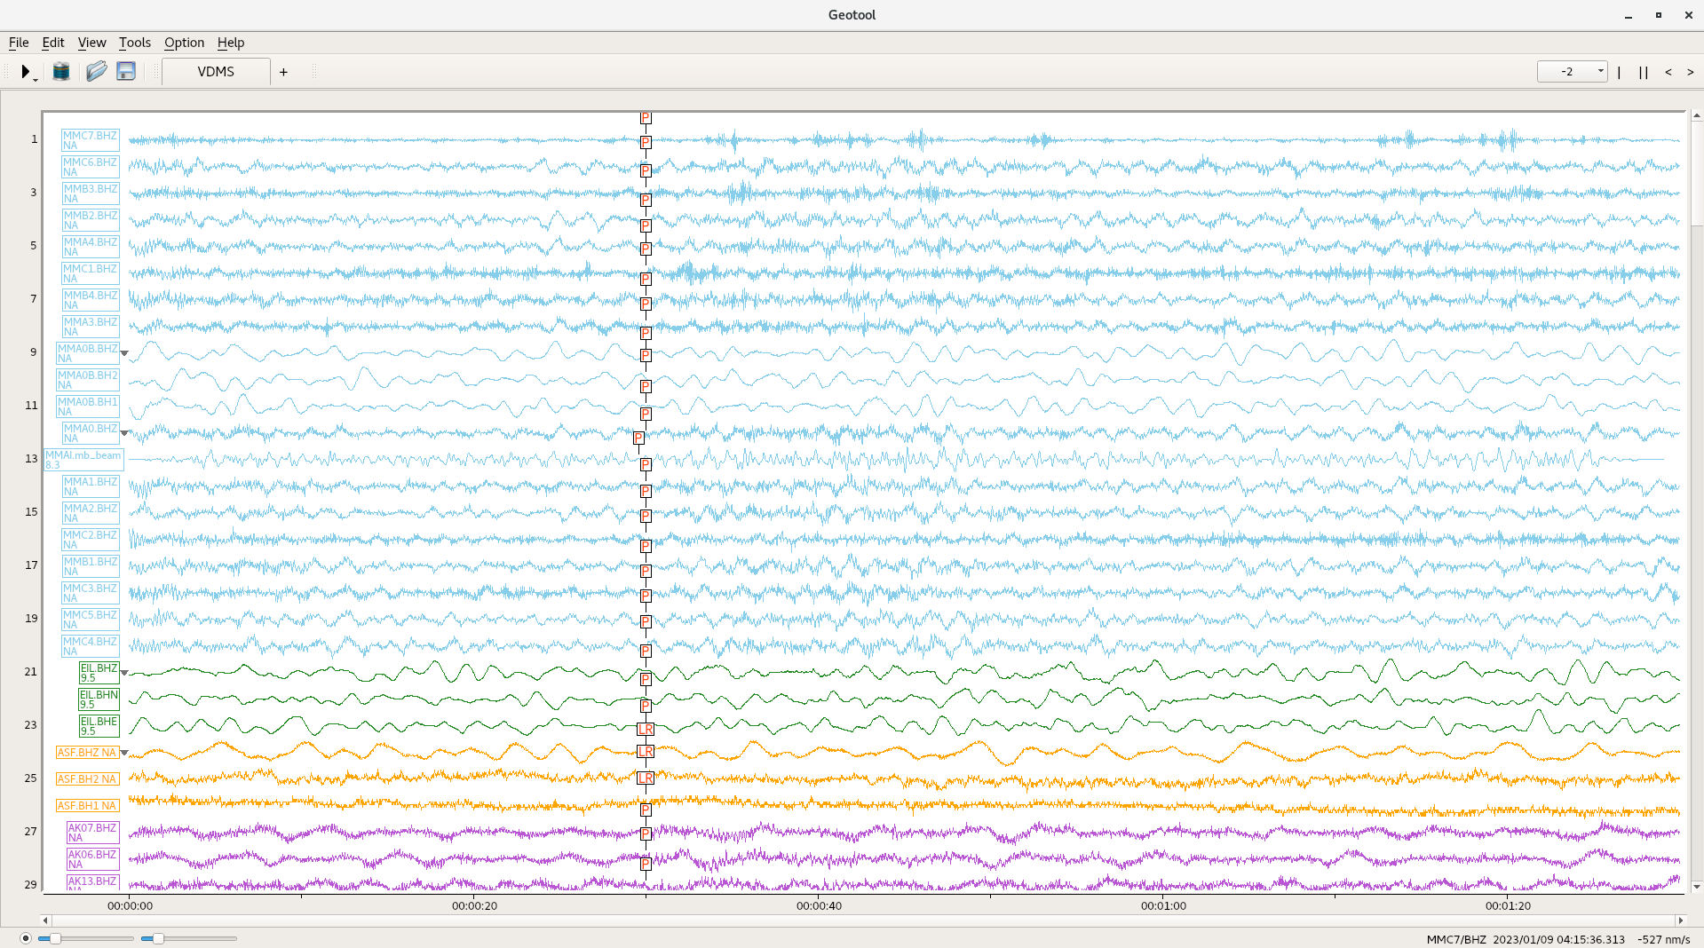
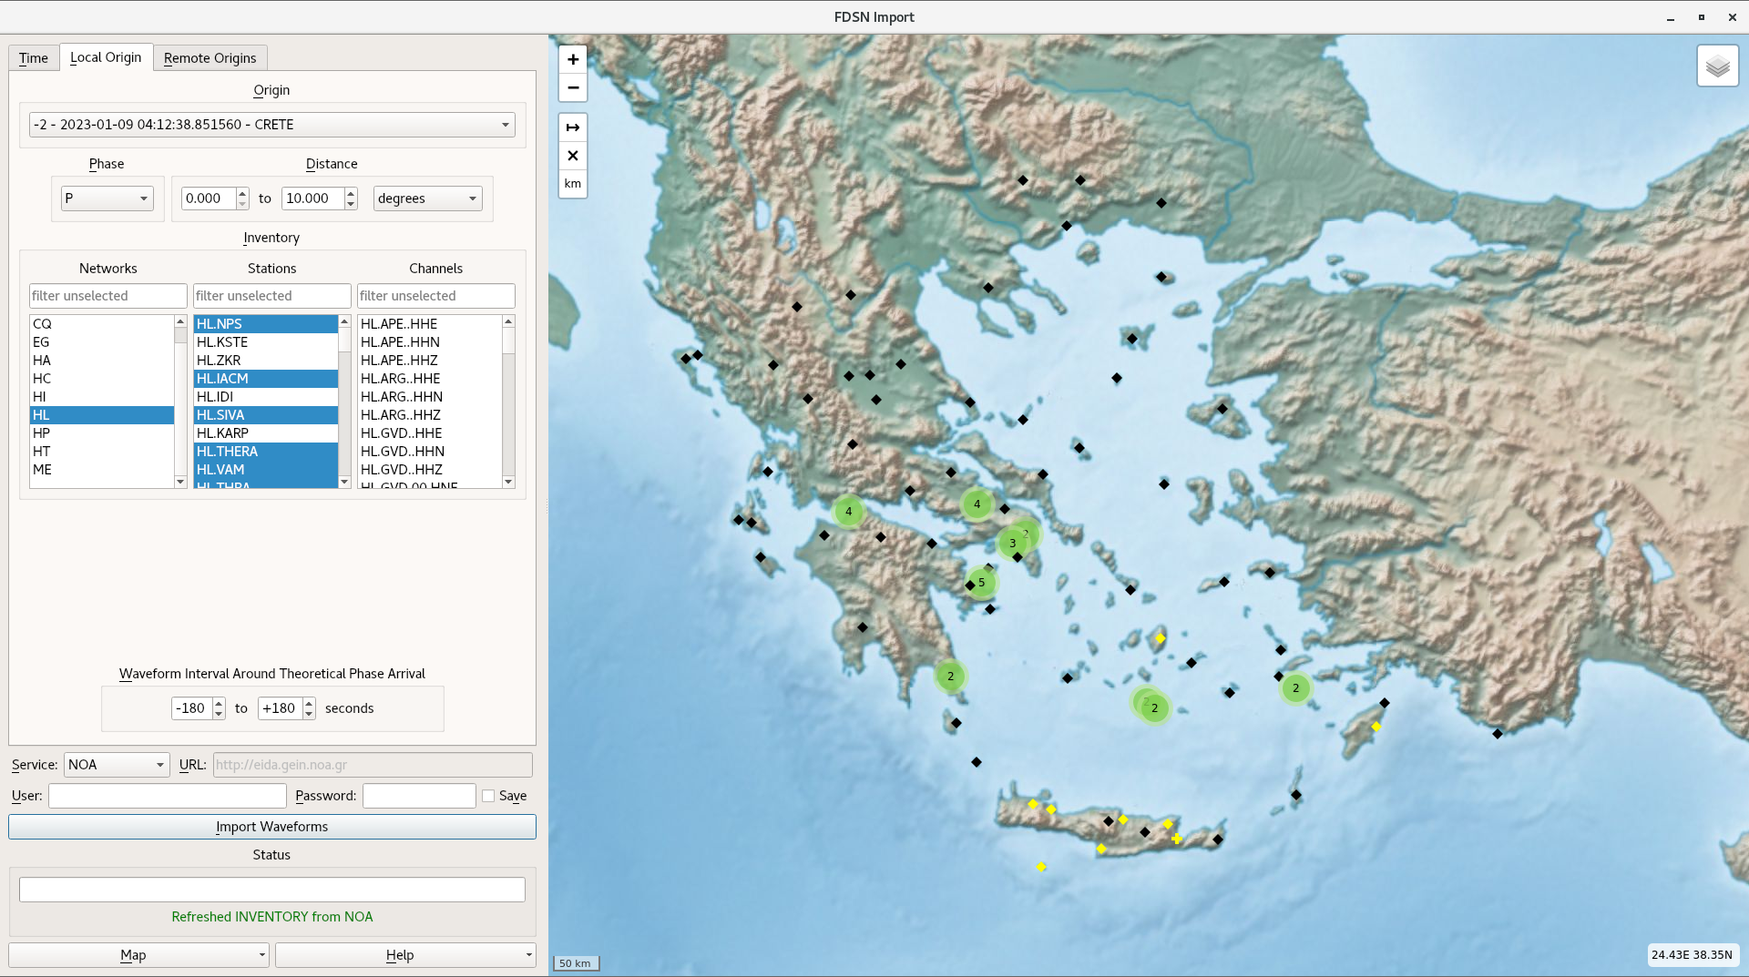
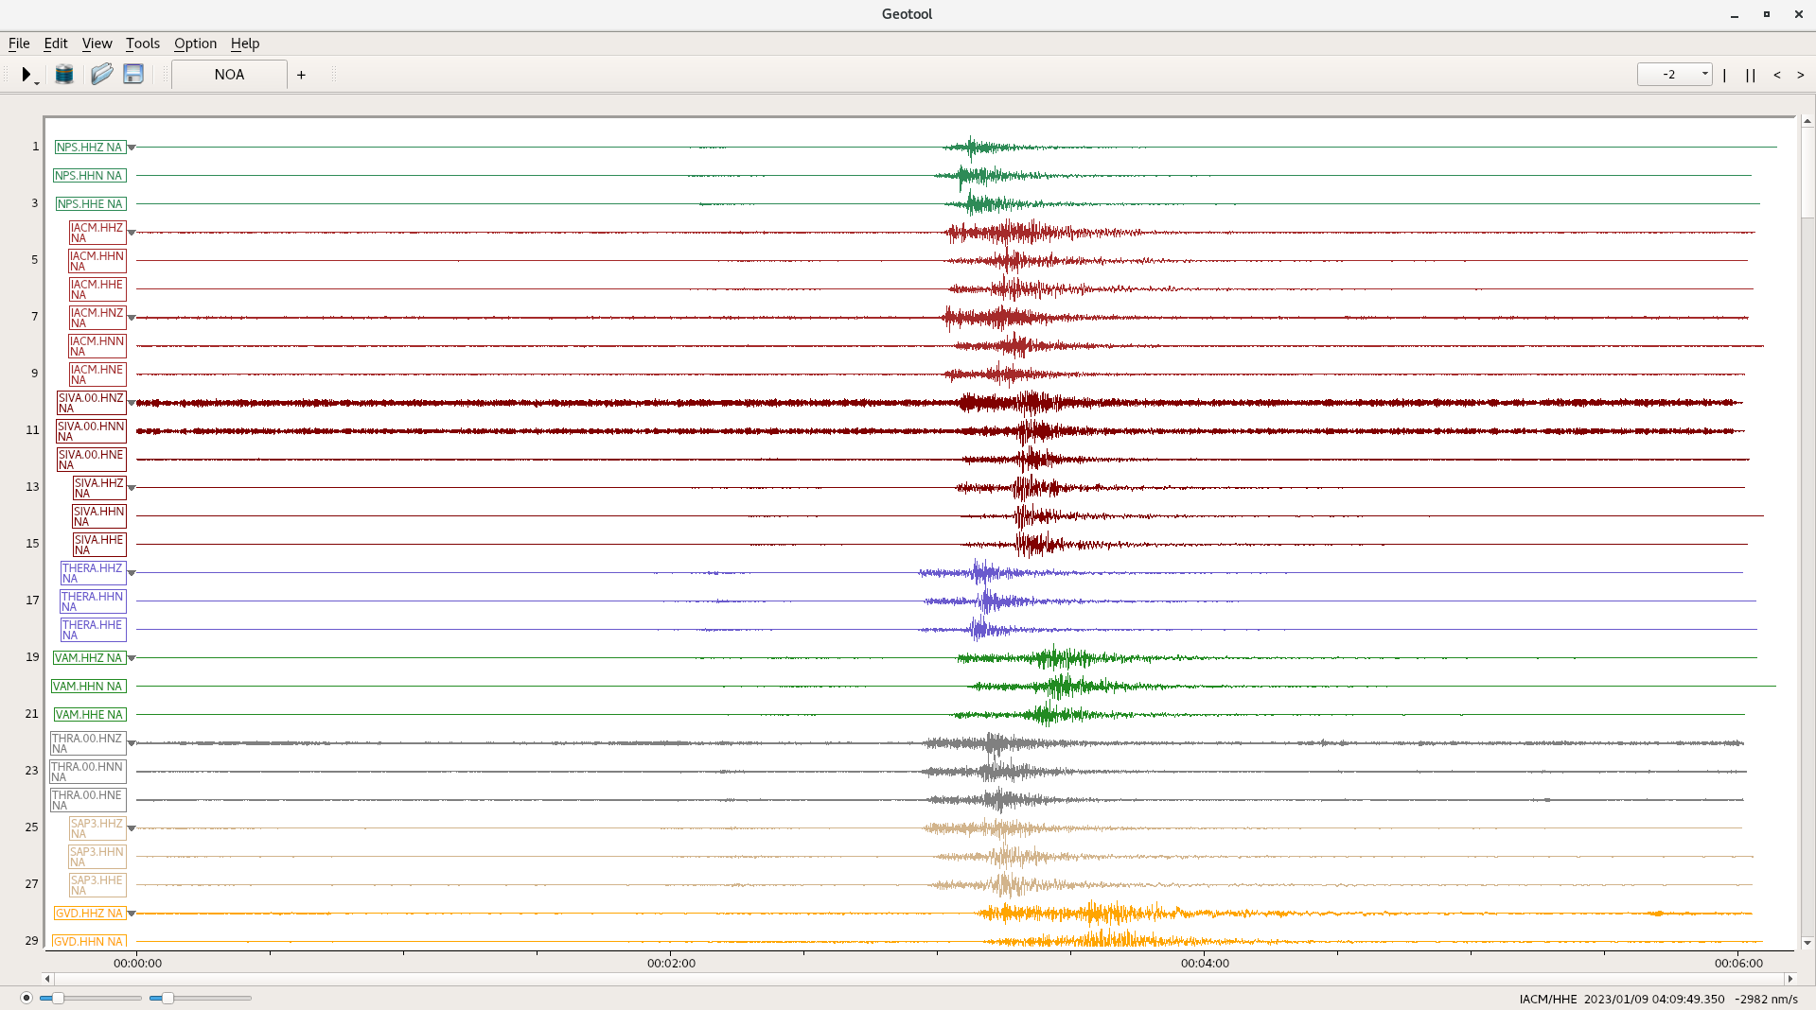
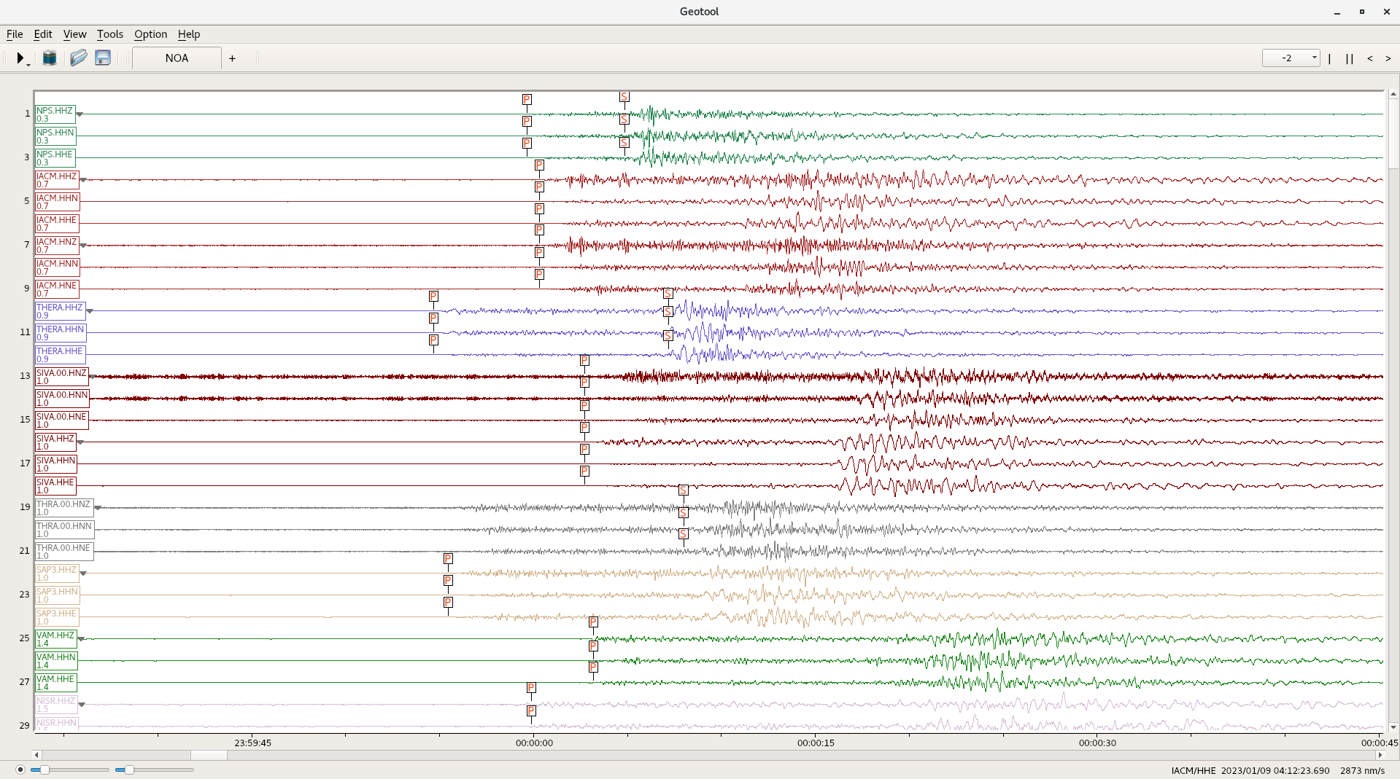
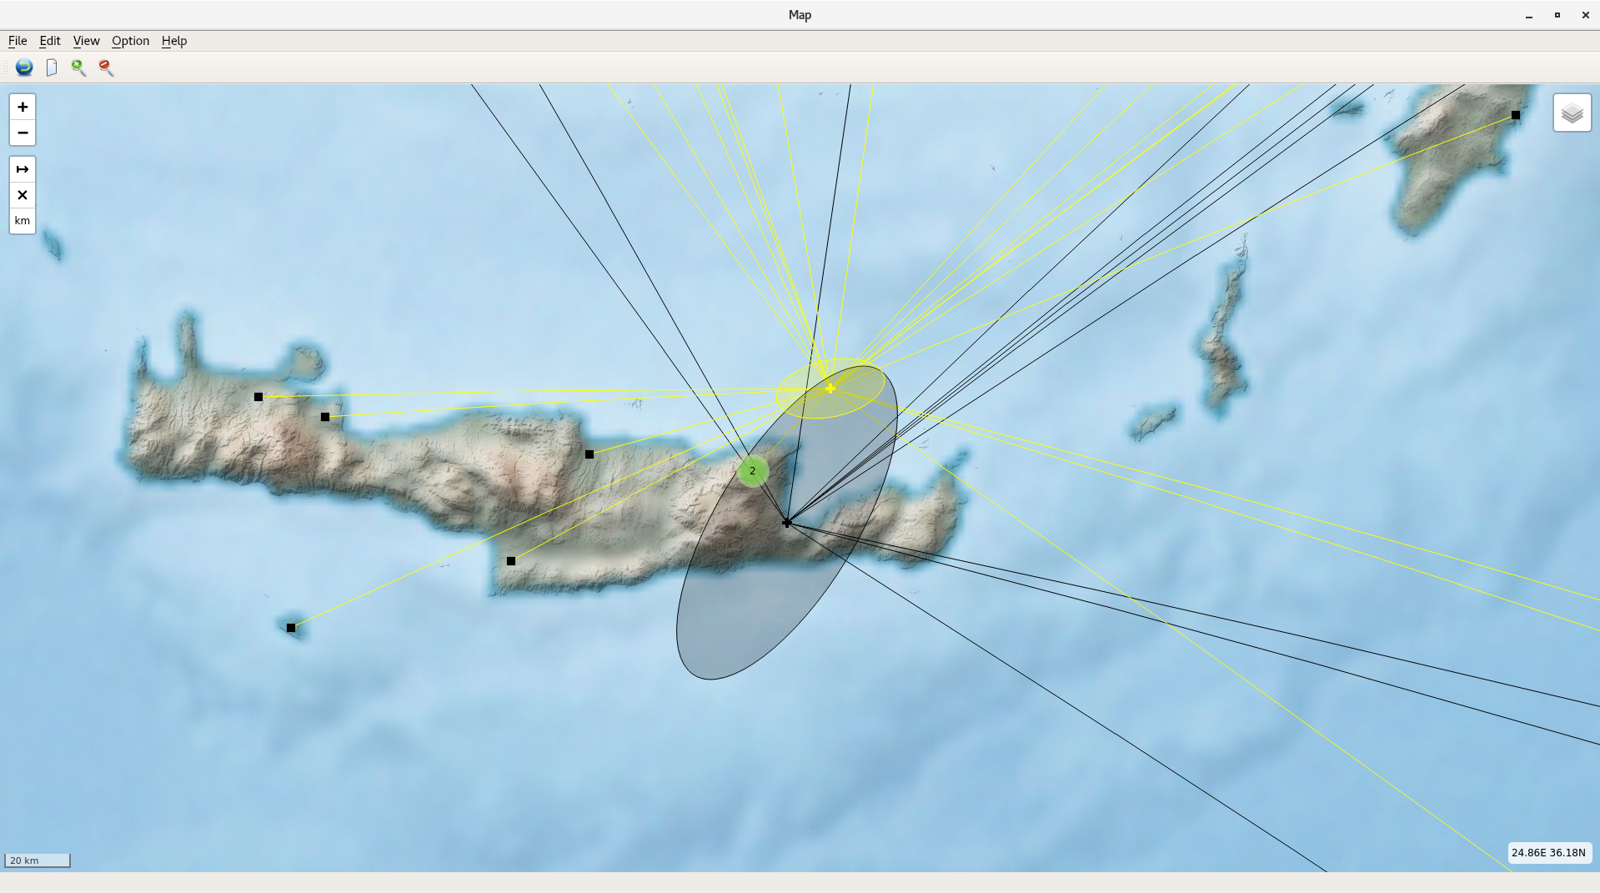
Refining Event Parameters in Geotool Using Non-International Monitoring System Stations
Wolfgang Sommerer, Alexander Poplavskiy, Dirk Metz, Haijun Wang, Leonid Kolesnykov CTBTO Preparatory Commission
P3.4-407
Select IDC event from selected bulletin (SEL1-3,REB,SEB,SSEB) in VDMS import.
Retrieve origin, arrival and waveforms for IDC event.
Select nearby stations from FDSN web services provider(s).
Retrieve waveform segments from FDSN web services provider. Segment start and end times are calculated based on theoretical arrival times
Place arrivals on waveforms retrieved from FDSN web services provider(s).
Relocate event using IMS stations and stations retrieved from FDSN web services provider(s).

