Slide 1
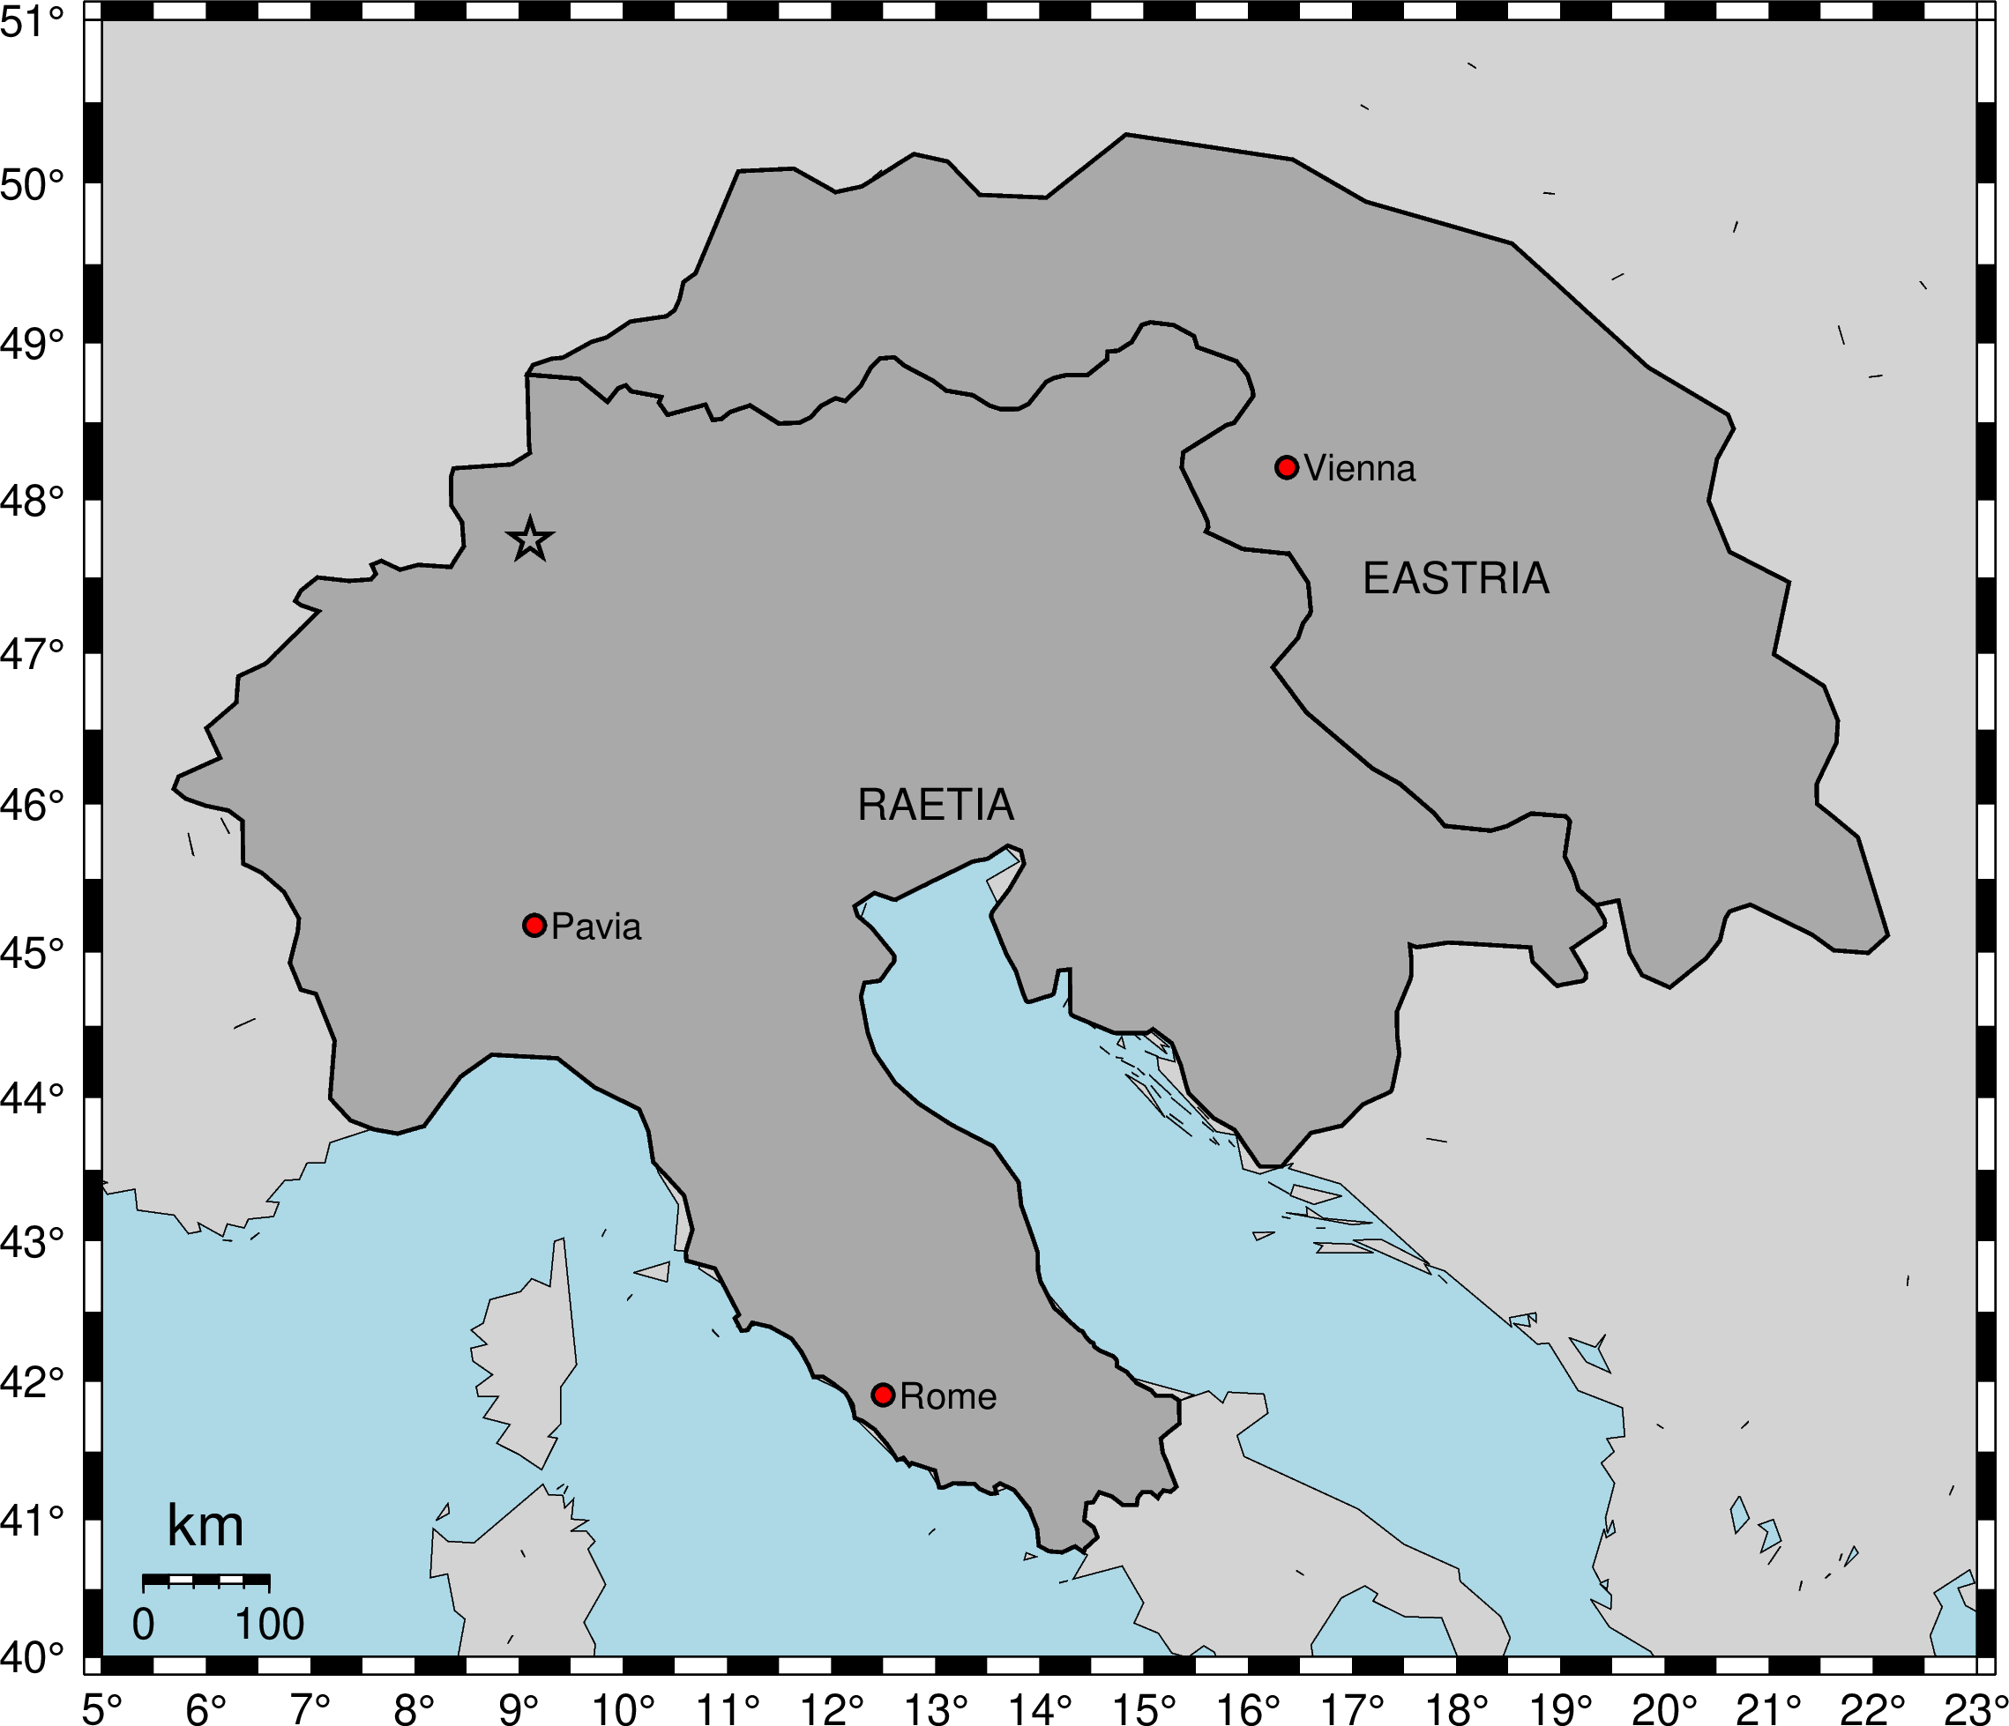
National Technical Means: The 2019 National Data Centre Preparedness Exercise scenario event case study
Stuart Nippress¹, Nicolai Gestermann², Ulrike Mitterbauer³, Rodolfo Console⁴, Francesca D’ajello Caracciolo⁴ and David Bowers¹
P3.4-572
National Data Centre Preparedness Exercises (NPE) practice combined analysis of CTBT verification technologies and National Technical Means (NTM)
NPE2019 trigger event was not in the standard automated or reviewed bulletins, but was detected by 1 primary and 3 auxiliary IMS stations, and widely detected by local seismic networks, which demonstrates the important potential role of such networks as NTM
NPE2019 provided a variety of opportunities to apply potential methods of an Expert Technical Analysis using data from both IMS and non-IMS stations
We re-analyse the NPE2019 seismic trigger event and compare it to other Lake Constance events to:
Understand why events are not in the IDC products
Locate events in the Lake Constance region
Perform regional event screening
Perform cluster analysis, and compare P/S amplitude ratio’s for events in this sequence

