Slide 1
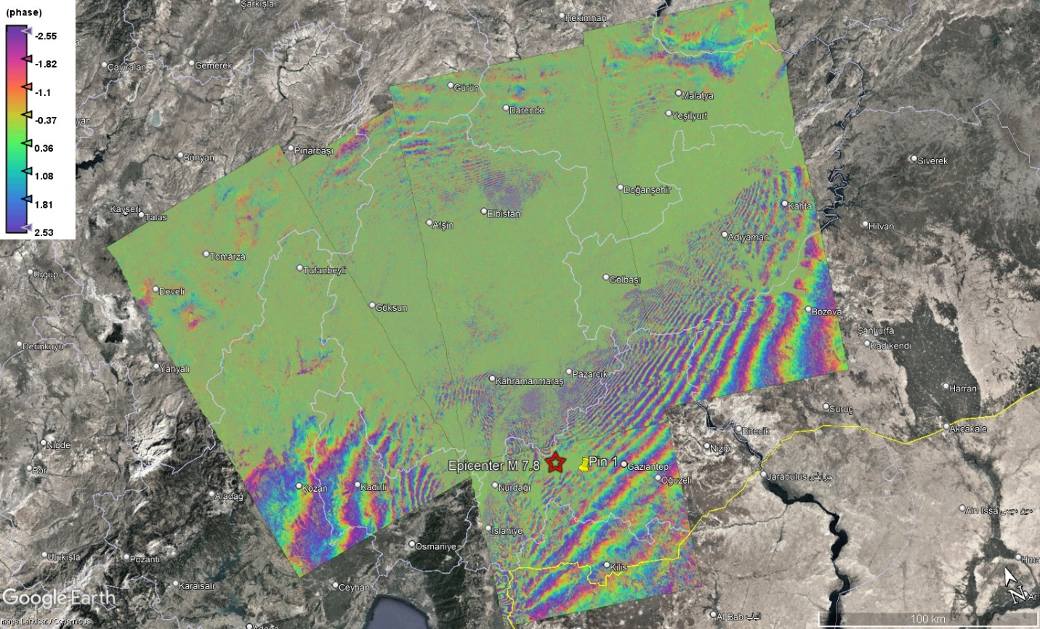
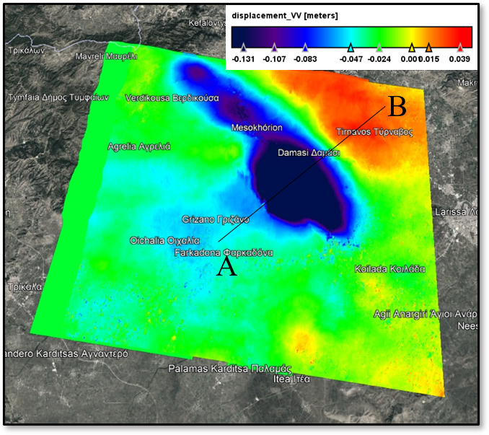
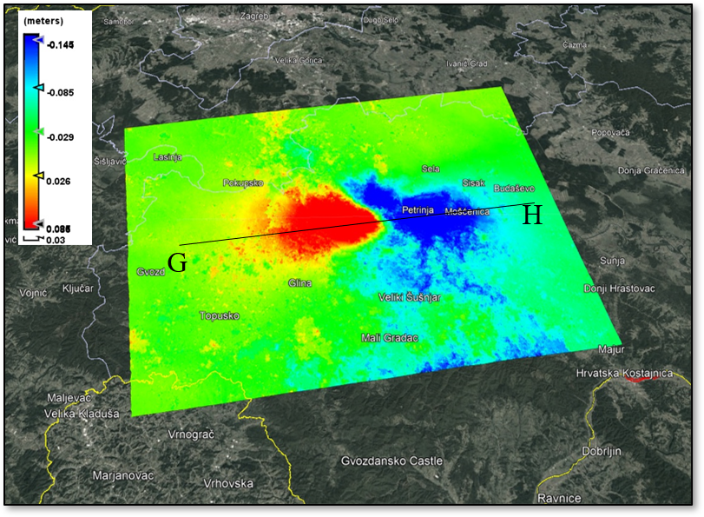
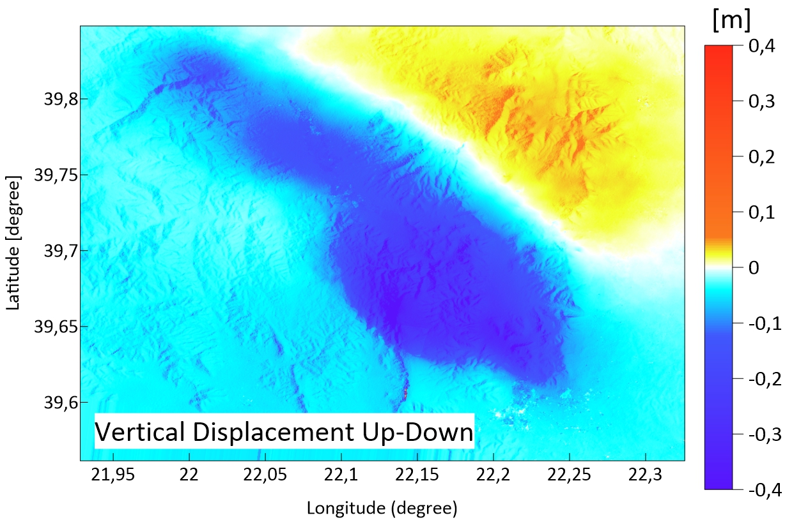
InSAR satellite data – application for earthquake deformations in the Balkan Peninsula
Lyuba Dimova¹, Reneta Raykova¹, Mila Atanasova²
¹Dept. Meteorology and geophysics, Faculty of Physics, Sofia University “St. Kliment Ohridski”, ²NIGGG – BAS
P3.4-725
The present study illustrates the InSAR technique applied for recent M6+ earthquakes.
As a results interferograms and deformation maps using SNAP software are built for several earthquakes: Croatia 2020,
Greece 2021 and Türkiye and Syria 2023.
Interferogram Türkiye and Syria
Deformation map
Orbit 146, Croatia
Deformation map
Orbit 7, Greece
Comparison between the obtained results by DInSAR procedure and the model of Okada for Croatia earthquake is made.
Line-Of-Sight displacements are converted into vertical (up-down) and horizontal (E-W) displacements for Larissa earthquake.

