Slide 1
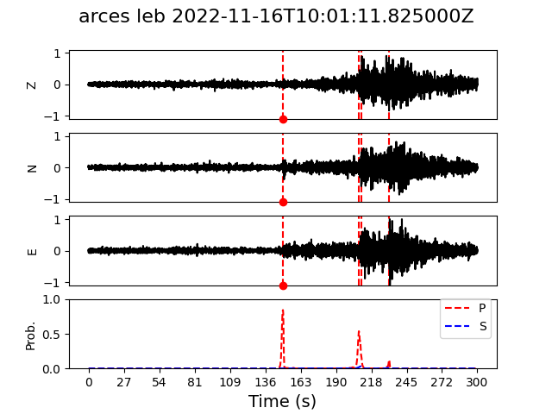
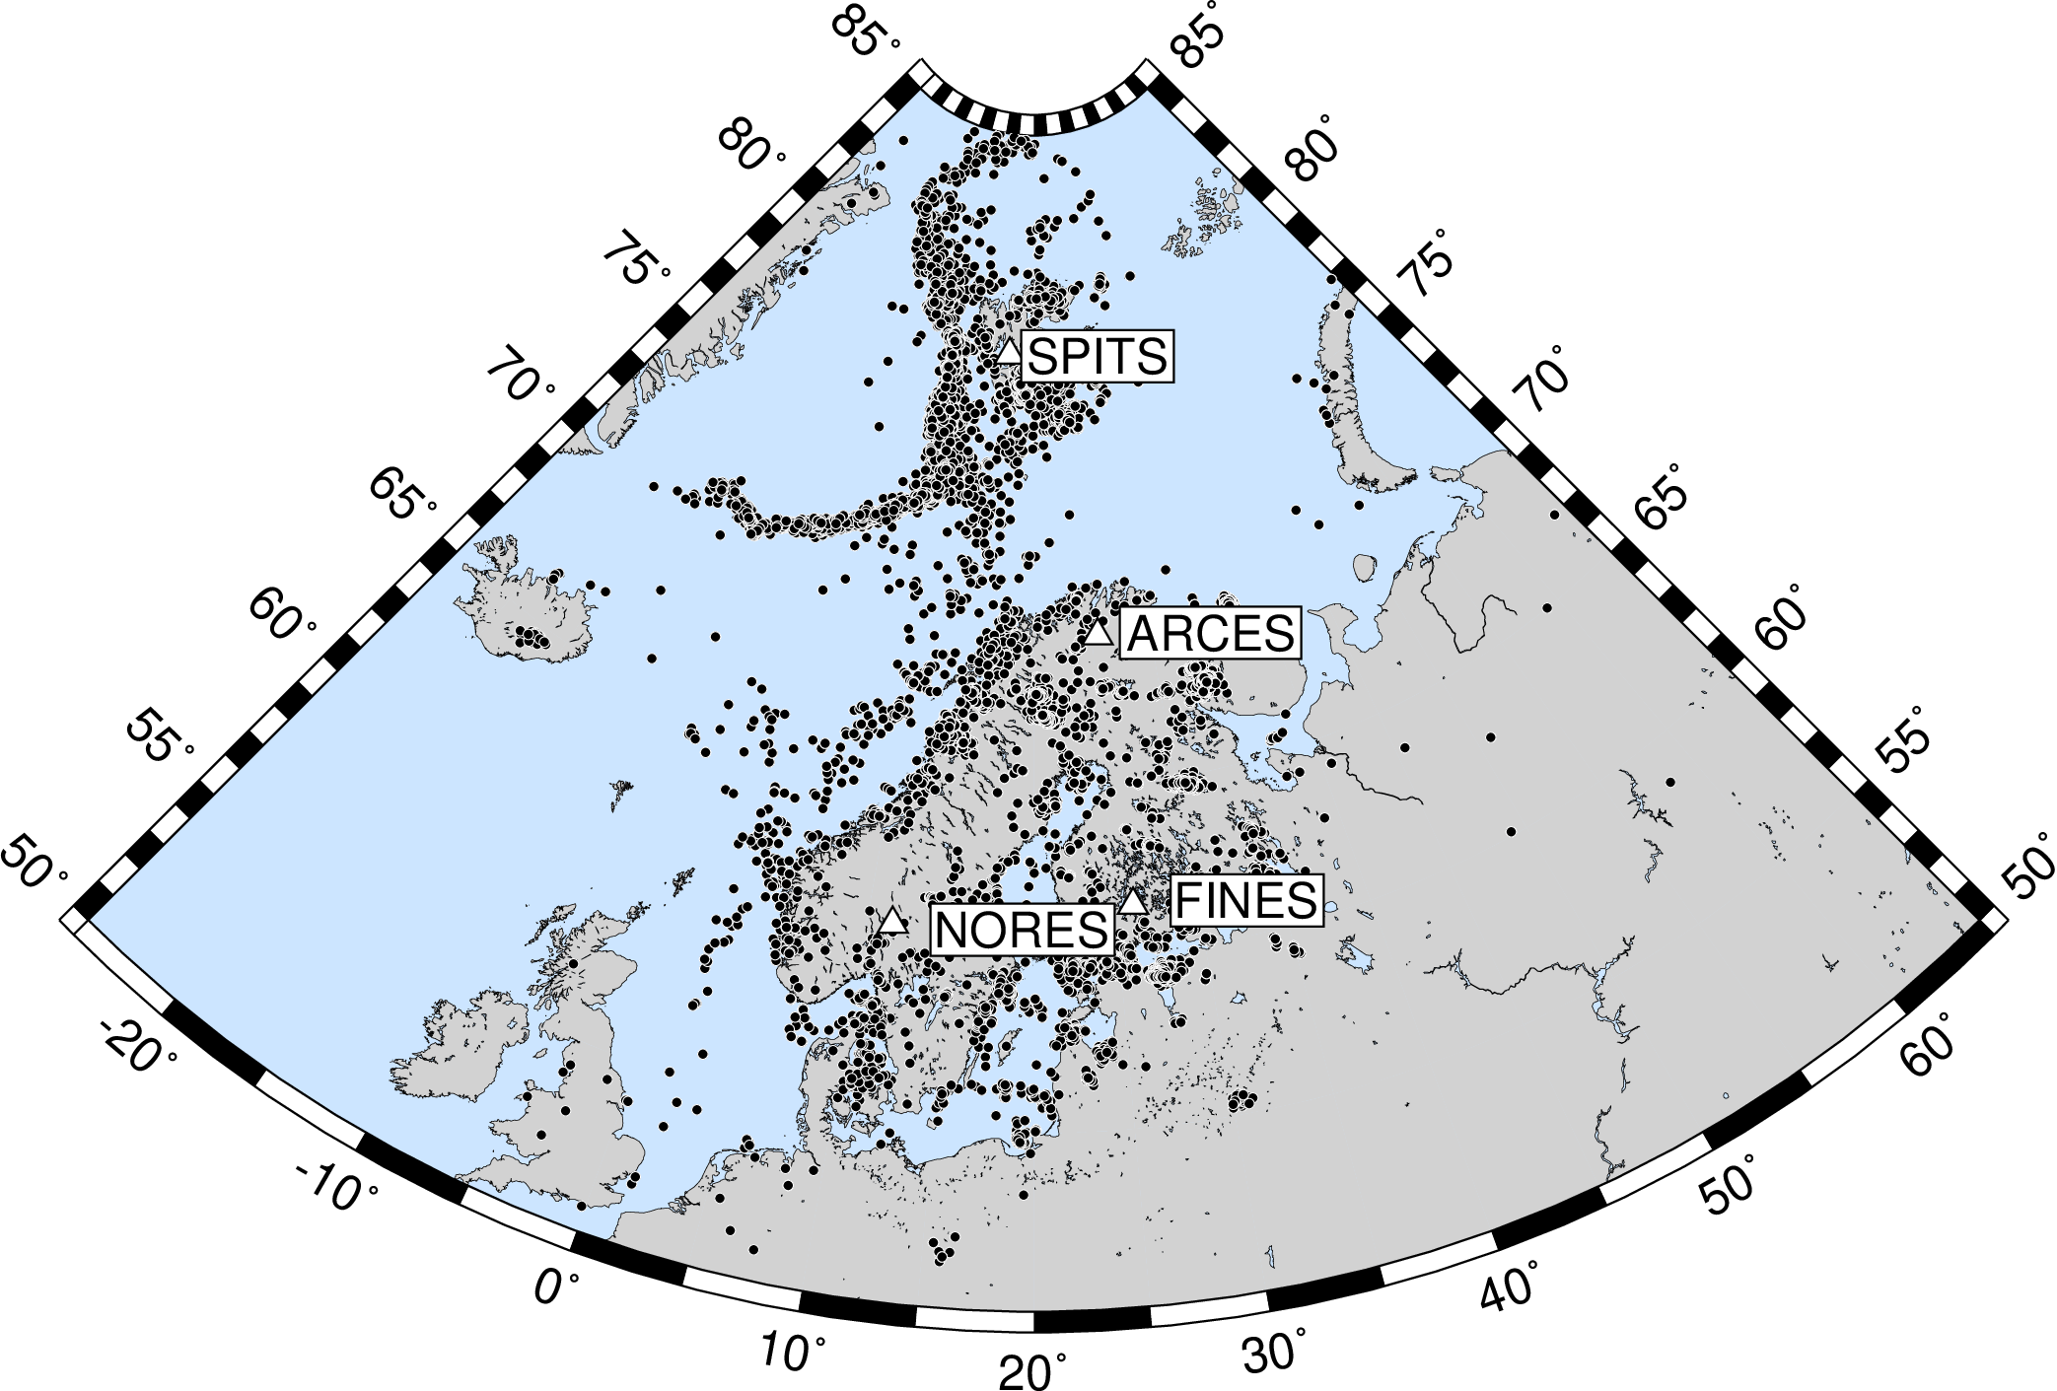
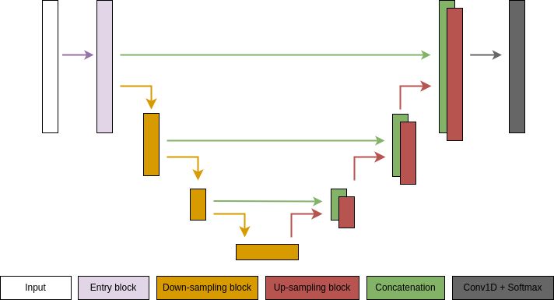
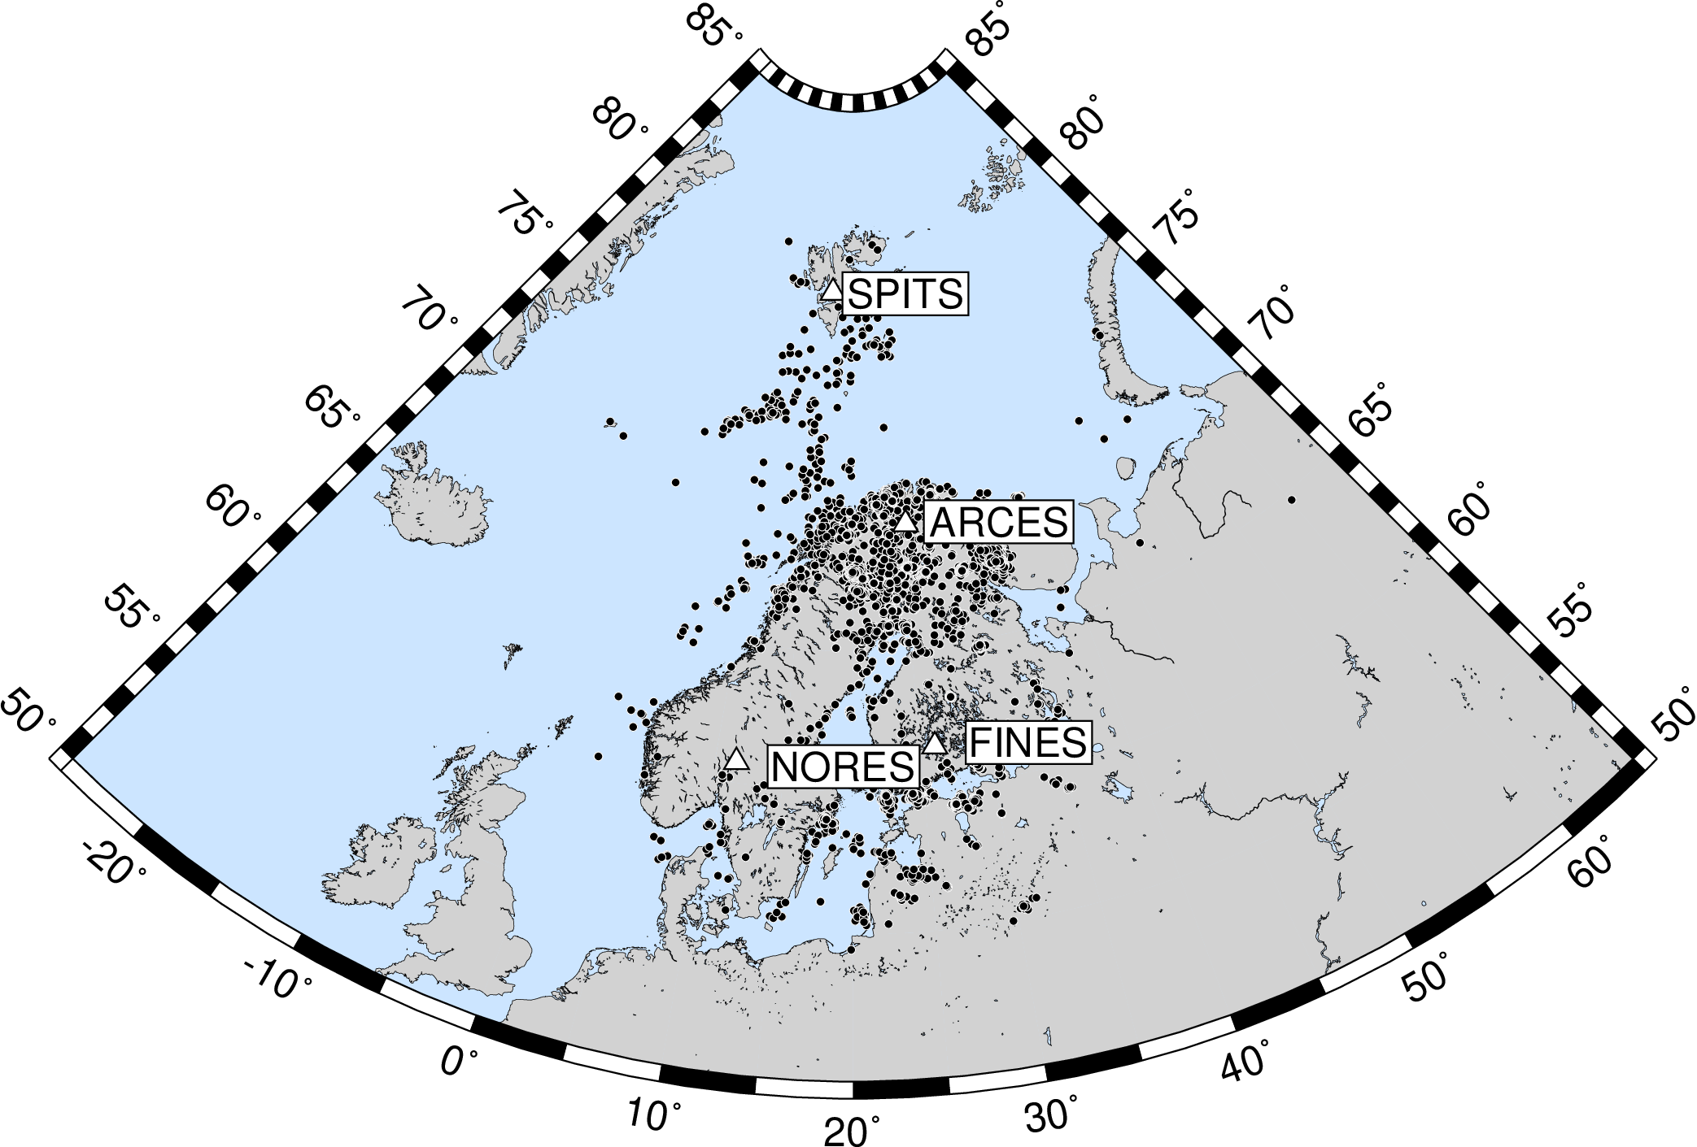
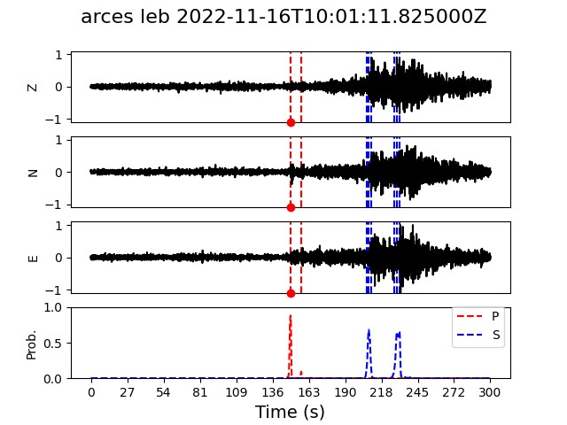
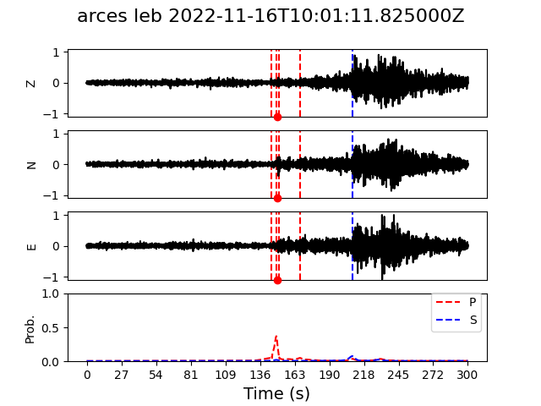
Regional Seismic Event Detection on Single Stations Using Deep Learning
Erik B. Myklebust & Andreas Köhler
NORSAR, Gunnar Randers Vei 15, 2007 Kjeller, Norway
P3.5-207
NORSAR catalog
PhaseNet
Generic PhaseNet architecture.
We replace PhaseNet convolution block with other block types:
ResNet style blocks (RPhaseNet).
Dynamic convolution (DPhaseNet).
Transformers (TPhaseNet).
TPhaseNet
U. of Helsinki catalog
We test several existing baselines:
PhaseNet
EQTransformer
EPick
These are all tested at different parameter sizes.
Dataset:
NORSAR, U. of Helsinki, CTBTO catalogs.
Picked on 4 arrays (center station only).
200,000 arrivals.
9min waveforms, randomly cropped to 5min for training.
EQTransformer

