Slide 1
Regional Seismic Event Detection on Single Stations Using Deep Learning
Erik B. Myklebust & Andreas Köhler
NORSAR, Gunnar Randers Vei 15, 2007 Kjeller, Norway
Enabling the use of the vast network of single seismic station is important in monitoring efforts. We apply deep learning for this task by training methods on events from Scandinavia picked on different IMS arrays. The trained models can be applied to all single stations in the region.
We extract 200,000 regional arrivals on 4 stations in Scandinavia.
These data are used to train existing state-of-the-art (baseline) and novel deep learning models for seismic phase and event detection.
Our novel method improves phase classification compared to the baseline models, but more importantly removes residual bias in the arrival picks.
We have evaluated existing and novel methods on a large regional dataset and shown the value of machine learning in this application.
Place your QR Code here after removing this text box!
P3.5-207

Slide 2
Introduction
Use the vast amounts of existing phase picks from seismic array data to enhance single station detections!
P
S
S
N
P
S
Event detection pipeline
used by e.g., at IDC and NDCs
Phase detection
Phase classification and
back-azimuth measurement
Event association and
location
Use machine learning here
The task is to predict P and S arrival probabilities from waveforms.
Add-ons and benefit compared to existing methods:
Regional dataset for Scandinavia is created.
Existing models are tested at a range of parameter sizes.
Novel models are constructed and evaluated towards baselines.
Improvements in the selected metrics using novel methods.
Model
Place your QR Code here after removing this text box!
P3.5-207

Slide 3
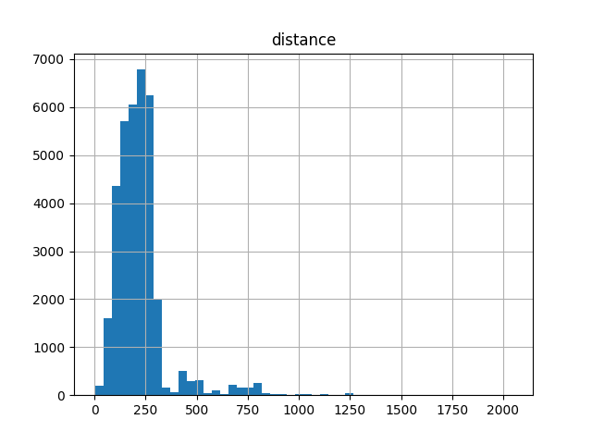
Objectives
Regional Scandinavian Dataset
Evaluation of existing models
Novel approaches
In contrast to local dataset like STEAD and INSTANCE, there are no existing dataset for regional phase detection.
We generate a new dataset using seismic bulletins available for Scandinavia.
We evaluate the most popular phase picker models on the regional dataset.
We test the provided models with hyperparameter settings from the original publications and increase model sizes to account for the increased waveform length.
We develop novel model architectures based on PhaseNet.
These approaches are based on improvements in other areas of deep learning in recent times.
Modifications include residual connections, dynamic convolution and transformers.
Place your QR Code here after removing this text box!
km
P3.5-207

Slide 4
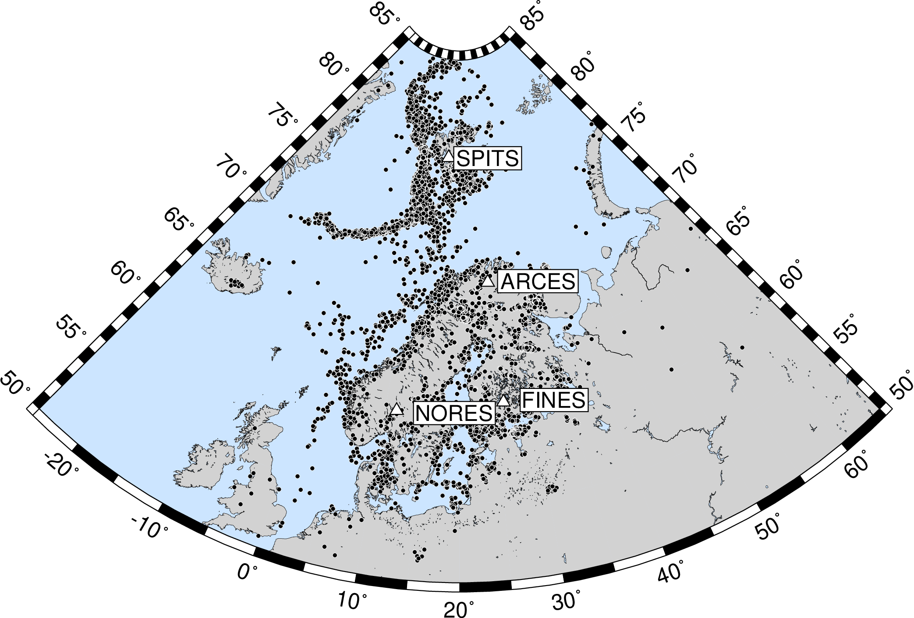
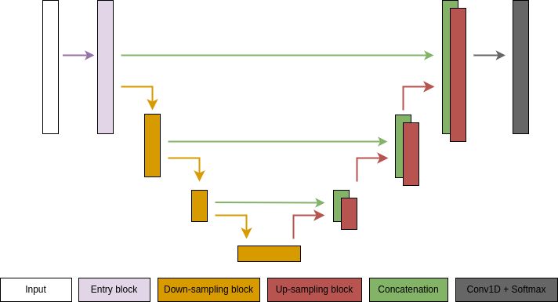
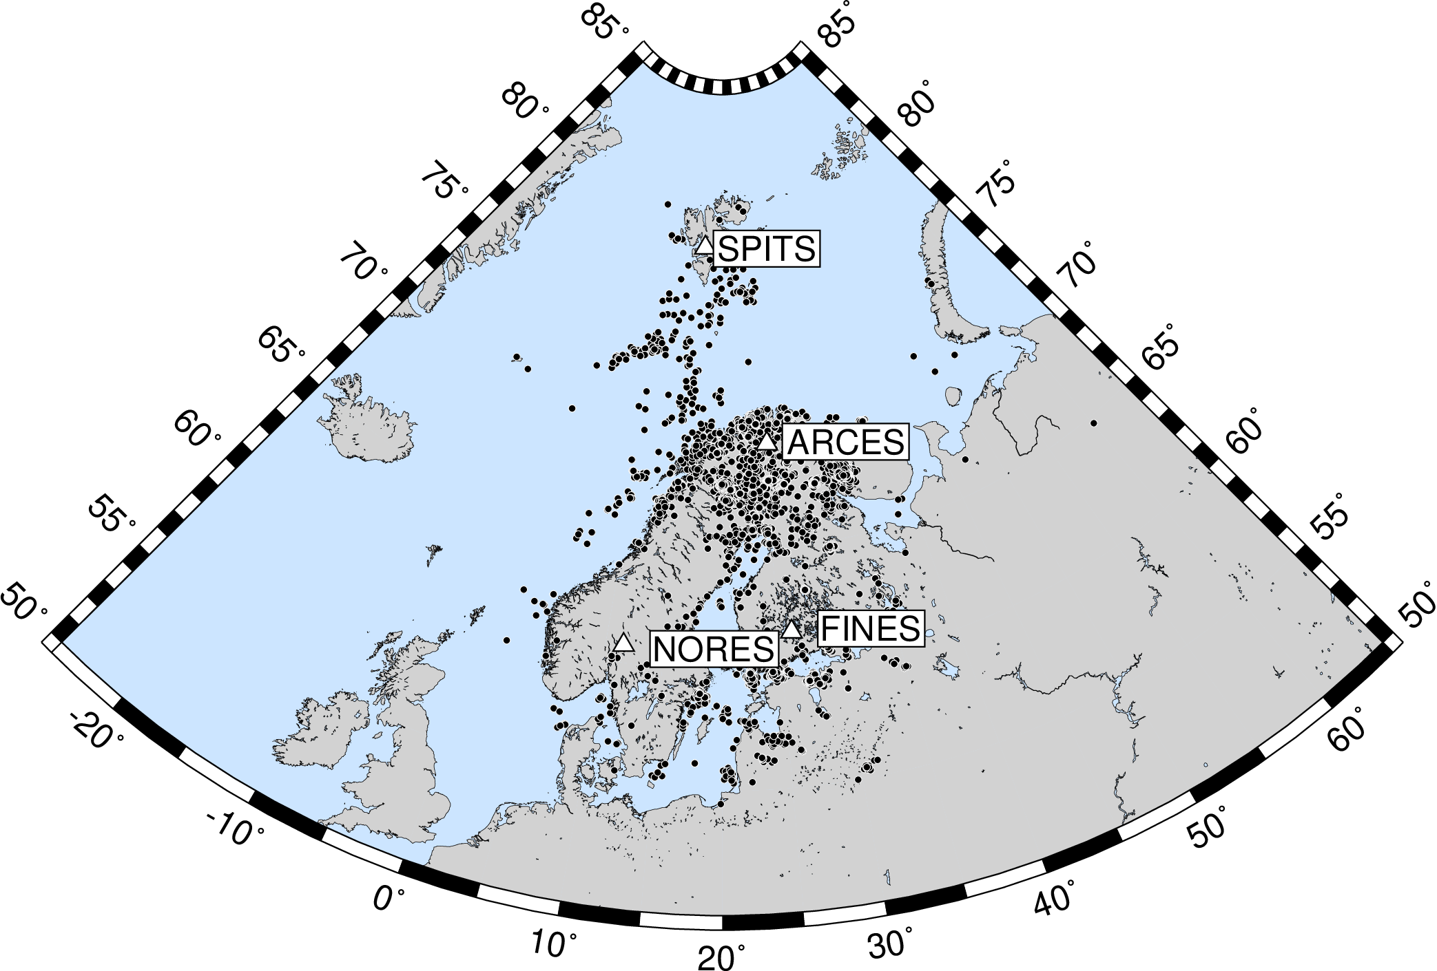
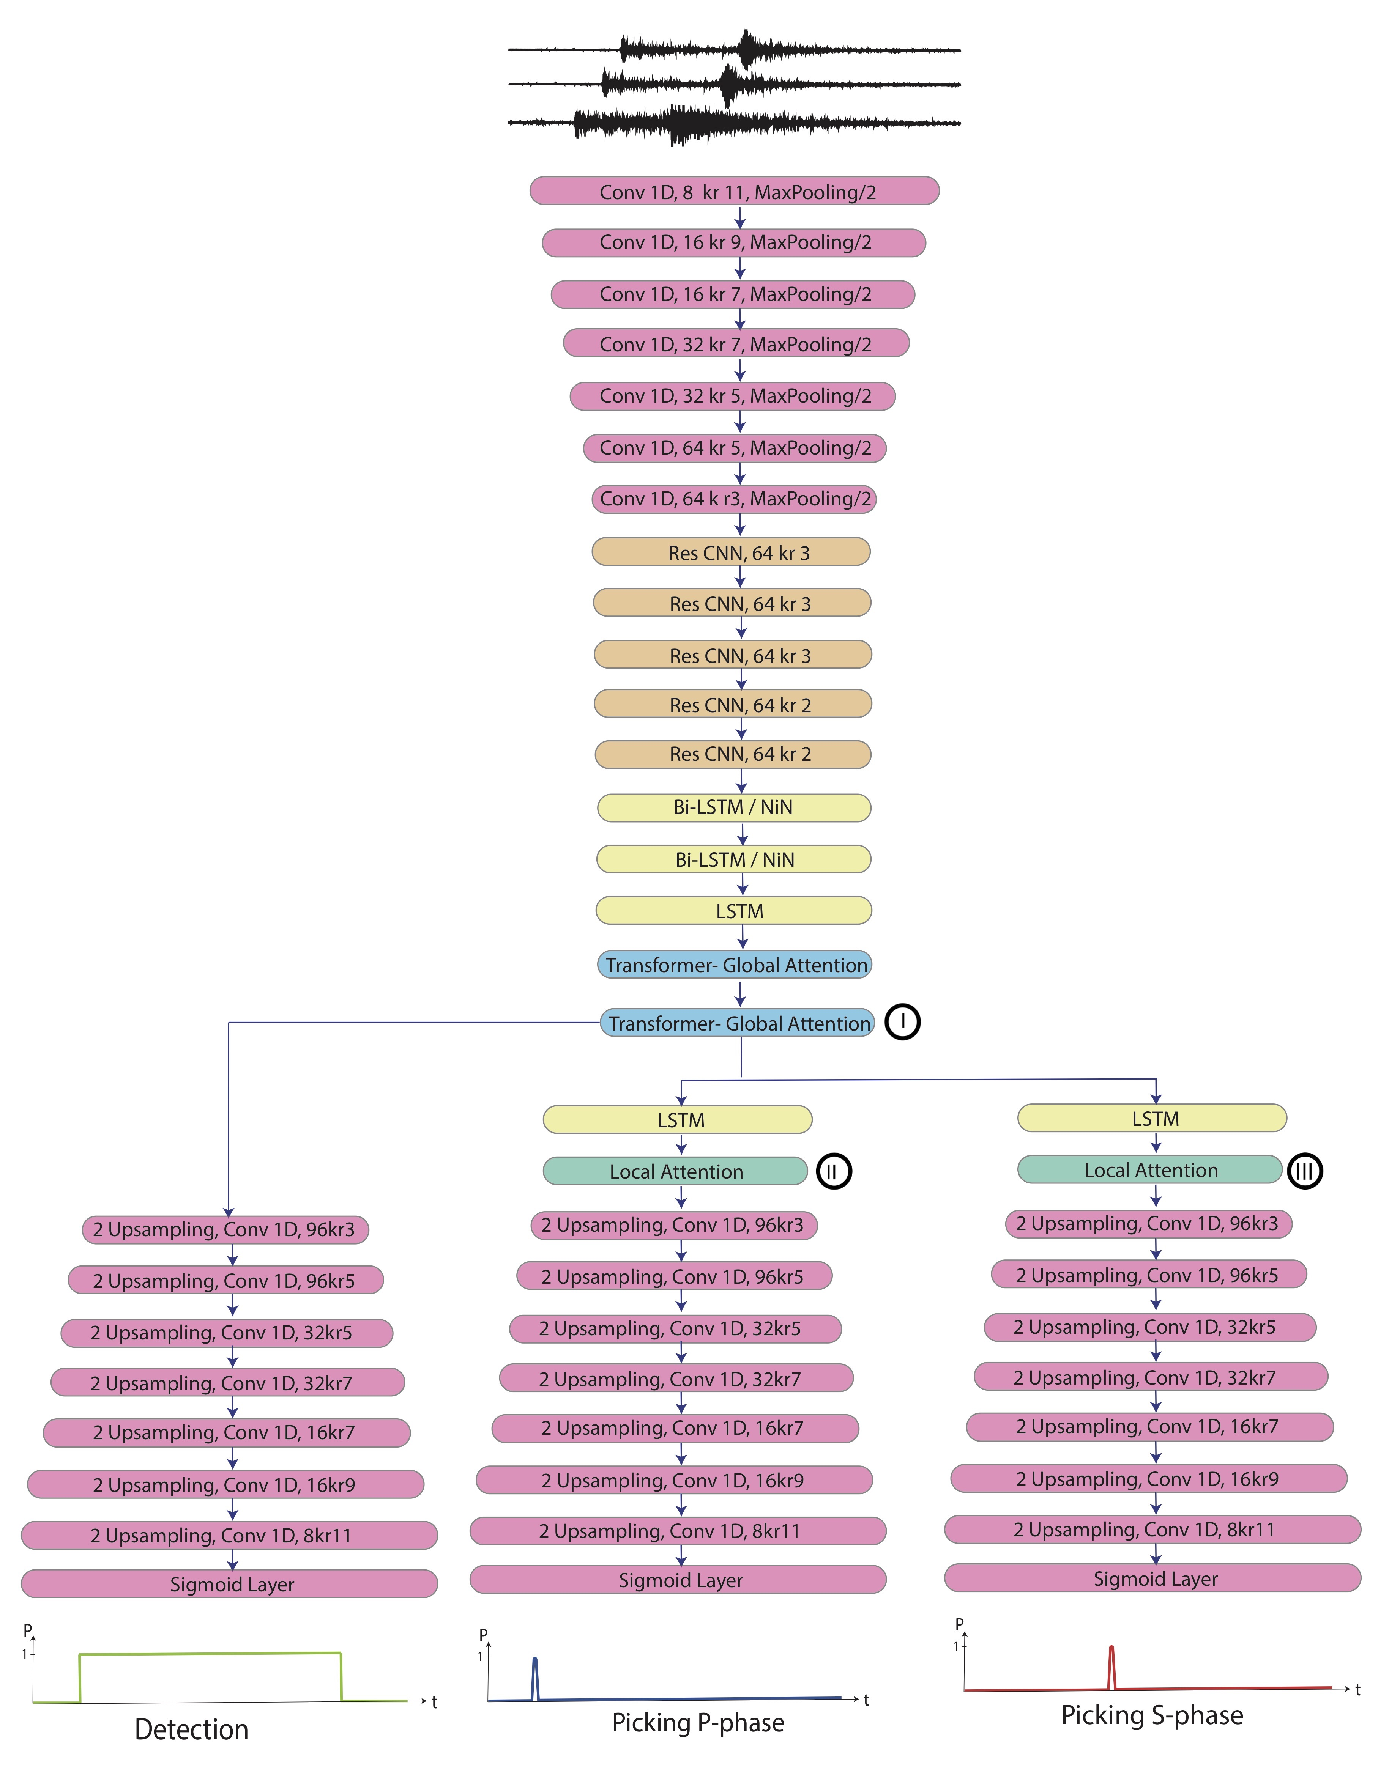
Data and Methods
We replace PhaseNet convolution block with other block types:
ResNet style blocks (RPhaseNet).
Dynamic convolution (DPhaseNet).
Transformers (TPhaseNet).
NORSAR catalog
Generic PhaseNet architecture.
We test several existing baselines:
PhaseNet
EQTransformer
EPick
These are all tested at different parameter sizes.
U. of Helsinki catalog
Dataset:
NORSAR, U. of Helsinki, CTBTO catalogs.
Picked on 4 arrays (center station only).
200,000 arrivals.
9min waveforms, randomly cropped to 5min for training.
Place your QR Code here after removing this text box!
EPick
P3.5-207
EQTransformer

Slide 5
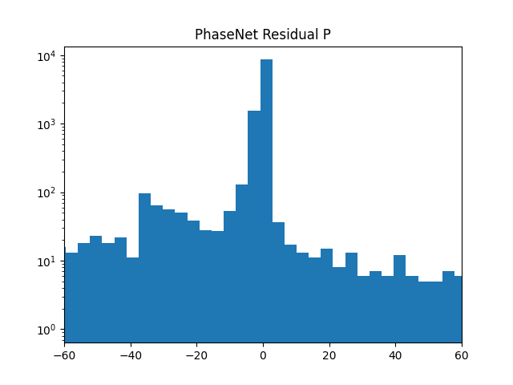
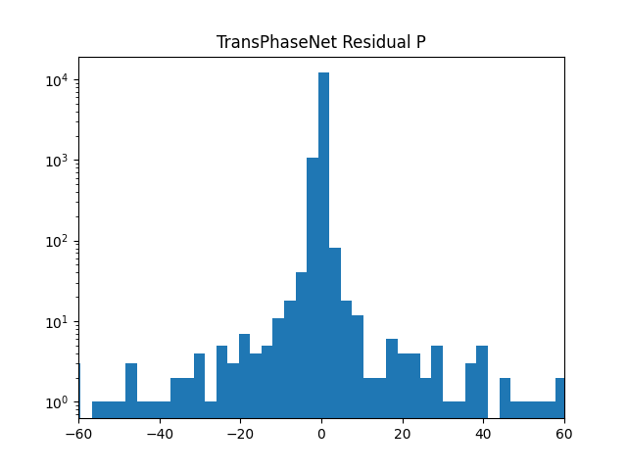
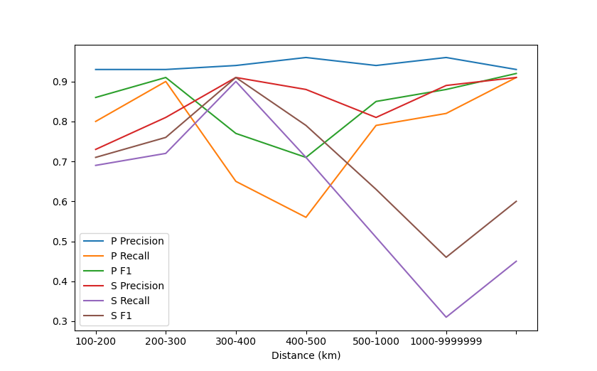
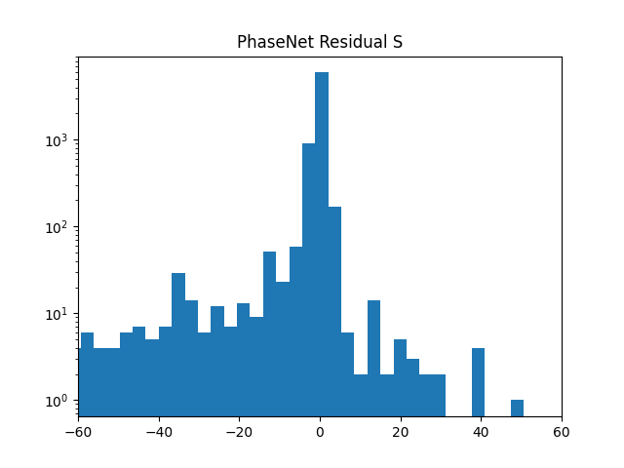
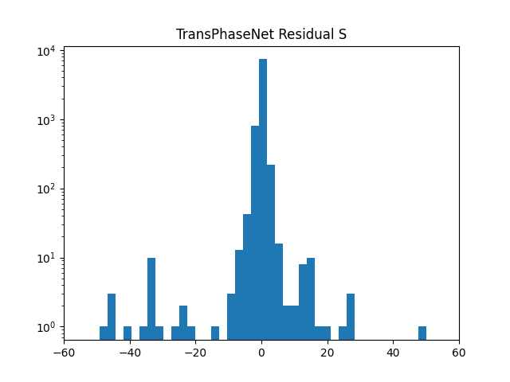
Results
Metrics:
Precision/Recall/F1 (1 second)
Residuals
Jenson-Shannon Divergence:
Mix of accuracy and confidence
Model | P precision | P recall | P F1 | S precision | S recall | S F1 | P JSD | S JSD
PhaseNet | 0.81 | 0.55 | 0.65 | 0.84 | 0.35 | 0.50 | 0.38 | 0.38
EPick | 0.81 | 0.56 | 0.66 | 0.84 | 0.37 | 0.51 | 0.37 | 0.38
EQTransformer | 0.75 | 0.49 | 0.60 | 0.80 | 0.30 | 0.44 | 0.55 | 0.54
TPhaseNet (our new method) | 0.90 | 0.75 | 0.82 | 0.90 | 0.47 | 0.72 | 0.26 | 0.36
Residuals: TPhaseNet removes bias toward predicting too early.
Log-scaled
Place your QR Code here after removing this text box!
Performance at different distances. P prediction remains accurate while S prediction deteriorates.
P3.5-207

Slide 6
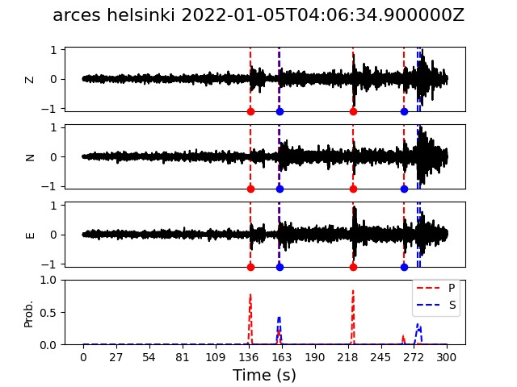
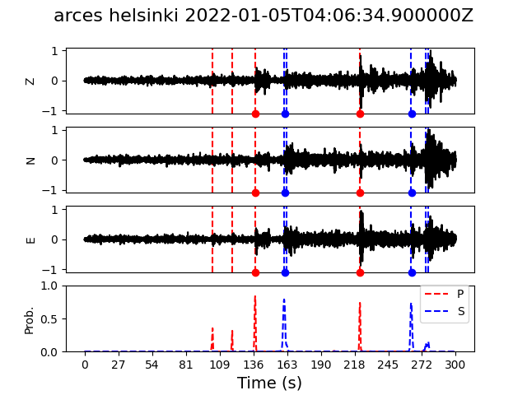
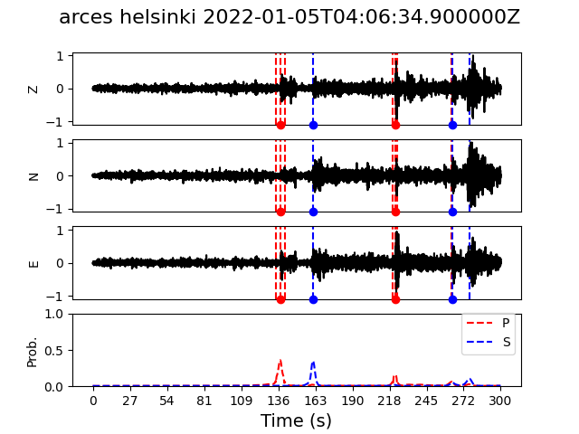
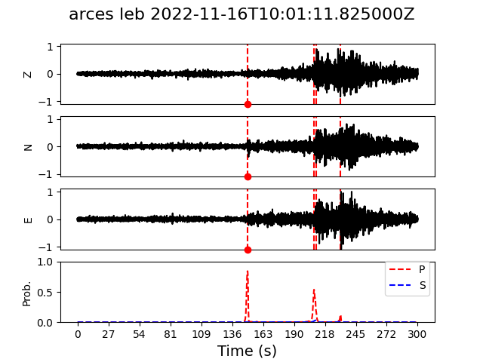
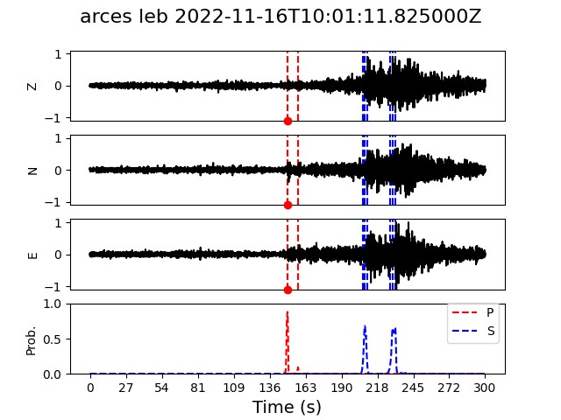
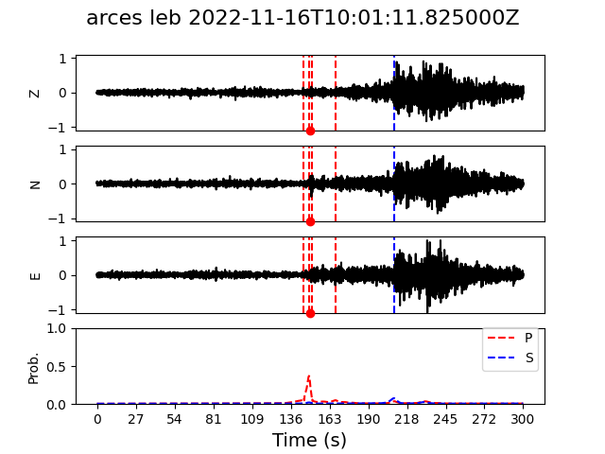
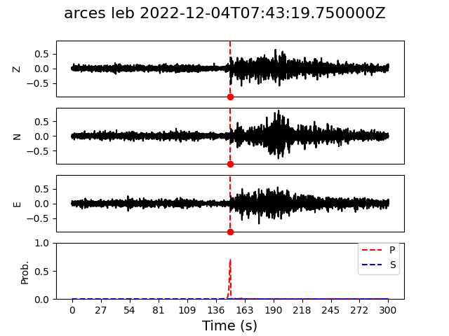
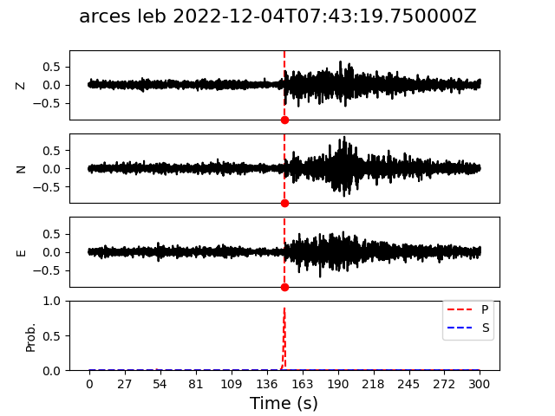
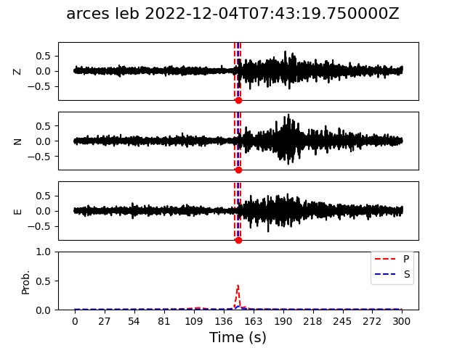
Results
PhaseNet
TPhaseNet
EQTransformer
Double event: PhaseNet confuse last S arrival. EQTransformer misses it while TPhaseNet is very precise; albeit two false positives.
Missing S label: TPhaseNet extracts two missing S arrivals while the other models either confuse them with P or fails to detect both.
Teleseismic event: All models are able to detect this teleseismic P while not triggering any S arrivals.
Place your QR Code here after removing this text box!
P3.5-207

Slide 7
Conclusion
Conclusion:
We created an extensive regional dataset for Scandinavia based on comprehensive bulletins.
We have evaluated existing models on this dataset.
We have created novel methods which improve prediction performance at regional distances.
The improvements in performance is related to increased context awareness due to the use of transformers.
We show that the methods work on a large array of events.
Future work:
Assess dataset quality, e.g., missing labels. As we’ve seen, some windows does not contain S arrivals.
Hyperparameter tuning. There might be large performance gains to be seen from finding optimal parameters.
Improved evaluation procedure.
Perform live testing on the large available set of single stations.
Implementation in detection pipeline.
Place your QR Code here after removing this text box!
P3.5-207

Slide 8
References
Weiqiang Zhu , Gregory C Beroza, PhaseNet: a deep-neural-network-based seismic arrival-time picking method, Geophysical Journal International, Volume 216, Issue 1, January 2019, Pages 261–273, https://doi.org/10.1093/gji/ggy423
Mousavi, S.M., Ellsworth, W.L., Zhu, W. et al. Earthquake transformer—an attentive deep-learning model for simultaneous earthquake detection and phase picking. Nat Commun 11, 3952 (2020). https://doi.org/10.1038/s41467-020-17591-w
Li, Wei & Chakraborty, Megha & Fenner, Darius & Faber, Johannes & Zhou, Kai & Rümpker, Georg & Stoecker, Horst & Srivastava, Nishtha. (2021). EPick: Multi-Class Attention-based U-shaped Neural Network for Earthquake Detection and Seismic Phase Picking.
Place your QR Code here after removing this text box!
P3.5-207

