Slide 1
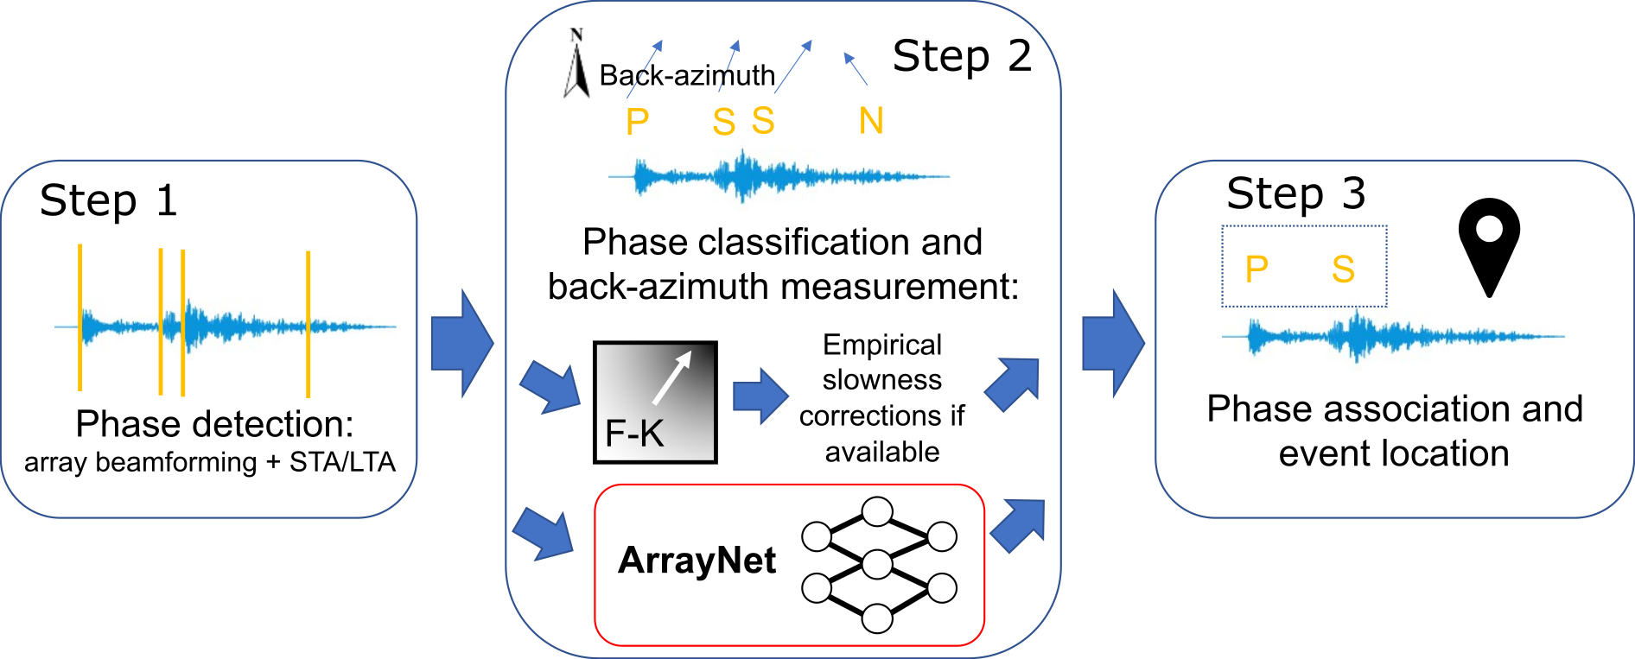
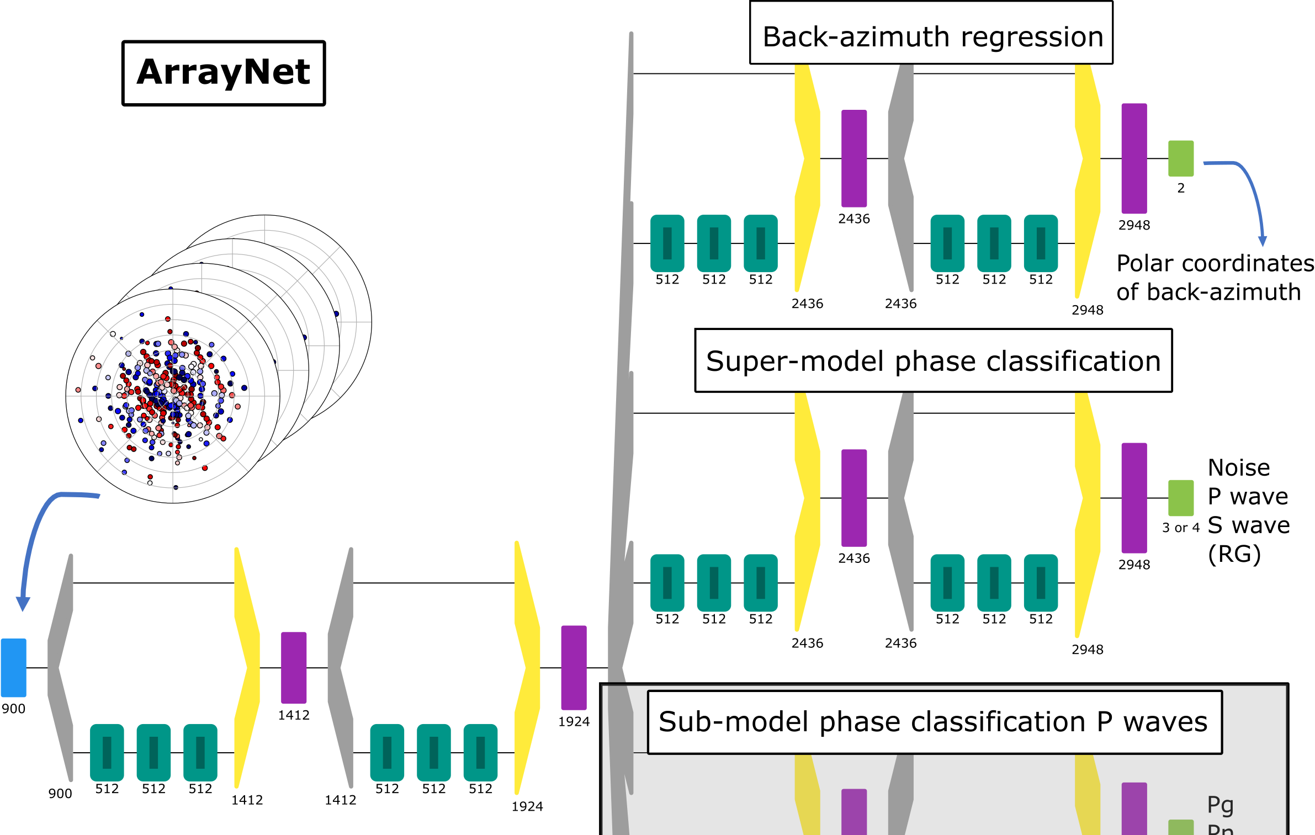
A seismic array data-based machine learning approach for seismic phase classification and back-azimuth estimation
Andreas Köhler, Erik Bryhn Myklebust
NORSAR
Affiliation / Organization / Company / Institute [if any / Font: Arial Size: 14]
1) Event detection processing flow: improve Step 2 with machine learning
P3.5-282
2) Use phase differences measured between array stations as input data
4) Excellent phase classification accuracy and improved BAZ estimation compared to F-K based processing
3) Neural Network
Back-azimuth to source
Type of arrivals
No plane wave assumption!

