Slide 1
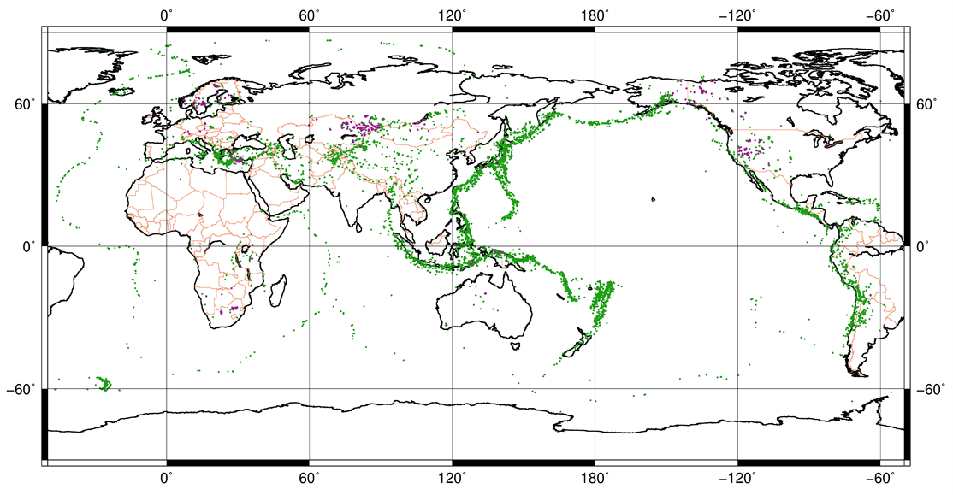
Review of NET-VISA in Operational and Test Environments and Implications for the Event Definition Criteria
Svetlana Nikolova, Spiro Spiliopoulos
Geoscience Australia
P3.5-461
In our presentation we discuss:
Tendencies in increase use of auxiliary stations in the bulletin by NET-VISA in tests;
Event Definition Criteria and trends in the number of LEB versus REB events;
Indicate possible approaches that will bring more well defined LEB events into REB;
More than 80% IMS SHI stations of each technology are contributing to IDC products during last 10 years . Accumulated data during this period give sufficient information to review EDC and bring more quality LEB into official IDC product REB.
If you want to learn more about this, come see my e-poster during session 3.5 on 22 of June 2023 10-11 a.m. Zeremoniensaal & Marmorsaal or access it online on the SnT2023 Conference platform!

