Slide 1
Noise Injection in Model Training for Better Calibrated Estimates of Origin Error in NET-VISA
Nimar Arora
Bayesian Logic, Inc.
NET-VISA is a Bayesian model of global-scale seismology. It includes a generative model of event formation, transmission of seismic, hydro-acoustic and infrasound waves from the event to the stations. A model for detections (or misdetections) at various stations as well as a model of coda and noise detections. In this work we are using this Bayesian Model to estimate the origin error ellipse of the events.
Use the NET-VISA model to estimate the origin error.
Devise a perturbed model to better estimate the origin error.
Compare with libloc on the same detections as well with LEB (which uses additional detections)
Evaluate on GT5 events for 2016.
NET-VISA event locations are better than libloc.
Perturbing the NET-VISA model increases the uncertainty in the origin errors.
Uncertainties front the perturbed model tend to be better calibrated.
The improvements are more pronounced for events with smaller ndef. (The number of defining phases)
The perturbed NET-VISA model gives the best calibrated distance uncertainty. However, there are still a lot of scope for improvement. Further analysis of correlated travel time errors might be needed for further improvements.
Please do not use this space, a QR code will be automatically overlayed
P3.5-891

Slide 2
Introduction
Authors: Geeta Arora (Bayesian Logic Inc.), Nimar Arora (Bayesian Logic, Inc.), Noriyuki Kushida (CTBTO Preparatory Commission), Ronan Le Bras (Former CTBTO Preparatory Commission)
NET-VISA is a Bayesian model of global-scale seismology. It includes
a generative model of event formation,
transmission of seismic, hydro-acoustic and infrasound waves from the event to the stations.
A model for detections (or misdetections) at various stations
as well as a model of coda and noise detections.
It is very natural to use the generative model to estimate the origin error ellipse of the events. In this work we provide two contributions.
An importance sampling schema to estimate the origin error.
Injection of noise in the training data to better estimate the uncertainties.
Finally we provide an analysis of the uncertainty calibration.
Please do not use this space, a QR code will be automatically overlayed
P3.5-891

Slide 3
Objectives
We want a calibrated uncertainty estimate.
That means 90% of the ground truth events should be within the 90% uncertainty estimate,
80% should be within the 80% ellipestimate, …, 10% should be within the 10% estimate, etc.
The uncertainty estimate of the event is calculated for the
Location
Time
Depth
We want all three to be well calibrated.
In this work we evaluated our NET-VISA model on the 2017 GT5 dataset from ISC. We also compared to the results of LEB (analyst produced bulletin) as well as the libloc algorithm for estimating origin errors which is part of Global Association.
Please do not use this space, a QR code will be automatically overlayed
P3.5-891

Slide 4
Importance Sampling
Suppose we want to estimate the expectation of some functional of a random variable X ~ p. We could do this by directly estimating samples from the distribution p.
However, if we can simulate from p we can use a different distribution q to simulate samples from, as follows:
Please do not use this space, a QR code will be automatically overlayed
The covariance of these samples can also be used to estimate the uncertainty of the estimate.
P3.5-891

Slide 5
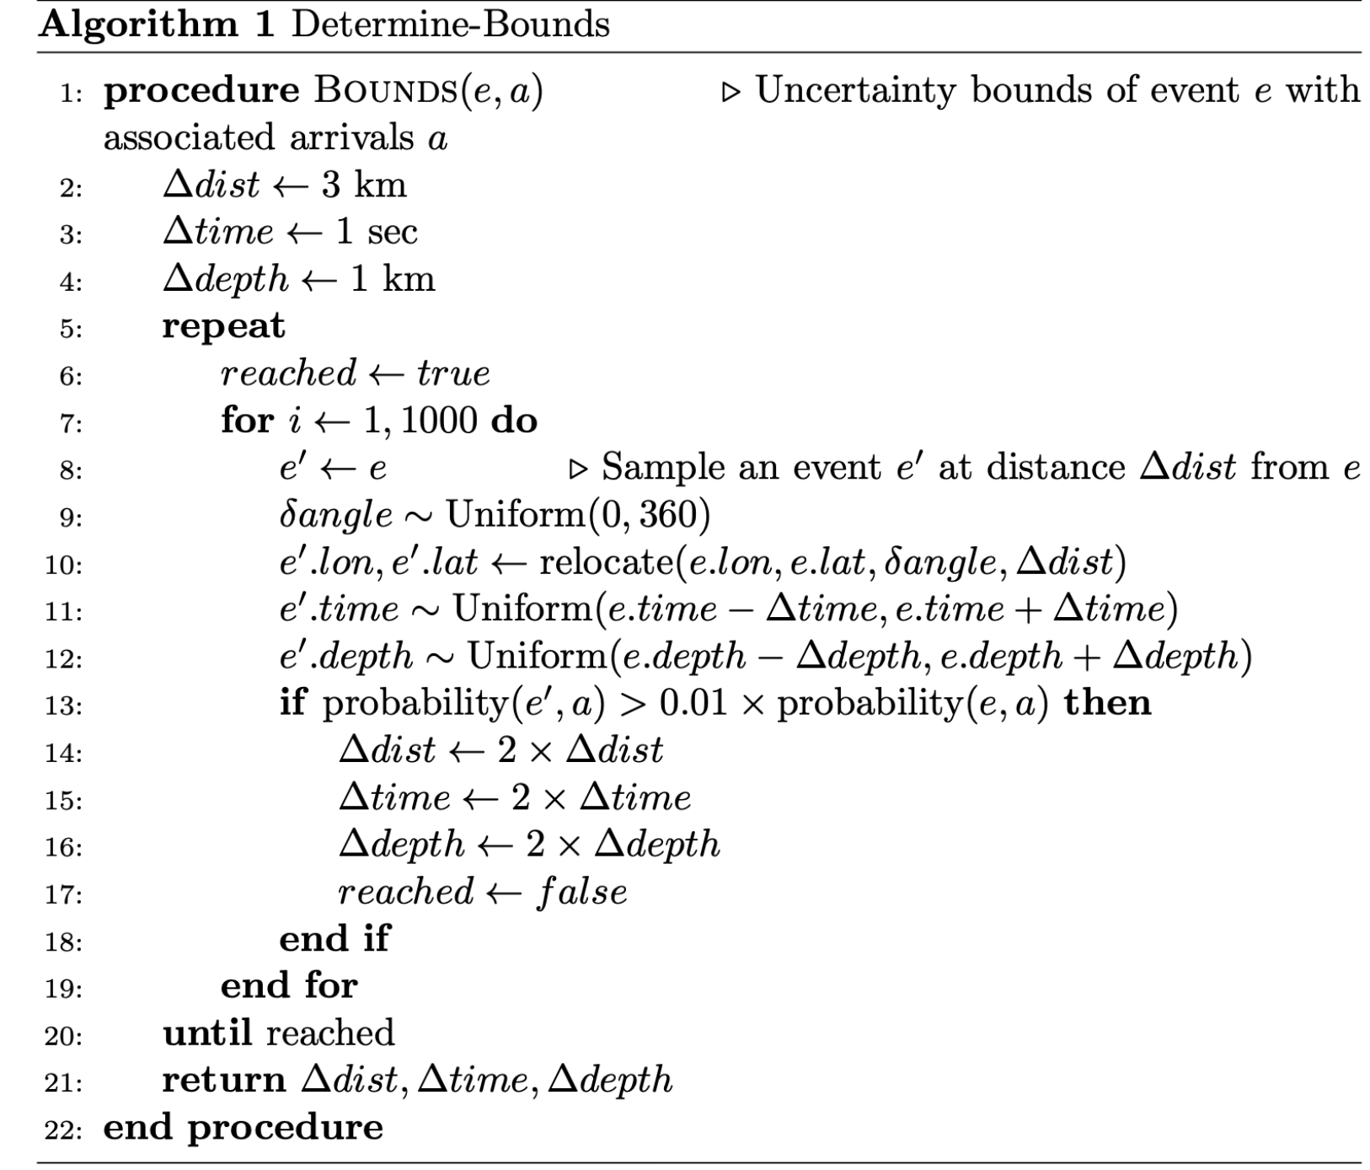
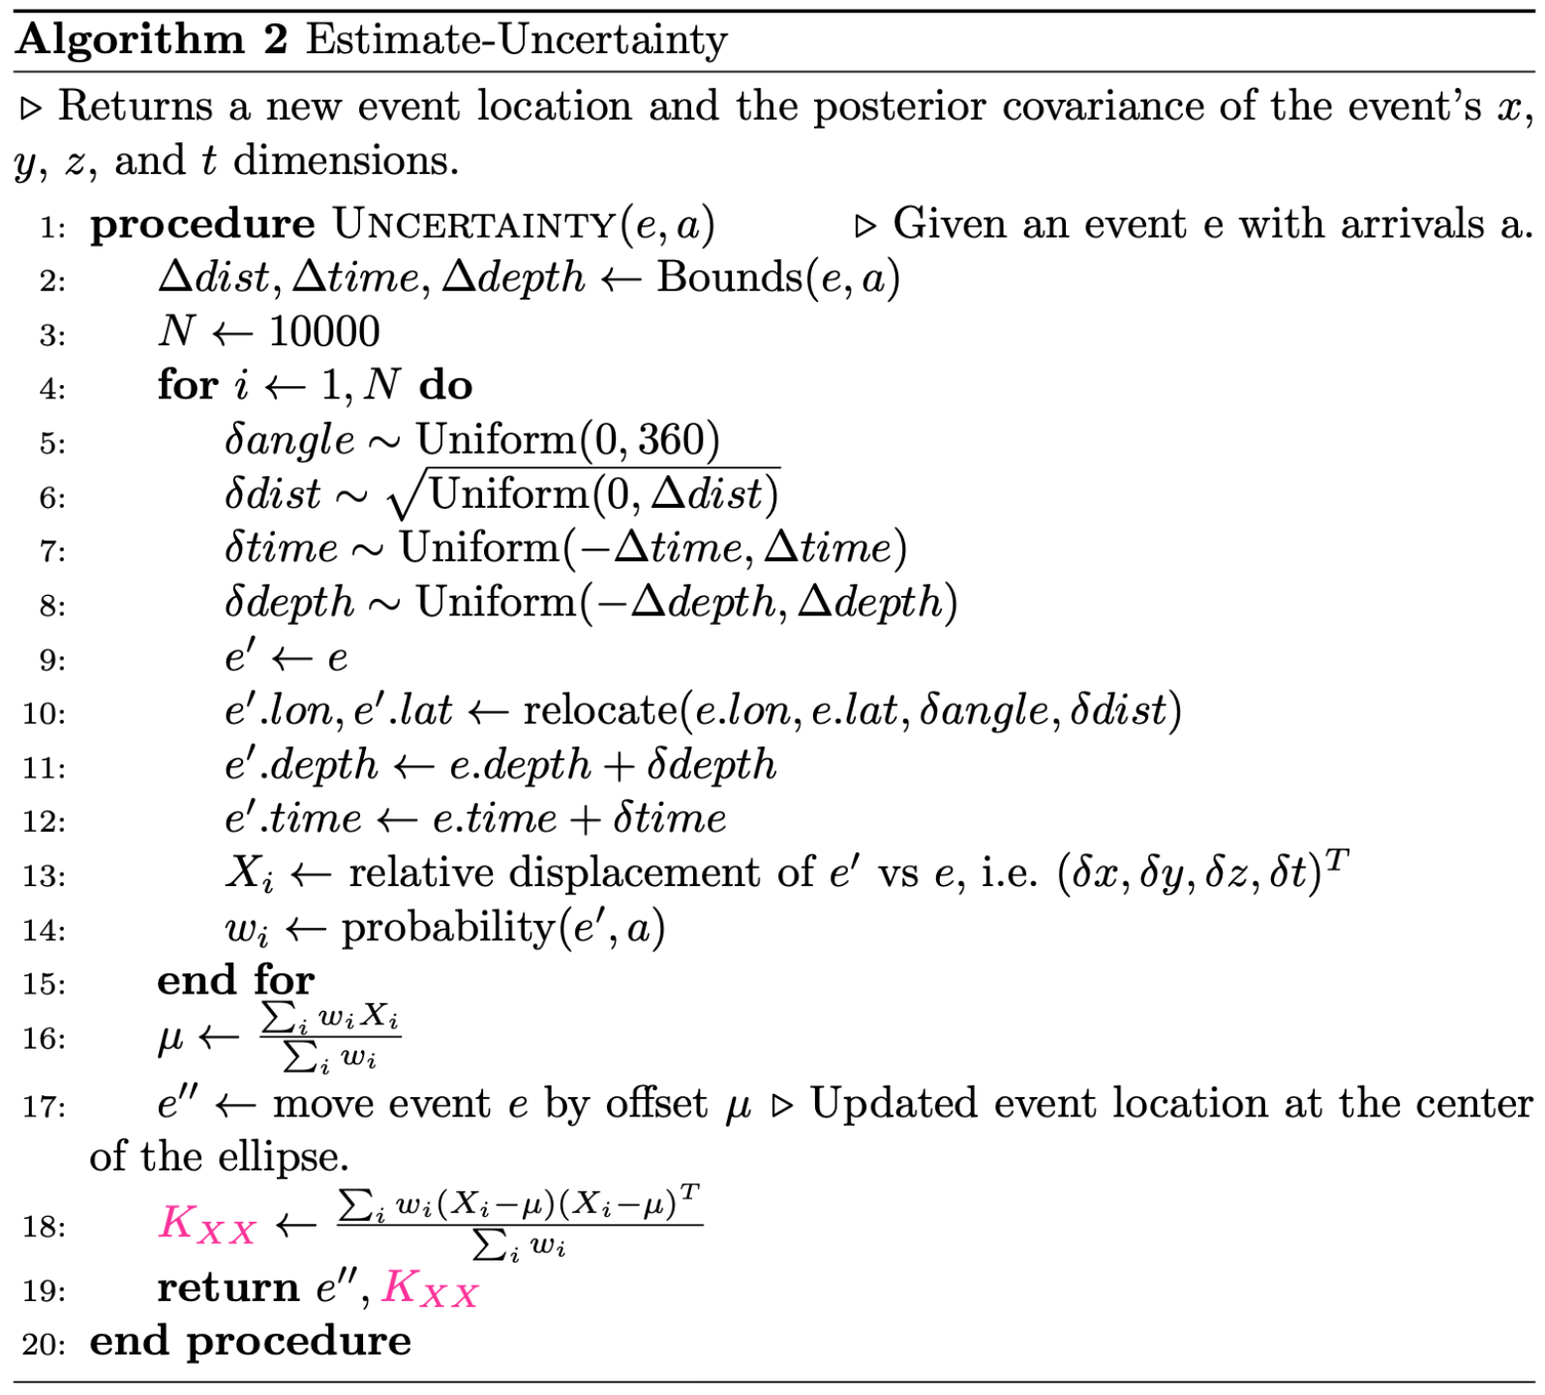
Uncertainty Estimation
Our algorithm first determines the overall bounds and does uniform sampling within the bounds.
Please do not use this space, a QR code will be automatically overlayed
P3.5-891

Slide 6
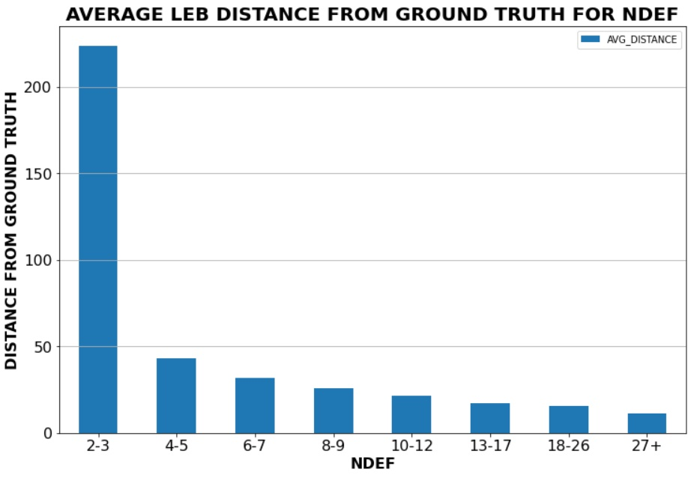
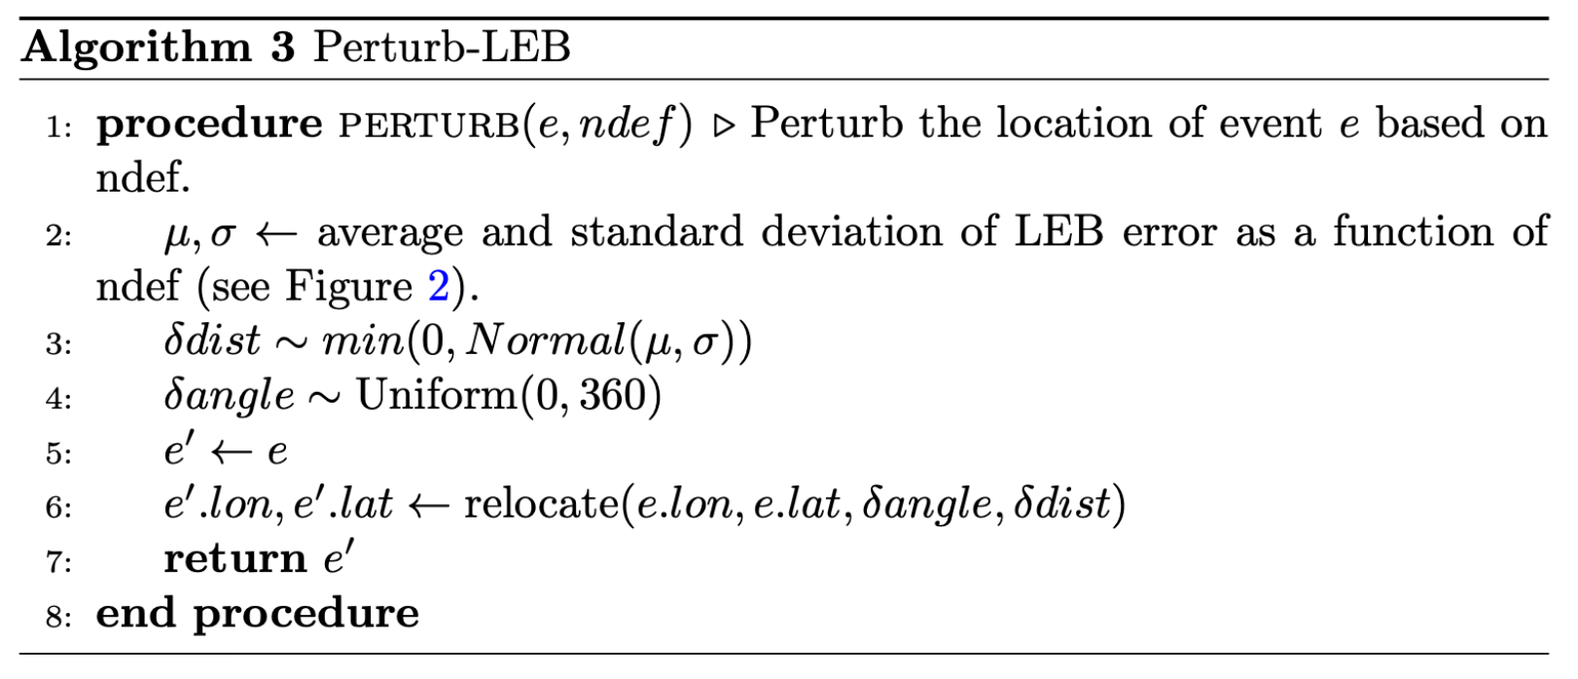
Noise Injection
Our initial attempt revealed that the model not producing smooth uncertainties. We improved this
by injecting noise into the training data to smoothen the model.
The figure on the right is the average error in LEB (versus the ground truth) as a function of ndef (number of defining phases). We use these statistics to inject noise in the LEB training data.
Please do not use this space, a QR code will be automatically overlayed
P3.5-891

Slide 7
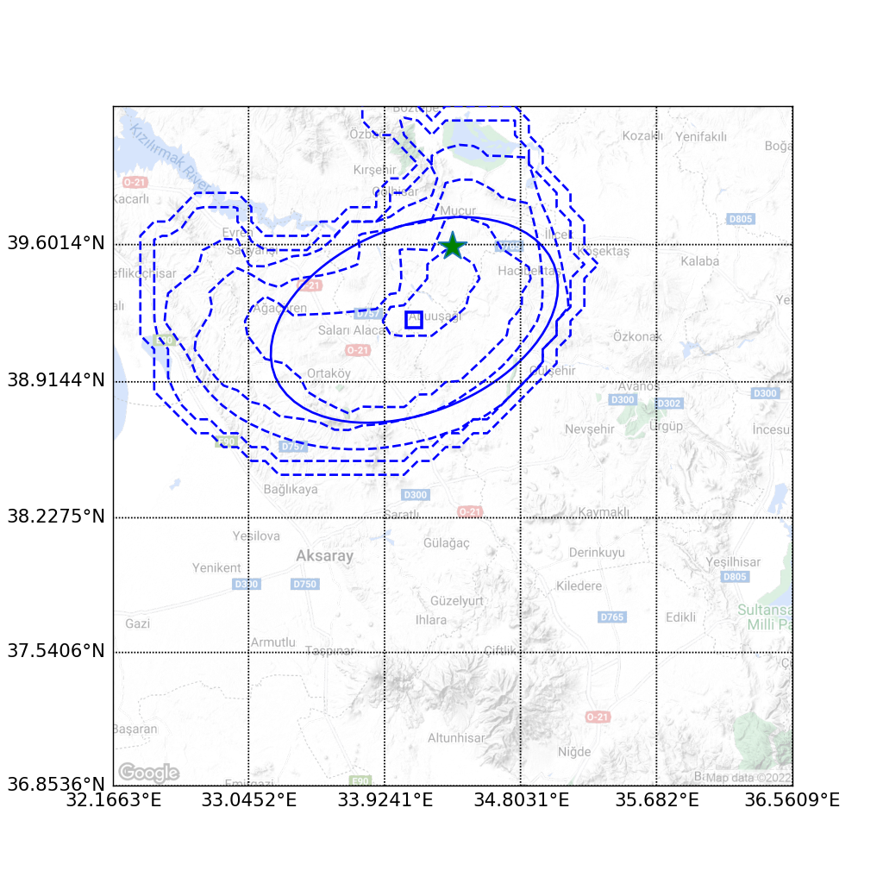
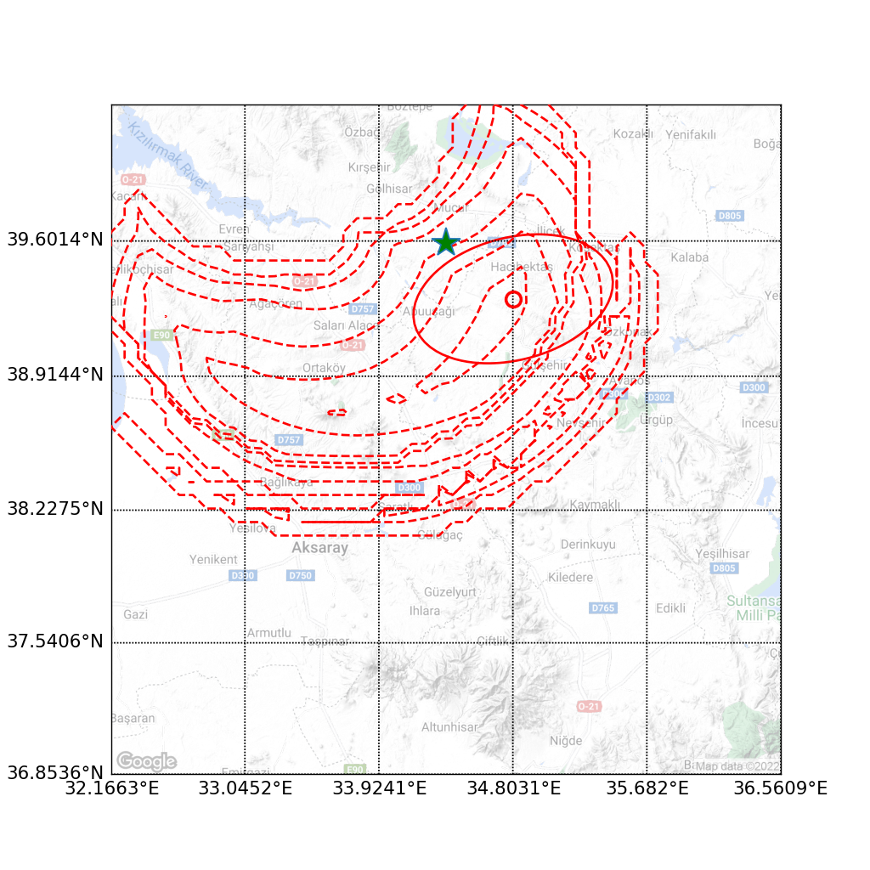
Results: Example event with ndef=2
Ground truth
Please do not use this space, a QR code will be automatically overlayed
Sharp contours small ellipse of the original model.
Perturbed model has smoother contours
P3.5-891
Notes:
An event with ndef=2. The sharpness in the contours (to the east of the event has gone away. Overall banana shape hasn’t gone away. The size of the ellipse is twice as big. For this event the libloc location is not on this graph.

Slide 8
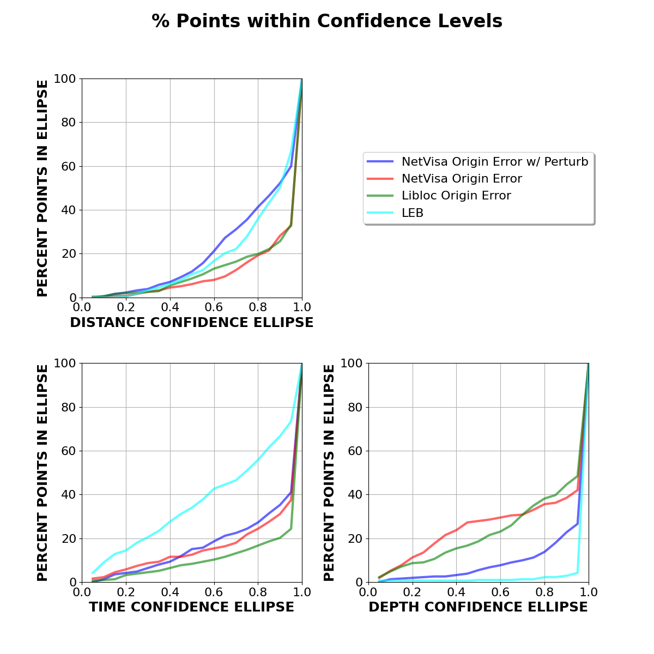
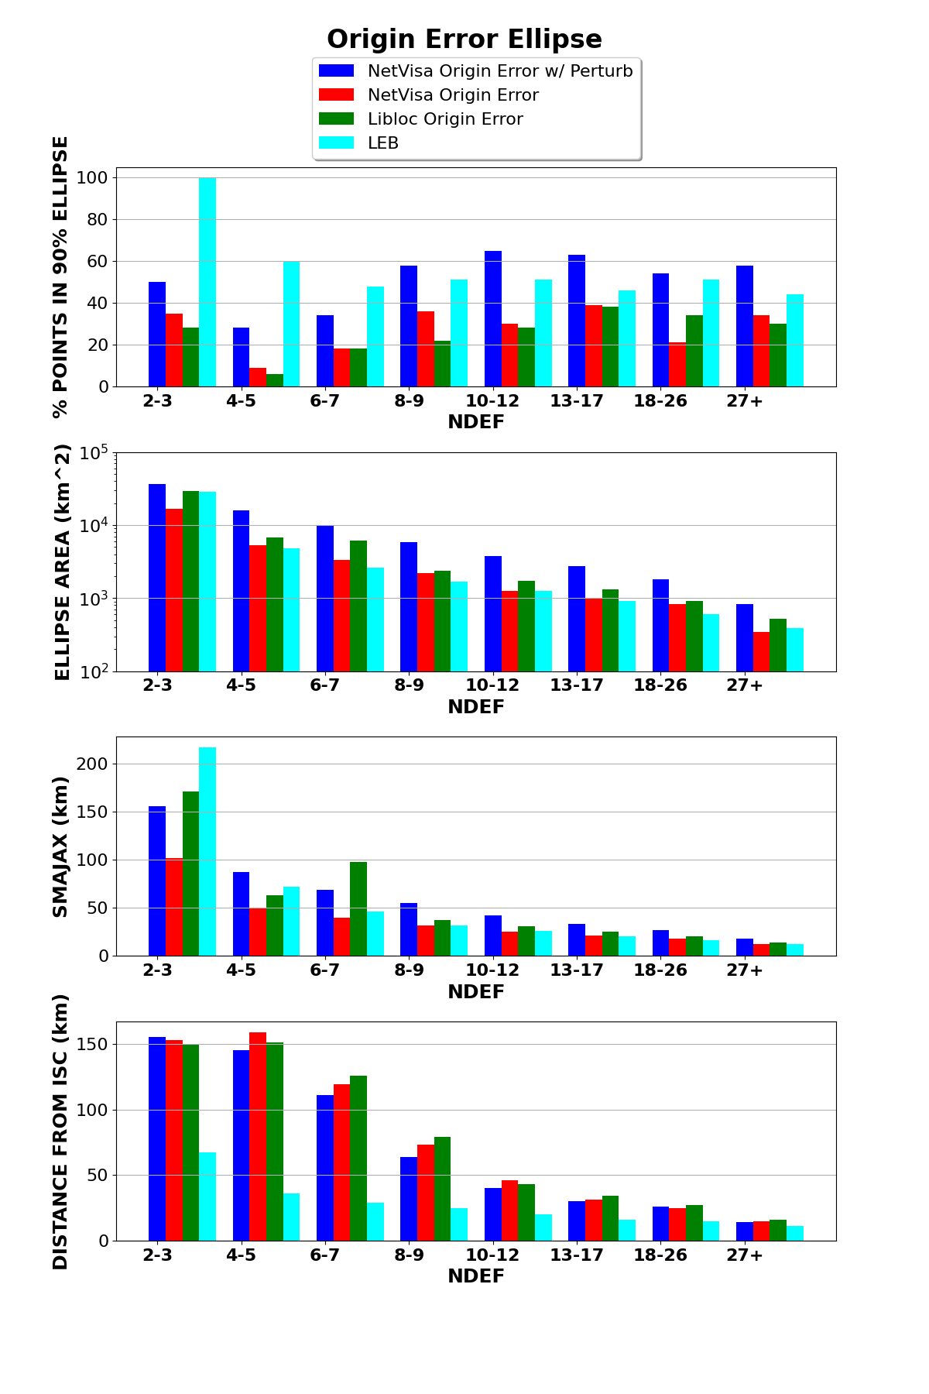
Results: Calibration and Error
Please do not use this space, a QR code will be automatically overlayed
P3.5-891
Notes:
NET-VISA model with perturbation is best for distance and best among automated bulletins for the time uncertainty. % points within the 90% confidence ellipse is best among the automated bulletins.

Slide 9
Conclusion: Best calibrated for distance uncertainty
The perturbed model and the NET-VISA origin error estimate has a number of advantages.
It produces the best calibrated origin errors in terms of distance to the ground truth event.
The percentage of points within the 90% confidence ellipse is even higher than LEB for events with ndef > 8
The distance to the ground truth is best among the other automated approaches (Note: LEB has better event location because the arrival times are improved by analysts manually).
The results show that none of the approaches is fully calibrated.
Please do not use this space, a QR code will be automatically overlayed
P3.5-891

