Slide 1
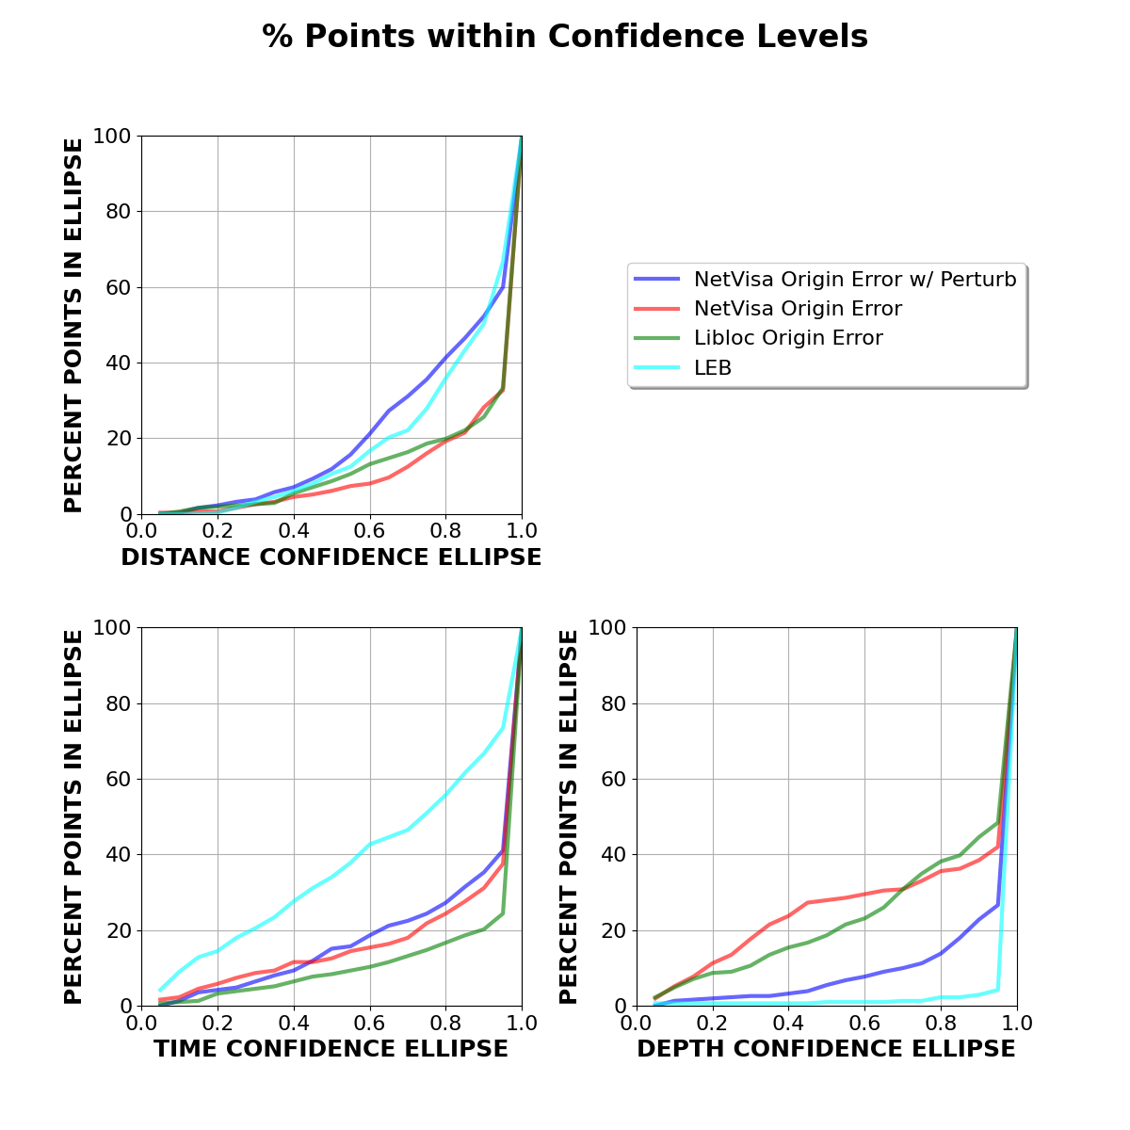
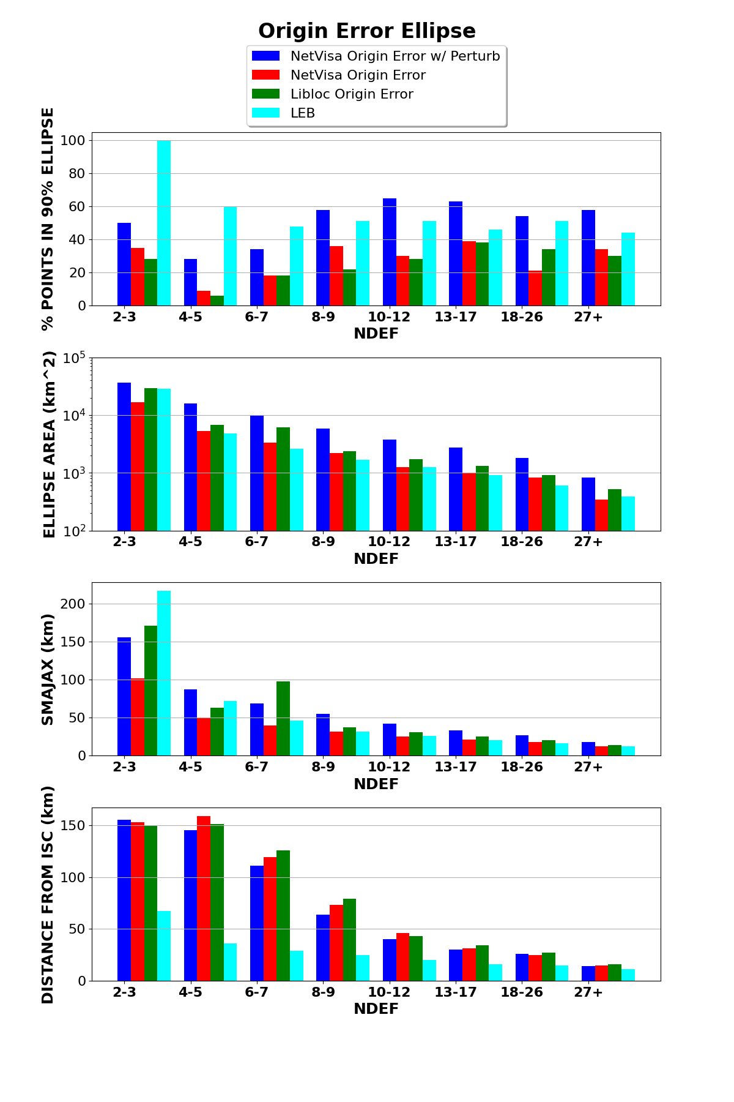
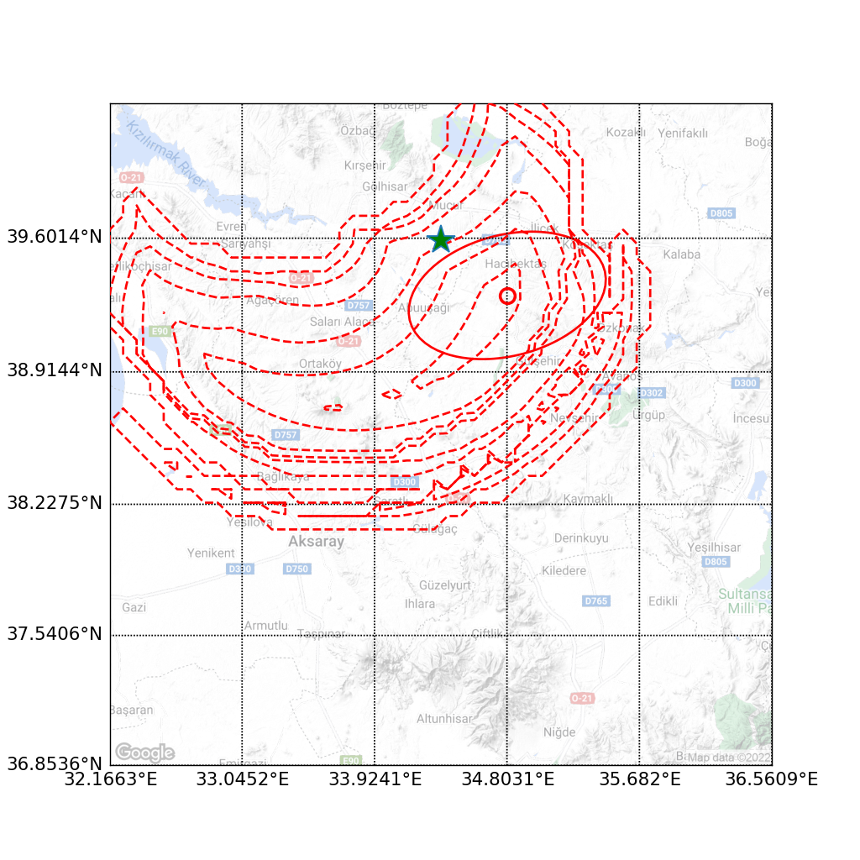
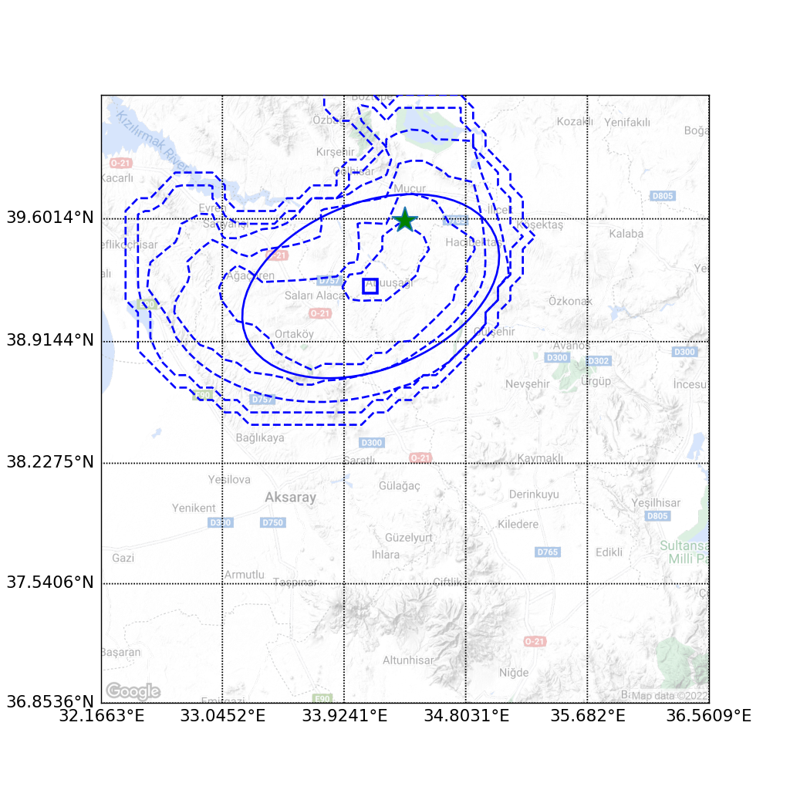
Noise Injection in Model Training for Better Calibrated Estimates of Origin Error in NET-VISA
Nimar Arora
Bayesian Logic, Inc.
P3.5-891
Notes:
We are now using our Bayesian model of global-scale seismology to also estimate the error estimates in the origins. As part of this work we realized that we needed to perturb the model to inject some noise so that we can smoother posteriors.
The perturbation in the model allows for much smoother contours and bigger uncertainty ellipses. See the figure on the right. The blue contours are smoother and the ellipse is bigger. Also in the bar graphs in the center the ellipse area is somewhat bigger. However, note that the new model has most points within the 90% ellipse.
Further the graphs on the left show that the model is better calibrated at multiple uncertainty levels. For example the 60% uncertainty ellipse has 30% points which is even better than LEB and much better than the other automated bulletins.
In future, we are studying if we can identify unmodeled sources of uncertainty to make this calibration line a perfect straight line.

