Slide 1
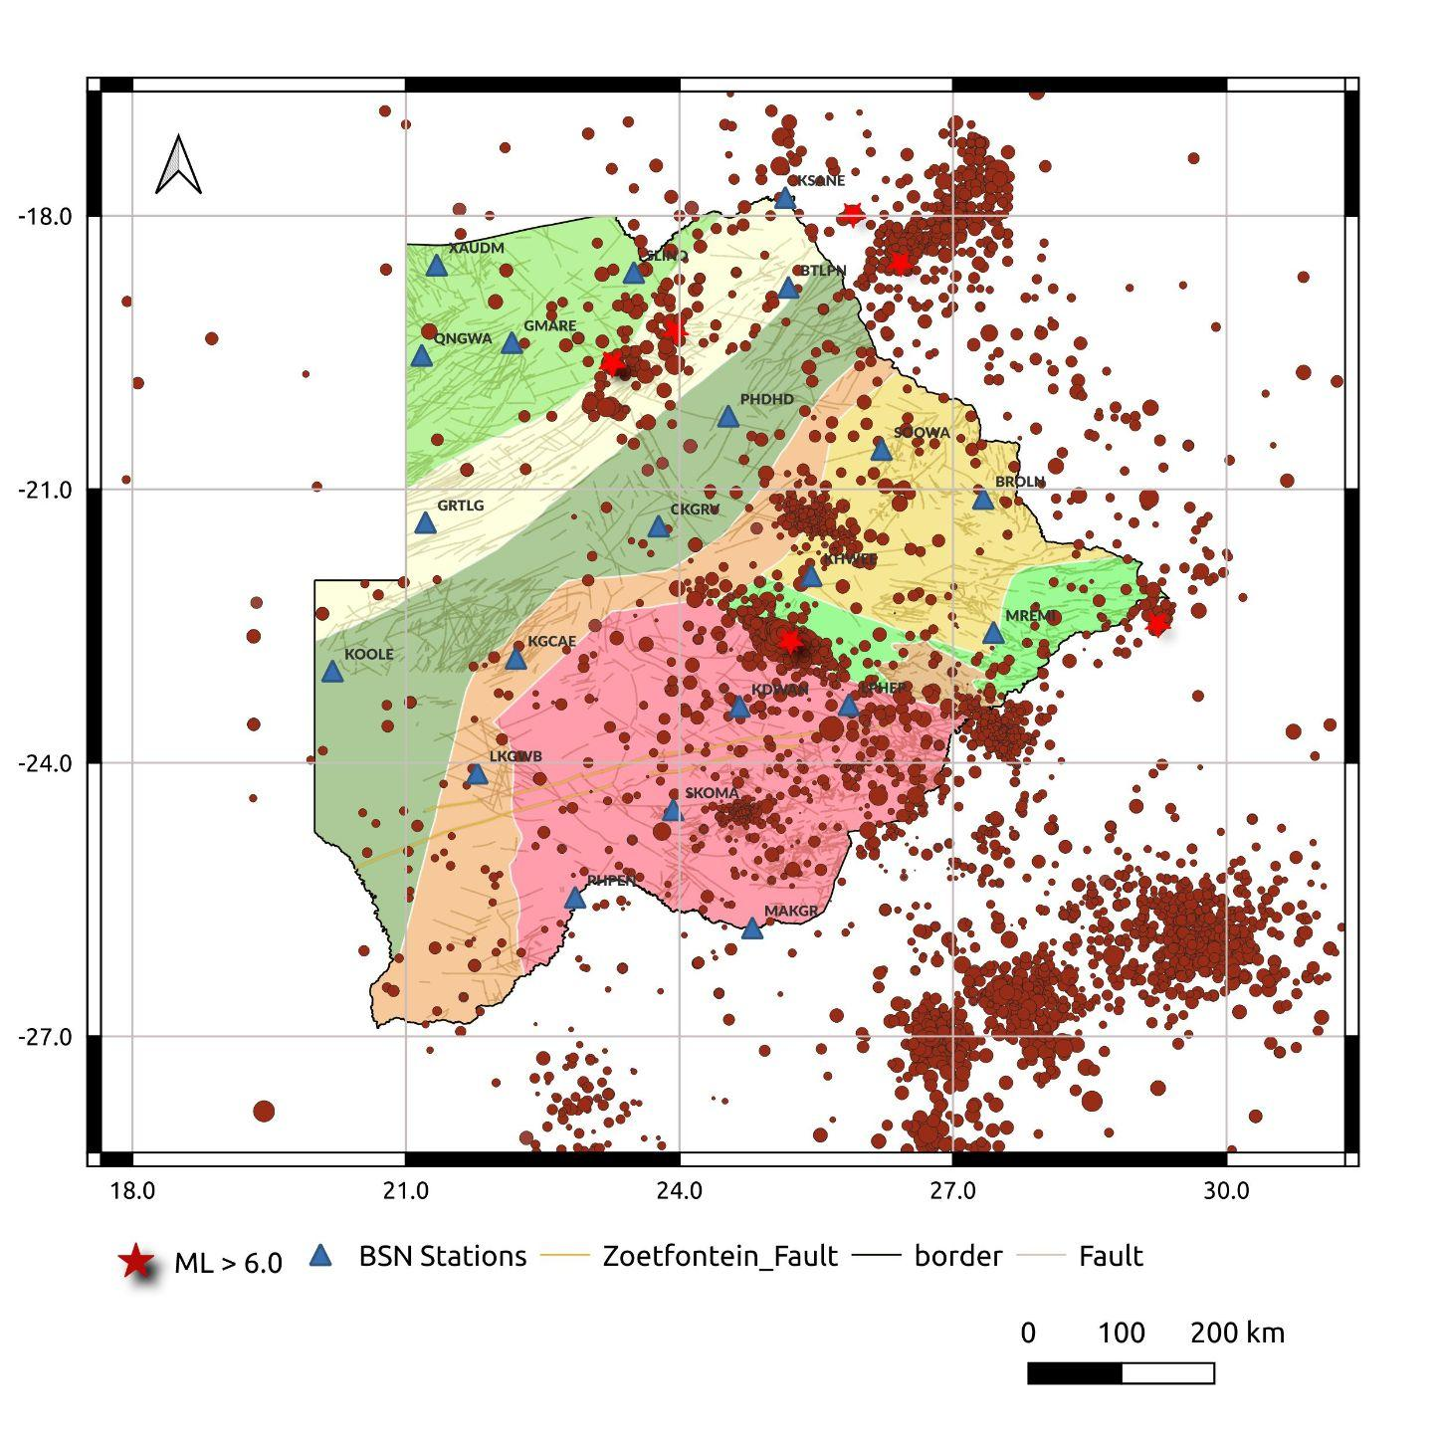
Automatic earthquake detection for Botswana M6.5 and its aftershocks using deep learning algorithms
Joseph Maritinkole, Onkgopotse Ntibinyane
Botswana Geoscience Institute
P3.5-780
MOTIVATION
The current earthquake processing in Botswana is performed manually.
However, analyzing large datasets leads to delays in reporting
Due to financial constraints, the institute relies on free modules of the seiscomp system for automatic processing, which may compromise the accuracy of the results.
This necessitates time-consuming human intervention to cross-check recorded events and identify missed events, hindering timely and reliable reporting.
To address these challenges, EQTransformer and PhaseNet is fine-tuned using earthquakes recorded in Botswana and their corresponding waveforms to automate earthquake detection and phase picking in Botswana.
This enables accurate and timely dissemination of earthquake parameters to stakeholders and the public.
The figure provides a visual representation of the seismic activity in Botswana and highlights the distribution of earthquakes in the region.
197 earthquakes of magnitude greater than Ml 3.0 are used for creating a labeled dataset, which is essential for training and evaluating models in seismic analysis and earthquake monitoring.

